Slide 1
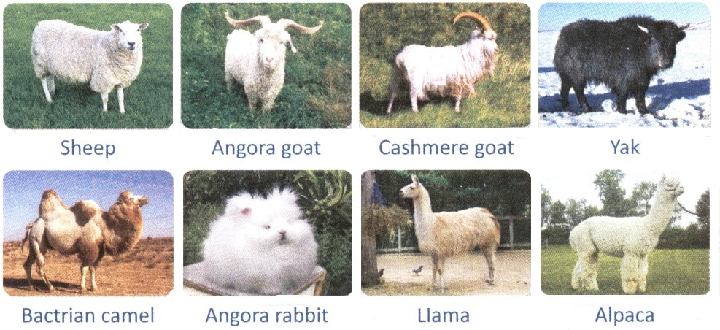
Animal fibers Course name: Spring/Second Semester Animal Resources: Agricultural Engineering Sciences
Lecturer's name: Prof. Dr. Kasim O. Aziz
Dr. Abdulqader A. Hussein

Slide 2
Contact
e-mail: kasim.aziz@su.edu.krd
Tel: (0750 4652234)
e-mail : abdulqader.hussein@su.edu.krd
Tel: (0750 4623947)

Slide 3
Course overview
The producer of synthetic fibers can easily outdo the woolgrower in many traits except the two most important properties; mechanical properties and the ability to absorb moisture.
Humans wear animal fibers, especially wool offers outstanding comfort properties.
The production of animal fibre is of economic importance, especially fine fibers (e.g. Cashmere).
Our country is suitable for breeding farm animals such as sheep & goats, especially as there are Maraz goats, which utilize their fleece in the manufacture of Kurdish national costume.
Therefore, the importance of the study of animal fibre lies by increasing the production.
Moreover, it is a guide for graduate who is looking for specialized knowledge and on the light of the needs of labour market in the area for improving animal fibre production quantitatively & qualitatively.

Slide 4
Course objective
This course is to deal with principles of Animal fibers and their applications in agricultural farms and related activates. Graduates should have the ability to:
Identify the animal fiber position from the rest of textile fibers.
State the economic importance of animal fibers.
Know the biology of fleece; the development of follicles and their impact on the production of animal fiber.
Diagnose compositional differences between animal and synthetic fibers.
Study the physical characteristics of animal fibers and factors affecting them.
Realize the technological importance of animal fibers and characteristics of their end products.

Slide 5
Student's obligation
the attendance,
scientific discussion,
completion of all tests,
exams,
reports.

Slide 6
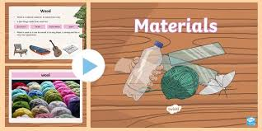
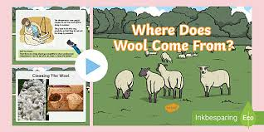
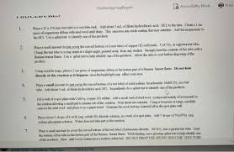
Forms of teaching
Power point-Data show, Hand out papers.

Slide 7
Assessment scheme
Time of exam:
Quiz = 10 Minutes.
Monthly = 1 hour.
Final = 2 hours. - The distribution of degrees:
Pre-final exam: 50% (15% theoretical + 35% practical)
Final exam: 50% (theoretical) =
Final mark (100%).

Slide 8
Student learning outcome:
Graduates - familiar with fleece biology, fiber structure, physical & mechanical properties, textile processing, carpet & local wool, mohair & cashmere.
Advice growers to improve production efficiency quantitatively & qualitatively and product development suitable for processors desires.
knowledge - obtained in terms of local & international carpet and cashmere breeds.
This will be a guide for graduate who is looking for specialized knowledge in terms of setting proposals and initiating projects for the development of the fiber productivity of local sheep and Maraz goats.

Slide 9
Course Reading List and References‌:
1- Onions W.J.(1962). Wool. An Introduction to its Properties, Varieties, Uses and
Production. Interscience Publishers. New York.
2- Ryder, M.L. and Stephenson, S.K. (1968).Wool Growth. Academic Press Inc. London.
3- Thomas Harmsworth and Graham Day (1979). Wool & Mohair. Intaka Press. Melbourne.
4- D'Arcy, J.B.D. (1979). Sheep management and wool technology. N.S.W. Univ. Press.
Australia.
5- Ensminger, M.E. and Parker, R.O. (1986). Sheep & Goat Science. 5th Edition. The
Interstate Printer & Publishers, Inc. Illinois.
6- Sandra G. Solaiman (2010). Goat Science and Production. Blackwell Publishing. USA
7- Scientific Journals:
1- Animal Breeding Abstracts.
2- Animal Science.
3- Livestock production Science.

Slide 10
Theoretical Topics:
-Textile fibers identification.
- The economic importance of animal fibers.
-Fleece biology: Skin structure, follicle types & development of follicles
-Wool fibre structure:
- The physical properties of wool:
- Mechanical properties: -
- Carpet wool:
- Local wool
Mohair and cashmere:
Wool value
- Wool Grades
- Wool processing

