Slide 1
Chapter -3 High Voltage Generators for Testing
Fourth Year / Power Engineering
Lecturer : Ahmed Kh. Ahmed

Slide 2
Generation of High Voltages
The power systems engineers is interested in high voltages primarily for power transmission, and secondly for testing of his equipment used in power transmission.
In many testing laboratories, the primary source of power is at low voltage (400 V three phase or 230 V single phase, at 50 Hz).
Thus we need to be able to obtain the high voltage from this.
Since insulation is usually being tested, the impedances involved are extremely high (order of Mohms) and the currents small (less than an ampere).

Slide 3
Generation of High Alternating Voltages
Single transformer test units are made for high alternating voltages up to about 200 kV.
However, for high voltages to reduce the cost (insulation cost increases rapidly with voltage) and make transportation easier, a cascade arrangement of several transformers is used.

Slide 4
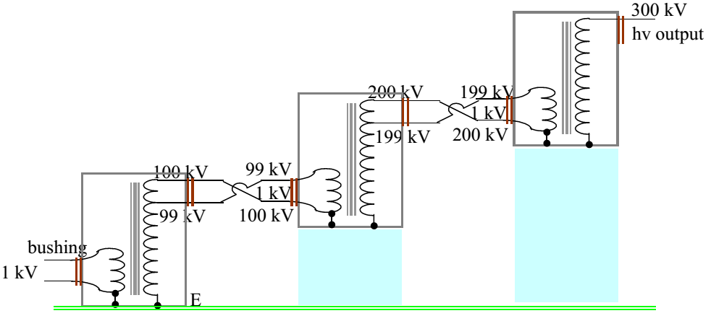
Cascade arrangement of transformers

Slide 5
Cascade arrangement of transformers
Typical cascade arrangement of transformers used to obtain up to 300 kV from three units each rated at 100 kV insulation.
The low voltage winding is connected to the primary of the first transformer, and this is connected to the transformer tank which is earthed.
One end of the high voltage winding is also earthed through the tank.
The high voltage end and a tapping near this end is taken out at the top of the transformer through a bushing, and forms the primary of the second transformer.
One end of this winding is connected to the tank of the second transformer to maintain the tank at high voltage.

Slide 6
Cascade arrangement of transformers
The secondary of this transformer too has one end connected to the tank and at the other end the next cascaded transformer is fed.
This cascade arrangement can be continued further if a still higher voltage is required.
In the cascade arrangement shown, each transformer needs only to be insulated for 100 kV, and hence the transformer can be relatively small.
If a 300 kV transformer had to be used instead, the size would be massive.

Slide 7
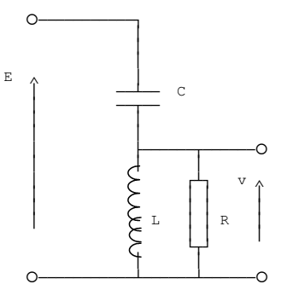
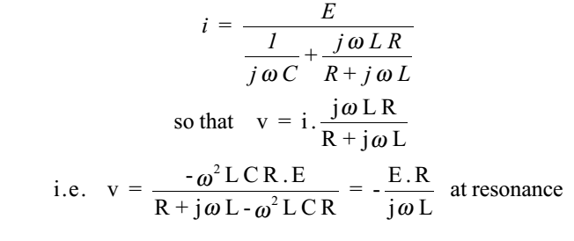
Resonant Transformers
The resonance principle of a series tuned L-C circuit can be made use of to obtain a higher voltage with a given transformer.
Let R represent the equivalent parallel resistance across the coil and the device under test. The current i would be given by

Slide 8
Resonant Transformers
Since R is usually very large, the Q factor of the circuit (Q = R/Lω) would be very large, and the output voltage would be given by
It can thus be seen that a much larger value that the input can be obtained across the device under test in the resonant principle.

Slide 9
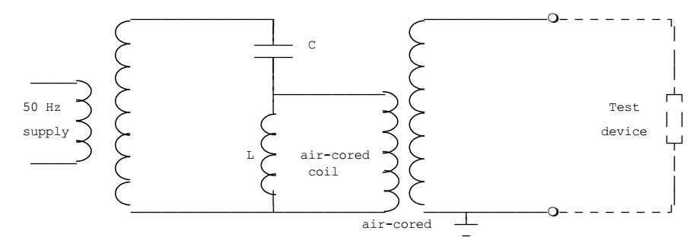
Resonant Transformers
The application of the resonance principle at power frequency.

Slide 10
Resonant Transformers
For certain applications, particularly when the final requirement is a direct voltage, it is an advantage to select a frequency higher than power frequency (50 Hz).
This would result in a smaller transformer having fewer turns, and also simplifies the smoothing after rectification.

Slide 11
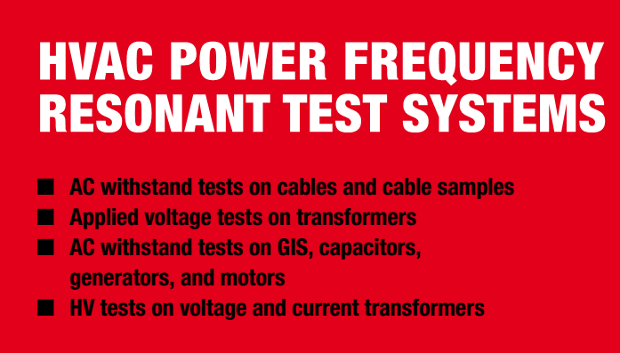
Advantages

Slide 12
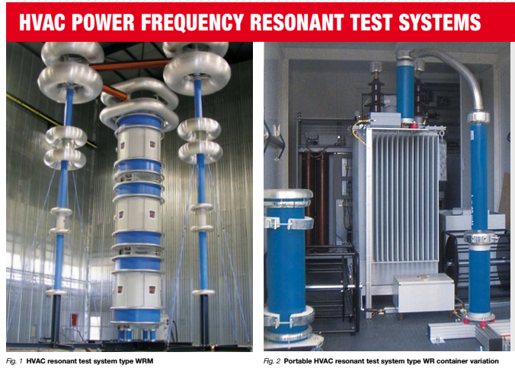

Slide 13
Main applications are:
Cable testing on delivery length, cable samples, and cable accessories with type WR or WRM
Applied voltage tests for transformer testing with type WRM
Current and voltage transformer testing (CTs and VTs) with type WRM
Capacitor testing with type WR
Generator and motor testing with type WR
GIS and accessories testing with type WRM

Slide 14
High frequency high voltages
High frequency (few kHz to Mhz) high voltages are required in testing apparatus for behaviour with switching surges, insulation flashover etc.
The importance of testing with high frequency is that high frequency oscillations cause failure of insulator at comparatively low voltage due to high dielectric los and consequent heating.
Thus it is necessary to produce damped high frequency voltages.
The damped oscillations are obtained by the use of a Tesla coil, together with a circuit containing a quenched spark gap.

Slide 15
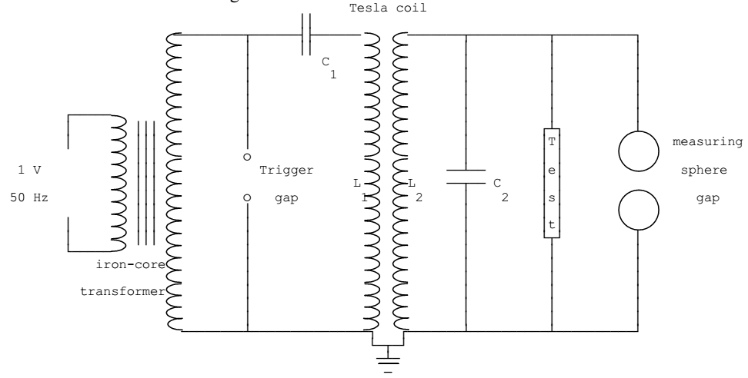
High frequency high voltages
The tesla coil constitutes the high voltage transformer. It consists of two air-cored coils which are placed concentrically. The high voltage secondary coil has a large number of turns, and is wound on a frame of insulating material, the insulation between turns being air, or in some cases, oil. The primary winding has only a few turns wound on an insulating frame.

Slide 16
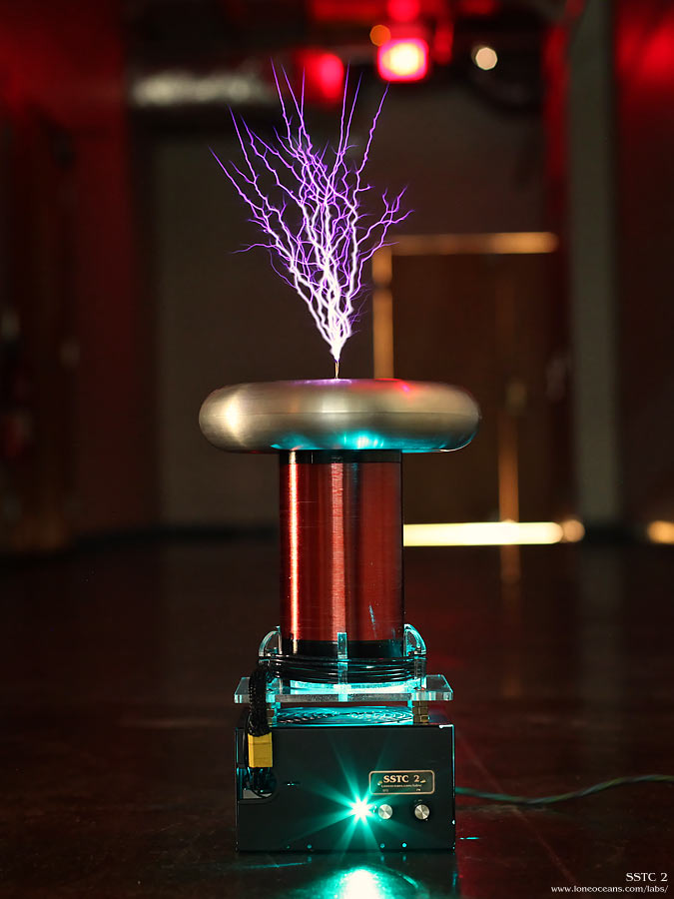
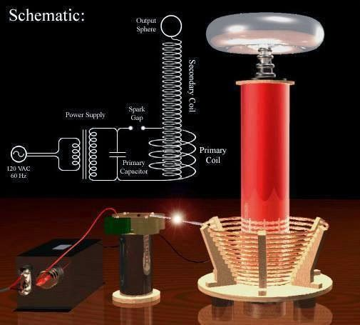
High frequency high voltages

Slide 17
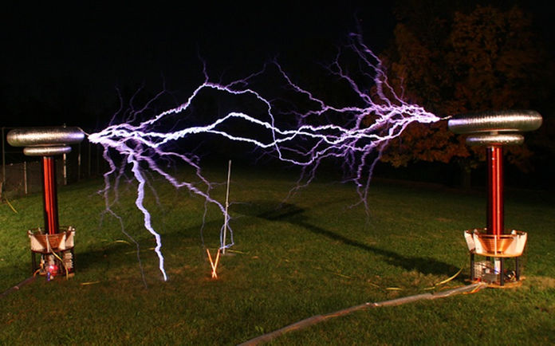
High frequency high voltages

Slide 18
High frequency high voltages
The primary circuit of the tesla transformer also contains a trigger spark gap.
Since the supply to the primary of the tesla transformer is alternating, the capacitor C1 is charged up to some maximum voltage, which depends upon the secondary side of the supply transformer, and upon the setting of the trigger gap.
At this voltage, the trigger gap breaks down, the capacitor C1 discharges, and a train of damped oscillations of high frequency is produced in the circuit containing C1, the spark gap and the primary winding of the tesla transformer.

Slide 19
High frequency high voltages
During the time taken for this train of oscillations to die away, the spark gap is conducting, due to the formation of an arc across it.
This charge and discharge of capacitor C1 takes place twice in one voltage cycle.
Thus there will be a hundred of these trains of damped oscillations per second.
The frequency of oscillations themselves is very high (about 100 kHz usually), its actual value depending upon the inductance and capacitance of the oscillatory circuit.

Slide 20
Generation of High Direct Voltages
Generation of high direct voltages are required in the testing of high voltage direct current apparatus as well as in testing the insulation of cables and capacitors where the use of alternating voltage test sets become impractical due to the steady high charging currents. Impulse generator charging units also require high direct voltages as their input.

Slide 21
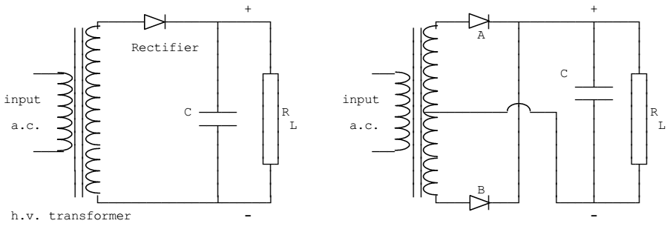
Rectifier circuits

Slide 22
Rectifier circuits
In theory, a low pass filter may be used to smooth the output, however when the test device is highly capacitive no smoothing is required.
In testing with high voltage direct current care must be taken to discharge any capacitors that may be present before changing connections. In certain test sets, automatic discharging is provided which discharges the capacitors to earth.

Slide 23
Voltage Multiplier Circuits
Both full-wave as well as half-wave circuits can produce a maximum direct voltage corresponding to the peak value of the alternating voltage. When higher voltages are required voltage multiplier circuits are used. The common circuits are the voltage double circuit and the Cockroft-Walton Circuit.

Slide 24
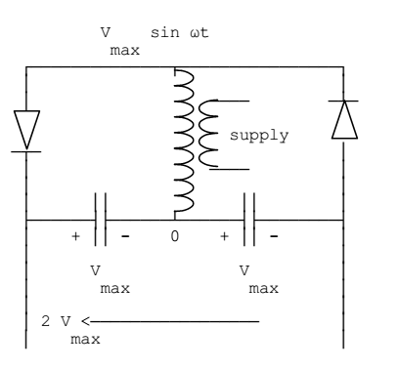
Voltage Doubler Circuit
The voltage doubler circuit makes use of the positive and the negative half cycles to charge two different capacitors. These are then connected in series aiding to obtain double the direct voltage output.

Slide 25
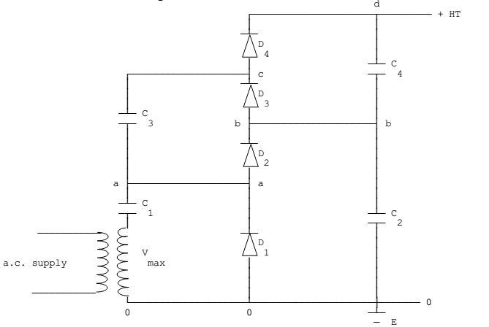
Cockroft-Walton Circuit
When more than doubling of the voltage is required, the Cockroft-Walton voltage multiplier circuit is commonly used. The circuit is shown below:

Slide 26
Cockroft-Walton Circuit
The Cockcroft Walton design is based on the Half-Wave Series Multiplier, or voltage doubler.
In fact, all multiplier circuits can be derived from its operating principles.
It mainly consists of a high voltage transformer Ts, a column of smoothing capacitors (C2,C4), a column of coupling capacitors (C1,C3), and a series connection of rectifiers(D1,D2,D3,D4).
The following description for the 2 stage CW multiplier, assumes no losses and represents sequential reversals of polarity of the source transformer Ts in the figure.
The number of stages is equal to the number of smoothing capacitors between ground and OUT, which in this case are capacitors C2 and C4.

Slide 27
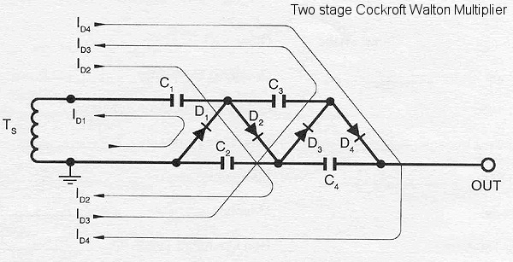
Cockroft-Walton Circuit

Slide 28
Cockroft-Walton Circuit
T_{s}=Negative Peak:C₁ charges through D₁ to E_{pk} at current I_{D1}
T_{s}=Positive Peak:E_{pk} of T_{s} adds arithmetically to existing potential C₁, thus C₂ charges to 2E_{pk} through D₂ at current I_{D2}
T_{s}=Negative Peak:C₃ is charged to 2E_{pk} through D₃ at current I_{D3}
T_{s}=Positive Peak:C₄ is charged to 2E_{pk} through D₄ at current I_{D4}. Output is then 2n*E_{pk} where N = number of stages.

Slide 29
Electrostatic generators
Electrostatic generators using the principle of charge transfer can give very high direct voltages. The basic principle involved is that the charge is placed on a carrier, either insulating or an isolated conductor, and raised to the required potential by being mechanically moved through the electrostatic field.

Slide 30
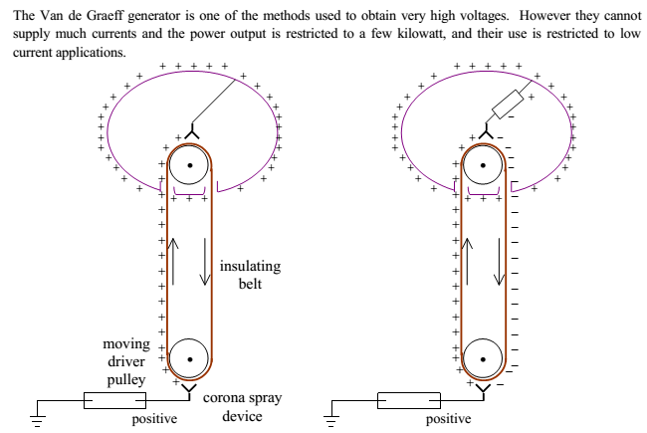

Slide 31
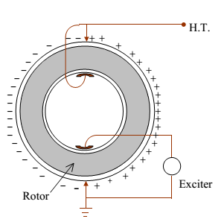
Sames Generator

