Slide 1
Electrical Circuits II
Week 1 – Fall Semester
Electrical Engineering Dept.

Slide 2
1- Network Theorems
Objectives:
• Become familiar with the superposition theorem and its unique ability to separate the impact of each source on the quantity of interest.
• Be able to apply Thévenin’s theorem to reduce any two-terminal, series-parallel network with any number of sources to a single voltage source and series resistor.
• Become familiar with Norton’s theorem and how it can be used to reduce any two-terminal, series - parallel network with any number of sources to a single current source and a parallel resistor.
• Understand how to apply the maximum power transfer theorem to determine the maximum
power to a load and to choose a load that will receive maximum power.
• Become aware of the reduction powers of Millman’s theorem and the powerful implications of the substitution and reciprocity theorems

Slide 3
1.1 Superposition Theorem
The superposition theorem is unquestionably one of the most powerful in this field. It has such widespread application that people often apply it without recognizing that their maneuvers are valid only because of this theorem.
In general, the theorem can be used to do the following:
• Analyze networks such as introduced in (CCT I ) that have two or more sources that are not in series or parallel.
• Reveal the effect of each source on a particular quantity of interest.
• For sources of different types (such as dc and ac, which affect the parameters of the network in a different manner) and apply a separate analysis for each type, with the total result simply the algebraic sum of the results.

Slide 4
1.1 Superposition Theorem
The superposition theorem states the following:
The current through, or voltage across, any element of a network is equal to the algebraic sum of the currents or voltages produced independently by each source.

Slide 5
1.1 Superposition Theorem
This theorem allows us to find a solution for a current or voltage using only one source at a time.
Once we have the solution for each source, we can combine the results to obtain the total solution.
Question: Why The term algebraic appears in the above theorem statement ?

Slide 6
1.1 Superposition Theorem
If we are to consider the effects of each source, the other sources obviously must be removed. Setting a voltage source to zero volts is like placing a short circuit across its terminals. Therefore,
When removing a voltage source from a network schematic, replace it with a direct connection (short circuit) of zero ohms. Any internal resistance associated with the source must remain in the network.

Slide 7
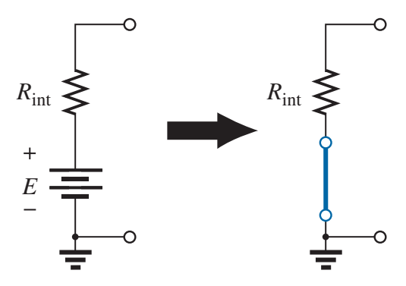
1.1 Superposition Theorem
When removing a voltage source from a network schematic, replace it with a direct connection (short circuit) of zero ohms. Any internal resistance associated with the source must remain in the network.

Slide 8
1.1 Superposition Theorem
Setting a current source to zero amperes is like replacing it with an open circuit. Therefore,
When removing a current source from a network schematic, replace it by an open circuit of infinite ohms. Any internal resistance associated with the source must remain in the network.

Slide 9
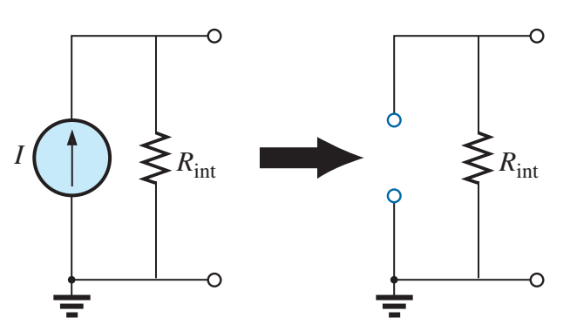
1.1 Superposition Theorem
When removing a current source from a network schematic, replace it by an open circuit of infinite ohms. Any internal resistance associated with the source must remain in the network.

Slide 10
1.1 Superposition Theorem
Since the effect of each source will be determined independently, the number of networks to be analyzed will equal the number of sources

Slide 11
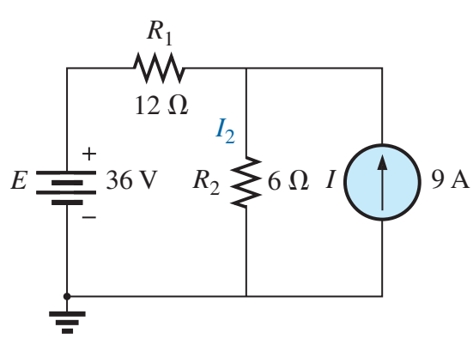
1.1 Superposition Theorem
Example 1: Using the superposition theorem, determine the current through resistor R2 for the network in Fig.

Slide 12
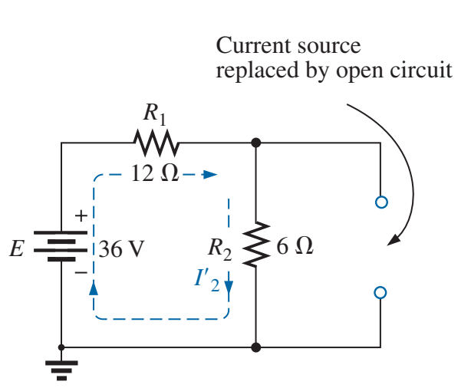
1.1 Superposition Theorem
Solution: In order to determine the effect of the 36 V voltage source, the current source must be replaced by an open-circuit equivalent as shown in Fig. The result is a simple series circuit with a current equal to

Slide 13
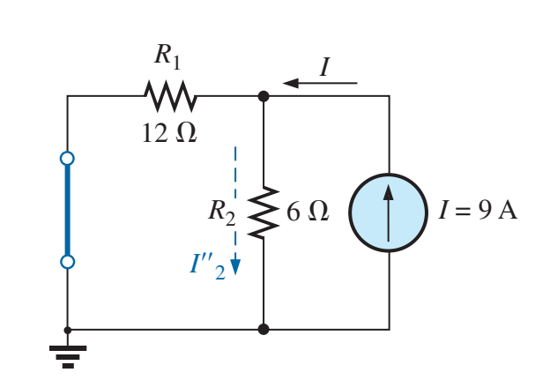
1.1 Superposition Theorem
Examining the effect of the 9 A current source :
Current Divider Rule

Slide 14
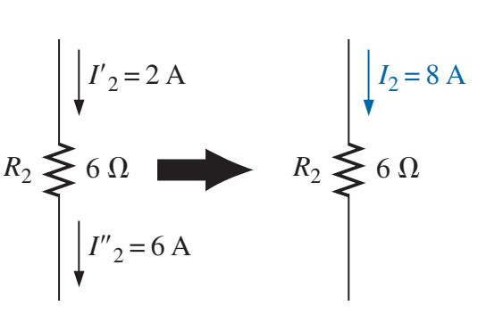
1.1 Superposition Theorem
Since the contribution to current I2 has the same direction for each source, as shown in Fig. the total solution for current I2 is the sum of the currents established by the two sources. That is,

Slide 15
1.1 Superposition Theorem
Question: Can a Superposition be applied to find power effects?
Answer: No , Because ,

Slide 16
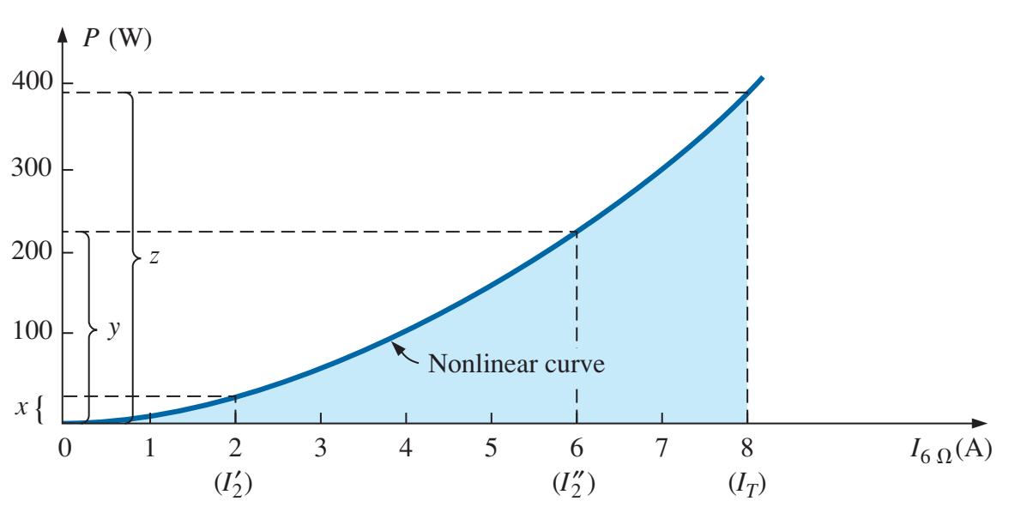
1.1 Superposition Theorem

Slide 17
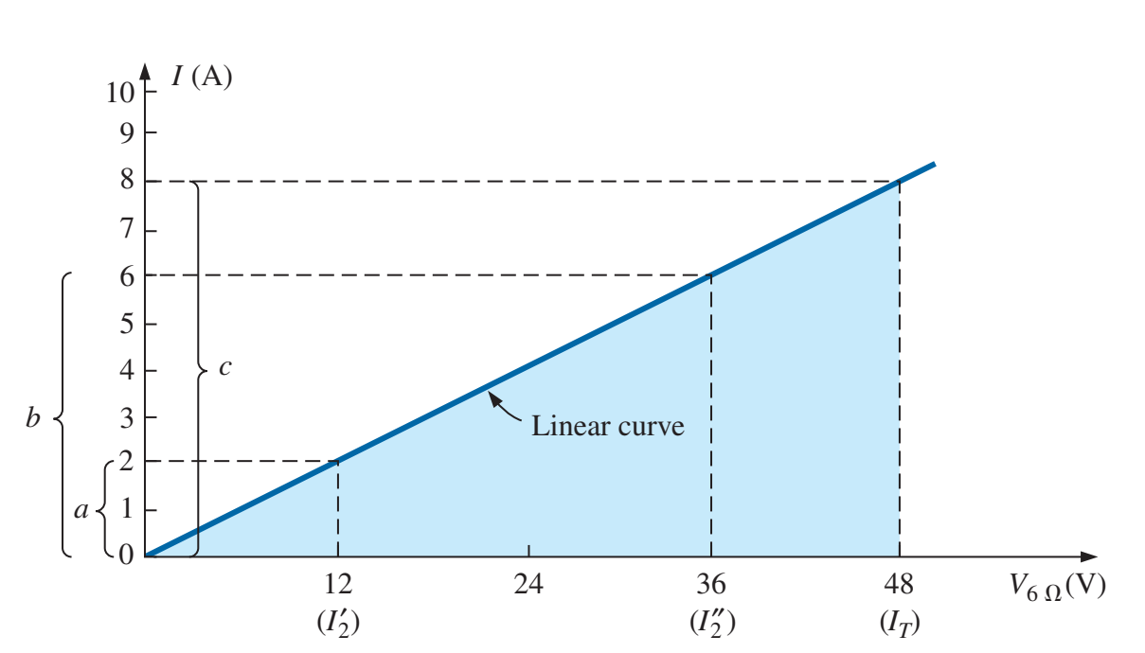
1.1 Superposition Theorem

Slide 18
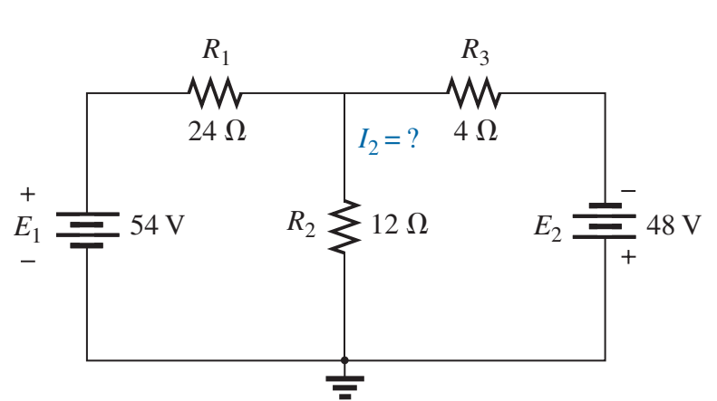
1.1 Superposition Theorem
Example 2: Using the superposition theorem, determine the current through the 12 Ω resistor in Fig.

Slide 19
1.1 Superposition Theorem
Solution: Considering the effects of the 54 V source.

Slide 20
1.1 Superposition Theorem
and the source current is

Slide 21
1.1 Superposition Theorem
Considering the effects of the 48 V source.

Slide 22
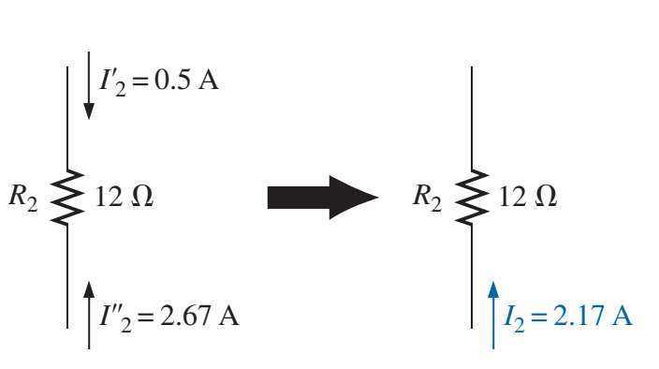
1.1 Superposition Theorem

