Slide 1
Electrical Circuits II
Week 2 – Fall Semester
Electrical Engineering Dept.

Slide 2
1.2 Thévenin’s Theorem
The next theorem to be introduced, Thévenin’s theorem, is probably one of the most interesting in that it permits the reduction of complex networks to a simpler form for analysis and design.

Slide 3
1.2 Thévenin’s Theorem
In general, the theorem can be used to do the following:
• Analyze networks with sources that are not in series or parallel. • Reduce the number of components required to establish the same characteristics at the output terminals. • Investigate the effect of changing a particular component on the behavior of a network without having to analyze the entire network after each change.

Slide 4
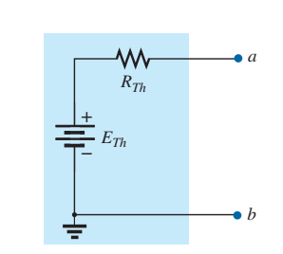
1.2 Thévenin’s Theorem
Thévenin’s theorem states the following:
Any two-terminal dc network can be replaced by an equivalent circuit consisting solely of a voltage source and a series resistor as shown.
Thévenin equivalent circuit

Slide 5
1.2 Thévenin’s Theorem
The theorem was developed by Commandant Leon-Charles Thévenin in 1883 as described in Fig.
Leon-Charles Thévenin.

Slide 6
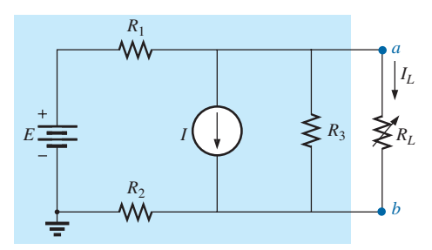
1.2 Thévenin’s Theorem
To demonstrate the power of the theorem, consider the fairly complex network in Fig. below, with its two sources and series-parallel connections.

Slide 7
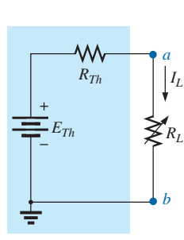
1.2 Thévenin’s Theorem
The theorem states that the entire network inside the blue shaded area can be replaced by one voltage source and one resistor as shown in Fig.

Slide 8
1.2 Thévenin’s Theorem
thévenin’s theorem procedure
Preliminary: 1. Remove that portion of the network where the Thévenin equivalent circuit is found. In Fig. in (slide 7) this requires that the load resistor RL be temporarily removed from the network. 2. Mark the terminals of the remaining two-terminal network. (The importance of this step will become obvious as we progress through some complex networks.) .

Slide 9
1.2 Thévenin’s Theorem
RTh:
3. Calculate RTh by first setting all sources to zero (voltage sources are replaced by short circuits and current sources by open circuits) and then finding the resultant resistance between the two marked terminals. (If the internal resistance of the voltage and/or current sources is included in the original network, it must remain when the sources are set to zero.)

Slide 10
1.2 Thévenin’s Theorem
ETh:
4. Calculate ETh by first returning all sources to their original position and finding the open-circuit voltage between the marked terminals. (This step is invariably the one that causes most confusion and errors. In all cases, keep in mind that it is the open-circuit potential between the two terminals marked in step 2.)

Slide 11
1.2 Thévenin’s Theorem
Conclusion:
5. Draw the Thévenin equivalent circuit with the portion of the circuit previously removed replaced between the terminals of the equivalent circuit. This step is indicated by the placement of the resistor RL between the terminals of the Thévenin equivalent circuit as shown in Fig. (b)

Slide 12
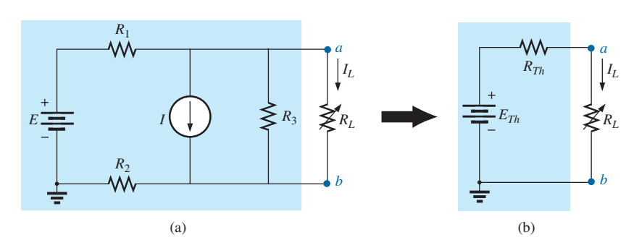
1.2 Thévenin’s Theorem
Substituting the Thévenin equivalent circuit for a complex network.

Slide 13
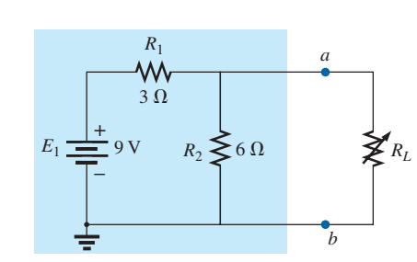
1.2 Thévenin’s Theorem
Example 3: Find the Thévenin equivalent circuit for the network in the shaded area of the network in Fig. below. Then find the current through RL for values of 2 Ω, 10 Ω, and 100 Ω.

Slide 14
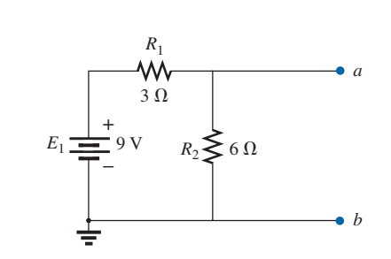
1.2 Thévenin’s Theorem
Solution: Steps 1 and 2: These produce the network in Fig. below. Note that the load resistor RL has been removed and the two “holding” terminals have been defined as a and b .

Slide 15
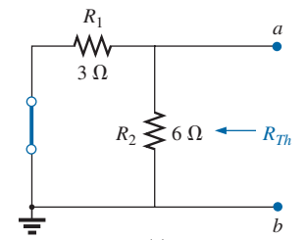
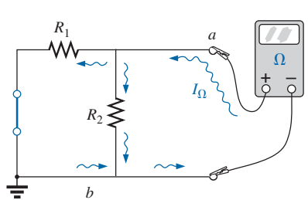
1.2 Thévenin’s Theorem
Step 3: Replacing the voltage source E1 with a short-circuit equivalent yields the network in Fig. below, where,

Slide 16
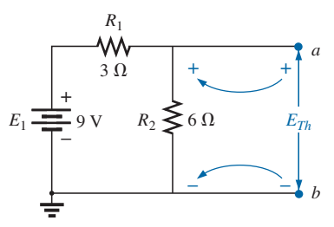
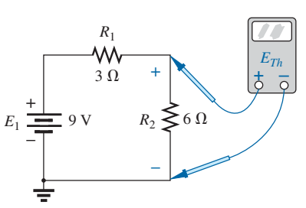
1.2 Thévenin’s Theorem
Step 4: Replace the voltage source (Fig). For this case, the open circuit voltage ETh is the same as the voltage drop across the 6 Ω resistor. Applying the voltage divider rule gives :

Slide 17
1.2 Thévenin’s Theorem
It is particularly important to recognize that ETh is the open-circuit
potential between points a and b.

Slide 18
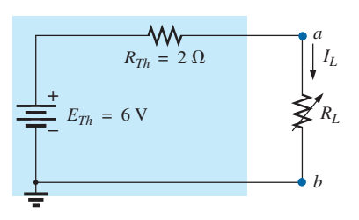
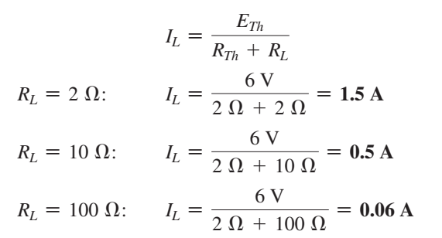
1.2 Thévenin’s Theorem
Step 5:
Substituting the Thévenin equivalent circuit for the network external to RL

Slide 19
1.2 Thévenin’s Theorem
If Thévenin’s theorem were unavailable, each change in RL would require that the entire network in Fig. in slide ( 13 ) be reexamined to find the new value of RL.

Slide 20
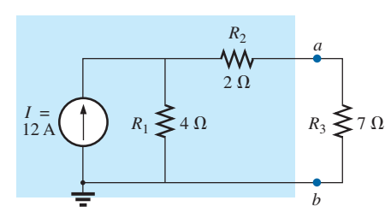
1.2 Thévenin’s Theorem
Example 4: Find the Thévenin equivalent circuit for the network in the shaded area of the network in Fig. below:

Slide 21
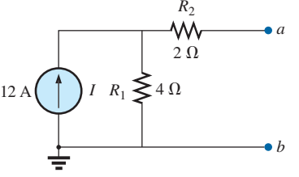
1.2 Thévenin’s Theorem
Solution:
Steps 1 and 2:

Slide 22
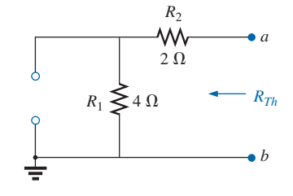
1.2 Thévenin’s Theorem
Step 3: (See Fig.) The current source has been replaced with an open-circuit equivalent and the resistance determined between terminals a and b.

Slide 23
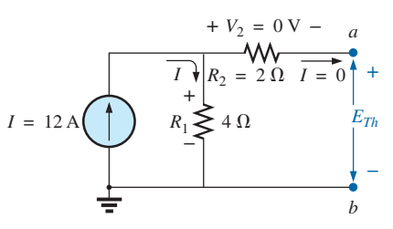
1.2 Thévenin’s Theorem
Step 4: See Fig. In this case, since an open circuit exists between the two marked terminals, the current is zero between these terminals and through the 2 Ω resistor. The voltage drop across R2 is, therefore,

Slide 24
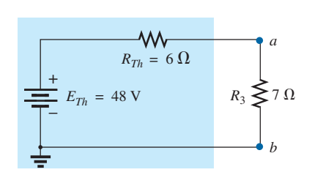
1.2 Thévenin’s Theorem
Equivalent CCT.

Slide 25
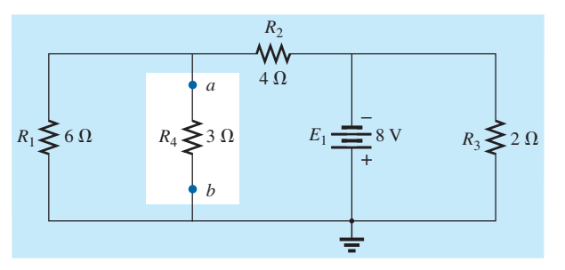
1.2 Thévenin’s Theorem
Example 5: Find the Thévenin equivalent circuit for the network in the shaded area of the network in Fig.

Slide 26
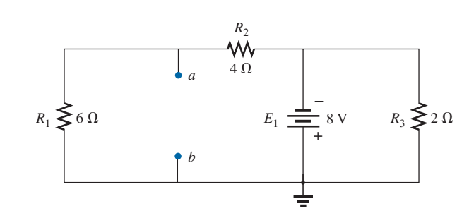
1.2 Thévenin’s Theorem

Slide 27
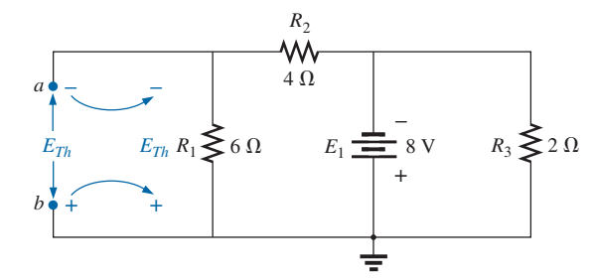
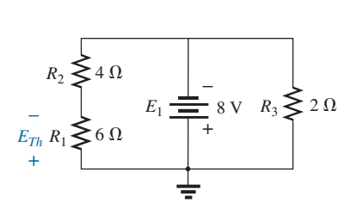
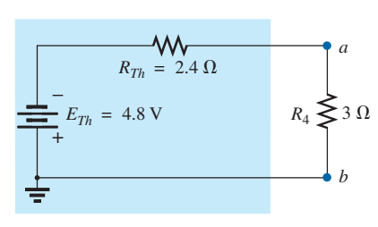
1.2 Thévenin’s Theorem

Slide 28
1.2 Thévenin’s Theorem
Self-Study: Review the all the examples between pages (385 to 393) & (378 – 380).

Slide 29
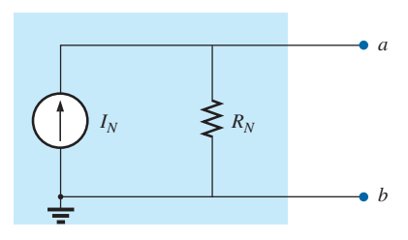
1.3 Norton’s Theorem
Any two-terminal linear bilateral dc network can be replaced by an equivalent circuit consisting of a current source and a parallel resistor, as shown in Fig.
Norton equivalent circuit.

Slide 30
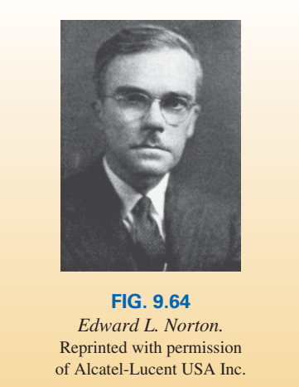
1.3 Norton’s Theorem
The discussion of Thévenin’s theorem with respect to the equivalent circuit can also be applied to the Norton equivalent circuit. The steps leading to the proper values of IN and RN are now listed. Norton’s theorem procedure Preliminary: 1. Remove that portion of the network across which the Norton equivalent circuit is found. 2. Mark the terminals of the remaining two-terminal network.

Slide 31
1.3 Norton’s Theorem
RN: 3. Calculate RN by first setting all sources to zero (voltage sources are replaced with short circuits and current sources with open circuits) and then finding the resultant resistance between the two marked terminals. (If the internal resistance of the voltage and/or current sources is included in the original network, it must remain when the sources are set to zero.) Since RN = RTh, the procedure and value obtained using the approach described for Thévenin’s theorem will determine the proper value of RN.

Slide 32
1.3 Norton’s Theorem
IN : 4. Calculate IN by first returning all sources to their original position and then finding the short-circuit current between the marked terminals. It is the same current that would be measured by an ammeter placed between the marked terminals

Slide 33
1.3 Norton’s Theorem
Conclusion:
5. Draw the Norton equivalent circuit with the portion of the circuit previously removed replaced between the terminals of the equivalent circuit.

Slide 34
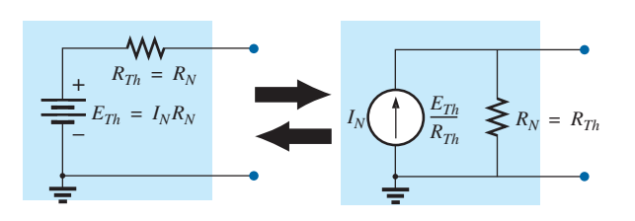
1.3 Norton’s Theorem
The Norton and Thévenin equivalent circuits can also be found from each other by using the source transformation discussed earlier and reproduced in Fig.
Converting between Thévenin and Norton equivalent circuits

Slide 35
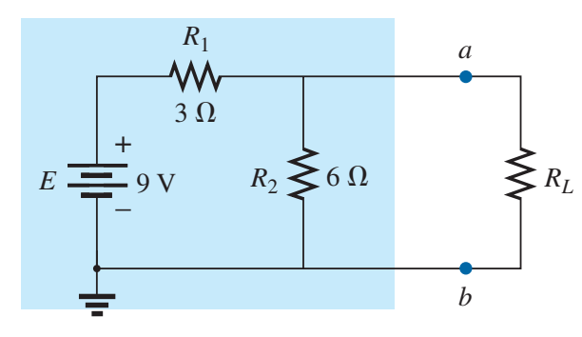
1.3 Norton’s Theorem
Example 5: Find the Norton equivalent circuit for the network in the shaded area in Fig. below.

Slide 36
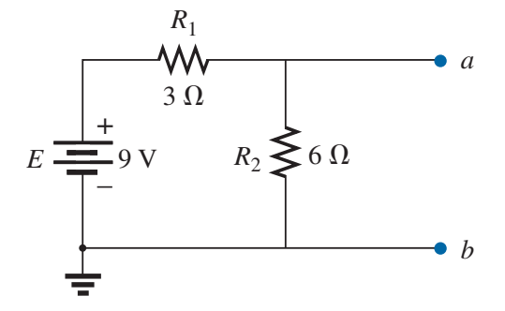
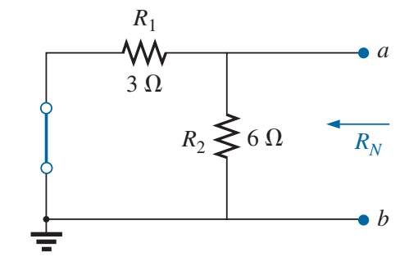
1.3 Norton’s Theorem
Solution:

Slide 37
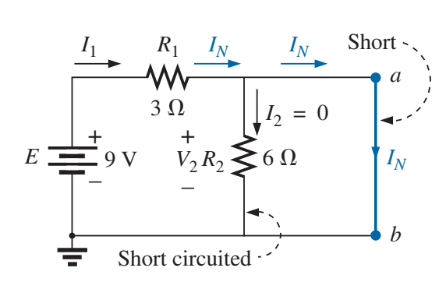
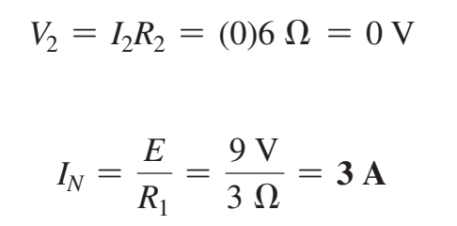
1.3 Norton’s Theorem

Slide 38
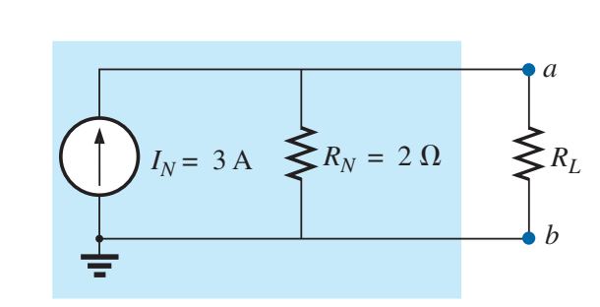
1.3 Norton’s Theorem
Substituting the Norton equivalent circuit for the
network external to the resistor RL

Slide 39
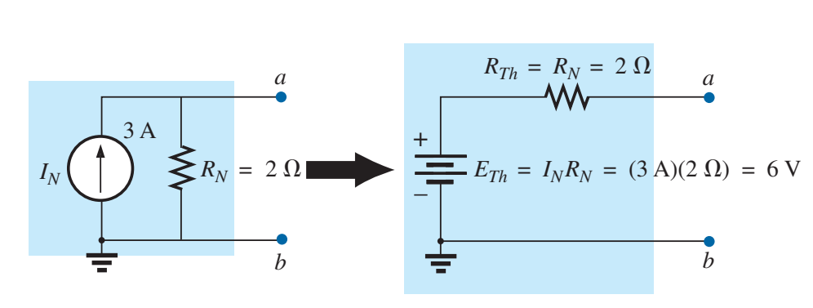
1.3 Norton’s Theorem
Converting the Norton equivalent circuit to a Thévenin equivalent circuit.

Slide 40
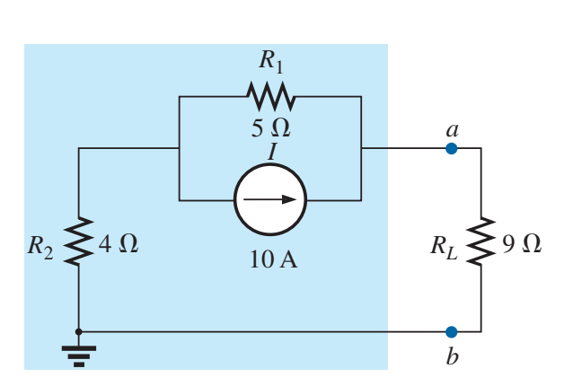
1.3 Norton’s Theorem
Example 6: Find the Norton equivalent circuit for the network external to the 9 Ω resistor in Fig. below.

Slide 41
1.3 Norton’s Theorem
Solution:

Slide 42
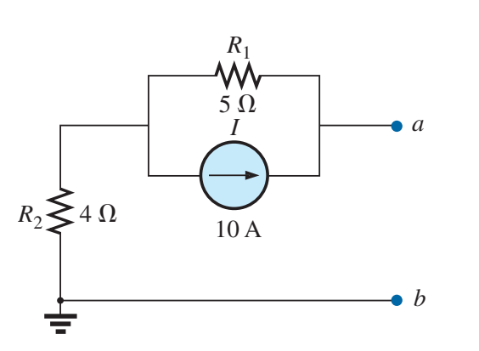
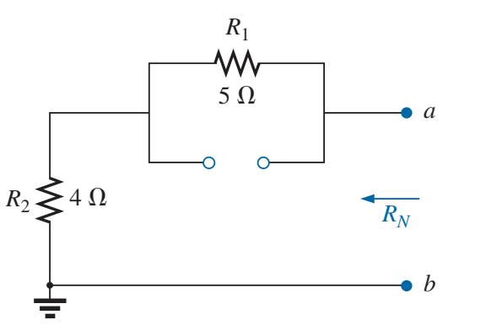
1.3 Norton’s Theorem

Slide 43
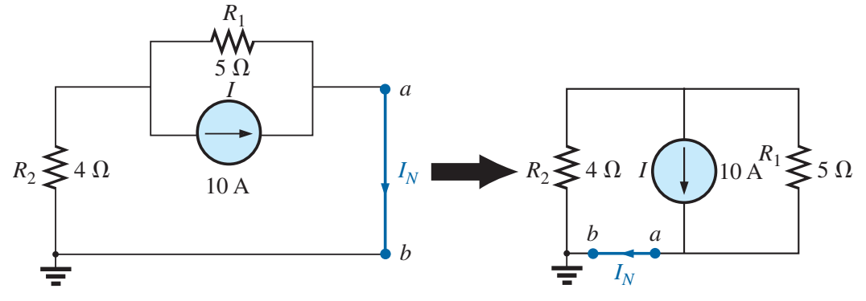
1.3 Norton’s Theorem

Slide 44
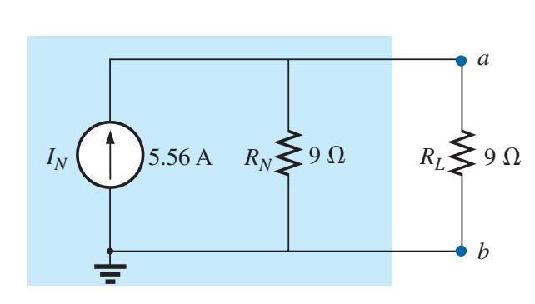
1.3 Norton’s Theorem
Substituting the Norton equivalent circuit for the network external to the resistor RL

Slide 45
1.3 Norton’s Theorem
Self-study: review all the solved examples between pages (396 – 397).
Please look after the Assignment-1 in G-drive (Assignments folder).
Please get ready for next week’s activities (May be a quiz).
End of Week 2.

