Slide 1
Solving Some Problems
Week 3 – Fall Semester 2020-2021
Circuits II

Slide 2
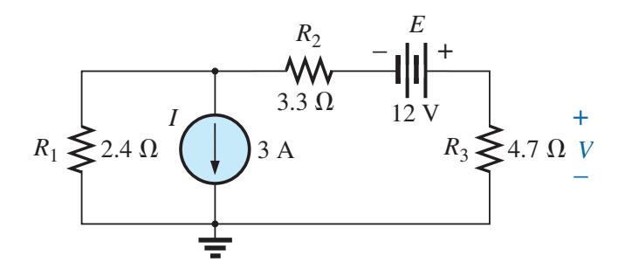
Problem 1
Using the superposition theorem, determine the voltage across the 4.7 Ω resistor .

Slide 4
Problem 2
Find the power delivered to the 4.7 Ω resistor due solely to the current source.

Slide 6
Problem 3
Find the power delivered to the 4.7 Ω resistor due solely to the voltage source.

Slide 8
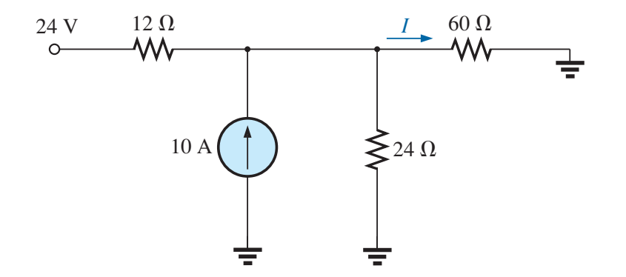
Problem 4
Using the superposition theorem, determine the current through the 60 Ω resistor

Slide 10
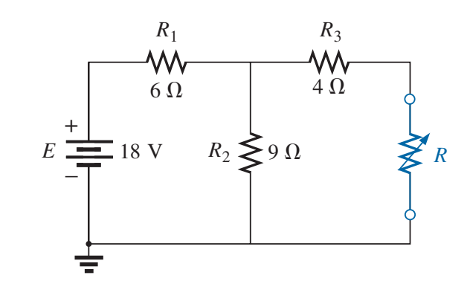
Problem 5
Find the Thévenin equivalent circuit for the network external to the resistor R

Slide 12
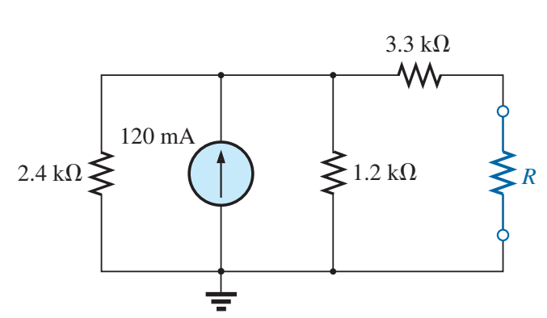
Problem 6
Find the Thévenin equivalent circuit for the network external to the resistor R for the network

Slide 14
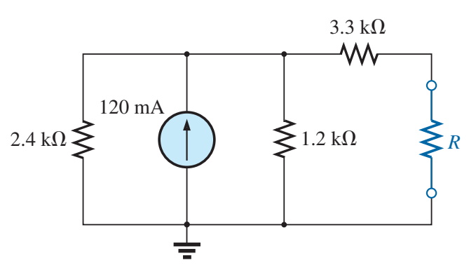
Problem 7
Find the power delivered to R when R is 2 kΩ and 100 kΩ

Slide 16
Problem 8
Find the Norton equivalent circuit for the network external to the resistor R . Do the same for Problem 6 .

