Slide 1
Igneous Petrology Earth’s Layered Structure
Layers of Differing Physical Properties
The internal structure of earth is deduced from variations in the velocity of seismic waves at depth. The velocity of both P- wave and S-waves increases until they reach a depth of approximately 100 km, this layer of increasing velocity is called the lithosphere.
After that between lithosphere mantle and the asthenosphere the waves abruptly slow down and their velocities continue to decrease until they have traveled to a depth of 150km. This low- velocity layer in upper part of asthenosphere the reason for this is that the asthenosphere contains a few percent of melt.

Slide 2
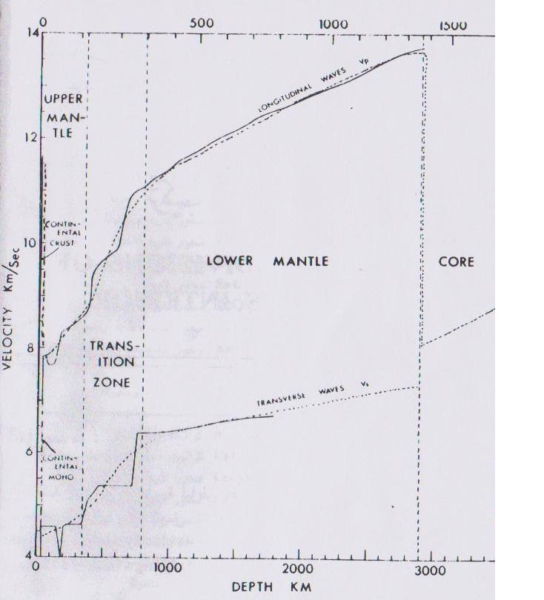

Slide 3
Layers Defined by Composition
Earth’s interior consists of three major zones defined by their chemical
composition the crust, mantle, and core.
Crust
Thin, rocky outer layer. varies in thickness. Roughly 7 km in oceanic regions
Continental crust averages 20-40km. Exceeds 70 km in mountainous regions.

Slide 4
Continental Crust
thickness: (40-50)Km, can divided to two parts depend of the velocity of seismic wave (P-Wave)
Can be classified to two parts
Upper crust:) in upper crust is (5.8-6.8) Km/sec consider acidic rock (acdic mineral) Qz, K-Feldspar, mica ± Amphibole this rock is closer to granodiorite than granite because this rock contain K-feldspar and plagioclase in same.
Upper continental crust is dominated by silicon- and aluminum-rich minerals and is said to be sialic.

Slide 5
Lower continental crust: the velocity of seismic wave (P-Wave) in lower crust is (6.7-7.2 )Km/sec this velocity consider with basic composition not basic rock. Because basic rock unstable under this condition of (T & P) the basic rock in lower crust change to garnet granulite if the heat flow is low but if the heat flow is high change to eclogite but its metamorphic the velocity of the seismic wave in eclogite and granulite is greater than 7.2 Km/sec.
The lower crust consist of two types of minerals the first are low velocity (Qz, Feld) the second are high velocity like (Olv, Px, Garnet)
The combination of these two types of minerals is a metamorphic combination and has basic composition.

Slide 6
Oceanic crust
is the upper most layer of the oceanic portion of a tectonic plate. It is composed of the upper oceanic crust, with pillow lavas and a dike complex, and the lower oceanic crust, composed of troctolite, gabbro and ultramafic cumulates. The crust overlies the solidified and Oceanic crust is primarily composed of mafic rocks, or sima,
which is rich in iron and magnesium. It is thinner than continental crust, or sial, generally less than 10 kilometers thick; however, it is denser, having a mean density of about 3.0g/cm3

Slide 7
The oceanic crust studied in three areas
1-Oceanic Basin
The oceanic crust consists of three layers which is
Layer 1 is on an average 0.4 km thick. It consists of unconsolidated or semi consolidated sediments, usually thin or even not present near the mid-ocean ridges but thickens farther away from the ridge. Near the continental margins sediment is terrigenous, meaning derived from the land, unlike deep sea sediments which are made of tiny shells of marine organisms, usually calcareous and siliceous, or it can be made of volcanic ash and terrigenous sediments transported by turbidity currents.
Layer 2 could be divided into two parts: layer 2A – 0.5 km thick uppermost volcanic layer of glassy to finely crystalline basalt usually in the form of pillow basalt, and layer 2B – 1.5 km thick layer composed of diabase dikes.
Layer 3 is formed by slow cooling of magma beneath the surface and consists of coarse grained gabbros and cumulate ultramafic rocks. It constitutes over two-thirds of oceanic crust volume with almost 5 km thickness..

Slide 8
2- Mid Oceanic Ridge ( MOR)
MOR is a seafloor mountain system formed by plate tectonics. It typically has a depth of ~ 2,600 meters and rises about two kilometers above the deepest portion of an ocean basin. This feature is where seafloor spreading takes place along a divergent plate boundary. The rate of seafloor spreading determines the morphology of the crest of the mid-ocean ridge and its width in an ocean basin. The production of new seafloor and oceanic lithosphere results from mantle upwelling in response to plate separation. The melt rises as magma at the linear weakness in the oceanic crust, and emerges as lava, creating new crust and lithosphere upon cooling.
The oceanic crust consists of two layers which are Layer 2 and 3

Slide 9
3-Island Arc
Island arcs are long chains of active volcanoes with intense seismic activity found along convergent tectonic plate boundaries (such as the Ring of Fire). Most island arcs originate on oceanic crust and have resulted from the descent of the lithosphere into the mantle along the subduction zone.
The oceanic crust consists of two layers which are Layer 2 and 3

