Slide 1
University of Salahaddin-Erbil
College of Education
Department of Mathematics
Academic Skills
First stage- Mathematics Department
Dr. Awaz Kakamam Muhammad
2022-2023

Slide 2
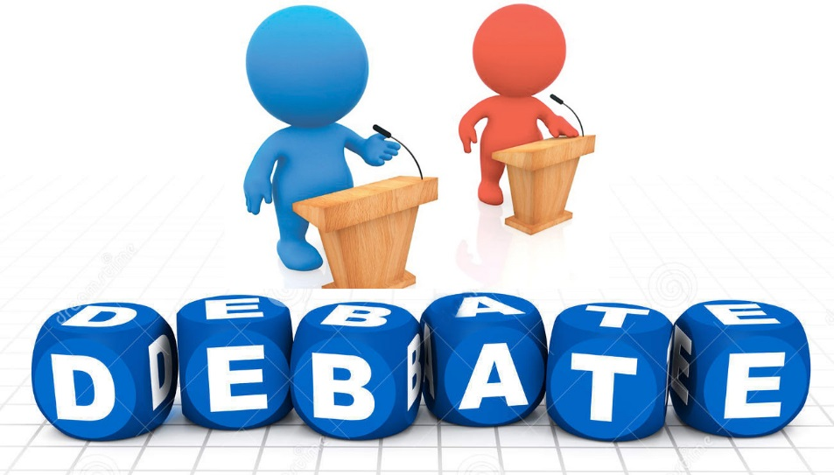
Academic Debate

Slide 3
Organization of Speeches ڕێکخستنی قسەکردنەکان لە گفتوگۆی ئەکادیمی
Constructive Speeches قسە بنیاتنەرەکان
Rebuttal Speeches تانە لێدەرەکان

Slide 4
Constructive Speeches قسە بنیاتنەرەکان

Slide 5
Rebuttal Speeches تانە لێدەرەکان

Slide 6
Academic Debate Formats شێوازەکانی گفتوگۆی ئەکادیمی
شێوازی گفتوگۆی ئەکادیمی زۆرهەن کە کاریان پێدەکرێت لەدامودەزگا فێرکاریەکاندا:
Lincoln-Douglas Debate
Policy Debate Format
Karl Popper Debate Format
Parliamentary Debate.
Spontaneous Argumentation.
Academic Debate.

Slide 7
Lincoln-Douglas Debate . شێوازی گفتوگۆی لینکۆلن-دۆگلاس

Slide 8
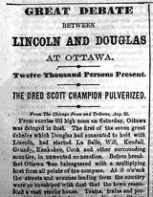
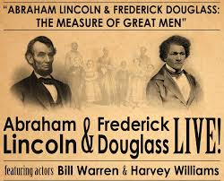

Slide 9
Policy Debate Format شێوازی گفتوگۆی پۆلیسی.

Slide 10
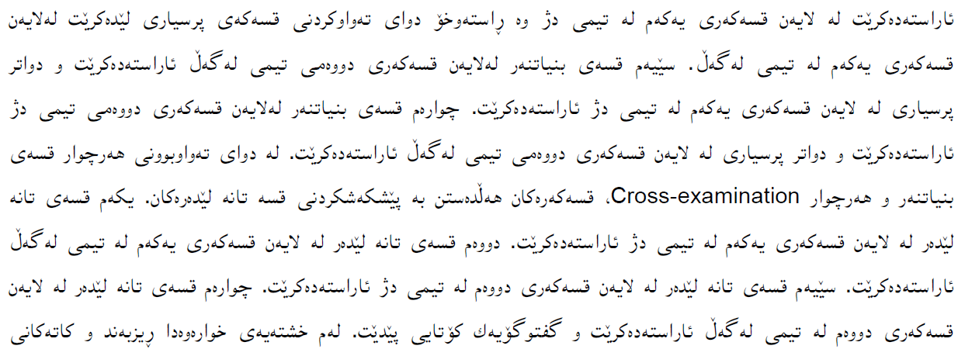
Policy Debate Format شێوازی گفتوگۆی پۆلیسی.

Slide 11
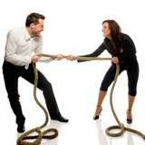
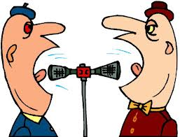

Slide 12
Karl Popper Debate Format شێوازی گفتوگۆی کارل پۆپەر.

Slide 13
Academic debate
These are debates of a purely academic nature.
Academic debating is a formal argumentation in which two opposing sides - teams propose a given proposition statements or attack the validity of a motion in a series of speeches.
Academic debating is a great combination of argumentation with knowledge of important issues like beliefs, social values, government policies, economics and current problems of the world and today's society.

Slide 14
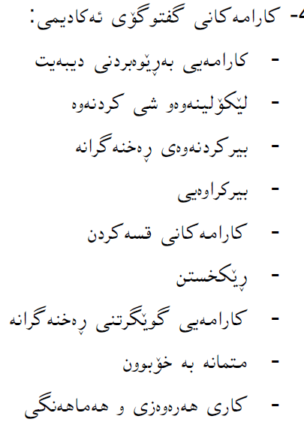
Debate Skills:
- Coordination skills
- Investigating and analyzing
- Critical thinking skills
- Open-mindedness
- Speaking skills
- Organization
- Listening skills
- Self-confidence
- Team work and cooperation

Slide 15
Thank you!

