Slide 1
University of Salahaddin-Erbil
Education College
Mathematics Department
Referencing using the Harvard Style
Prepared by: Dr. Awaz Kakamam Muhammad
Academic Skills
2022-2023

Slide 2
Referencing

Slide 3
Referencing styles
There are several different styles of referencing:
APA (American Psychological Association)
MLA (Modern Language Association)
ACS (American Chemical Society)
Oxford
Harvard
Chicago
Vancouver
IEEE
JAMA
Each style has its own rules for properly citing sources.

Slide 4
Referencing -The Harvard System
The Harvard System is one of many available methods of referencing and is the preferred choice of most departments in the University. It is also called the Author - Date System.
However, students should check with their lecturers which system their course requires before they do their first assignments, reports and projects.

Slide 5
Referencing -The Harvard System
When you have included information from published sources in your work, you must acknowledge this information fully and accurately by:
In-text citation:
It consists mainly of the authors' last name and the year of publication (and page numbers if it is directly quoted) in round brackets placed within the text. If there is no discernable author, the title and date are used.
Reference list:
The reference list should be ordered alphabetically by the last name of the first author of each work. References with no author are ordered alphabetically by the first significant word of the title.

Slide 6
Referencing -The Harvard System
Here is an example that cites a book with one author using Harvard style.

Slide 7
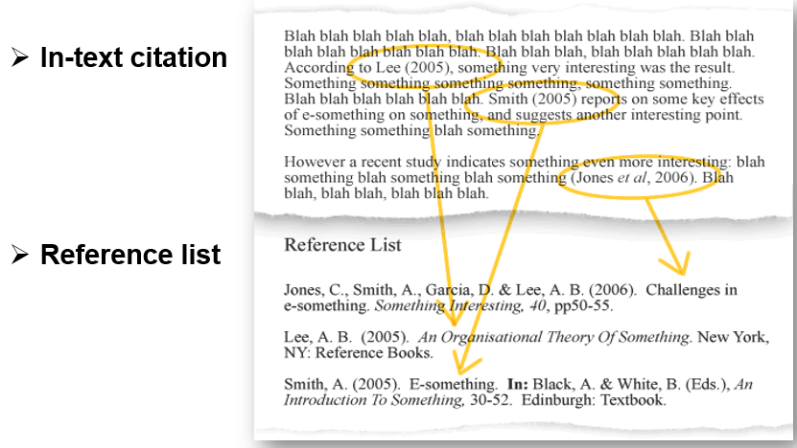
Referencing -The Harvard System

Slide 8
When do you need to reference?
You should acknowledge your source with a reference whenever you include:
Mention of a theory, fact, argument or viewpoint attributable to a specific person.
Statistics, examples and case studies.
Illustrations examples from another source.
Direct quotations from another source.

Slide 9
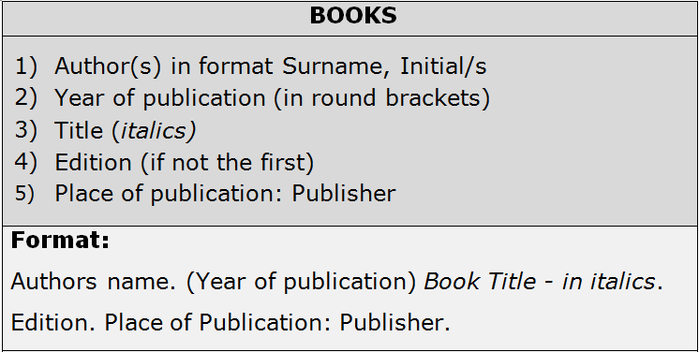
Printed Book (Hard Copy)

Slide 10
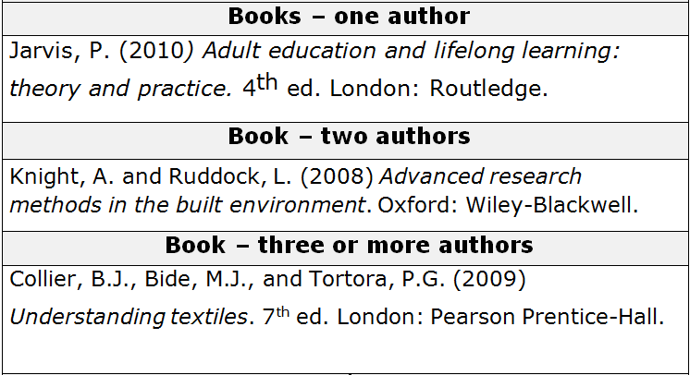
Printed Book (Hard Copy)

Slide 11
Electronic Book (Soft Copy)
URL Computing uniform (or universal) resource locator, the address of a World Wide Web page.

Slide 12
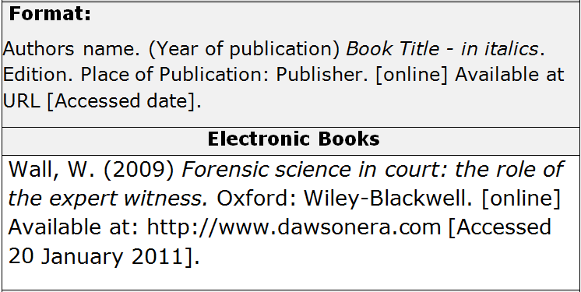
Electronic Book (Soft Copy)

Slide 13
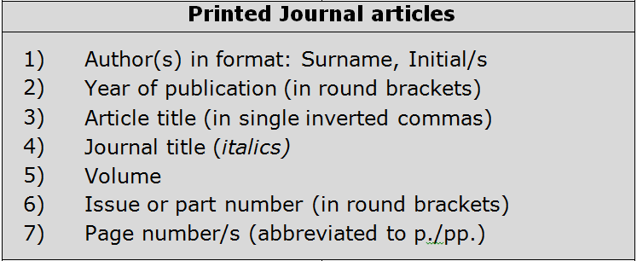
Printed Journal Articles

Slide 14
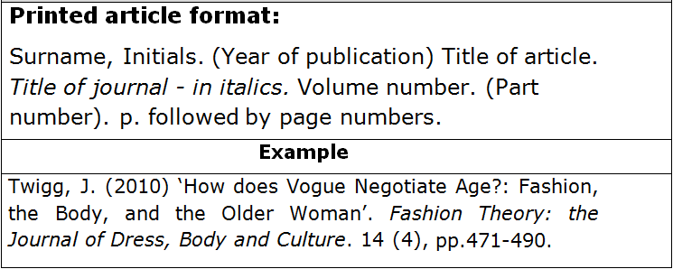
Printed Journal Articles

Slide 15
Electronic Journal Articles

Slide 16
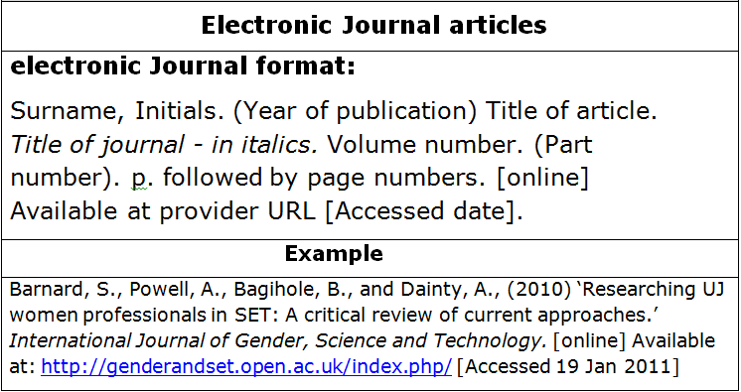
Electronic Journal Articles

Slide 17
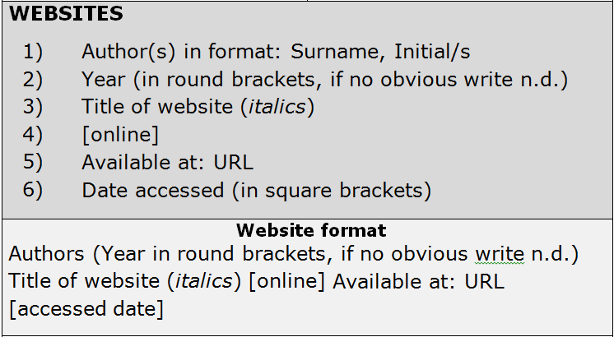
Websites Information
no date

Slide 18
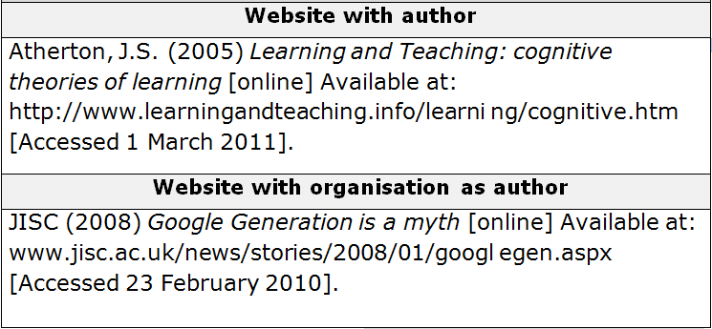
Websites Information

Slide 19
THANKS !

