Slide 1
Chapter 1
STARTING WITH MATLAB

Slide 2
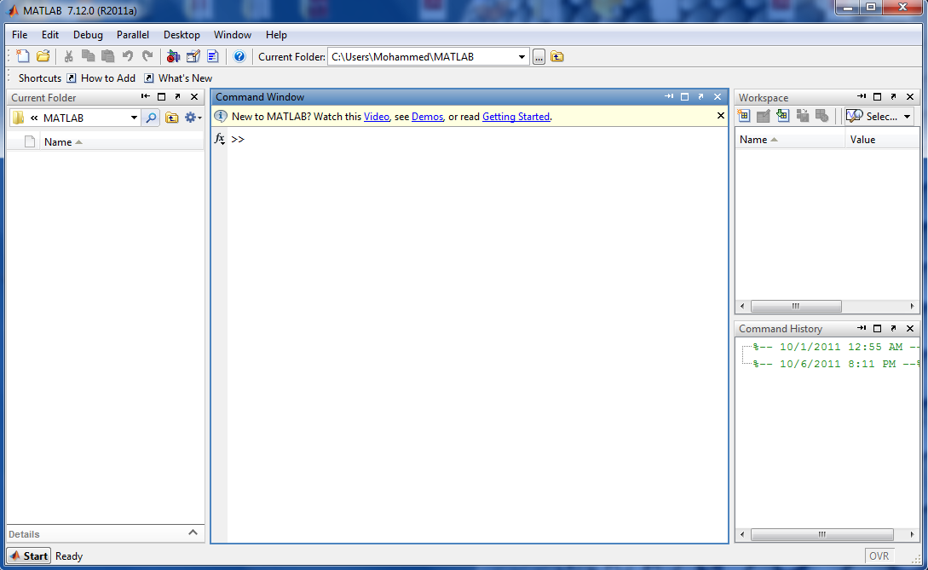
1.1 Starting Matlab, Matlab Windows
Provides information about variables that are used.
Shows the files in the current directory
Command Window, enters variables, runs programs.
Logs commands entered in the command window
Figure 1-1: The default view of MATLAB Desktop

Slide 3
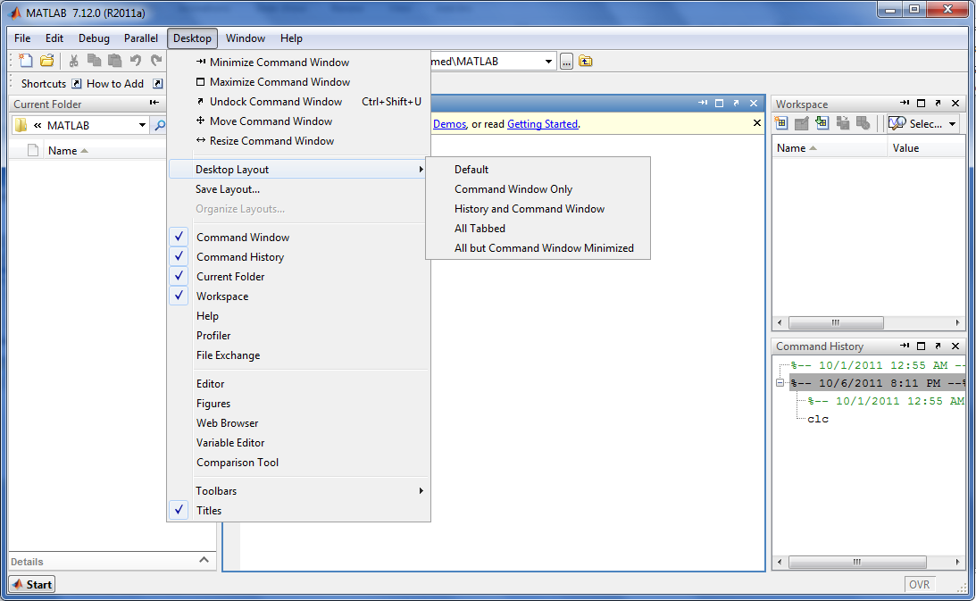
1.1 Starting Matlab, Matlab Windows
Figure 1-2: Controlling MATLAB Windows

Slide 4
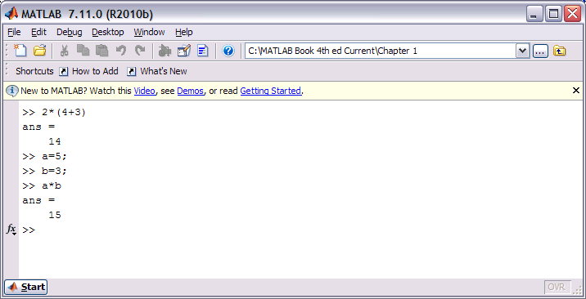
1.2 Working In The Command Window
Notes for working in the Command Window:
To type the cursor must be placed next to ( >> ).
The command is executed by pressing the ENTER key.
Everything Executed previously is remain unchanged.
Several Commands can be typed in the same line by typing COMMA ( , ) between and when ENTER key is pressed the commands run from left to right.
A previously typed command can be recalled with up-arrow key and down-arrow key.
If a command is too long to fit one line, it can be continued by typing ( … ) called an ellipsis after pressing ENTER key and then typing it in the new line.
|
Figure 1-3: The Command Window

Slide 5
1.3 Defining Scalar Variables
Predefined Keywords and Variables
There are 20 words, called keywords, that are reserved by MATLAB for various purposes and cannot be used as variable names. These words are:
break case catch classdef continue else elseif end for function global if otherwise parfor persistent return spmd switch try while.
The keywords can be displayed by typing the command iskeyword.
>> break=71;
??? break=71;
|
Error: The expression to the left of the equals sign is not a valid target for an assignment.

Slide 6
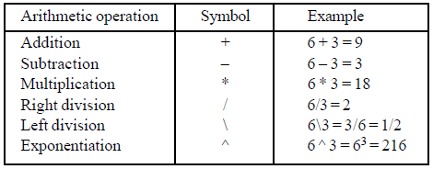
1.4 Arithmetic Operations With Scalars
The symbols for arithmetic operations with scalars are summarized below:
The left division is mostly used for operations with arrays. For scalars, the left division is the inverse of the right division.
Table 1-1

Slide 7
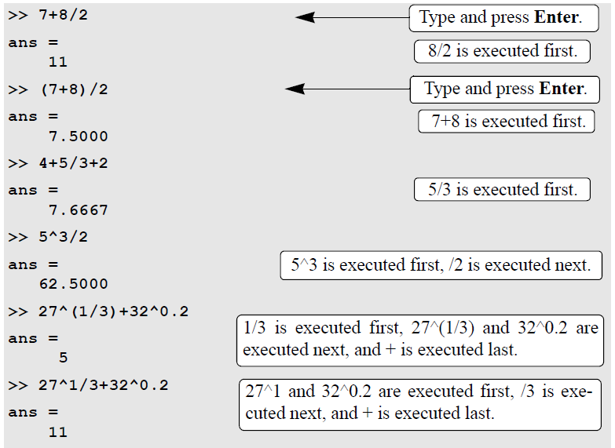
1.4 Arithmetic Operations With Scalars

Slide 8
1.5 Some Useful Commands
clc: clears the command window.
who: lists the names of all created variables.
whos: lists the names of all created variables and some information about each variable.
clear: removes all variables and functions from memory
help: shows help topics.

Slide 9
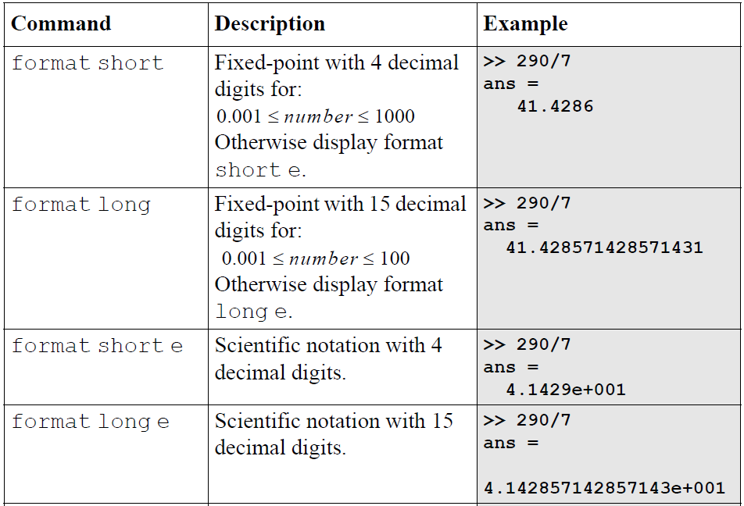
1.6 Display Formats

Slide 10
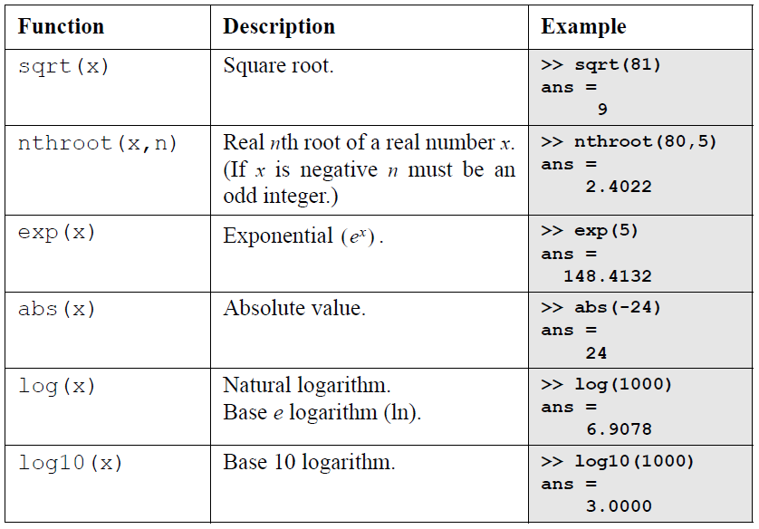
CHAPTER ONE
1.6 Elementary Math Built-in Functions

Slide 11
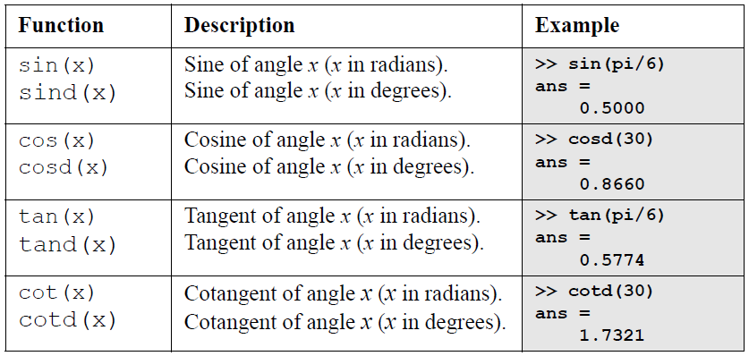
1.6 Elementary Math Built-in Functions
The inverse trigonometric functions are asin(x), acos(x), atan(x), acot(x) for the angle in radians; and asind(x), acosd(x), atand(x), acotd(x) for the angle in degrees. The hyperbolic trigonometric functions are sinh(x), cosh(x), tanh(x), and coth(x) and their inverses are asinh(x), acosh(x), atanh(x), and acoth(x) .

Slide 12
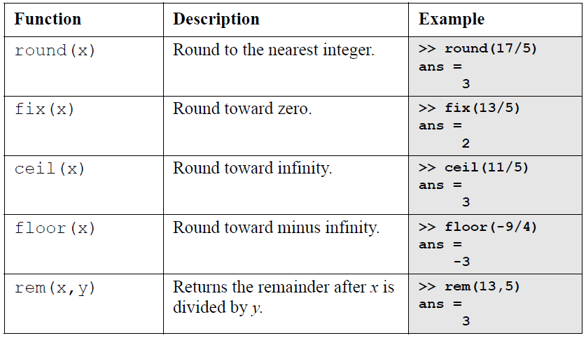
CHAPTER ONE
1.6 ELEMENTARY MATH BUILT-IN FUNCTIONS
Round towards Plus infinity

Slide 13
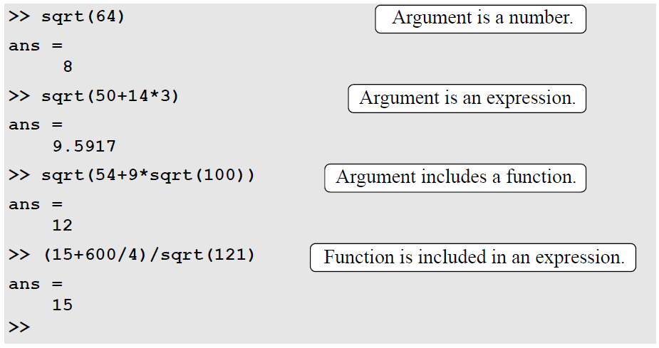
CHAPTER ONE
1.6 Elementary Math Built-in Functions

Slide 14
Example
A trigonometric identity is given by
verify the identity is correct by calculating each side of equation,
let,
use
Command window

