Slide 1
Chapter 2
ARRAYS

Slide 2
CAPTER TWO
Creating Arrays
Creating a One-dimensional Array (Vector) & Creating a Two-dimensional Array (Matrix)
The Zeros, Ones and, Eye Commands & The Transpose Operator
Array Addressing & Using a Colon (Vector & Matrix)
Adding & Deleting Elements To/From Existing Variables
Built-in Functions For Handling Array
Mathematical Operations With Arrays
Built-in Function For Analyzing Array

Slide 3
CHAPTER T
① Creating a Vector and a Matrix
I. Creating a vector from a known list of numbers

Slide 4
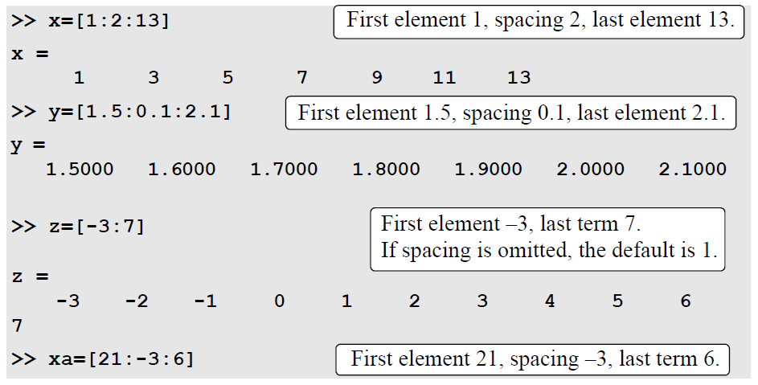
① Creating a Vector and a Matrix
II. Creating a vector with constant spacing by specifying the first term, the spacing, and the last term

Slide 5
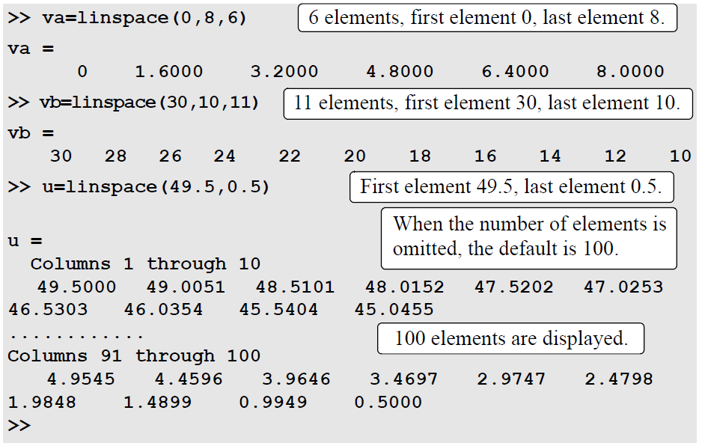
① Creating a Vector and a Matrix
III. Creating a vector with constant spacing by specifying the first term and last terms, and the number of terms

Slide 6
① Creating a Vector and a Matrix

Slide 7
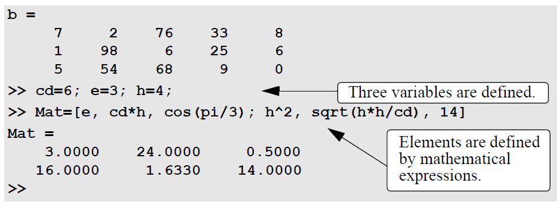
① Creating a Vector and a Matrix

Slide 8
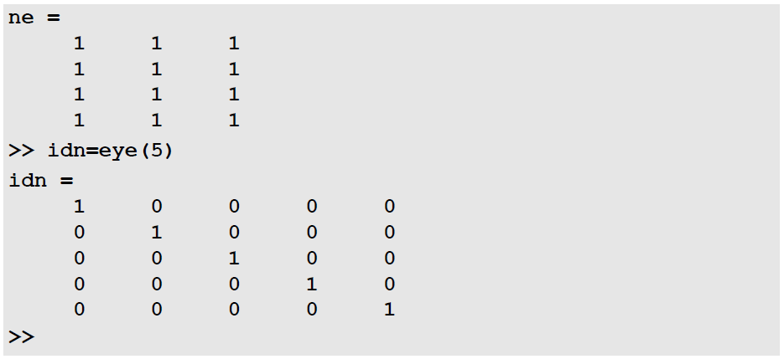
② The Zeros, Ones and, Eye Commands & The Transpose ……Operator

Slide 9
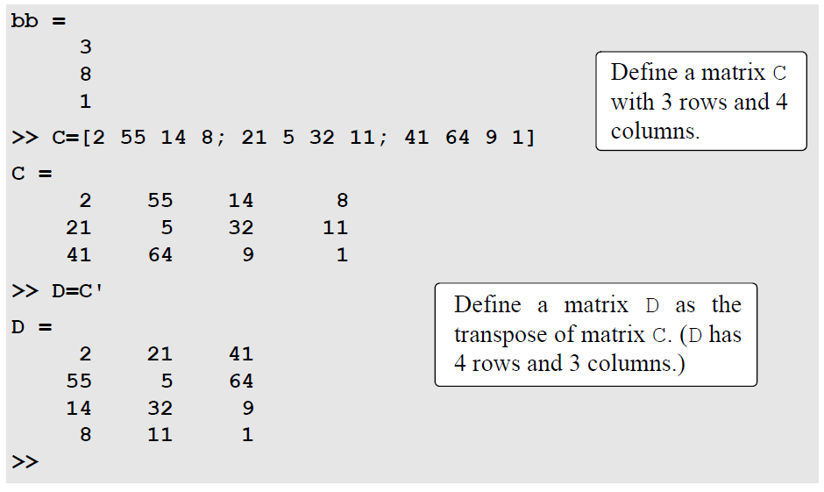
② The Zeros, Ones and, Eye Commands & The Transpose ……Operator

Slide 10
③ Array Addressing & Using a Colon (Vector & Matrix)
Elements in an array (either vector or matrix) can be addressed individually or in subgroups. This is useful when there is a need to redefine only some of the elements, when specific elements are to be used in calculations, or when a subgroup of the elements is used to define a new variable.
Vector
The address of an element in a vector is its position in the row (or column). For a
vector named ve, ve (k) refers to the element in position k. The first position is
1. For example, if the vector ve has nine elements:
ve = 35 46 78 23 5 14 81 3 55
then
ve(4) = 23, ve(7) = 81, and ve( l ) = 35.
A single vector element, v(k), can be used just as a variable. For example, it
is possible to change the value of only one element of a vector by assigning a new
value to a specific address. This is done by typing: v(k) = value. A single element
can also be used as a variable in a mathematical expression. Examples are:

Slide 11
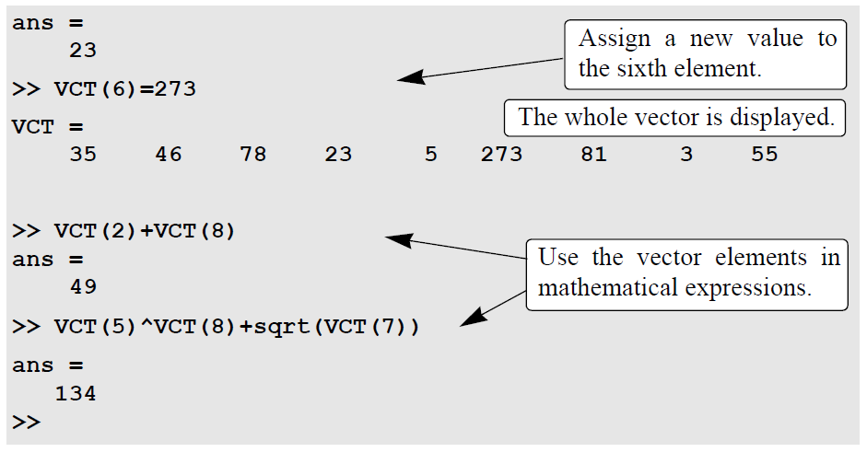
③ Array Addressing & Using a Colon (Vector & Matrix)

Slide 12
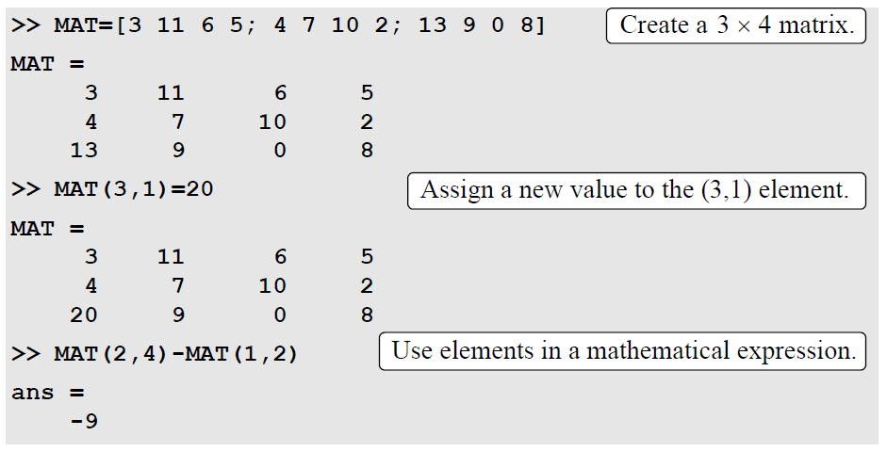
③ Array Addressing & Using a Colon (Vector & Matrix)

Slide 13
③ Array Addressing & Using a Colon (Vector & Matrix)
For a Vector:
va(:) Refers to all the elements of the vector va (either a row or a ……….column vector).
va(m:n) Refers to elements m through n of the vector va

Slide 14
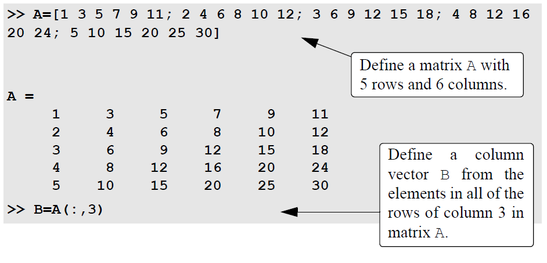
③ Array Addressing & Using a Colon (Vector & Matrix)
For a Matrix:
A(:,n) Refers to the elements in all the rows of column n of the matrix A.
A(n,:) Refers to the elements in all the columns of row n of the matrix A.
A(:,m:n) Refers to the elements in all the rows between columns m and n of the matrix A.
A(m:n,:) Refers to the elements in all the columns between rows m and n of the matrix A.
A(m:n,p:q) Refers to the elements in rows m through n and columns p through q of the matrix A.

Slide 15
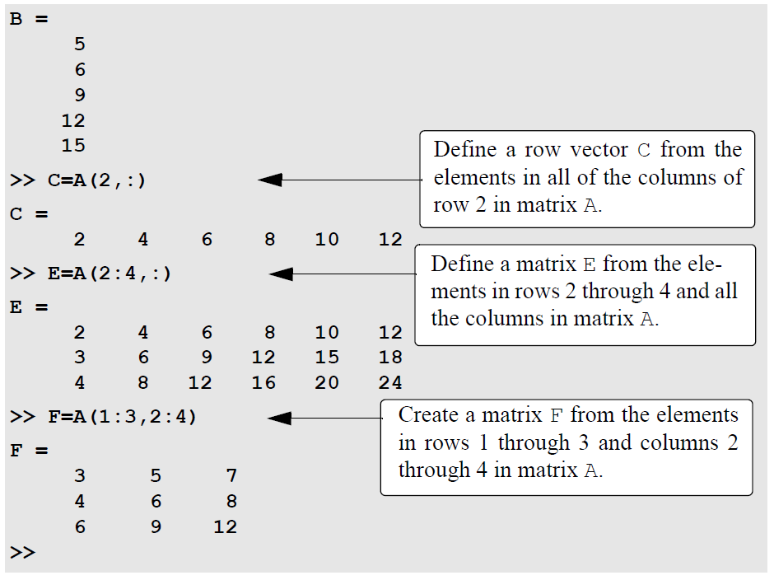
③ Array Addressing & Using a Colon (Vector & Matrix)

Slide 16
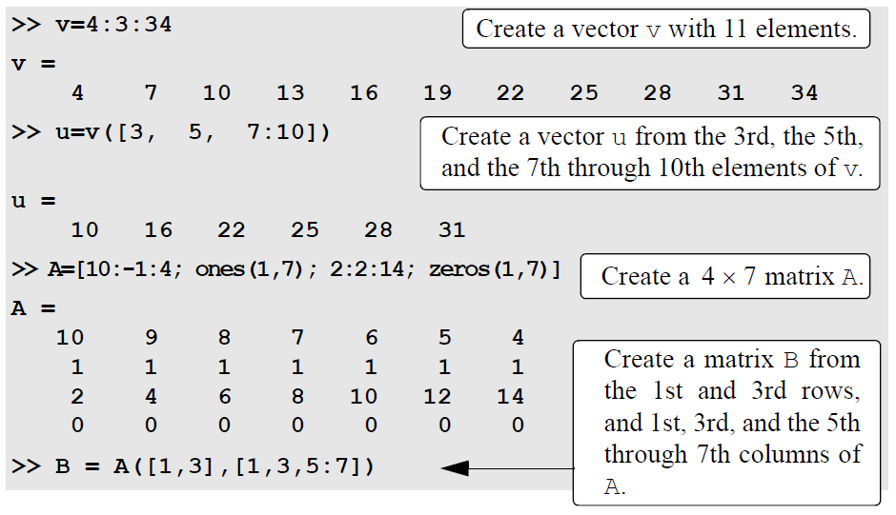
③ Array Addressing & Using a Colon (Vector & Matrix)

Slide 17
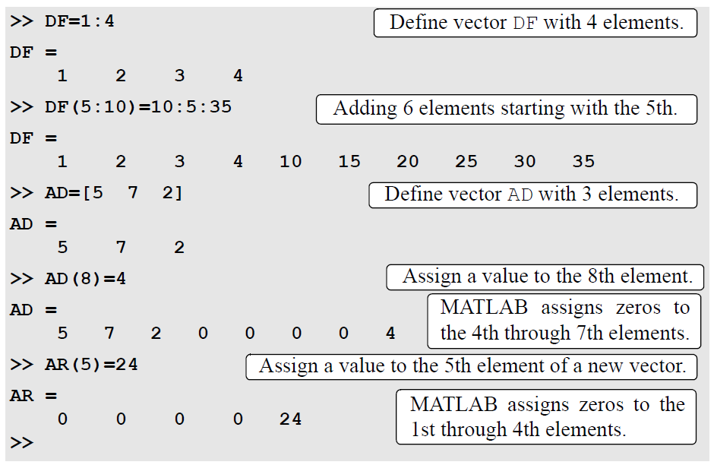
④ Adding & Deleting Elements To/From Existing Variables

Slide 18
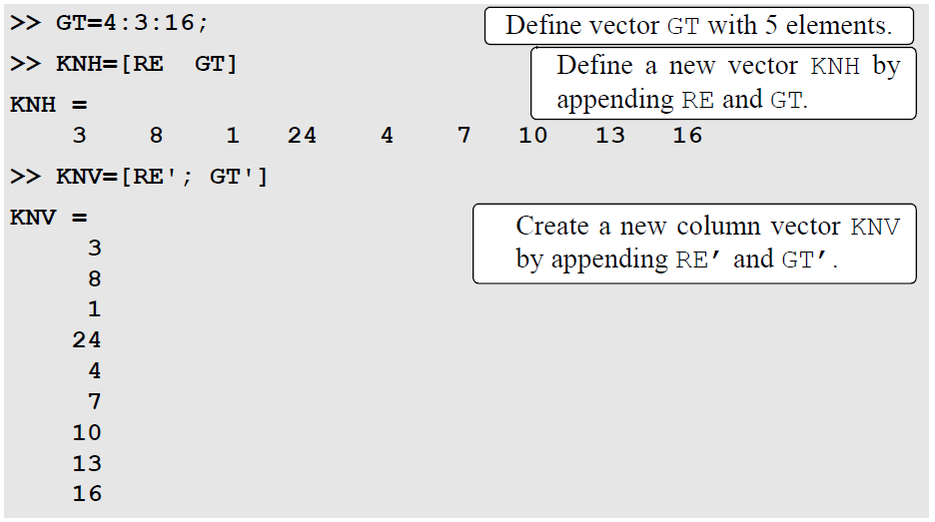
④ Adding & Deleting Elements To/From Existing Variables
Notes:
Append: to add something to the end of a piece of writing

Slide 19
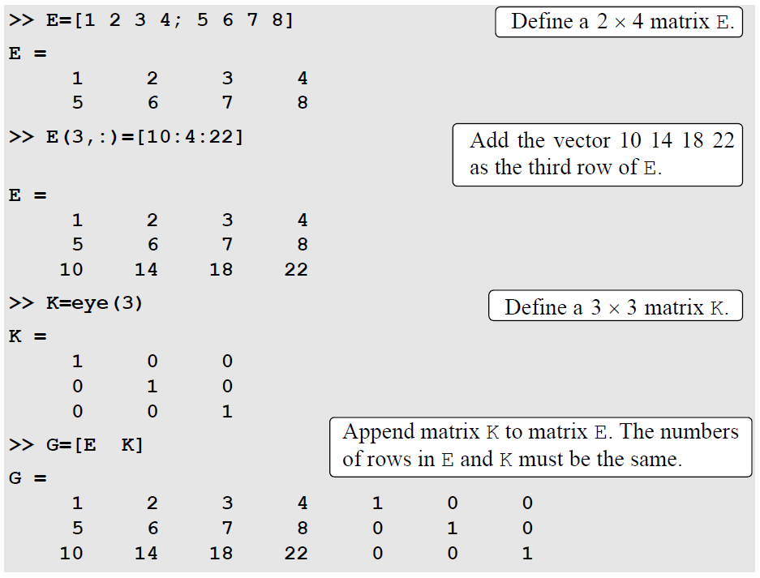
④ Adding & Deleting Elements To/From Existing Variables
Notes:
Append = add

Slide 20
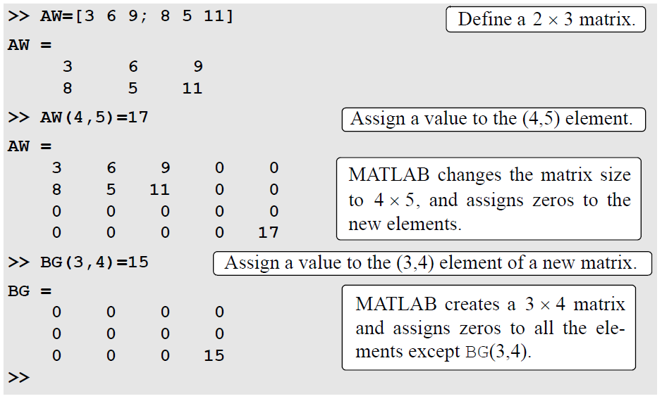
④ Adding & Deleting Elements To/From Existing Variables

Slide 21
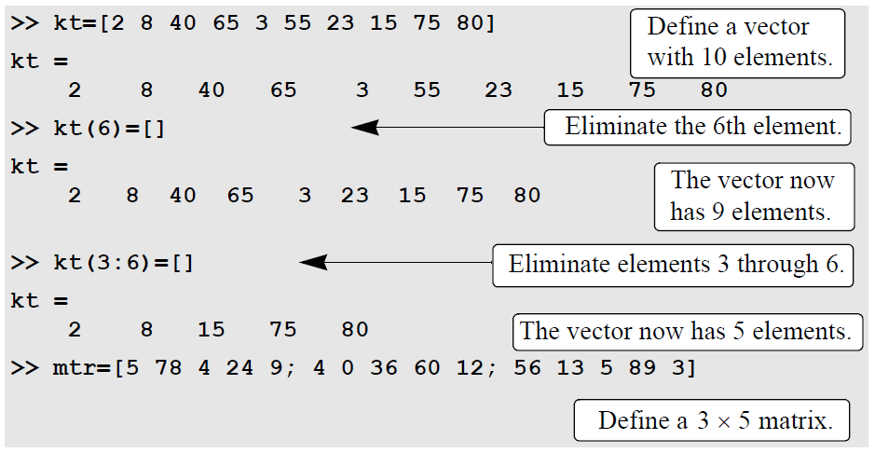
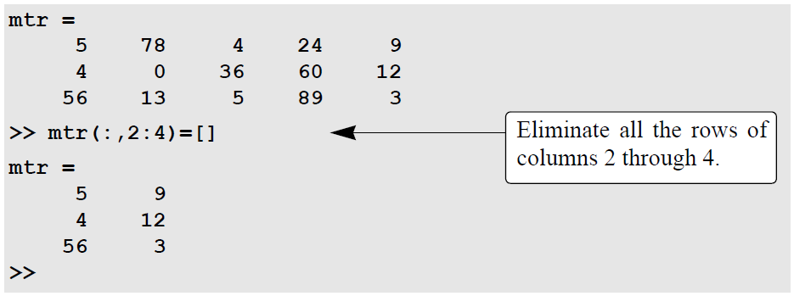
④ Adding & Deleting Elements To/From Existing Variables

