Slide 1
Chapter 2
ARRAYS

Slide 2
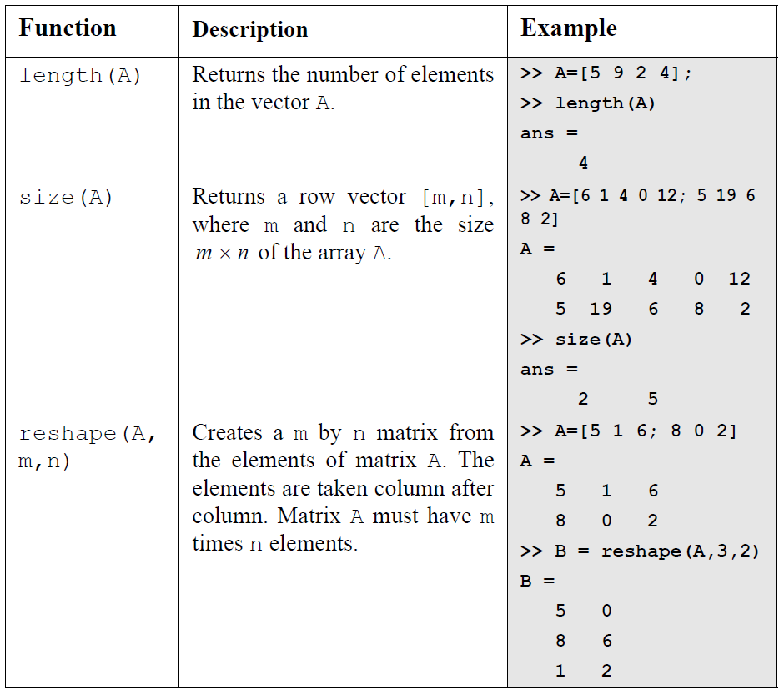
⑤ Built-in Functions For Handling Arrays
[R,C]=size(A) , R returns the number of rows and C returns the number of columns.

Slide 3
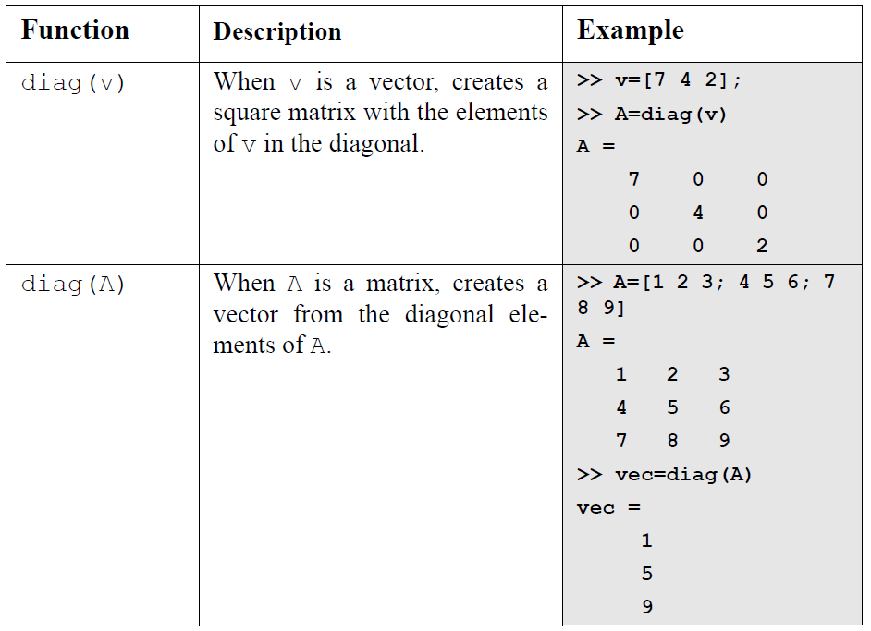
⑤ Built-in Functions For Handling Arrays

Slide 4
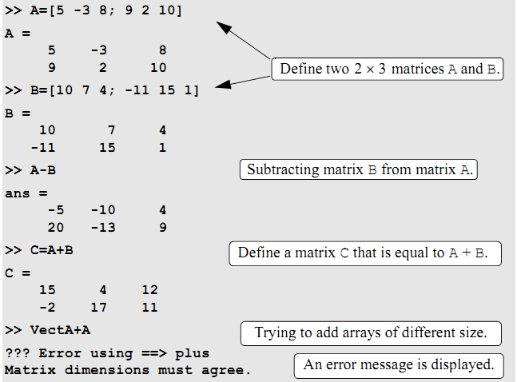
CHAPER 3
6 Mathematical Operation With Arrays
I. Addition And Subtraction

Slide 5
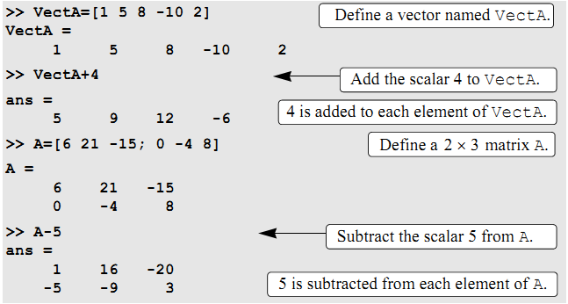
I. Addition And Subtraction
When a scalar (number) is added to (or subtracted from) an array, the scalar is added to (or subtracted from) all the elements of the array. Examples are:
6

Slide 6
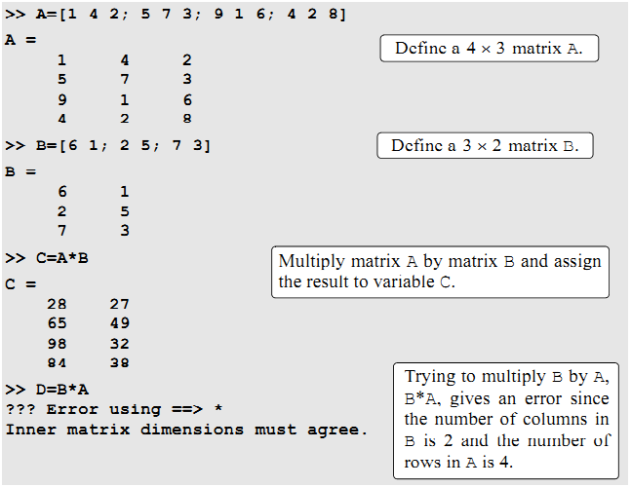
Condition : No. of 1st Columns = No. of 2nd Rows
The Result: No. 1st Rows X No. 2nd Columns
CHAPTER 3
II. Array Multiplication

Slide 7
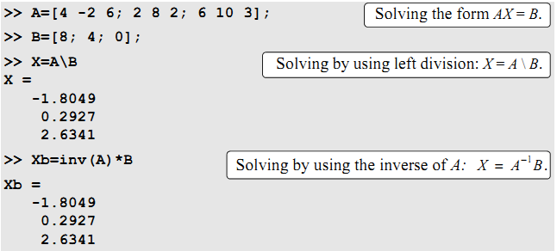
CHAPTER 3
III. Array Division

Slide 8
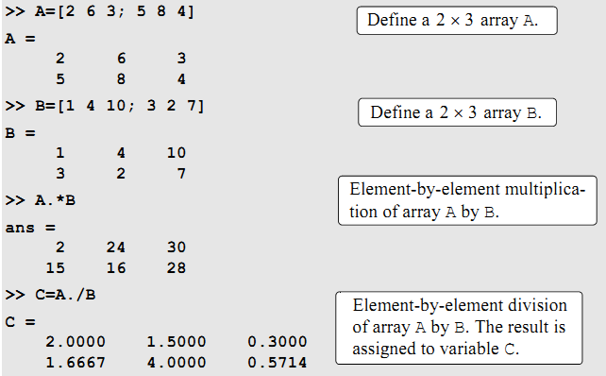
CHAPTER 3
IV. Element-By-Element Operation

Slide 9
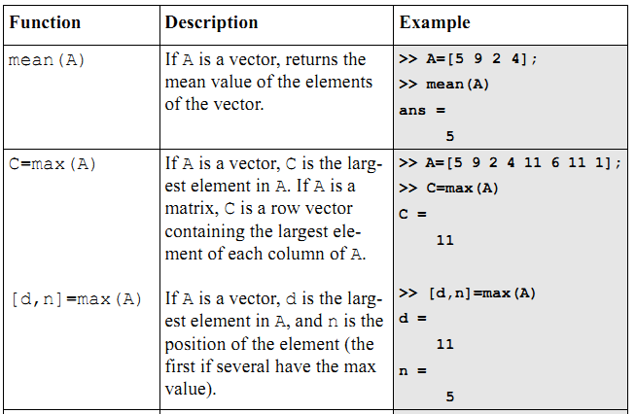
CHAPTER 3
7 Built-in Function For Analysing Array
MATLAB has many built-in functions for analyzing arrays. The below table lists some of these functions.

Slide 10
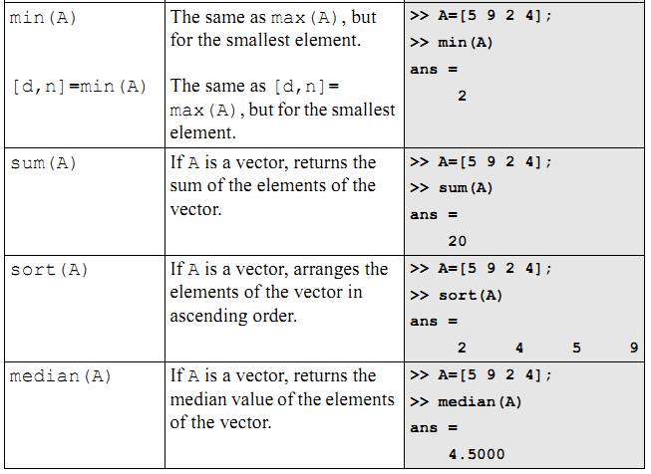
CHAPTER 3
7 Built-in Function For Analysing Array
Notes:
ascend

Slide 11
