Slide 1
Chapter 4
Two-Dimensional Plots

Slide 2
CHAPTER 4
Outline
Introduction
The plot Command
The fplot Command
Plotting Multiple Graphs In The Same Plot:
Using the plot Command
Using the hold on and hold off Commands
Plotting Multiple Plots In The Same Figure By Using The subplot Command
Formatting a Plot

Slide 3
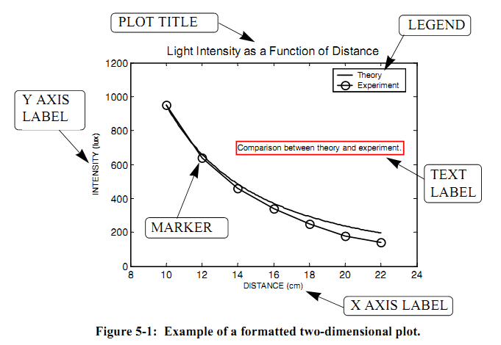
CHAPTER 4
Introduction
Plots are a very useful tool for presenting information.
MATLAB has many commands that can be used for creating different types of plots.
In this chapter we will describe how MATLAB can be used to create and format many types of two-dimensional plots.

Slide 4
CHAPTER 4
4.1 THE plot COMMAND
The plot command is used to create two-dimensional plots.
The arguments x and y are each a vector (one-dimensional array).
The two vectors must have the same number of elements.
When the plot command is executed, a figure is created in the Figure Window.

Slide 5
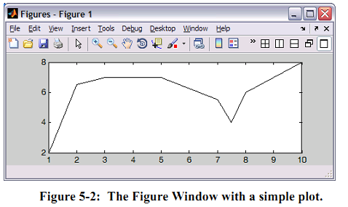
CHAPTER 4
4.1 THE plot COMMAND

Slide 6
CHAPTER 4
4.1 THE plot COMMAND

Slide 7
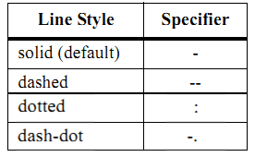
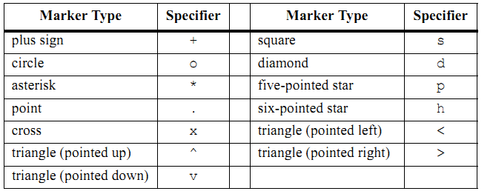
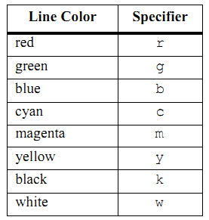
CHAPTER 4
4.1 THE plot COMMAND
Line Specifiers:

Slide 8
CHAPTER 4
4.1 THE plot COMMAND
Notes about using the specifiers:
• The specifiers are typed inside the plot command as strings.
• Within the string the specifiers can be typed in any order.
• The specifiers are optional. This means that none, one, two, or all three types can be included in a command.

Slide 9
CHAPTER 4
4.2 THE fplot COMMAND
The fplot command plots a function with the form y=f(x) between specified limits.
function: The function can be typed directly as a string inside the command and can be typed as a function of any letter.
Example: 8*x^2+5*cos(x)
limits: The limits argument is a vector with two elements that specify the domain of x [xmin,xmax], or a vector with four elements that specifies the domain of x and the limits of the y-axis [xmin,xmax,ymin,ymax].
line specifiers: The line specifiers are the same as in the plot command.

Slide 10
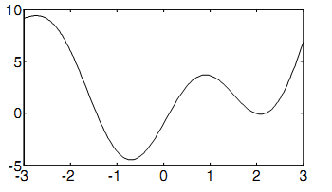
CHAPTER 4
4.2 THE fplot COMMAND

Slide 11
CHAPTER 4
4.3 PLOTTING MULTIPLE GRAPHS IN THE SAME PLOT
4.3.1 Using the plot Command
Two or more graphs can be created in the same plot by typing pairs of vectors inside the plot command.

Slide 12
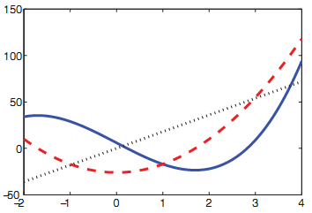
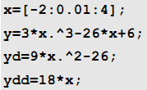
CHAPTER 4
4.3 PLOTTING MULTIPLE GRAPHS IN THE SAME PLOT
4.3.1 Using the plot Command

Slide 13
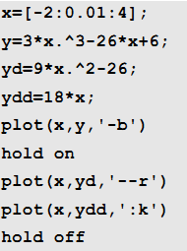
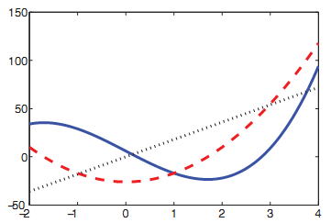
CHAPTER 4
4.3 PLOTTING MULTIPLE GRAPHS IN THE SAME PLOT
4.3.2 Using the hold on and hold off Commands
To plot several graphs using the hold on and hold off commands, one graph is plotted first with the plot command.
Then the hold on command is typed. This keeps the Figure Window with the first plot open, including the axis properties and formatting if any was done.
Additional graphs can be added with plot commands that are typed next.
The hold off command stops this process.

Slide 14
CHAPTER 4
4.3 PLOTTING MULTIPLE GRAPHS IN THE SAME PLOT
4.3.2 Using the hold on and hold off Commands
To plot several graphs using the hold on and hold off commands, one graph is plotted first with the plot command.
Then the hold on command is typed. This keeps the Figure Window with the first plot open, including the axis properties and formatting if any was done.
Additional graphs can be added with plot commands that are typed next.
The hold off command stops this process.

Slide 15
CHAPTER 4
4.4 PLOTTING MULTIPLE Plots IN THE SAME Figure by Using the subplot Command
It can sometimes be useful to display multiple plots on the same figure for comparison.
This can be done using the subplot function, that takes arguments for number of rows of plots, number of columns of plots, and plot number currently being plotted:
subplot (nrows,ncols,plot_number)

Slide 16
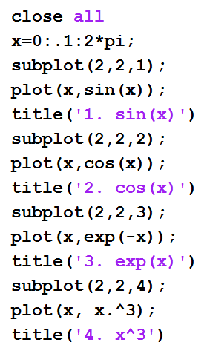
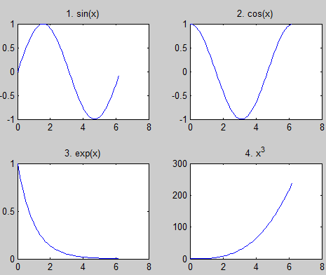
CHAPTER 4
4.4 PLOTTING MULTIPLE Plots IN THE SAME Figure by Using the subplot Command
Example:

Slide 17
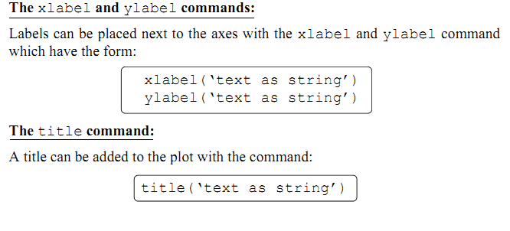
CHAPTER 4
4.5 FORMATTING A PLOT
Formatting a Plot Using Commands

