Slide 1
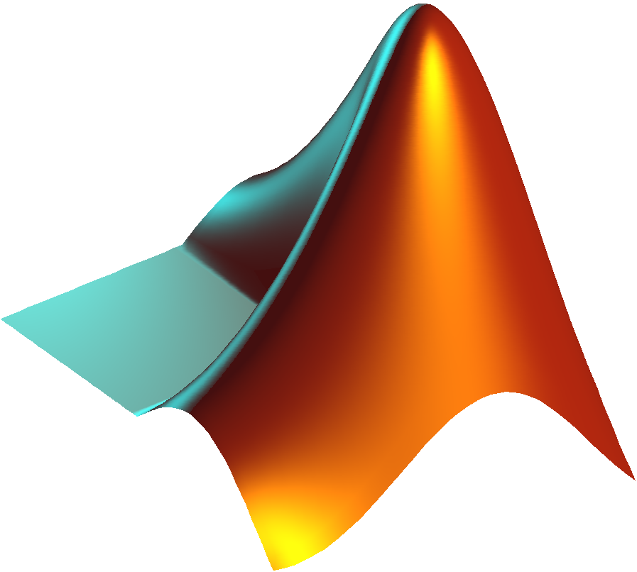
Chapter 5
USER-DEFINED FUNCTIONS

Slide 2
5.1 Introduction
Functions
Is a mathematical expression in terms of variables.
Built-in Functions
User-Defined Functions
used in mathematical expressions simply by typing their name with an argument. Examples are sin(x), cos(x), sqrt(x), exp(x)….etc.
MATLAB program that is created by the user, saved as a function file, and then can be used like a built-in function.
Objective:
when a function needs to be evaluated many times for different values of arguments, it is convenient to create a “user-defined” function.
user-defined functions can be used as subprograms in large programs. In this way large computer programs can be made up of smaller “building blocks” that can be tested independently.

Slide 3
5.2 User-Defined Functions
Creating a Function File
File New Function
Using a User-Defined Function
1
4
USER-DEFINED FUNCTION
2
3
Structure of a Function File
Saving a Function File

Slide 4
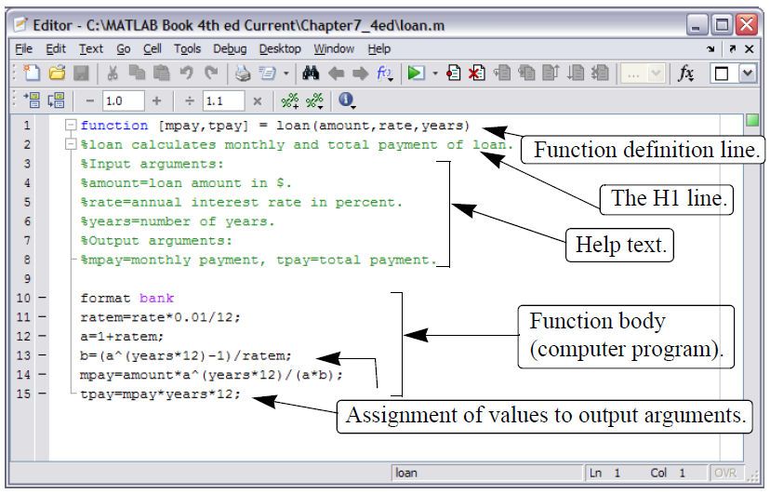
5.3 Structure of a Function File
Figure 4-1: The Editor/Debugger Window.

Slide 5
5.3.1 Function Definition Line
The first executable line in a function file must be the function definition line. Otherwise the file is considered a script file. The function definition line:
Defines the file as a function file.
Defines the name of the function.
Defines the number and order of the input and output arguments.
function [mpay,tpay] = loan(amount,rate,years)
function [A] = RectArea(a,b)
function A = RectArea(a,b)
function [V, S] = SphereVolArea(r)
EXAMPLES

Slide 6
5.4 Saving a Function File
A function file must be saved before it can be used.
It is highly recommended that the file be saved with a name that is identical to the function name in the function definition line.
Function definition line File name
function [mpay,tpay] = loan(amount,rate,years) loan.m
function [A] = RectArea(a,b) RectArea.m
function [V, S] = SphereVolArea(r) SphereVolArea.m

Slide 7
5.4.1 Example #1
Write a function file (name it chp7one) for the function y. The input to the function is x and the output is y . Write a function such that x can be a vector. Use the function to calculate:
y for x = 6.
y for x = 1, 3, 5, 7, 9, and 11.
INPUT
x (Scalar OR Vector)
OUTPUT
y (Scalar OR Vector)

Slide 8
5.5 Anonymous Function
In cases when the value of a relatively simple mathematical expression has to be determined many times within a program, MATLAB provides the option of using anonymous functions.
An anonymous function is a simple (one-line) user-defined function that is defined without creating a separate function file (M-file).
Anonymous functions can be constructed in the Command Window, within a script file, or inside a regular user-defined function.
A simple example is: cube = @ (x) x^3, which calculates the cube of the input argument.

Slide 9
5.5.1 Examples of an Anonymous Function
one independent variable
with several independent variables:

