Slide 1
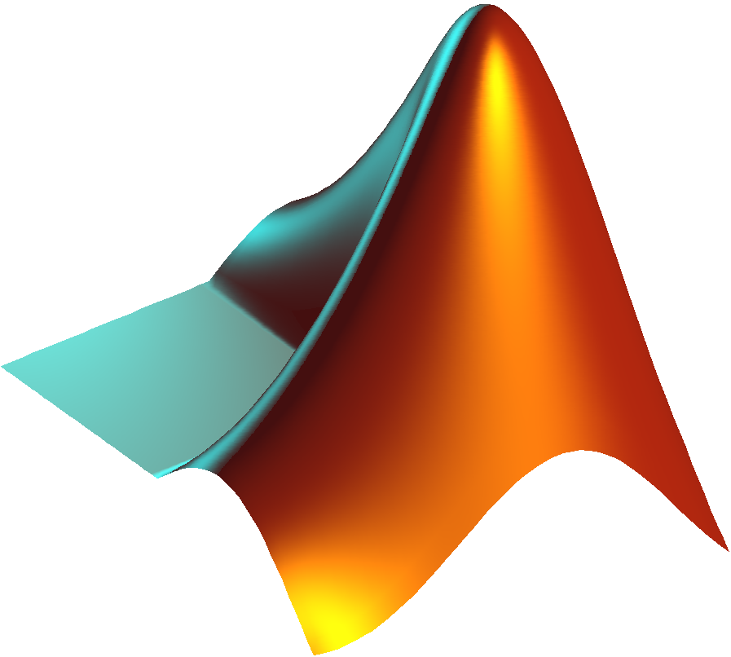
Session One
METHODS OF SOLUTIONS

Slide 2
Methods of Solutions
There are two groups of methods to solve the functions:
1- Bracketing methods:
It is named because all the methods used within a certain interval (or range) of the function. It includes:
- Graphical method
- Bisection method
- False position method
2- Open methods:
There are other methods that is called "Open Methods" that require a single starting value or two values that are not necessary bracket a root. We shall study three of them:
- Simple One-Point Iteration
- Newton-Raphson method
- Secant method

Slide 3
Bisection method
Algorithm
To find a solution to f(x) = 0 given the continuous function on the interval [x_{l},x_{u}] where f(x_{l}) and f(x_{u}) have opposite signs.
INPUT endpoints x_{l},x_{u}; (εs); maximum number of iteration (i_{max}).
OUTPUT approximate solution x_{m} (root) or message of failure.
step 1 find f(x_{l}) , f(x_{u}) and Set i = 1 for the first iteration;
step 2 for i <= i_{max} do steps 3-6.

Slide 4
Bisection method
step 3 Set x_{m} = (x_{l} + x_{u})/2 (compute x_{m} for each iteration)
find f(x_{m}) and tol = b-a/2 .
step 4 if f(x_{m}) = 0 or tol< ε then output(x_{m}).
step 5 if f(x_{l}) . f(x_{m}) > 0 set x_{l} = x_{m}; else x_{u} = x_{m}.
step 6 output(‘method failed after i_{max} iterations’).

Slide 5
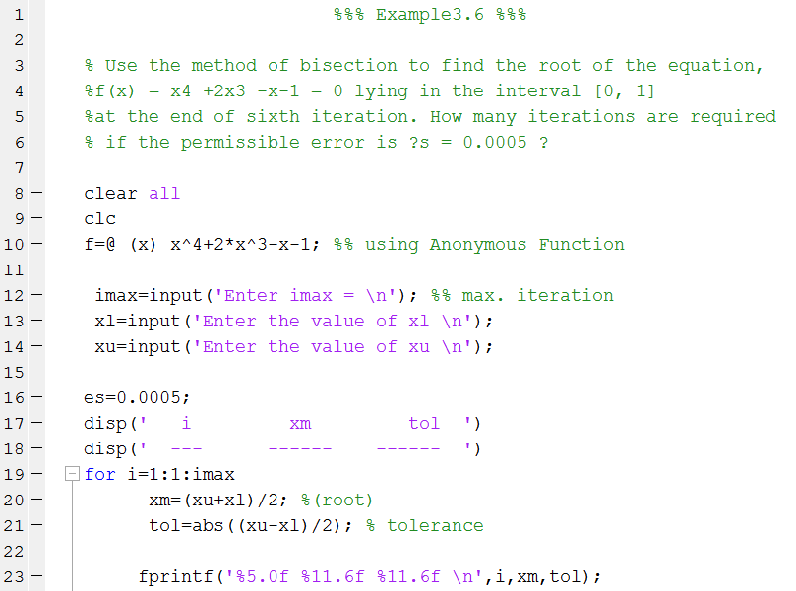
Bisection method – MATLAB code

Slide 6
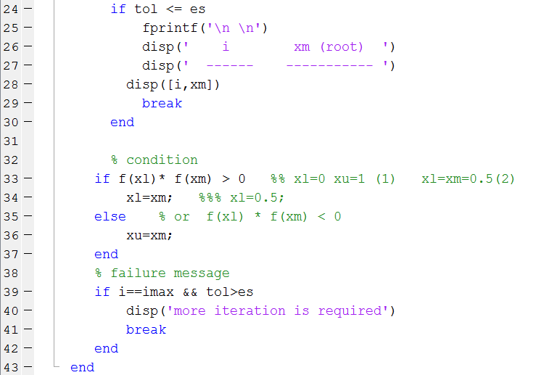
Bisection method – MATLAB code

