Slide 1
Disk Storage and Indexing 2nd stage
University of Salahaddin
College of Engineering
Software & Informatics Engineering Department
Lecturer:
Hanan Kamal

Slide 2
Content
Introduction
Storage of Database
Files
Types of Single-Level Ordered Indexes
Primary Indexes
Clustering Indexes
Secondary Indexes

Slide 3
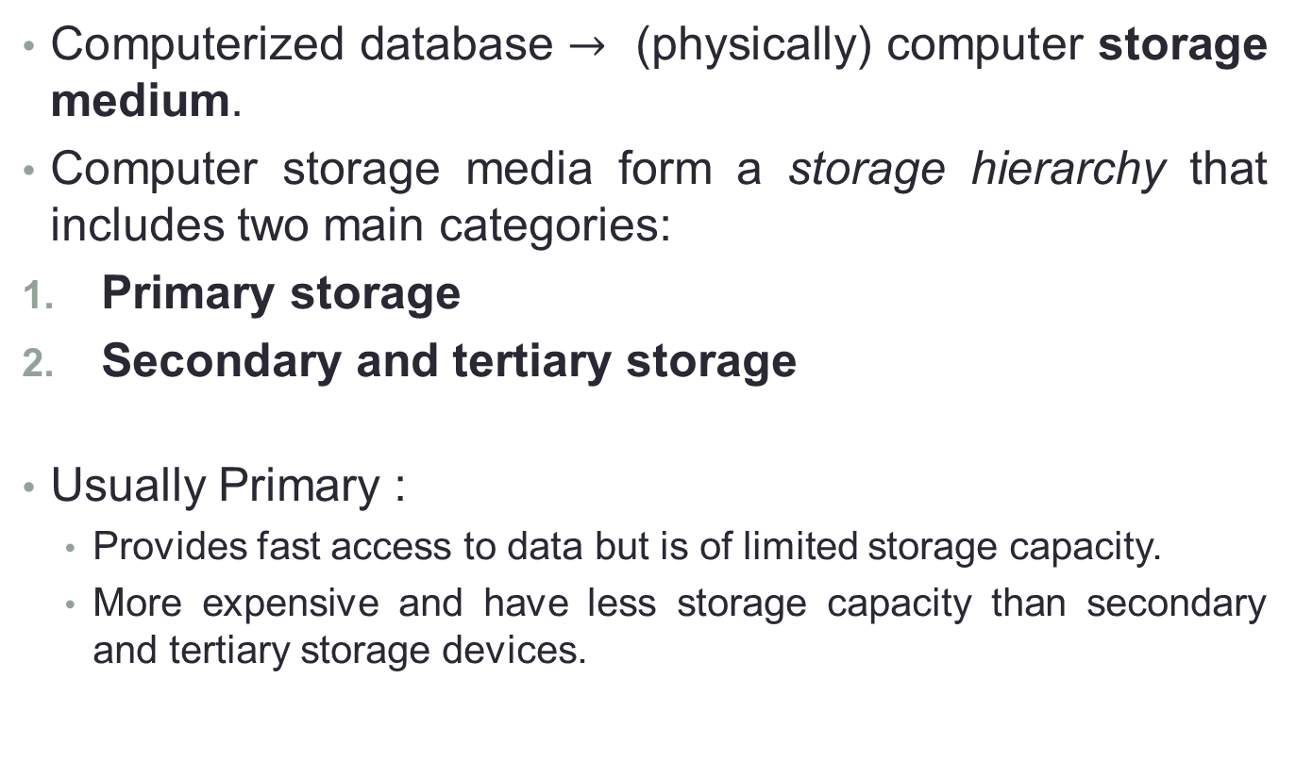
Introduction
Computerized database $→$ (physically) computer storage medium.
Computer storage media form a storage hierarchy that includes two main categories:
Primary storage
Secondary and tertiary storage
Usually Primary :
Provides fast access to data but is of limited storage capacity.
More expensive and have less storage capacity than secondary and tertiary storage devices.
Notes:
Primary storage. This category includes storage media that can be operated on directly by the computer’s central processing unit (CPU), such as the computer’s main memory and smaller but faster cache memories. Primary storage usually provides fast access to data but is of limited storage capacity.
Although main memory capacities have been growing rapidly in recent years, they are still more expensive and have less storage capacity than secondary
and tertiary storage devices.
Primary storage (or main memory or internal memory), often referred to simply as memory, is the only one directly accessible to the CPU. The CPU continuously reads instructions stored there and executes them as required.

Slide 4
Storage of Databases
Databases typically store large amounts of data that must persist over long periods of time, and hence is often referred to as persistent data.
Transient data Parts of data are accessed and processed repeatedly during this period.
Databases are stored permanently (or persistently) on magnetic disk, for the following reasons:
Size
losses
The cost
Notes:
Most databases are stored permanently (or persistently) on magnetic disk secondary
storage, for the following reasons:
■ Generally, databases are too large to fit entirely in main memory.
■ The circumstances that cause permanent loss of stored data arise less frequently
for disk secondary storage than for primary storage. Hence, we refer
to disk—and other secondary storage devices—as nonvolatile storage,
whereas main memory is often called volatile storage.
■ The cost of storage per unit of data is an order of magnitude less for disk secondary
storage than for primary storage.

Slide 5
Storage of Databases (cont.)
The data stored on disk is organized as files of records.
Each record is a collection of data values that can be interpreted as facts about entities, their attributes, and their relationships.
There are several primary file organizations
heap file (or unordered file)
sorted file (or sequential file) (sort key).
hashed file (hash key)
B-trees
Notes:
There are several primary file organizations, which determine how the file records
are physically placed on the disk, and hence how the records can be accessed. A heap file
(or unordered file) places the records on disk in no particular order by appending
new records at the end of the file, whereas a sorted file (or sequential file) keeps the
records ordered by the value of a particular field (called the sort key). A hashed file
uses a hash function applied to a particular field (called the hash key) to determine
a record’s placement on disk. Other primary file organizations, such as B-trees, use
tree structures.We discuss primary file organizations in Sections 17.6 through 17.9.
A secondary organization or auxiliary access structure allows efficient access to
file records based on alternate fields than those that have been used for the primary
file organization.Most of these exist as indexes and will be discussed in Chapter 18.

Slide 6
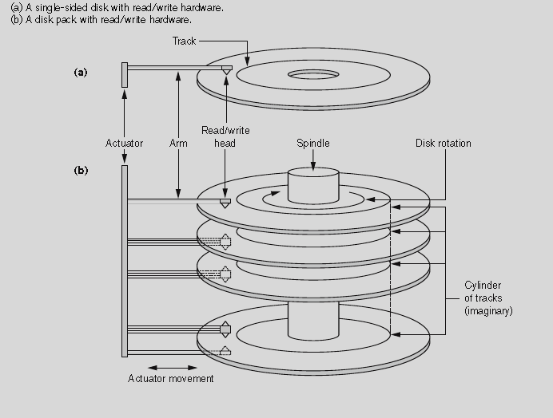
Secondary Storage Devices

Slide 7
Files
Unordered (heap) files
Ordered (Sorted) Files
New records are inserted at the end of the file.
To search for a record, a linear search .
Record insertion is quite efficient.
Reading the records in order of a particular field requires sorting the file records.
File records are kept sorted .
A binary search can be used
Insertion is expensive: records must be inserted in the correct order.
Reading the records in order of the ordering field is quite efficient.

Slide 8
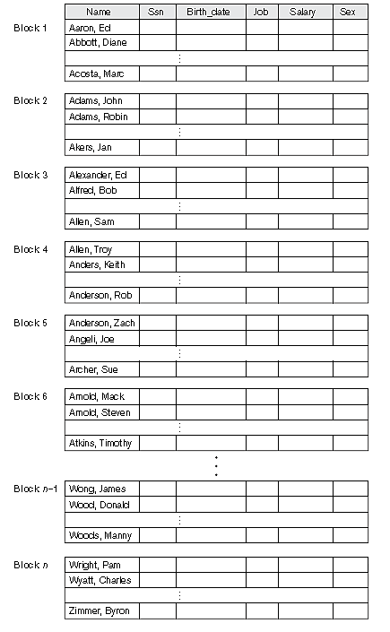
Some blocks of an ordered (sequential) file of EMPLOYEE records with Name as the ordering key field.

Slide 9
Types of Single-Level Ordered Indexes
Indexing idea (book index)
An index access structure is usually defined on a single field of a file, called an indexing field (or indexing attribute).
Indexes can also be characterized as dense or sparse.
A dense index has an index entry for every search key value (and hence every record) in the data file.
A sparse (or nondense) index, has index entries for only some of the search values.
Notes:
Tree-structured multilevel indexes (see Section 18.2) implement an extension of the binary search idea that reduces the search space by 2-
way partitioning at each search step, thereby creating a more efficient approach that divides the search space in the file n-ways at each stage.

Slide 10
Primary Indexes
A primary index is an ordered file whose records are of fixed length with two fields
Index entry (or index record) in the index file, will refer to the two field values of index entry i as <K(i), P(i)>.
K(i) is of t he same data type as the ordering key Field called the primary key of the data file
P(i) is a pointer to a disk block (a block address).
Notes:
Figure 18.1 illustrates this primary index. The total number of entries in the index is the same as the number of disk blocks in the ordered data file. The first record in each block of the data file is called the anchor record of the block, or simply the block anchor.2

Slide 11
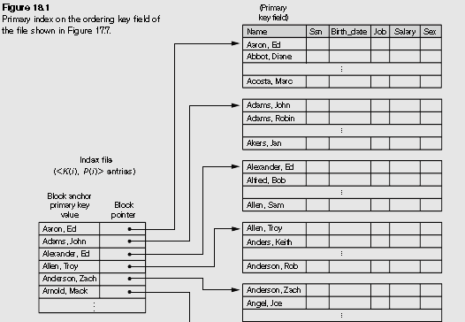

Slide 12
Clustering Indexes
If file records are physically ordered on a nonkey field which does not have a distinct value for each record that field is called the clustering field and the data file is called a clustered file.
A clustering index is also an ordered file with two fields:
field is of the same type as the clustering field of the data file
disk block pointer.

Slide 13
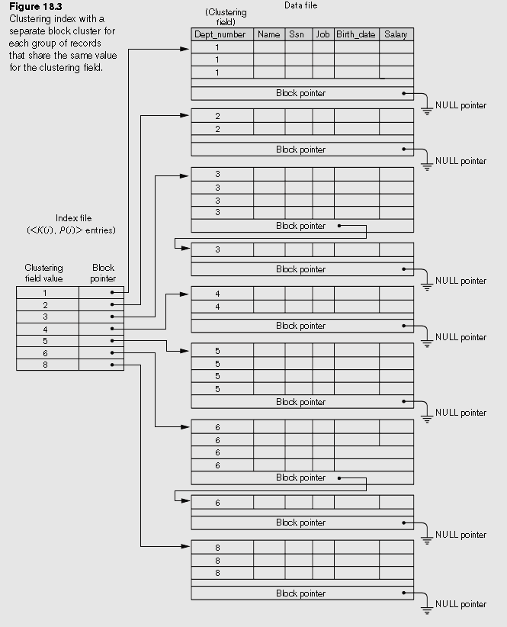

Slide 14
Secondary Indexes
A secondary index provides a secondary means of accessing a data file for which some primary access already exists.
The data file records could be ordered, unordered.
The secondary index may be created on:
Candidate key and has a unique value in every record
Nonkey field with duplicate values.

Slide 15
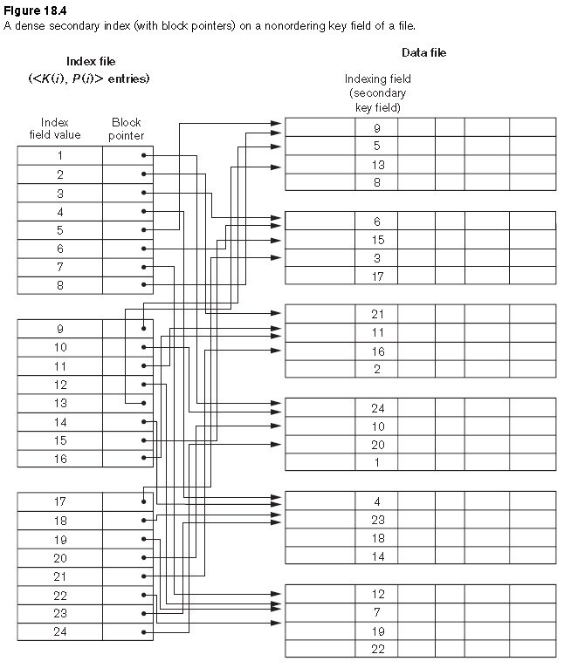
Secondary index on a key, nonordering field of a file.

Slide 16
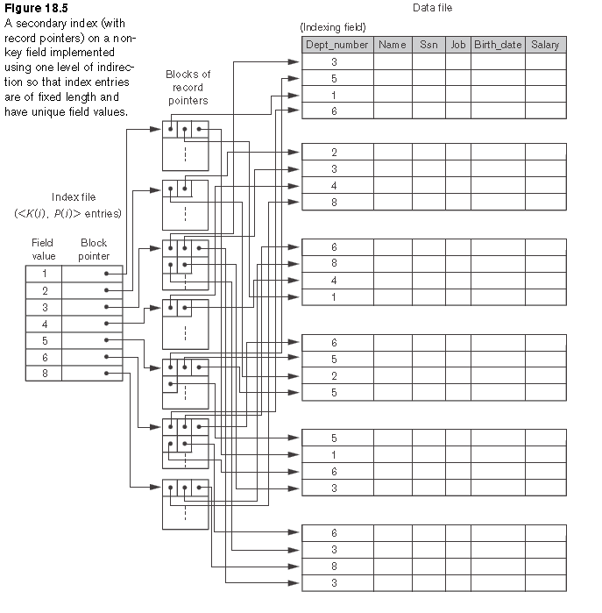
Secondary index on a nonkey, nonordering field of a file.

Slide 17
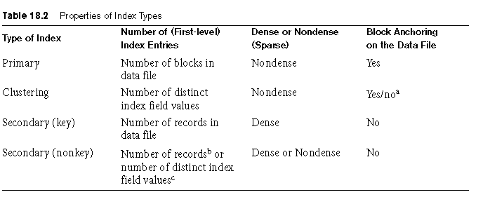
Summary of Indexes

Slide 18
Thank you

