Slide 1
Introduction to the Database 2nd stage
University of Salahaddin
College of Engineering
Software & Informatics Engineering Department
Lecturer:
Hanan Kamal

Slide 2
Content
Introduction
Types of Databases and applications
Example of DB
Characteristics of the Database Approach

Slide 3
Introduction
A database (DB) is a collection of related data.
Data is known facts that can be recorded and that have implicit meaning.
Examples:
Name
Telephone no.
Address
A database can be of any size and complexity.
A database may be generated and maintained manually or it may be computerized
Notes:
For example, a library card catalog is a database that may be created and maintained
manually. A computerized database may be created and maintained either by a
group of application programs written specifically for that task or by a database
management system. We are only concerned with computerized databases in this
book.

Slide 4
Introduction (cont.)
Mini-world Some part of the real world about which data is stored in a database. For example, student grades and transcripts at a university.
Mini-world for the example: Part of a UNIVERSITY environment.
Some mini-world entities:
STUDENTs
COURSEs
SECTIONs (of COURSEs)
(academic) DEPARTMENTs
INSTRUCTORs (lecturers)

Slide 5
Introduction (cont.)
A database management system (DBMS) is a collection of programs that enables users to create and maintain a database.
DBMS is a general-purpose software system that facilitates:
Defining, constructing, manipulating, and Sharing
Other important functions include protecting, and maintaining DB over a long period of time
Notes:
The DBMS is a general-purpose software system
that facilitates the processes of defining, constructing, manipulating, and sharing
databases among various users and applications. Defining a database involves specifying
the data types, structures, and constraints of the data to be stored in the database.
The database definition or descriptive information is also stored by the DBMS
in the form of a database catalog or dictionary; it is called meta-data. Constructing
the database is the process of storing the data on some storage medium that is controlled
by the DBMS. Manipulating a database includes functions such as querying
the database to retrieve specific data, updating the database to reflect changes
in the miniworld, and generating reports from the data. Sharing a database allows multiple
users and programs to access the database simultaneously.
An application program accesses the database by sending queries or requests for
data to the DBMS. A query2 typically causes some data to be retrieved; a
transaction may cause some data to be read and some data to be written into the
database.
Protection includes system protection
against hardware or software malfunction (or crashes) and security protection
against unauthorized or malicious access. A typical large database may have a life
cycle of many years, so the DBMS must be able to maintain the database system by
allowing the system to evolve as requirements change over time.

Slide 6
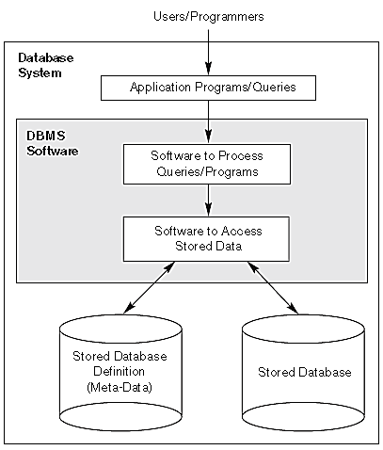
Introduction(cont.)
database and DBMS software together is call a database system.
Fig. database system
Notes:
An application program accesses the database by sending queries or requests for
data to the DBMS. A query2 typically causes some data to be retrieved; a
transaction may cause some data to be read and some data to be written into the
database.

Slide 7
Types of Databases and applications
Numeric and Textual Databases (temporal DB)
Hotel , airline, train,…
Multimedia Databases
DB for multimedia information such as movie, vedio clips…
(spatial SB)
Geographic Information Systems (GIS) Data Warehouses
Real-time and Active Databases
Event – conditions - action
Deductive DB
Knowledge based systems

Slide 8
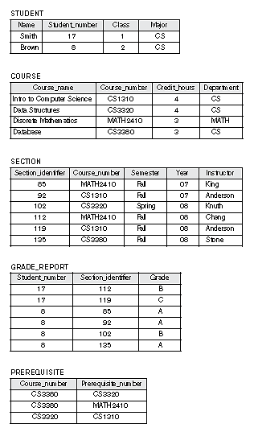
Example of DB
entity
attribute
tuple

Slide 9
Advantage of DBMSs
Control of data redundancy
Data consistency
More information from the same amount of data
Sharing of data
Improved data integrity
Improved security
Enforcement of standards
Economy of scale
Balance of conflicting requirements
Improved data accessibility and responsiveness
Increased productivity
Improved maintenance through data independence
Increased concurrency
Improved backup and recovery services
Notes:
Control of data redundancy
Data consistency
More information from the same amount of data
Sharing of data
Improved data integrity
Improved security
Enforcement of standards
Economy of scale
Balance of conflicting requirements
Improved data accessibility and responsiveness
Increased productivity
Improved maintenance through data independence
Increased concurrency
Improved backup and recovery services

Slide 10
Disadvantage of DBMSs
Complexity
Size
Cost of DBMSs
Additional hardware costs
Cost of conversion
Performance
Higher impact of a failure
Notes:
Complexity
Size
Cost of DBMSs
Additional hardware costs
Cost of conversion
Performance
Higher impact of a failure

Slide 11
Characteristics of the Database Approach
A number of characteristics distinguish the database approach from the much older approach of programming with files.
The main characteristics of the database approach versus the file-processing:
Self-describing nature of a database system: A DBMS catalog stores the description of the database. The description is called meta-data). This allows the DBMS software to work with different databases.
Notes:
In traditional file processing, each user
defines and implements the files needed for a specific software application as part of
programming the application. For example, one user, the grade reporting office, may
keep files on students and their grades. Programs to print a student’s transcript and
to enter new grades are implemented as part of the application. A second user, the
accounting office, may keep track of students’ fees and their payments. Although
both users are interested in data about students, each user maintains separate files—
and programs to manipulate these files—because each requires some data not available from the other user’s files. This redundancy in defining and storing data results in wasted storage space and in redundant efforts to maintain common up-to-date data.
In the database approach, a single repository maintains data that is defined once
and then accessed by various users. In file systems, each application is free to name
data elements independently. In contrast, in a database, the names or labels of data
are defined once, and used repeatedly by queries, transactions, and applications.

Slide 12
Characteristics of the Database Approach (cont.)
Insulation between programs and data: Called program-data independence. Allows changing data storage structures and operations without having to change the DBMS access programs.
Support of multiple views of the data: Each user may see a different view of the database, which describes only the data of interest to that user.

Slide 13
Characteristics of the Database Approach (cont.)
Sharing of data and multiuser transaction processing : allowing a set of concurrent users to retrieve and to update the database. Concurrency control within the DBMS guarantees that each transaction is correctly executed or completely aborted. OLTP (Online Transaction Processing) is a major part of database applications.

Slide 14
Thanks for your attention
Questions???

