Slide 1
Black Piedra.
Piedra is the Spanish word for stone. In black piedra, superficial infection of hair shafts by Piedraia hortae results in asymptomatic, stone-like concretions on scalp and facial hair. The nodule is the ascomycete fruiting body of the fungus, know as an ascostroma. Alopecia does not occur but hairs may break at the site of infection.

Slide 2
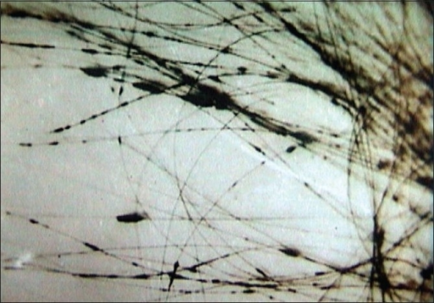
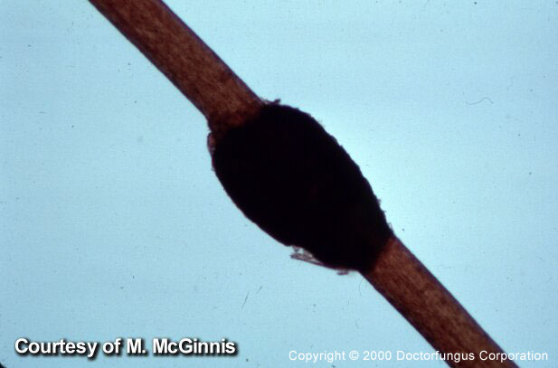

Slide 3
Lab Diagnosis:
can be made by submerging hair in a solution of 25% KOH or NaOH with 5% glycerol and heating.
Microscopic examination will reveal compact masses of dark, septate hyphae and round to oval asci containing 2-8 hyaline, aseptate banana-shaped ascospores.

Slide 4
White Piedra:
This is a superficial infection of hair of the beard and moustache, occasionally of the axillary or groin hair, caused by basidiomycetous white yeasts of the genus Trichosporon species including T. ovoides. The mycosis is characterized by white to light brown nodules on hair shafts. Nodules are soft and are not firmly adherent to the hair. Usually there is only one concretion per shaft. Concretions in this disease are white to tan and are found on facial, axillary, and pubic hair.
White piedra occurs worldwide and is most prevalent in temperate and semitropical climates

Slide 5
Lab Diagnosis
KOH squash preps for the presence of relatively soft, white to tan nodules, 0.5 mm in diameter, can easily be detached from the hair shaft because they affect only the outer lipid layers.
Within the crushed nodule, hyaline, septate hyphae that segment into oval or rectangular, encapsulated arthroconidia, are seen, often along with budding yeast
Histopathology Diagnosis of systemic disease is made primarily by biopsy study,
Culture Trichosporon species grow rapidly on SDA at 25◦C (without cycloheximide). Initially, the colony is cream colored, of buttery texture, becoming membranous, wrinkled, with radial ridges and folded with age. When mature, within
2–3 weeks, the colony becomes elevated, yellowish-gray, and consists of arthroconidia and budding cells.

Slide 6
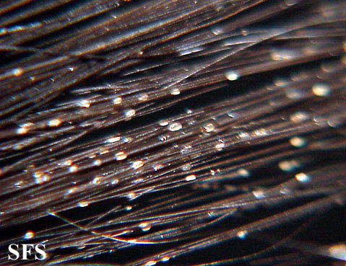
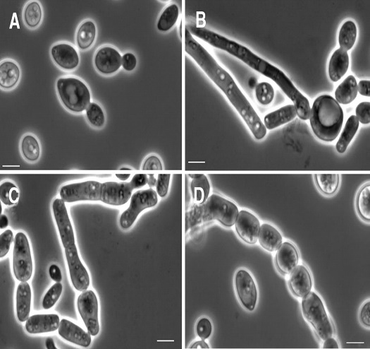
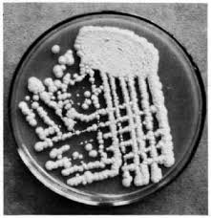
white nodules on hair shafts Trichosporon yeast cell Culture

Slide 7
Treatment:
Treatment of white piedra can be a therapeutic challenge, as scalp and hair infection may sometimes be successfully treated with a combination of oral azole antifungals and shampoos without shaving the scalp. Therapy with oral itraconazole for the treatment of uncomplicated white piedra affecting the scalp hair may be a good choice if topical remedies fail.

Slide 8
Tinea Nigra
caused by Hortaea werneckii, synonyms are, Exophiala werneckii, and Cladosporium werneckii. Tinea nigra is characterized by asymptomatic, nonscaly, coin-sized, brown to gray patches on the palms and soles of young adults, common in tropical regions.

Slide 9
Lab Diagnsis:
Direct Examination, KOH prep of skin scrapings studied in the microscope reveal one- to two-celled light brown yeasts and masses of thick, septate, frequently branched hyphae with dark pigment in their walls.
Histopathology: A biopsy specimen can be obtained by carefully scraping off the stratum corneum show hyperkeratosis and mild acanthosis. PAS stain reveals red-stained septate hyphae in the stratum corneum.
Culture: Scrapings planted on SDA with and without antibiotics at 25◦C yields growth in about 1-week velvety gray-black aerial hyphae form.
Microscopic Morphology: Both pseudo and true hyphae develop and olive colored 1–2-celled yeast forms. They then bud or form clumps of chlamydospores.

Slide 10
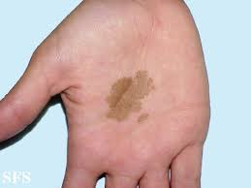
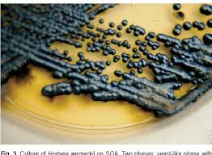
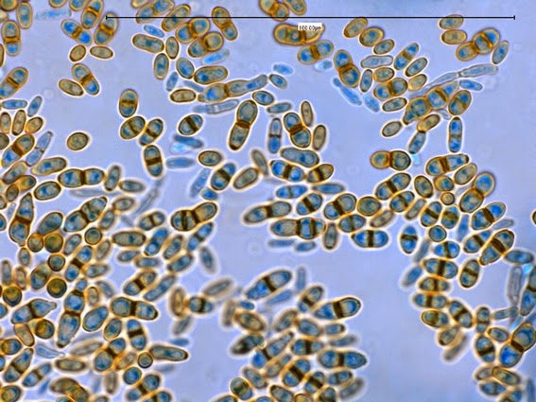
Hortaea werneckii Colony yeast cell
Tinea Nigra

Slide 11
Treatment:
A topical approach is successful in treating tinea nigra. Topical terbinafine (TRB) (Lamisil®), 4% and aspirin, are all effective. Curative treatments with azoles include topical KTC twice daily for 2 weeks, or oral ITC, 200 mg/day for 3 weeks. Tinea nigra does not tend to recur.

