Slide 1
Superficial Mycoses:
a. Black piedra: Piedraia hortae
b. White piedra: Trichosporon sp:
C. Tinea nigra: Hortaea werneckii

Slide 2
White piedra
White piedra is a dermatosis caused by the yeasts of the Trichosporon sp:
It is caused by Trichosporon beigelii
T. asahii, T. ovoides, T. inkin, T. mucoides, T. asteroides and T. cutaneum genuses;
it is clinically characterized by soft, whitish nodules attached to the hair cuticle, varying in color from white to light brown.
Essentially no pathological changes are elicited.
found worldwide, but is most common in tropical or subtropical regions.

Slide 3
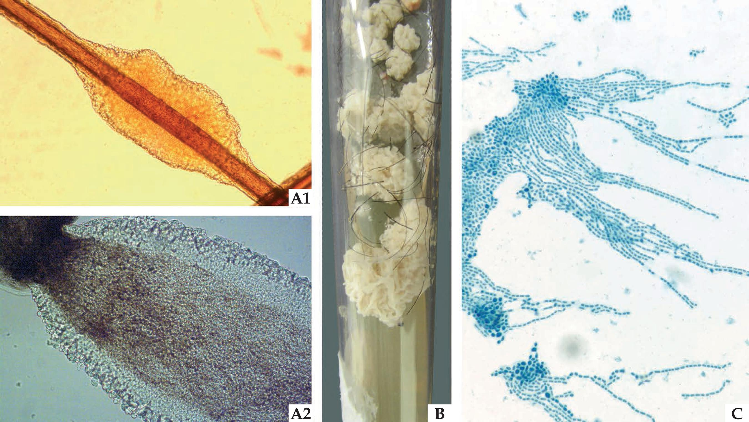
(A1) Light microscopy (x40): light color nodule attached to the pillar shaft.
(A2) Light microscopy (x100) yeasts the make up the structure on the edge of the nodule.
(B) Culture Mycosel medium: yeast-like colony, with filamentous appearance.
(C) yeasts with blasto-arthrospores, typical of Trichosporon sp

Slide 4
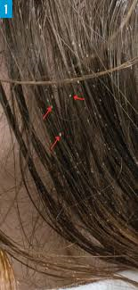
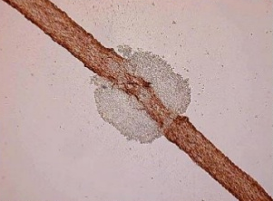
White piedra (Trichosporon beigelii)

Slide 5
Laboratory Diagnosis:
1. Clinical Material: Epilated hairs with white soft nodules present on the shaft.
2. Direct Microscopy: . Hairs should be examined using 10% KOH and Parker ink or calcofluor white mounts. Look for irregular, soft, white or light brown nodules, 1.0-1.5 mm in length, firmly adhering to the hairs.
3. Culture: . Hair fragments should be implanted onto SDA Sabouraud's dextrose agar. Colonies of Trichosporon spp. are white or yellowish to deep cream colored, smooth, wrinkled, velvety, dull colonies
4. Serology: Not required for diagnosis.

Slide 6
Management:
Shaving the hairs is the simplest method of treatment.
Topical application of an imidazole agent may be used to prevent reinfection.

Slide 7
Black piedra
is a superficial mycosis
caused by the dematiaceous filamentous fungus Piedraia hortae
Consists of black-colored, firm, irregular nodules involving the hair shaft.
In black piedra, DME reveals dark nodules attached to the shaft, containing several ascus, with two to eight fusiform, curved ascospores. The culture is dark, and its growth is slow

Slide 8
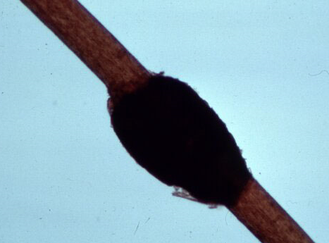
Black piedra (Piedraia hortae)

Slide 9
Laboratory Diagnosis:
1. Clinical Material: Epilated hairs with hard black nodules present on the shaft.
2. Direct Microscopy: . Hairs should be examined using 10% KOH and Parker ink or calcofluor white. Look for darkly pigmented nodules that may partially or completely surround the hair shaft. Nodules are made up of a mass of pigmented with a stroma-like center containing asci.
3. Culture: . Hair fragments should be implanted onto primary isolation media, like SDA Sabouraud's dextrose agar.
Colonies of Piedra hortae are dark, brown-black and take about 2-3 weeks to appear.
4. Serology: Not required for diagnosis.

Slide 10
Tinea nigra
Tinea nigra, caused by a distinct dematiaceous filamentous fungus, Hortaea werneckii,
It is due to Hortaea werneckii.
Tinea nigra most typically presents as a brown to black silver nitrate-like stain on the palm of the hand or sole of the foot. Affects the corneum layer, especially in children, producing an asymptomatic brownish macula.

Slide 11
Management:
The usual treatment is to shave or cut the hairs short, but this is often not considered acceptable, particularly by women.
In-vitro susceptibility tests have shown that Piedra hortae is sensitive to terbinafine and it has been successfully used, at a dose of 250 mg a day for 6 weeks.

Slide 12
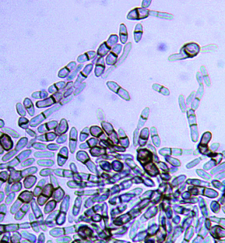
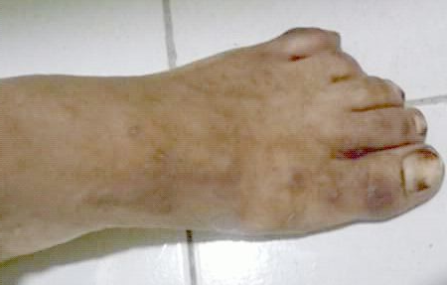
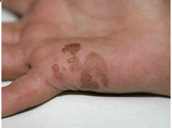
Tinea nigra (Phaeoannellomyces werneckii)

Slide 13
(A) Direct mycological examination of a sample collected through skin lesion scraping, clarified with KOH 10%, illustrating dematiaceous septate hyphae.
(B) Culture Mycosel medium dematiaceous colony with a waxy appearance.
(C) dematiaceous yeasts with binary fission, typical of Hortaea werneckii

Slide 14
Laboratory Diagnosis:
Clinical Material: . Skin scrapings.
2. Direct Microscopy: . Skin scrapings should be examined using 10% KOH and Parker ink or calcofluor white mounts.
3. Culture: . Clinical specimens should be inoculated onto primary isolation media, like SDA Sabouraud’s dextrose agar.
4. Serology: Not required for diagnosis

Slide 15
Management:
Usually, topical treatment with Whitfield's ointment (benzoic acid compound) or an imidazole agent twice a day for 3-4 weeks is effective.

