Slide 1
Systems Analysis and Design
Lecture -1-
General Overview
Introduction to Systems Analysis and Design
Convenor: Hero Muhamad Sulaiman
MSc in Advanced Computer Science
Computer Science & IT Department
College of Science
Salahaddin University/Hawler
Email: hero.sulaiman@su.edu.krd
2023-2024

Slide 2
Lectures Timetable
Systems Analysis and Design
4 hrs/Week
Tuesday : 12:30 – 01:30
Wednesday: 12:30 – 01:30
Thursday: 8:30 – 10:00
10:30 – 12:00
Bring notebook and a pen to take notes!

Slide 3
Assessment
Systems Analysis and Design
Coursework (% 40)
Second Semester
Exam % 20
Quiz & Daily Activities % 10
Homework % 5
Report + Assignment % 5
Final Exam (% 60)
Your total mark:
Coursework : % 40
Final exam : % 60
100%

Slide 4
Resources for study
Systems Analysis and Design
Dennis, A., Wixom, B. H., and Roth, R. M. (2012): Systems Analysis and Design. 5th edn. Hoboken: John Wiley & Sons, Inc.
Dennis, A., Wixom, B. H., Tegarden, D. (2005): Systems Analysis and Design with UML Version 2.0 An Object-Oriented Approach. 2nd edn. Hoboken: John Wiley & Sons, Inc.
Kendall, K. E. and Kendall, J. E. (2011): System Analysis and Design. 8th edn. New Jersey: Pearson Education, Inc.
Other relevant papers, websites and books.

Slide 5
Syllabus
Systems Analysis and Design
Introduction to System Analysis and Design.
SDLC (System Development Life Cycle).
The Planning phase
Apply Planning Phase On A system.
Project Management.
Analysis phase.
Apply Analysis phase On A system.
Requirements Gathering Techniques (1).
Requirements Gathering Techniques (2).
Introducing the Design Phase
Apply Analysis Design On A system.
The Architecture Design.
The User Interface Design.
Program Design
Data Management Layer Design:

Slide 6
Some topic related concepts:-
Systems Analysis and Design
A system: can be defined as a collection of components that work together to achieve some certain objectives. It is composed of five parts: Input, processing, output. Control and feedbacks.

Slide 7
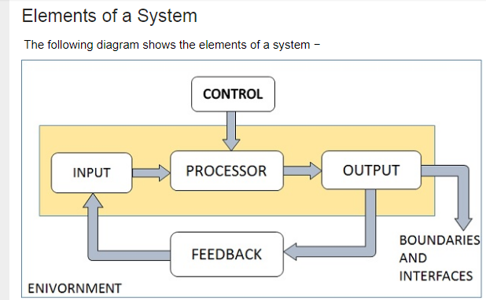
Some topic related concepts:-
Systems Analysis and Design
Notes:
The main aim of a system is to produce an output which is useful for its user. Inputs are the information that enters into the system for processing.
Output is the outcome of processing.
The processor is the element of a system which is responsible for processing inputs
The control element guides the system.
for EX: The behavior of a computer System is controlled by the Operating System and software. In order to keep system in balance, what and how much input is needed for the system
5. vendors and competitors of organization’s environment may provide constraints that affect on the business.
6. Boundaries are the limits of components, processes, and interrelationship when it interfaces with another system.

Slide 8
Some topic related concepts:-
Systems Analysis and Design
System analysis:- It is a problem solving technique that improves the system and ensures that all the components of the system work efficiently to accomplish their purpose.
System Design:- the process of defining the architecture, components, and data of a system to satisfy specified requirements, it is most effective when more than one solution can be proposed.
System Analyst:- The person who studies and analyzes a system.

Slide 9
Some topic related concepts:-
Systems Analysis and Design
Information System:- Set of people, processes, applications and data working together to enable the day-to-day business and support the problem solving and decision making needs for users and management.
Information Technology:- Combination of hardware, telecommunication and software that enable the creation and operation of an information system.

Slide 10
Outline
Importance of Systems Analysis
Roles of the system analyst
Types of Information System:-
Transactional Processing System (TPS)
Management Information System (MIS)
Decision Support System (DSS)
Executive Support System (ESS)

Slide 11
Why System Analysis and design is important?
Tries to understand human needs to analyze, process, transform, store data and output information in the context of a particular organization.
Try to build or improve information systems.?How?
SA & D include users in every step of building systems which lead the users to have an idea about the new system when it is installed.
Notes:
2. (How?) by thoroughly understanding problems with current systems and deciding how to solve these problems.

Slide 12
Why System Analysis and design is important?
It helps saving costs of system building because every step is well thought-out.
Lead to a better understanding of the organizational environment such as political and cultural feature.

Slide 13
What are the Qualities of the System Analyst
The system analyst has many roles inside companies or organizations. Such as :-
A successful system analyst is a good problem solver. How?
A system analyst must also be a good communicator.
A system analyst must have enough programming experience and knowledge of technology.
Notes:
1. How? He or she is someone who sees problems as challenges and enjoys solving them by applying different techniques and tools when necessary and based on his or her past experience.

Slide 14
What are the Qualities of the System Analyst
System analyst is someone who is motivated and passionate about his or her job.
System analysts must be professional and possess strong work ethics to be able to form robust relationship with their clients.
Understand both human and computer system well to be able to work with them for producing useful and usable information systems.

Slide 15
Types of System Analyst
System analyst
Business analyst
Requirement analyst
Infrastructure analyst

Slide 16
Types of Information System
IS has been developed for different purposes, it depends on the users need and businesses in a company or organization.
There are four types of IS
Transactional Processing Systems (TPSs)
Management Information Systems (MISs)
Decision Support Systems (DSSs)
Executive Support Systems (ESSs)

Slide 17
Types of Information System
1- Transactional Processing Systems (TPS):-
Transaction can be any activity inside a company or organization.
Perform the everyday transactions of an organization.
Capture, process, collect, edit and store large amount of data about business transactions.
Also known as operational system or real time processing.
Notes:
Real-time programs must guarantee response within specified time constraints, often referred to as "deadlines"

Slide 18
Types of Information System
1- Transactional Processing Systems(TPSs):-
Advantages:-
Speed up the transactions.TPSs works on Databases and large amounts of data can be processed and retrieved in a very short time compared to the time it would take if humans did the job.
Keep managers aware of the day-to-day work, because it can produce daily reports which make the business process faster.

Slide 19
Types of Information System
1- Transactional Processing Systems(TPSs):-
Examples:-
E-banking system
Hotel reservations systems
Payroll systems
Inventory systems

Slide 20
Types of Information System
2- Management Information Systems (MISs):-
Take the information generated mainly by transaction processing systems and convert it into aggregated and more meaningful forms.
Their aim is to support managers by analyzing information and make decisions.
All MISs include TPSs (which means that MISs depend on databases too in their work).

Slide 21
Types of Information System
2- Management Information System (MIS):-
The information is saved in a shared database which can be accessed by managers.
MISs are used by lower-level managers.
E.g. Periodic tables, reports…

Slide 22
Types of Information System
3- Decision Support Systems (DSSs):-
They depend on databases like MISs and TPSs for their works.
They are used for making strategic decisions while TPSs are used for making day-to-day business decisions.
DSSs are used by upper-level managers.

Slide 23
Types of Information System
3- Decision Support Systems (DSSs):-
DSSs help users to make long-term business decisions, because they are more suitable to specific user needs and provide graphs and mathematical simulations to help the process of decision making.

Slide 24
Types of Information System
4. Executive Support Systems:-
Used by executives in an organization to make strategic decisions.
They are used for making decisions based on a larger amount of knowledge not only of what happens inside the organization, but also what happens outside of it E.g. the economic status, competitive between companies.

Slide 25
Types of Information System
4. Executive Support Systems:-
ESSs rely on the information generated by TPSs and MISs.
It helps users to address unstructured decision problems.
It belongs to a higher level compared to DSSs because they are used by senior executives.
Notes:
Decisions can vary from structured to unstructured. They can be differentiated in that structured decisions have a well defined methodology for finding a solution and have the data to reach a decision. They are usually straight forward and made on a regular basis.

Slide 26
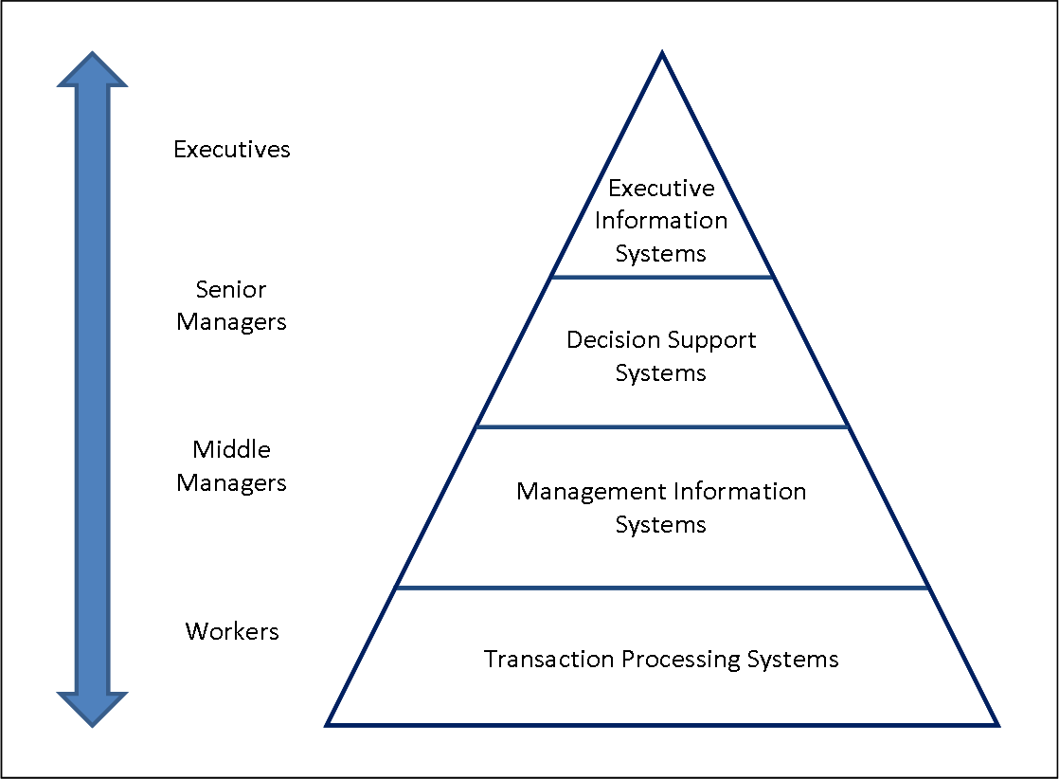
Hierarchy of Information System Types
Source: http://www.chris-kimble.com/Courses/World_Med_MBA/Four-Level-Pyramid-model.png

