Slide 1
Service-Oriented Architectures (SOA) and Semantic Web
Convenor: Hero Muhamad Sulaiman
MSc in Advanced Computer Science
Computer Science & IT Department
College of Science
Salahaddin University/Hawler
Email: hero.sulaiman@su.edu.krd
2022-2023

Slide 2
Syllabus
Introduction, Motivation, and concepts of SOA
XML
DTD
Schema
Introduction to UML
Use Case Diagrams
Sequence Diagrams
Component Diagrams
Class Diagrams

Slide 3
Syllabus
Converting Class diagram to DTD
XML based Messaging using SOAP
Describing and Publishing Web Services using WSDL and UDDI
Introduction to Web Services.
Web Services and Semantic Web
Introduction to Semantic Web
Infrastructure of Semantic Web + Ontologies

Slide 4
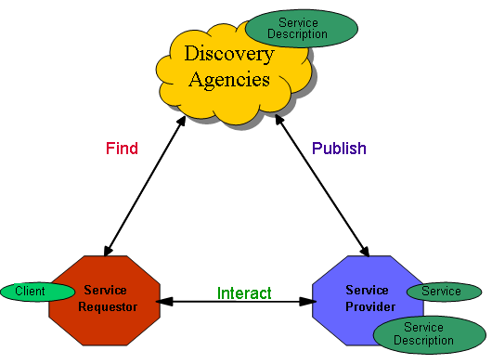
Service-Oriented Architecture Lecture 1: Introduction to SOA
Interact/Bind

Slide 5
Outline
Introduction
Definitions of SOA
Goals and Benefits of SOA
SOA motivators
Terminology

Slide 6
Introduction
"Things should be made as simple as possible, but no simpler." -- Albert Einstein
Loose Coupling or Loosely coupled: Services are connected to other services and clients using standard, dependency-reducing, decoupled and message-based methods such as XML document exchanges.
Notes:
What are the methods used for connecting services to other services and clients?

Slide 7
Introduction
If you travel overseas on business, you need to bring power adapters along with you.
Real dependency… (you need power)
Artificial dependency… (your plug must fit into the local outlet)
The aim is that, artificial dependencies can not be removed, however they can be reduced to the minimum.
Reworking Einstein’s principle: "Artificial dependencies should be reduced to the minimum but real dependencies should not be altered.“
So, Einstein was just talking about Loose Coupling…

Slide 8
SOA Definitions by different vendors
“A service-oriented architecture (SOA) is an application framework that takes everyday business applications and breaks them down into individual business functions and processes, called services. An SOA lets you build, deploy, and integrate these services independent of applications and the computing platforms on which they run.” – IBM
“Service-Oriented Architecture is an approach to organizing information technology in which data, logic, and infrastructure resources are accessed by routing messages between network interfaces.” – Microsoft
“An SOA is a set of components which can be invoked, and whose interface descriptions can be published and discovered.” – W3C.

Slide 9
So, What is SOA?
Essentially, SOA is a software architecture that starts with an interface definition and builds the entire application topology as a topology of interfaces, interface implementations and interface calls.

Slide 10
SOA Goals & Benefits
Loose Coupling: among interacting software agent.
Quality of Service: Security, Availability, Reliability, Scalability, Performance.
Flexibility and Agility: Services can be effectively designed and reconfigured in response to changing business requirements.
Reusability: SOA provide infrastructure that makes reuse possibilities in heterogeneous environment such as Java, .Net etc.
Notes:
Software Agent :- is a program that acts for a user or other program. Example Chatbot.
Applications integration (or enterprise application integration) is the sharing of processes and data among different applications in an enterprise.
* Non-reusable program is a factor that makes SOA to be needed by online systems. T
*

Slide 11
SOA Goals & Benefits
Reduces IT Burden: SOA allow IT to better support the organization by providing more value with less cost and less overall burden.
Increased Return on Investment (ROI): Services are delivered as IT assets and provide repeated value with lower maintenance and integration cost.
Notes:
counts

Slide 12
SOA motivators
Increasing nature of distributed systems.
Heterogeneity of systems and computing environments
Dynamics of operating environments
Processes require multiple services
Some other issues… (Next slide)
Notes:
A distributed system is a system whose components are located on different networked computers, which then communicate and coordinate their actions by passing messages to one other.

Slide 13
SOA motivators (Continued)
Problems:
Problem 1: Complexity
Budget constraints
Operating efficiencies
New business models
Growth by merger and acquisition leads to integrating entire IT organizations, applications and infrastructures.
Problems:
Problem 1: Complexity
Budget constraints
Operating efficiencies
New business models
Growth by merger and acquisition leads to integrating entire IT organizations, applications and infrastructures.
Reuse systems, no replacing
Notes:
counts

Slide 14
SOA motivators (Continued)
Problems:
Problem 2: Redundant and non-reusable programming
Mergers & acquisition
Redundant apps & non-reusable functions of apps
Increasing both cost (using more resources) and time
Notes:
Non-reusable program is a factor that makes SOA to be needed by online systems.

Slide 15
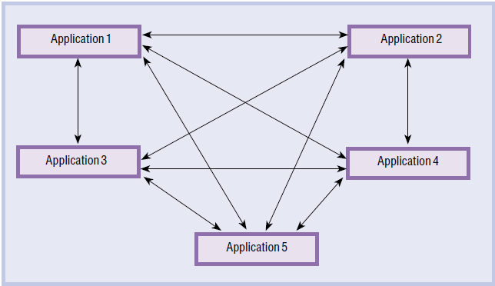
SOA motivators (Continued)
Problem 3: Multiple interfaces
- n(n-1) integration problem (n= No. off Appl.)
- Integrate another application (A_{(n+1)})
Notes:
Que
*Multiple Interfaces is considered as one of the SOA motivators. Explain this briefly using a diagram?
stion

Slide 16
Terminology
Interact/Bind
Interact/Bind

Slide 17
Terminology (Continued)
Components
1. Service: A service is an implementation of a well-defined piece of business functionality, with a published interface that is discoverable and can be used by service consumers when building different applications and business processes.
Interact/Bind
Notes:
………………. Is a piece of business functionality that is discoverable by service consumer when building different business process.

Slide 18
Terminology (Continued)
Components
2. Service Description: The service description contains the details of the interface and implementation of the service. This includes its data types, operations, and binding information. It could also include categorization and other meta data to facilitate discovery and utilization by requestors.
The complete description may be realized as a set of XML description documents.
The service description is usually published to a discovery agency.
Interact/Bind
Notes:
*Q for the red one
*The service description contains implementation of the service which is published to ………… .
service provider b. service requestor c. registry d. published interface
*The service description is usually published by ………………. at the first step.
Service Requester b. Service Provider c. Discovery Agency d. Registry

Slide 19
Terminology (Continued)
Roles
1. Service requester (Client): The software entity that calls a service provider. Traditionally, this is termed a “client”; however, a service requester can be an end-user application or another service.
Interact/Bind
Notes:
Q the red one
*Service Requestor, Service Provider and Registry are considered as ……… in SOA.
a.Roles b. Operations c. Discovery Agencies d. Components
* A service requester is the software entity that implements a service description.

Slide 20
Terminology (Continued)
Roles
2. Service provider: The software entity that implements a service description, and publishes the service to a discovery agency.
3. Discovery agency (Registry): agency through which a Web service description is published and made discoverable.
Interact/Bind

Slide 21
Terminology (Continued)
Operations
1. Publish: In order to be accessible, a service needs to publish its description such that the requestor can subsequently find it.
2. Find: The service requestor retrieves a service description directly or queries the registry for the type of service required.
Interact/Bind

Slide 22
Terminology (Continued)
Operations
3. Interact/Bind: The service requestor invokes or initiates an interaction with the service provider at runtime using the binding details in the service description to locate, contact, and invoke the service.
Interact/Bind

Slide 23
Terminology (Continued)
Other related terms and concepts:
Interface: Defines a set of public method signatures, logically grouped but providing no implementation. An interface defines a contract between the requestor and provider of a service. Any implementation of an interface must provide all methods.
Published interface: An interface that is uniquely identifiable and made available through a registry for clients to dynamically discover.
Notes:
Interface?
To achieve loose coupling and encapsulation components are accessed through ………..
RPC b. Message Signatures c. Messages d. Interfaces

Slide 24
Terminology (Continued)
Asynchronous Messaging: Asynchronous means sender does not block when sends a request to the receiver.
Synchronous Messaging: Synchronous means sender blocks when sends a request to the receiver. i.e. The sender waits, after sending the request, until the receiver sends a response.

Slide 25
Summary
Introduction
Definitions of SOA
Goals and Benefits of SOA
SOA motivators
Terminology

Slide 26
References
Using Service-Oriented Architecture and Component-Based Development to Build Web Service Applications, A. Brown et al, 2002.
What is Service-Oriented Architecture, Hao He, 2003 (www.xml.com)
Lecture Slides, Prof. Dr. Reiko Heckel
Lecture Slides, M. All Babar
http://www.w3.org/TR/2002/WD-ws-arch-20021114/

Slide 27
Questions?

Slide 28
Read about XML document…

