Slide 1
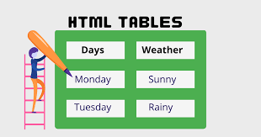
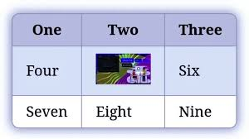
HTML: Lecture 6

Slide 2
Outline
HTML Table
Table Attributes
Table Caption

Slide 3
HTML Table
HTML tables allow web developers to arrange data into rows and columns.
Tables have many uses in HTML.
Table Tags are:

Slide 4
HTML Table
The <TABLE> </TABLE> element has four sub-elements:
Table Row <TR> </TR>.
Table Header <TH> </TH>.
Table Data <TD> </TD>.
Caption <CAPTION> </CAPTION>.
The table row elements usually contain table header elements or table data elements.
Cells can also be TH (Table Header) elements which results in the contents of the table header cells appearing centered and in bold text.

Slide 5
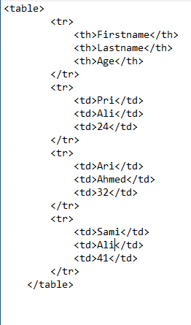
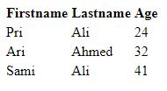
HTML Table

Slide 6
Table Attributes
1. BGColor: Some browsers support background colors in a table.
2. Width: you can specify the table width as an absolute number of pixels or a percentage of the document width. You can set the width for the table cells as well.
3.Border: You can choose a numerical value for the border width, which specifies the border in pixels.
4. CellSpacing: Cell Spacing represents the space between cells and is specified in pixels.
5. Cell Padding: Cell Padding is the space between the cell border and the cell contents and is specified in pixels.
6. Align: tables can have left, right, or centre alignment.
7. ????Background: Background Image, will be titled in IE3.0 and above.

Slide 7
Table Caption
A table caption allows you to specify a line of text that will appear centred above or bellow the table.
<TABLE BORDER=1 CELLPADDING=2>
<CAPTION ALIGN=“BOTTOM”>Label For My Table </CAPTION>
The Caption element has one attribute ALIGN that can be either TOP (Above the table) or BOTTOM (below the table).

Slide 8
<colgroup> tag
The <colgroup> tag specifies a group of one or more columns in a table for formatting.
The <colgroup> tag is useful for applying styles to entire columns, instead of repeating the styles for each cell, for each row.
The span attribute defines the number of columns a <colgroup> element should span.
The <col> tag specifies column properties for each column within a <colgroup> element.

Slide 9
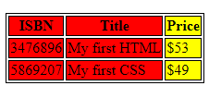
<colgroup> tag
<table>
<colgroup>
<col span="2" style="background-color:red">
<col style="background-color:yellow">
</colgroup>
<tr>
<th>ISBN</th>
<th>Title</th>
<th>Price</th>
</tr>
<tr>
<td>3476896</td>
<td>My first HTML</td>
<td>$53</td>
</tr>
<tr>
<td>5869207</td>
<td>My first CSS</td>
<td>$49</td>
</tr>
</table>

Slide 10
Attributes of Table Data and Header
1. Colspan: Specifies how many cell columns of the table this cell should span.
2. Rowspan: Specifies how many cell rows of the table this cell should span.
3. Align: Cell data can have left, right, or center alignment.
4. Valign: Cell data can have top, middle, or bottom alignment.
5. Width: You can specify the width as an absolute number of pixels or a percentage of the document width.
6. Height: You can specify the height as an absolute number of pixels or a percentage of the document height.

Slide 11
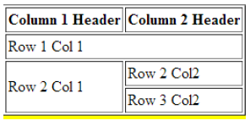
Attributes of Table Data and Header
Example:
<Table border=1 cellpadding =2>
<tr>
<th> Column 1 Header</th>
<th> Column 2 Header</th>
</tr>
<tr>
<td colspan=2> Row 1 Col 1</td>
</tr>
<tr>
<td rowspan=2>Row 2 Col 1</td>
<td> Row 2 Col2</td>
</tr>
<tr>
<td> Row 3 Col2</td>
</tr> </table>

Slide 12
<thead> tag
The <thead> tag is used to group header content in an HTML table.
The <thead> element is used in conjunction with the <tbody> and <tfoot> elements to specify each part of a table (header, body, footer).
Browsers can use these elements to enable scrolling of the table body independently of the header and footer. Also, when printing a large table that spans multiple pages, these elements can enable the table header and footer to be printed at the top and bottom of each page.
The <thead> tag must be used in the following contexts: As a child of a <table> element, after any <caption>, and <colgroup> elements, and before any <tbody>, <tfoot>, and <tr> elements.
Note: The <thead> element must have one or more <tr> tags inside.
Tip: The <thead>, <tbody>, and <tfoot> elements will not affect the layout of the table by default. However, you can use CSS to style these elements.

Slide 13
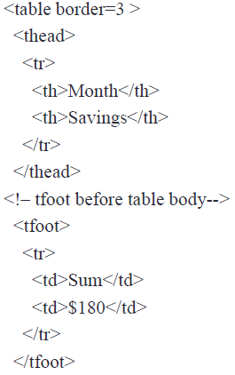
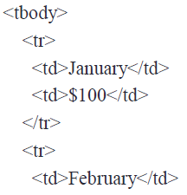
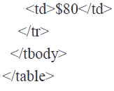
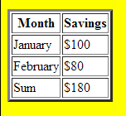
<thead><tbody><tfoot> Tag s Example

Slide 14
Special Things to Note
TH, TD and TR should always have end tags.
Although the end tags are formally optional, many browsers will mess up the formatting of the table if you omit the end tags.
In particular, you should always use end tags if you have a TABLE within a TABLE --in this situation, the table parser gets hopelessly confused if you don't close your TH, TD and TR elements.
A default TABLE has no borders, by default, tables are drawn without border lines. You need the BORDER attribute to draw the lines.

Slide 15
Special Things to Note
By default, a table is flush with the left margin, TABLEs are plopped over on the left margin.
If you want centered tables,
You can either: place the table inside a DIV element with attribute ALIGN="center“.
Or use table alignment. Most current browsers supports table alignment, using the ALIGN attribute. Allowed values are "left", "right", or "center", <TABLE ALIGN="left">

Slide 16
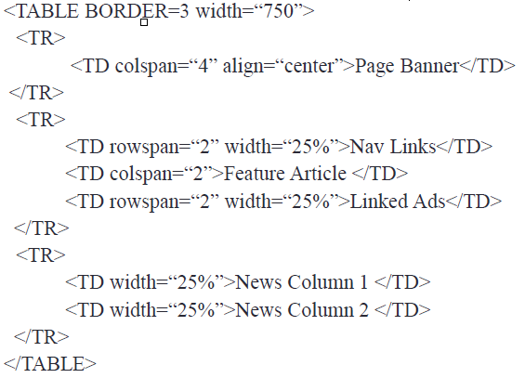
Guess the Output of this code!

Slide 17
Guess the Output of this code!

Slide 18
Summary
HTML Table
Table Attributes
Table Caption

Slide 19
References
Smith, B. E. 2009. Creating Web Pages For Dummies, 9th ed. Wiley Publishing, Inc., Indianapolis: Indiana.
Deitel, H. M. and Deitel, P. J. 2008, Internet and World Wide Web How to Program, 4th Ed1424 pp, Paperback; Publisher: Prentice Hall; 4th Ed. (Septembar 5, 2007); ISBN-10: 0-131-75242-1; ISBN-13: 978-0131752429.
Refsnes, H. et.al. 2010, Learn HTML and CSS, Wiley Publishing, Inc., Indianapolis, Indiana
Meyer, E., Cascading Style Sheets (CSS): The Definitive Guide, 3rd Ed., O’Reilly, 2006.
Zakas, N. C.2009. Professional JavaScript® for Web Developers, 2nd Edition. Wiley Publishing, Inc., Indianapolis: Indiana
www.w3schools.com
www.tutorialspoint.com

