Slide 1
Project Management
Lecture notes
Lec#2
Project Identification/screening
Feb 2022

Slide 2
Project Selection
Project identification
Project appraisal
Project selection

Slide 3
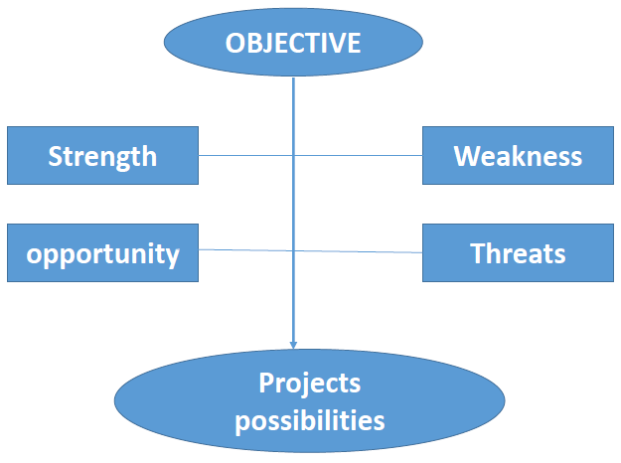
Project identification

Slide 4
Search for new ideas
Identifying objectives,
Brainstorm ( Market trend, SWOT, constraint)
Scrutiny shortlisted candidates and ideas
Objectives
Increase Profit
Reduce losses
Becoming more competitive ( in term of prices, quality,…)

Slide 5
SWOT Analysis (Strength)
What do you do better than others (experience and expertise)
Financial Position
What advantage do your staff have?
Foreign collaboration
…

Slide 6
SWOT Analysis (weakness)
Lack of experience
Unavailability of trained staff
Inability of forecast market trend
What your competition do better than you
…

Slide 7
SWOT Analysis (opportunities)
New product with new market
New process with better features
Are you can do something your competition cant?
…

Slide 8
SWOT Analysis (Threats)
New competitors
Poor state of economy
poor management skills

Slide 9
Source of new product or service ideas
Top management
Marketing ad sales department
Statistic analysis

Slide 10
Brainstorming
Purpose:
to generate large number of ideas
Simulate the creativity
Technique:
Describe the problem
Document all ideas
No judgment or criticism
Exercise is over when there are no more idea

Slide 11
Screening of ideas
Profit
Payback
Risk
Life time
Flexibility
Investment
Similarity to existing business
…

Slide 12
Mortality of new project ideas

