Slide 1
Project Management
Lecture notes
Lec#3
Project appraisal, project Selection
Feb 2021

Slide 2
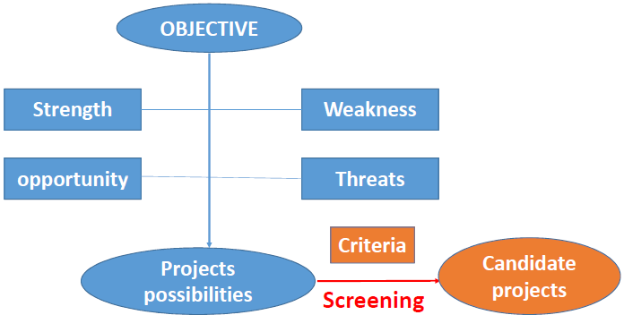
Project identification

Slide 3
Project appraisal
• Market appraisal ( the purpose is to identify the market to the
product, to identify who will be the customer, the nature of demand,
also to identify who are the other players in the system, what will be
the market share
• Technical appraisal (look after engineering aspects of the project)
• Financial appraisal ( NPV, Payback, IRR,return of investment, risks, profitability)

