Slide 1
Project Management
Lecture notes
Lec#4
Project Planning-Project representation
Feb 2022

Slide 2
Project representation
• Represent project manager
• Define project team
• Share the objective of the project clearly to project team
• Basic work breakdown of the project must raise the following
questions:
1- How work will be done
2- how people will be organized
3- how resources will be allocated
4- how progress will be monitored

Slide 3
Means of project representation
• Project name and description
• List of jobs that constitute the project( it will not provide the
precedence and relation of the jobs)
• Charts or graphs that shows when the activities take place.
• Project network showing activities, their dependencies and relation
to the whole.
• Project network is a common vehicle for planning, communication
and implementation of the project from inception.
• Generally there are two type of project representation
1- Activity On Arrow (A-O-A) arrows represent the activities
2- Activity On Node (A-O-N) nodes represents the activities

Slide 4
Why using project networks
• To show the activities and precedence
• Responsibility allocation
• Definition of subcontracting units
• Role of different players
• Basic scheduling and creating time table for the project.
• Determination of critical path ( the activities that the control the
duration of the project)
• Resource planning ( Resource aggregation, leveling and limited
resource allocation)
• It useful in project implementation phase for updating the schedules,
monitoring and reporting progress

Slide 5
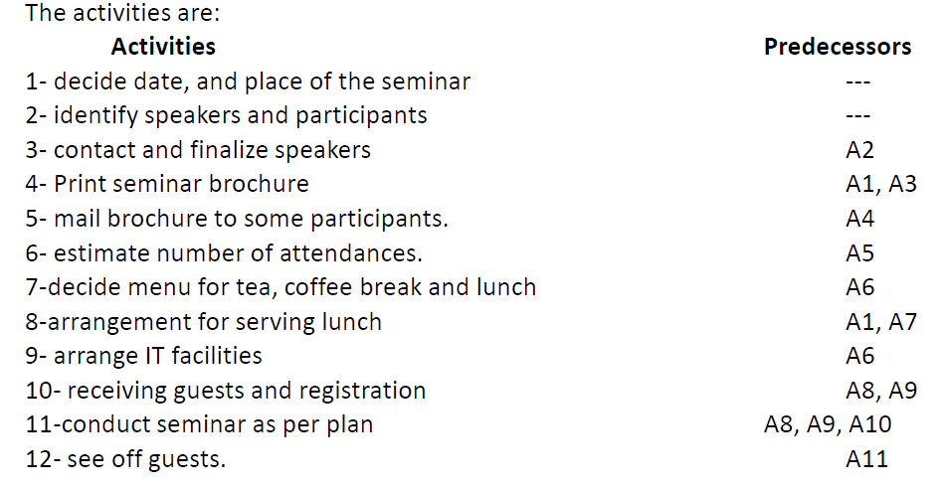
Example#1 Organizing one day Seminar

Slide 6
A-O-A and A-O-N
Class activity Example #1

Slide 7
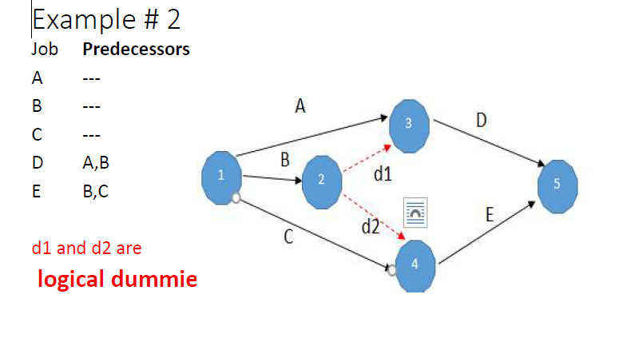
Logical dummies

Slide 8
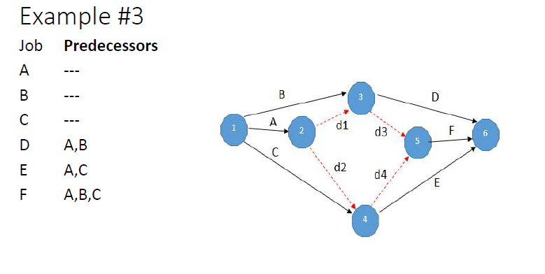

Slide 9
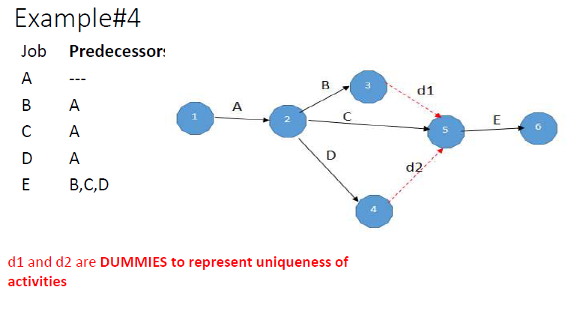
Dummies to represent Uniqueness of activities

Slide 10
Dummies: Single source and Single Terminal

Slide 11
Role of DUMMIES
1- correct representation of precedence logic (only A-O-A)
2- uniqueness of activities representation (only A-O-A)
3- creation of single source and termination (A-O-A and A-O-N )

Slide 12
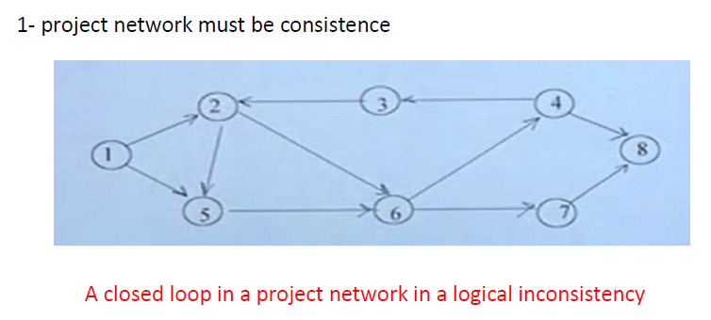
Properties of project networks

Slide 13
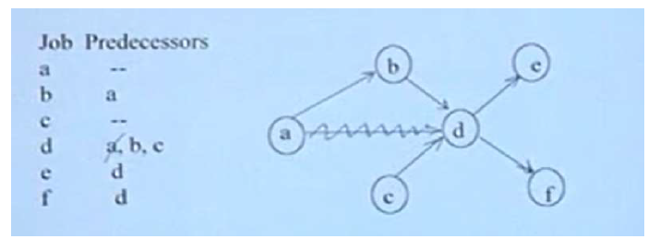
Redundancy (A-O-N)

