Slide 1
Project Management
Lecture notes
Lec#5
Basic scheduling
April 2022

Slide 2
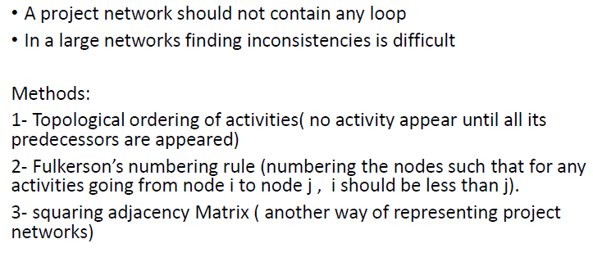
Checking consistency and remove redundancy in project Networks

Slide 3
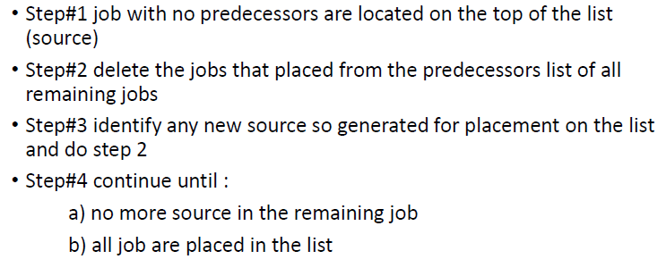
Topological ordering

Slide 4
Example ( class activity)

Slide 5
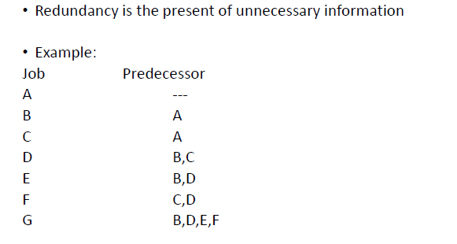
Redundancy check- Example

Slide 6
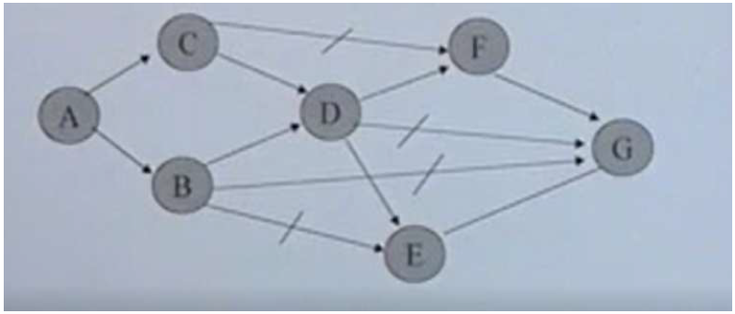

Slide 7
Basic scheduling in A-O-A Networks

Slide 8
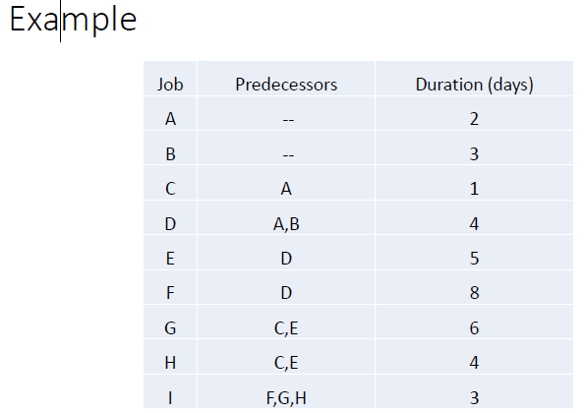

Slide 9
Critical path

Slide 10
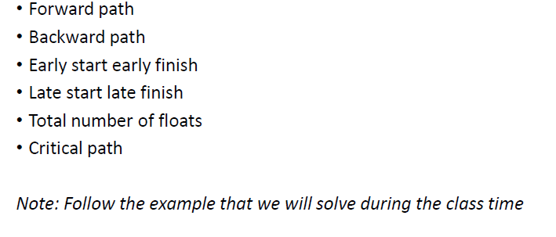
Critical path identification

