Slide 1
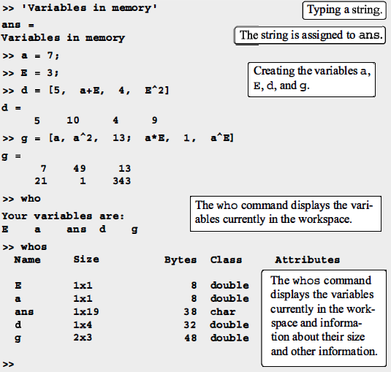
Chapter Three
Using Script Files

Slide 2
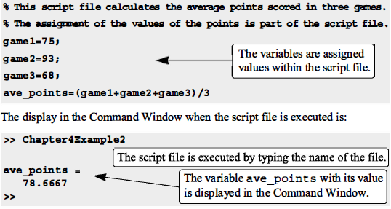
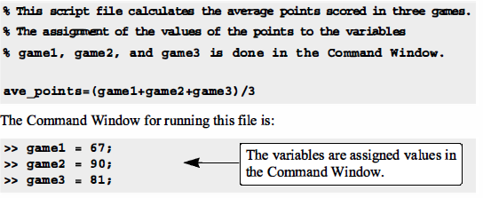
INPUT TO A SCRIPT FILE
1. The variable is defined and assigned a value in the script file.
2. The variable is defined and assigned a value in the Command Window.

Slide 3
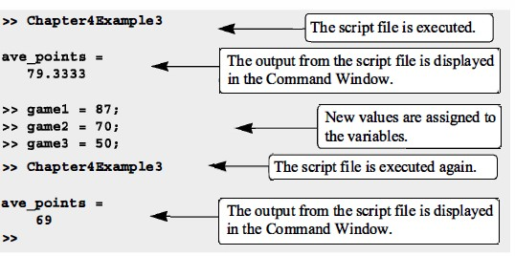
3. The variable is defined in the script file, but a specific value is entered in the Command Window when the script file is executed.

Slide 4
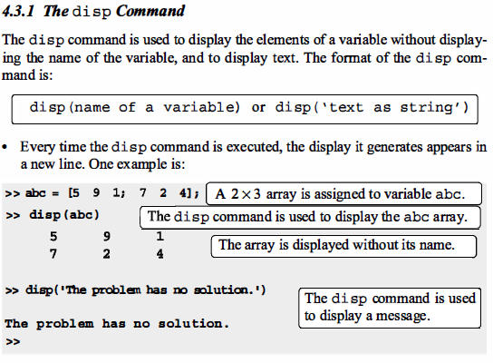
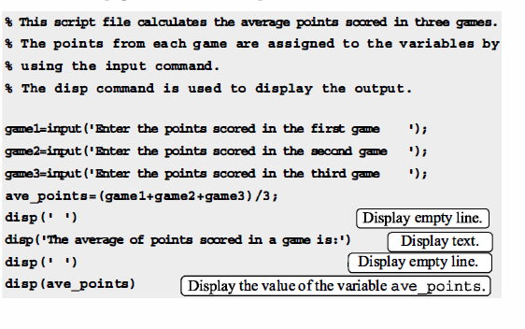
OUTPUT COMMANDS

Slide 5
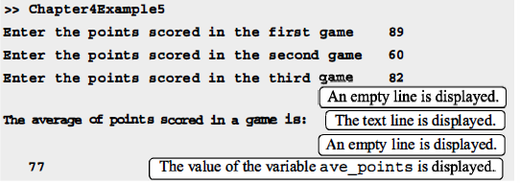
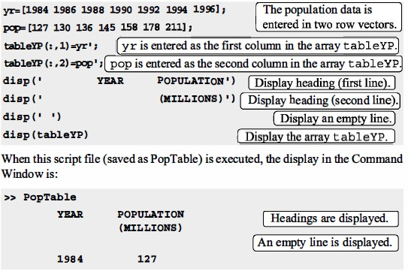

Slide 6
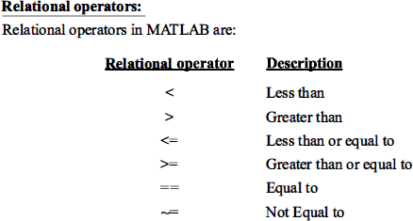
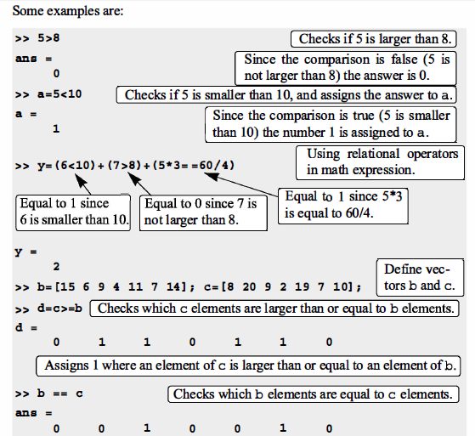

Slide 7
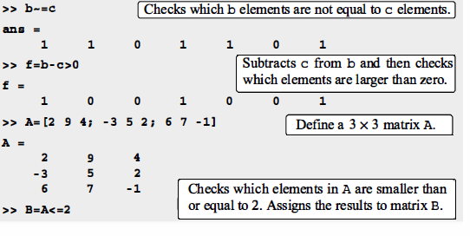
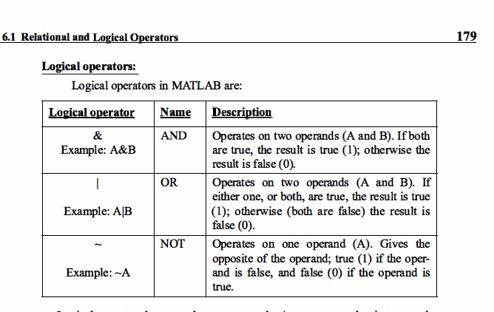

Slide 8
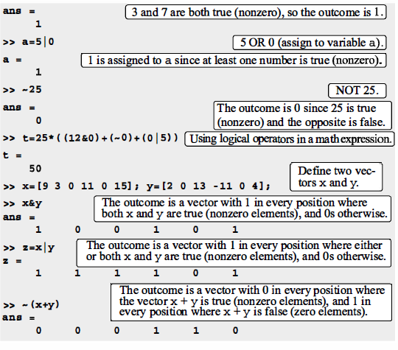
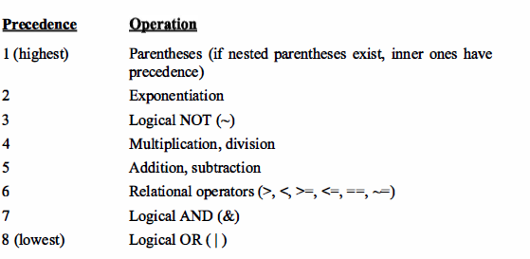

Slide 9
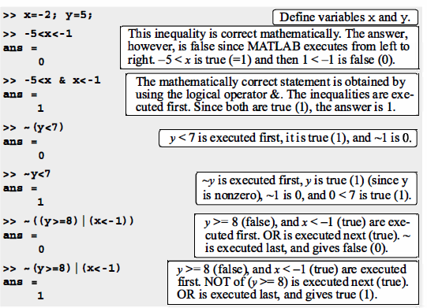

Slide 10
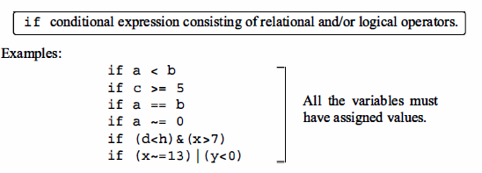
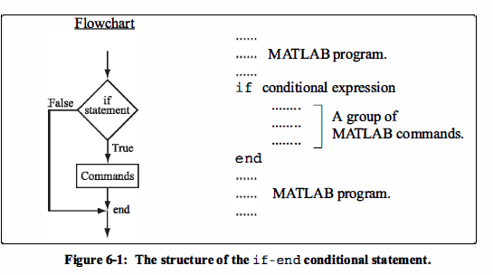
CONDITIONAL STATEMENTS
The if- end Structure
Example 1:-
Write a program to test if the numbers are entered positive.
a=input('a='); if a>0
b=a;
disp('a is positive') end

Slide 11
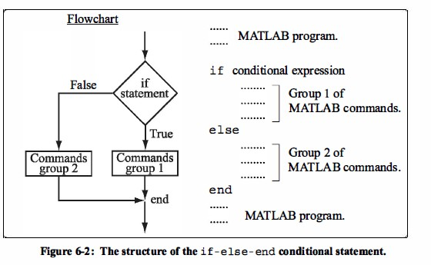
Example 2 :-
W. P. to find the value of 𝑦 =
𝑥³−5𝑥+2
, 𝑥 ≠ 3
𝑥−3
x=input('x='); if (x~=3)
y=(x^3-5*x+2)/(x-3);
disp(y); end
Example 3:- W.P. to input the following number 8 5 10 11 18 21 Then print the even number
x=input('x=');
if (rem(x,2)==0) disp(x);
end
The if - else - end Structure

Slide 12
Example 1 :-
Write a program to input the temperature to either print “'normal condition'” if temperature greater than 37 or print 'catch a fever'
temp=input('enter the measured temperature:');
if temp >37
disp('normal condition') else
disp('catch a fever') end
Example 2 :-
Write a program to test input x is positive or negative number
x=input('x='); if x>= 0
disp('x is positive');
else
disp('x is negative'); end
Example 3 :-
Write a program to input number then test if it is even or odd number?
x=input('x=');
if(rem(x,2)==0)
disp('x is even'); disp(x);
else
disp('x is odd');

Slide 13
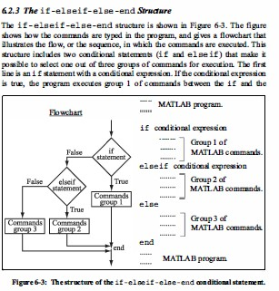
disp(x); end
Example 1:- Write a program to input number 𝑥 to find the value of 𝑦 such that
𝑥² − 5𝑥 + 1
𝑦 = { 𝑥 + 5
𝑥² − 7𝑥 + 3
𝑖𝑓 𝑥 ≥ 3
𝑖𝑓 𝑥 < 2
𝑜𝑡ℎ𝑒𝑟𝑤𝑖𝑠𝑒
x=input('x='); if x>= 3
y=x^3-5*x+1;

Slide 14
disp(y); elseif x<2
y=x+5;
disp(y);
else
y=x^2-7*x+3; disp(y)
end
Example 2:- Write a program to input the degree of student to print the grade as the following
Degree | 0-49 | 50-59 | 60-69 | 70-79 | 80-89 | 90-100
Grade | Fail | Pass | Medium | Good | Very good | Excellent
x=input('x='); if x > 100
% fprintf('input
%-5.2f out of the range',x);
disp('the input number out of the range'); elseif x>= 90 && x<=100
disp('Grade is Excellent'); elseif x>=80 && x<=89
disp('Grade is V. Good'); elseif x>=70 && x<=79
disp('Grade is Good'); elseif x>=60 && x<=69
disp('Grade is Medium'); elseif x>=50 && x<=59
disp('Grade is Pass');

Slide 15
else
disp('Grade is Fail');
end
Home Works
1- write a program to find the average of the student exams and write the grade Of it as the following:-
No. | Exams |  | Avr. | grade
1 | 40 |  | 100≤ Avr ≤ 90 | A
2 | 60 |  | 90< Avr ≤ 80 | B
3 | 30 |  | 80< Avr ≤ 70 | C
4 | 50 |  | 70< Avr ≤ 60 | D
5 | 70 |  | 60< Avr ≤ 50 | E
 |  |  | otherwise | F
2- Write a program to input number 𝑥 to find the value of 𝑦
such that
_{𝑒}𝑥
𝑦 = { |𝑥|
sin 𝑥
𝑖𝑓 𝑥 = (20 𝑡𝑜 25)
𝑖𝑓 𝑥 = (30 𝑡𝑜 35)
𝑖𝑓 𝑥 = (40 𝑡𝑜 45)
3- Write a program to input the values 𝑥 and 𝑦 to find the value of 𝑧

Slide 16
3 5 21 23
_{𝑧 =} (𝑥+𝑦) ₊ (𝑥+𝑦) ₊ (𝑥+𝑦) _{+ ⋯ +} (𝑥+𝑦) ₊ (𝑥+𝑦)
3! 5! 7! 23! 25!
A vector is given by 𝑉 =
[5, 17, 15, 8, 0, −7, 12, −3, 20, −6, 6, 4, −7, 16]. Write a
program that doubles the elements that are positive and are divisible by 3 and divisible by 5, raises to the power of 3 the
elements that are negative but greater than −5.
A vector is given by 𝑉 =
[13, −4, −3, 1, 15, −8, 12, −18, 5, 21]. Write a program to
multiply the elements of 𝑉 by 2 if such elements are positive and even number, and multiply the elements of 𝑉 by −5 if such element are negative and odd number.
A list of 30 exam scores is:
31, 70, 92, 5, 47, 88, 81, 73, 51, 76, 80, 90, 55, 23, 43,98,36,87,22,61,
19,69,26,82,89,99, 71,59,49,64
Write a computer program that determines how many grades are from 0
to 19, from 20 to 39, from 40 to 59, from 60 to 79, and
from 80 to 100.
let’s say we were asked to write a program that calculates the tip based on amount of bills, using the following rules and
the variable ‘bill’:
bill is less than $10
Tip is $1.80

Slide 17
bill is between $10 and $60
Tip is %18
bill is above $60
Tip is %20
Q/ Write a script file using Conditional If-Elseif-Else statements to shows the grade of the score as following:-
Grade | Score
A+ | 100
A | Score ≥ 90
B | Score ≥80
C | Score ≥70
D | Score ≥60
F | otherwise

