Slide 1
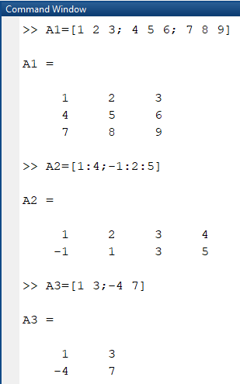
Chapter Two
MATRICES
Def: - A matrix in Matlab is similar to defining a vector commas or spaces are used to separate elements in a row and semi colons are used to separate individual rows.
1 | 2 | 3
Ex:- 𝐴₁ = [4 | 5 | 6]
7 | 8 | 9
Transpose of matrix interchange rows with the corresponding column

Slide 2
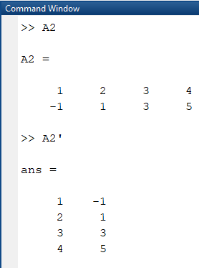
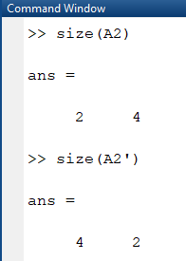
To find the dimension of matrix use command size(A) where A is matrix

Slide 3
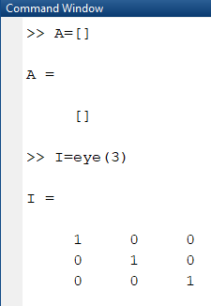
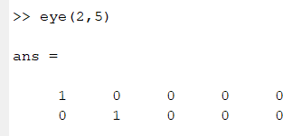
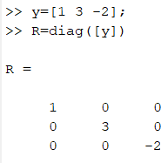
Special Matrices
E=[ ]
% empty 0-by-0 matrix

Slide 4
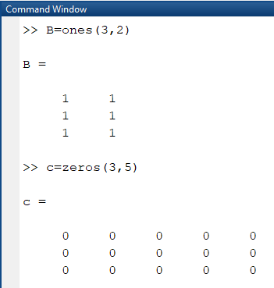
To find determinant of matrix use command det(A) where A is matrix

Slide 5
Diag(A,k)
If 𝑘 = 0 that mean the diagonal of matrix
If 𝑘 > 0 that mean the upper diagonal of matrix If 𝑘 < 0 that mean the lawer diagonal of matrix

Slide 7
Example: -
To find rank use command rank(A) where A is matrix
To find the value of location of matrix you can do the following

Slide 8
To find loawer and upper triangler of matrix

Slide 10
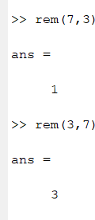
Variable
they may not start with anumeral
matlab in case sensitive 𝑨 and 𝒂 are different variable
we can not user the words such as for , if , switch, else , if ,…
Mathematical matlab command
Mathematical Expression | Matlab Command
𝑠𝑖𝑛𝑥 , 𝑐𝑜𝑠𝑥 | Sin(x), cos(x)
tan⁻¹ 𝑥 | atan(x)
𝑠𝑖𝑛ℎ𝑥 | sinh(x)
_{𝑒}𝑥 | exp(x)
Reminder | rem(a,b)
True for real number | isreal(x)
_{𝑥}𝑏 | x^b
√𝑥 | sqrt(x) or x^0.5
|𝑥| | abs(x)
lnx, logx | log(x) , log10(x)
π | pi
a±b | a±b
ab | a*b
Round toword zero | fix(x)
Round toword −∞ | floor(x)
Round toword +∞ | ceil(x)
Round to nearest integer | round(x)
3+3+1 here 1 is reminder
0+3 here 3 is reminder

Slide 11
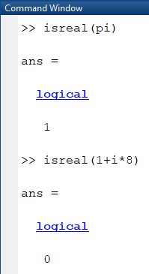
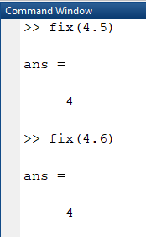
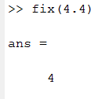

Slide 12
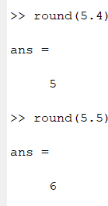
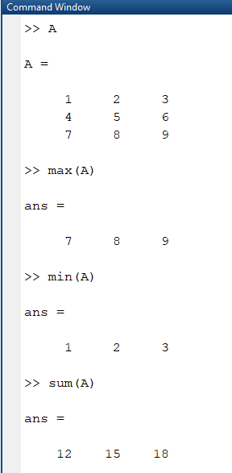
To find maximum or minimum or summation use the following commands

Slide 13
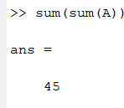
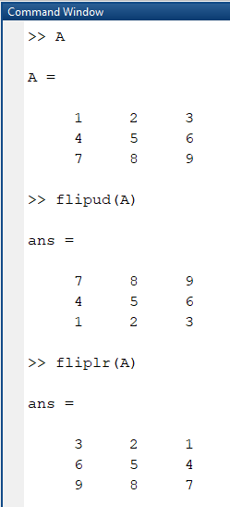
flip
flip(A) returns array B the same size as A, but with the order of the elements reversed ,If A is a matrix, then flip(A) reverses the elements in each column.

Slide 14
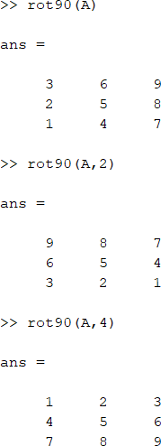
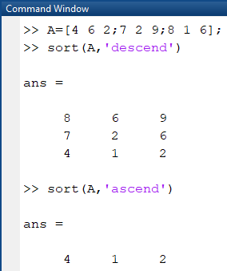
rot90
rot90(A) rotates array A counterclockwise by 90 degrees. For multidimensional arrays, rot90 rotates in the plane formed by the first and second dimensions.
Sort of matrix
sort(A, direction) sorts the elements of A in ascending order

Slide 15
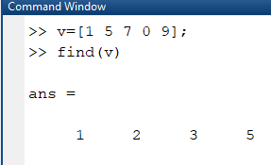
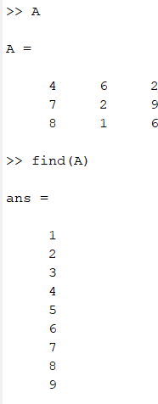
Command (Find(x))
find(X) returns a vector containing the linear indices of each nonzero element in array X.

Slide 16
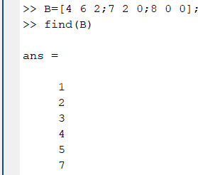
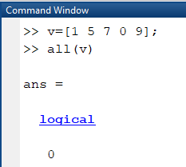
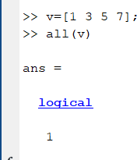
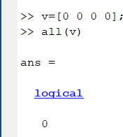
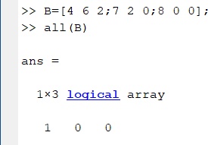
Command ( all(A) )
all(A) tests along the first array dimension of A whose size does not equal 1, and determines if the elements are all nonzero or logical 1 (true). In practice, allis a natural extension of the logical AND operator.

Slide 17
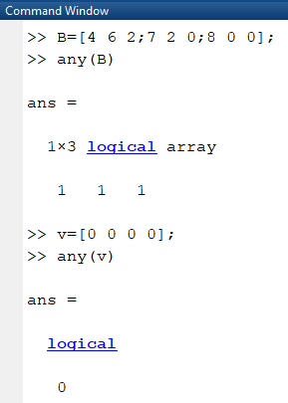
Command ( any(A) )
any(A) tests along the first array dimension of A whose size does not equal 1, and determines if any element is a nonzero number or logical 1 (true). In practice, any is a natural extension of the logical OR operator

Slide 18
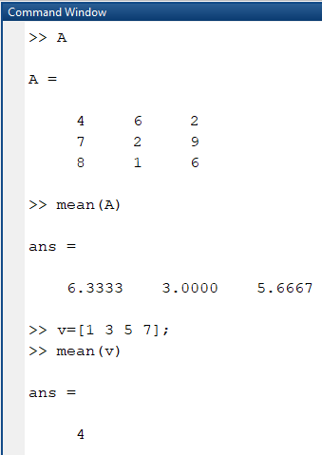
Command (mean “Average or mean value of array”)
mean(A) returns the mean of the elements of A along the first array dimension whose size does not equal 1.
If A is a vector, then mean(A) returns the mean of the elements.
If A is a matrix, then mean(A) returns a row vector containing the mean of each column.

Slide 19
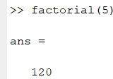
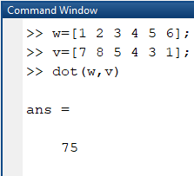
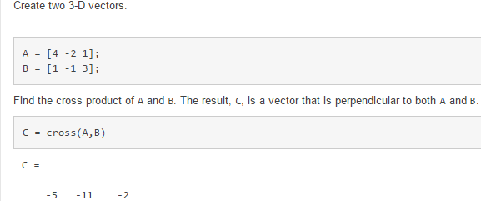
Command (factorial)
factorial(n) returns the product of all positive integers less than or equal to n, where n is a nonnegative integer value. If n is an array, then f contains the factorial of each value of n. The data type and size of f is the same as that of n.
Command (Dot product)
dot(A,B) returns the scalar dot product of A and B.
If A and B are vectors, then they must have the same length.
Command (Cross product)
cross(A,B) returns the cross product of A and B. must be 3 dim mean A=[a1]

Slide 20
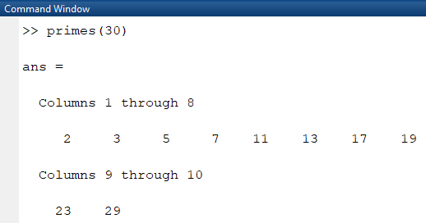
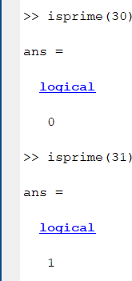
Command (primes)
primes(n) returns a row vector containing all the prime numbers less than or equal to n. The data type of p is the same as that of n.
isprime(X)
isprime(X) returns a logical array the same size as X. The at TF(i) is true when X(i) is a prime number. Otherwise, the value is false
value

Slide 21
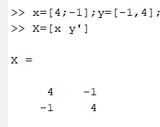
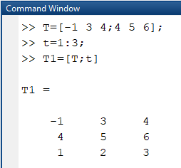
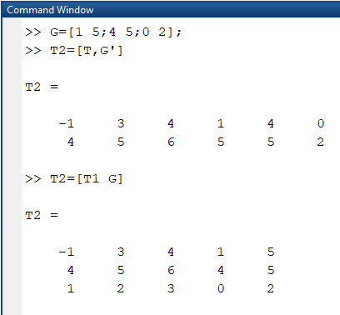
Building matrices and extracting part of matrices
Example 1:-

Slide 22
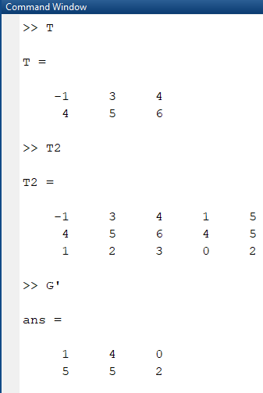
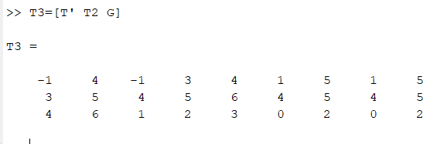

Slide 23
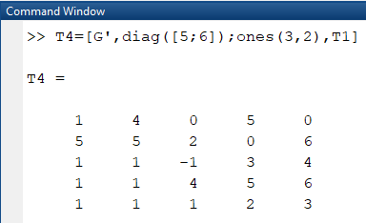
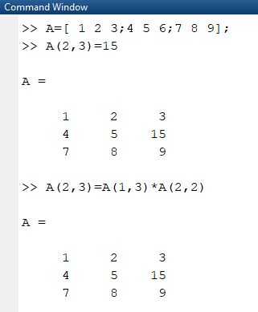
Example 2: -

Slide 24
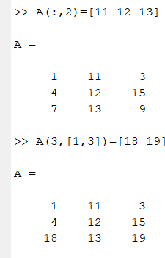
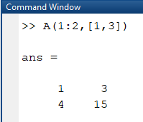
Change column 2 by v=[11 12 13 ]

Slide 25
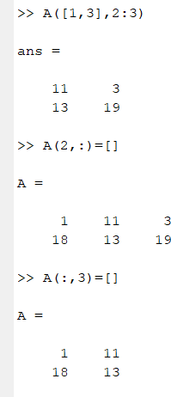
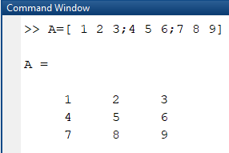
Example: -
Swap R1 and R2

Slide 26
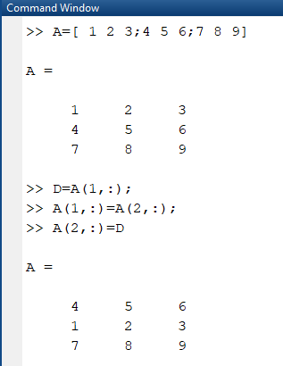
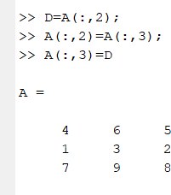
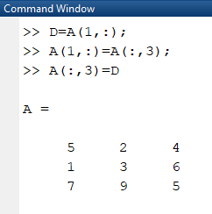
Change C2 with C3
Swap R1 and R3

Slide 27
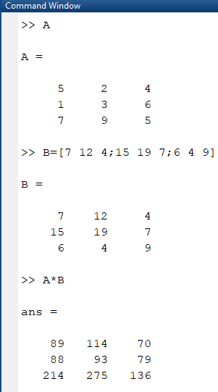
Matrices Arithmetic

Slide 28
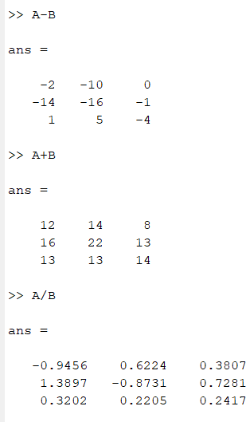
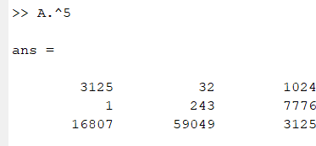
Euclidean Norm
The Euclidean norm (or 2-norm) of a vector v that has N elements is defined by

Slide 29
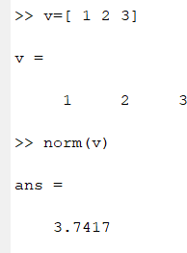
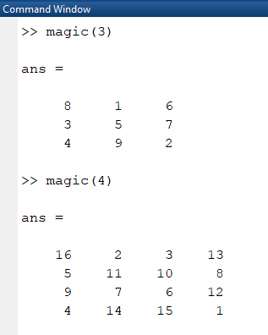
\
Magic Function
Matlab has build in function that create magic sequence of almost any size
>> magic(n) → build a square matrix of size 𝑛 ∗ 𝑛 and that elements between 0 −>
𝑛^2

