Slide 1
Ministry of Higher Education & Scientific Research
Salahaddin University College of Education Mathematics Departments
Programming Application
Prepared by
Maher Ali Nawkhass
Email: maher.nawkhass@su.edu.krd
Second Year for
First Semester & Second Semester Academic Year 2022-2023

Slide 2
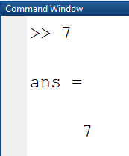
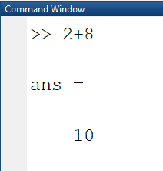
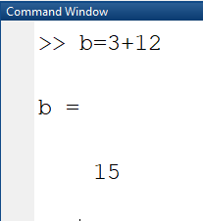
Maher Ali Nawkhass Second Year
MATLAB
MATLAB is a tool for mathematical calculator, first it can be used as scientific calculator next it allows you to plot or visualize data in many different ways.
You can start MATLAB, double clicking on MATLAB icon that should be on the desktop of your computer
The string (>>) is the MATLAB prompt appears when the command windows is active commands in MATLAB are excited by pressing enter or return to out put will be by displayed or screen immediately
The exist matlab the commend exist or quite NOTE: the spaces are not important in matlab You can also define your own variable

Slide 3
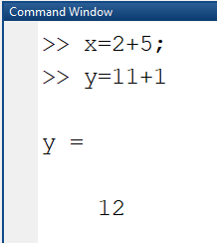
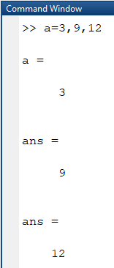
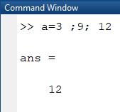
Maher Ali Nawkhass Second Year
When the comment is following by semi colom (;) then the output is suppressant
It is possible to excute more than one variable at same time by use comm as (,)
or by use semcolom (;)

Slide 4
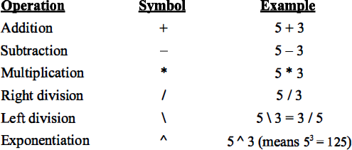
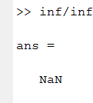
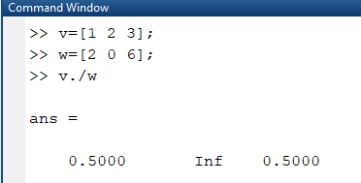
Maher Ali Nawkhass
Second Year
Operation in Matlab
Matlab as Calculater
There are three kinds of numbers used in matlab integer , real and complex. In addition (inf) for postive infinity by dividing a non-zero number by zero and NoN which is not a number
For example:-
If we input v and w as follow then

Slide 5
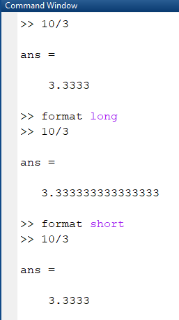
Maher Ali Nawkhass
Second Year
Matlab disply only 5 digite and use the command format long to increase this number to 15 digite while use the command is format short reduced to 5 digite.
All lext after a present sgin % in thr end of the line is the trented as a Note.

Slide 6
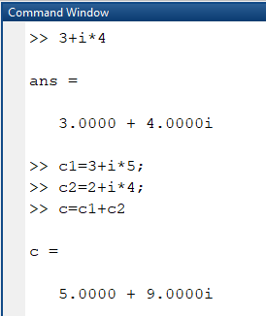
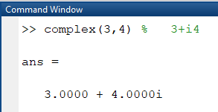
Maher Ali Nawkhass
Second Year
Complex Number
Matlab working with complex number is easy:
Or
also

Slide 7
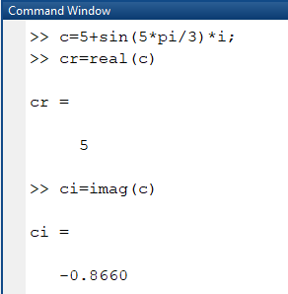
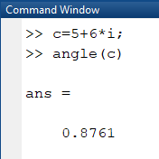
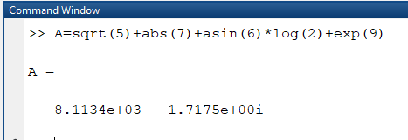
Maher Ali Nawkhass
Second Year
Lin function in matlab write as log
Example :- write the following equation in matlab
𝐴 = √5 + |7| + sin⁻¹ 6 + 𝑙𝑖𝑛2 + exp (9)
Solution:-

Slide 8
Maher Ali Nawkhass
Second Year
Exercise 1:-
Exercise 2:-

Slide 9
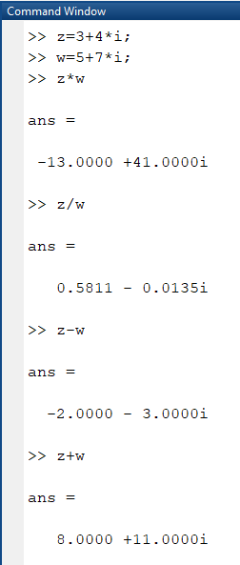
Maher Ali Nawkhass Second Year
Variable
Variable in matlab are named objects that are assigned using the equal sign (=)
Mathematics with Vectors and Matrix
The basis elements of matlab is matrix or (an array) special case
1) a x matrix , a scaler or a single number

Slide 10
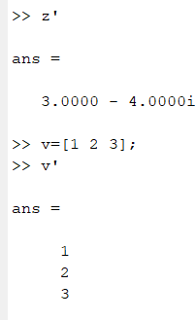
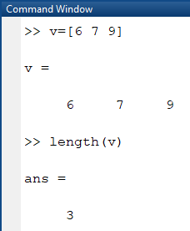
Maher Ali Nawkhass
Second Year
Ex :- 𝑎 = 5
2) a matrix existing only of one row or one column Ex:- 𝑣 = [1 5 2]
Note 𝑣’ is transpose of vector v For example
Vector :- Row vector are lists of numbers separated either by comma (,) or by space
They are examples of single array first elements has index 1 the number of entires known as the long of vectors. The entires must be enclosed in [ ].
Example 1:-

Slide 11
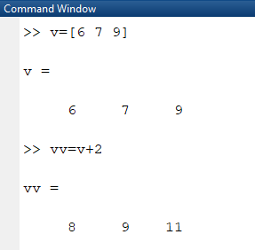
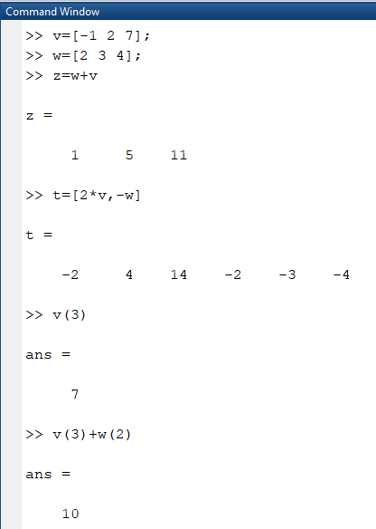
Maher Ali Nawkhass
Second Year
Example 2:-
Example 3:-
10

Slide 12
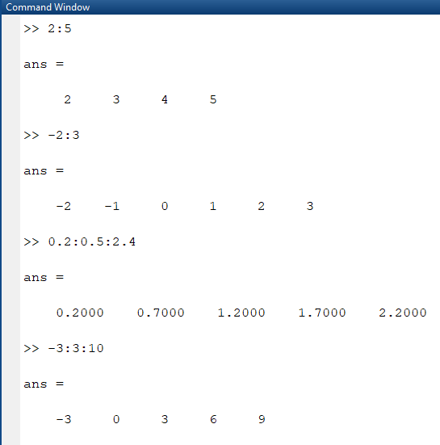
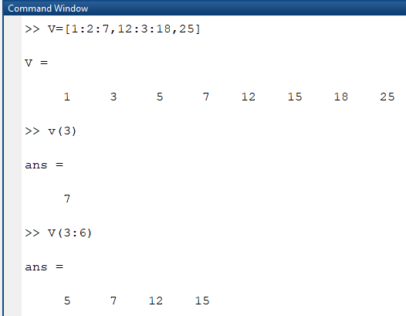
Maher Ali Nawkhass
Second Year
Colon Nation and Extraction ( Part of a Vector)
Example 1:-
Example 2:-
11

Slide 13
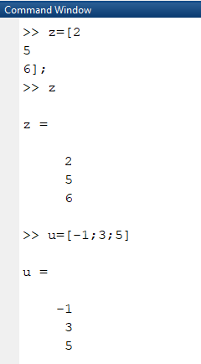
Maher Ali Nawkhass
Second Year
Colomn Vectors and Transposing
To create column vectors, you should sperate entries by new lines or by semicolon.
Example 1 :-
12

Slide 14
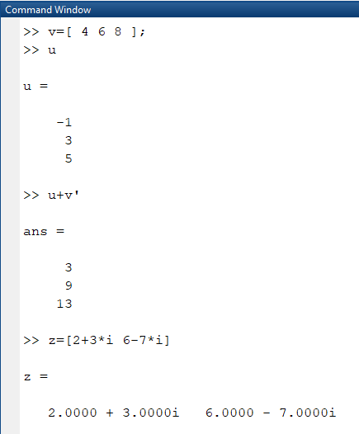
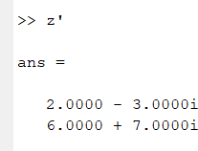
Maher Ali Nawkhass
Second Year
13

Slide 15
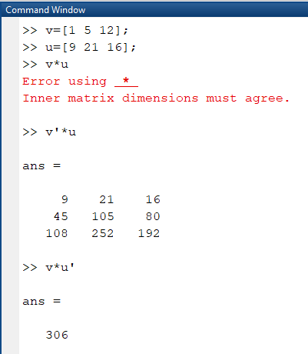
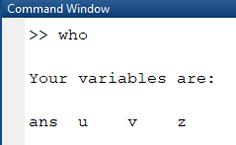
Maher Ali Nawkhass
Second Year
Example 2:-
The command “who”
Give a list of all variables that used
14

Slide 16
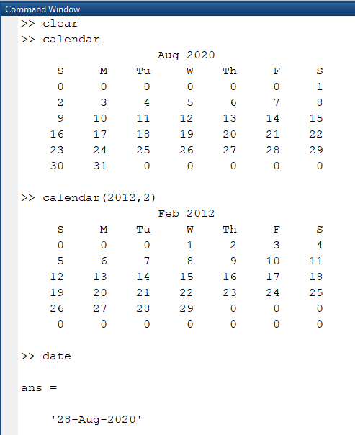
Maher Ali Nawkhass Second Year
The command “whos”
Gives a list of all variables that are used with more information
The command “clc”
Used for rase the command window with out deleting the variable and other commands that used
The command “clear”
Used to delete the variables that are used
15

Slide 17
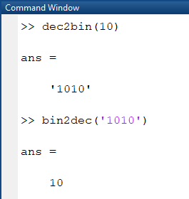
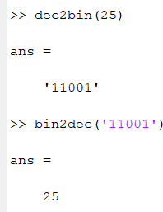
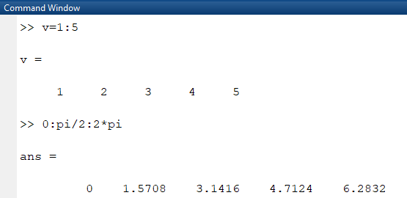
Maher Ali Nawkhass
Second Year
Converting of Numbers
Example 1:-
Example 2:-
The Colon Operation
To generate a vector of equally spaced elements, provides the colon operation
16

Slide 18
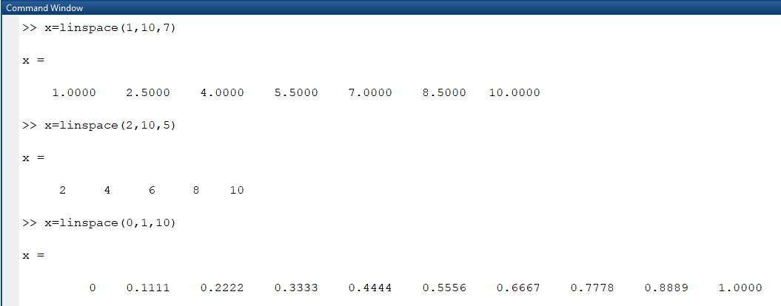
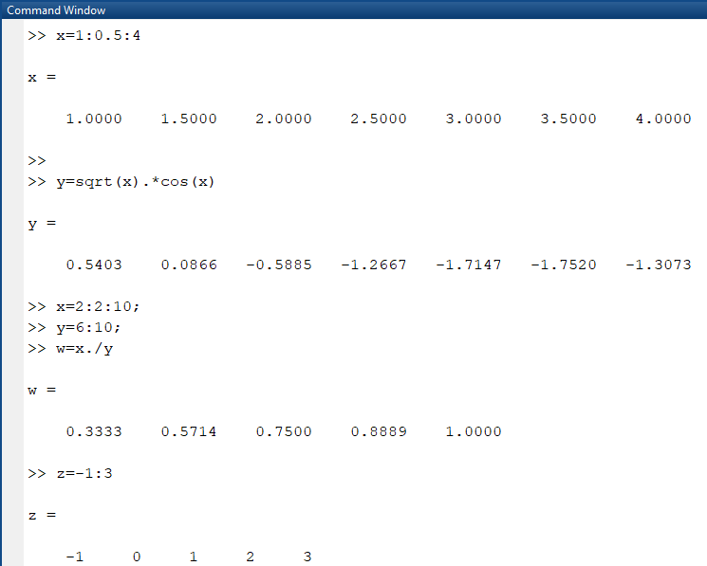
Maher Ali Nawkhass
Second Year
Linspace: to gererate a vector of equally space point between two end points.
𝑋 = 𝑙𝑖𝑛𝑠𝑝𝑎𝑐𝑒(𝑎, 𝑏, 𝑛) gererate a vector x of n equally space point between a & b
Example 1:-
You can now tabulate easily values of a function for gives list of arguments
Example 2:-
17

Slide 19
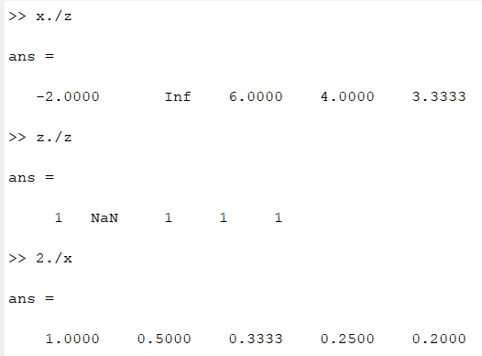
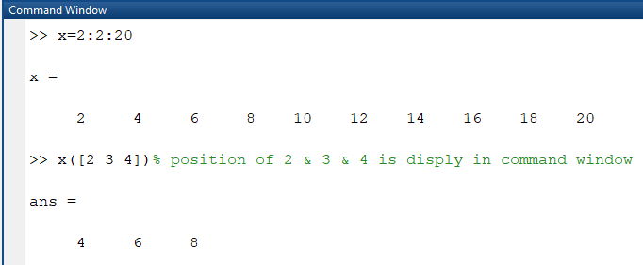
Maher Ali Nawkhass
Second Year
Example 3:-
18

