Slide 1
Chapter Four
Application in Matlab
Solution of linear systems
Back slash ( inverse ) method
Example 1:- Solve the following matrix equation (the system ) in Matlab by using back slash ( inverse ) method
5𝑥 − 3𝑦 − 10 − 2𝑧 = 0
4𝑦 = −8𝑦 + 3𝑥 + 20
2𝑥 + 4𝑦 − 4𝑧 = 9
Solution: - 1) rearrange the equation
5𝑥 − 3𝑦 − 2𝑧 = 10
−3𝑥 + 8𝑦 + 4𝑧 = 20 2𝑥 + 4𝑦 − 9𝑧 = 9
Write the equation in matrix, Ax=B:-
𝑥
5 −3 2 10
𝐴 = [−3 8
2 4 −9 9
4 ] , 𝑥 = [𝑦] , 𝐵 = [20]
𝑧

Slide 2
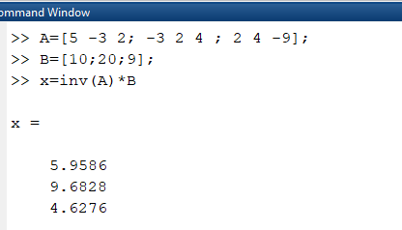
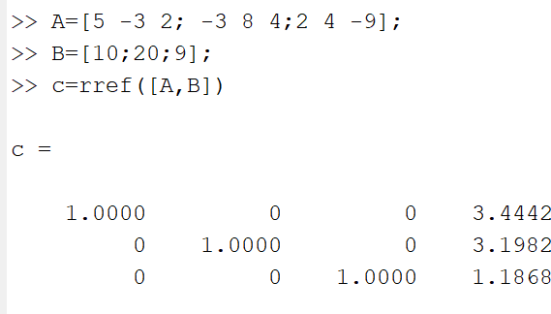
3) Solve the matrix equation in Matlab by using back slash ( \ ) or inverse (𝑖𝑛𝑣) method.
ii) Gauss – Elimination Method (𝒓𝒓𝒆𝒇) :-
Example 2:- Solve the following system using Gauss - Elimination Method
5 −3 2
𝐴 = [−3 8 4 ]
2 4 −9
𝑥
10
, 𝑥 = [𝑦] , 𝐵 = [20]
𝑧
9
iii)Gramer Method
Example: - Solve the following system using Gramer method
5𝑥 − 3𝑦 − 2𝑧 = 10
−3𝑥 + 8𝑦 + 4𝑧 = 20 2𝑥 + 4𝑦 − 9𝑧 = 9

Slide 3
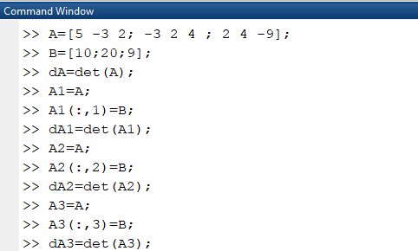
Solution

Slide 4
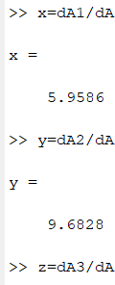
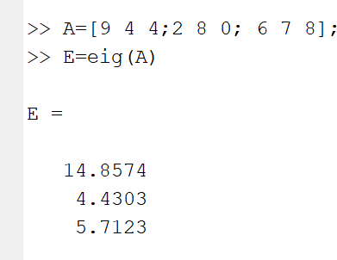
z=
4.6276
Eigen Value & Eigen Vectors
Eigen Value
9 | 4 | 4
Let A= [2 | 8 | 0]
6 | 7 | 8

Slide 5
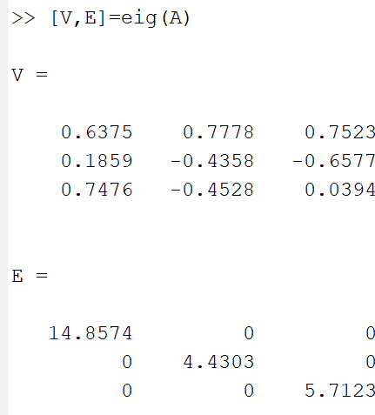
B) Eigen Vectors
Polynomials
Roots(p)
Example: - 𝑝(𝑥) = 𝑥³ − 6𝑥² + 11𝑥 − 6

Slide 6
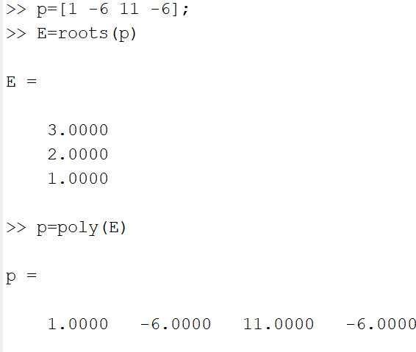
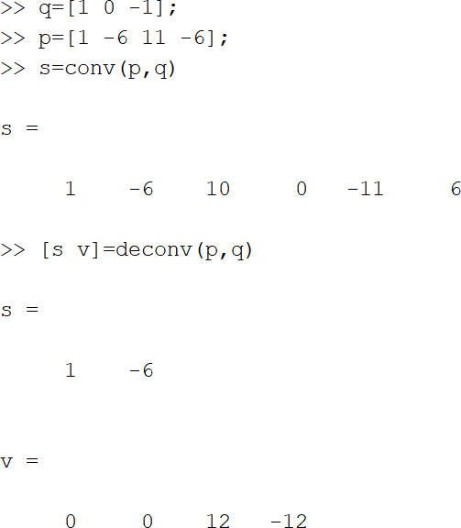
>> polyval(p,3)
ans =
-3.5527e-15

Slide 7
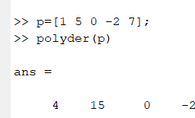
Derivative of polynomial
To find the derivative of 𝑃
𝑃𝑜𝑙𝑦𝑑𝑒𝑟(𝑝) = 𝑝′ return to the derivative of P Ex:- 𝑝(𝑥) = 𝑥⁴ + 5𝑥³ − 2𝑥 + 7
𝑝 = [1 5 0 − 2 7]
𝑑 = 𝑝′ = 𝑝𝑜𝑙𝑦𝑑𝑒𝑟(𝑝)
ii) To find the derivative of product of two polys, 𝑝(𝑥), 𝑞(𝑥)
𝐶 = 𝑝𝑜𝑙𝑦𝑑𝑒𝑟(𝑝, 𝑞); (𝑝. 𝑞)’
𝑑 = 𝑝𝑜𝑙𝑦𝑑𝑒𝑟(𝑐𝑜𝑚𝑝𝑜𝑠𝑒(𝑝, 𝑞)); (𝑝 ∘ 𝑞)’
𝑃𝑙𝑜𝑦𝑖𝑛𝑡(𝑝) Integral of polynomial
𝑤 = 𝑝𝑜𝑙𝑦𝑑𝑒𝑟(𝑝𝑜𝑙𝑦𝑑𝑒𝑟(𝑝)); 𝑝′’
Example:- 𝑝(𝑥) = 𝑥³ + 5𝑥 − 3, 𝑞(𝑥) = 𝑥² + 6𝑥 + 9

Slide 8
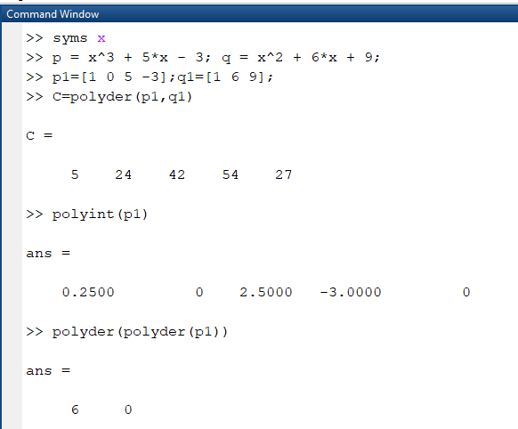

Slide 9
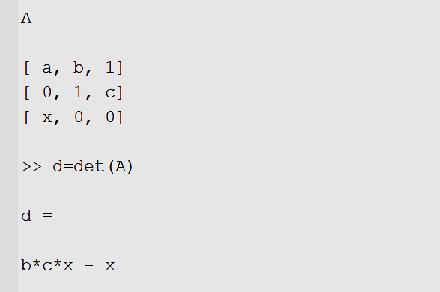
4) Symbolic Calculation
Creating symbolic Expression
Variable 𝑥, 𝑦, 𝑧, 𝑎, 𝑏, 𝑐, … can be declared as symbolic variables with command
5) Differentiation in Matlab
First creat a symbolic expression the command 𝑑𝑖𝑓𝑓(𝑓) the differentation of f with respect to 𝑥 or 𝑑𝑖𝑓𝑓(𝑓, 𝑥)
Example:- find the Differentiation of function 𝑓(𝑥) = 7𝑥⁴ − 5𝑥³ + 2𝑥² − 10𝑥 + 11

Slide 10
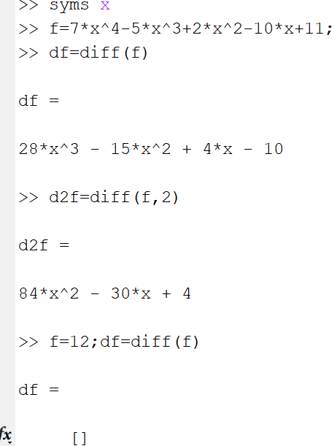
6) Partial derivative
Example :- 𝑓(𝑥) = 𝑥²𝑦 + 3𝑦² + 𝑥
𝜕𝑓
1- = 𝑓_{𝑥}
𝜕𝑥
2- = 𝑓_{𝑥𝑥}
𝜕𝑥²
3- = 𝑓_{𝑦}
𝜕𝑦
4- = 𝑓_{𝑦𝑦}
𝜕𝑦²
5- = 𝑓_{𝑥𝑦}
𝜕𝑥 𝜕𝑦
𝜕²𝑓
𝜕𝑓
𝜕²𝑓
𝜕 𝜕𝑓
𝜕 𝜕𝑓
6- = 𝑓_{𝑦𝑥}
𝜕𝑦 𝜕𝑥

Slide 11
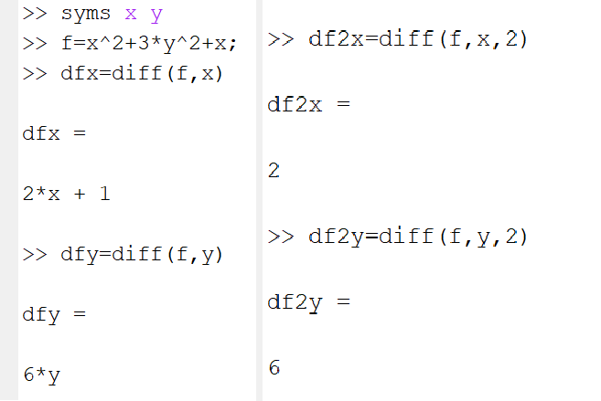
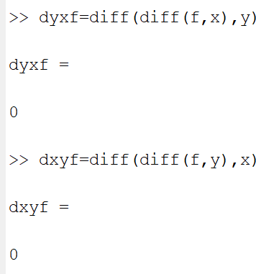
8- limits
Limit of an expression:-
1) limit (𝑓, 𝑥, 𝑎) take the limit of the symbolic expression 𝑓 as 𝑥 → 𝑎 ie lim 𝑓(𝑥)
𝑥→0
2) 𝑙𝑖𝑚𝑖𝑡(𝑓) uses 𝑎 = 0 ie lim 𝑓(𝑥)
𝑥→0
3) 𝑙𝑖𝑚𝑖𝑡(𝑓, 𝑥, 𝑎, ’𝑙𝑒𝑓𝑡’) ie lim 𝑓(𝑥)
𝑥→𝑎−
𝑙𝑖𝑚𝑖𝑡(𝑓, 𝑥, 𝑎, ’𝑟𝑖𝑔ℎ𝑡’) ie lim 𝑓(𝑥)
𝑥→𝑎+

Slide 12
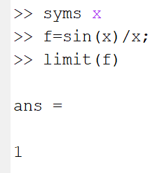
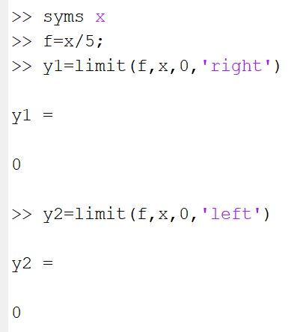
Example 1:-
_{lim} 𝑠𝑖𝑛(𝑥) ₌ ₁
𝑥→0
𝑥
Example 2:-
lim ⁵
𝑥→0 𝑥
9- integration
The symbolic of integration is 𝑖𝑛𝑡(𝑓)
We have two type of integration 1- indefinite integral 2- definite intgral 1- indefinite integral
i- 𝑖𝑛𝑡(𝑓)
ii-𝑖𝑛𝑡(𝑓, 𝑥)
2- definite intgral

Slide 13
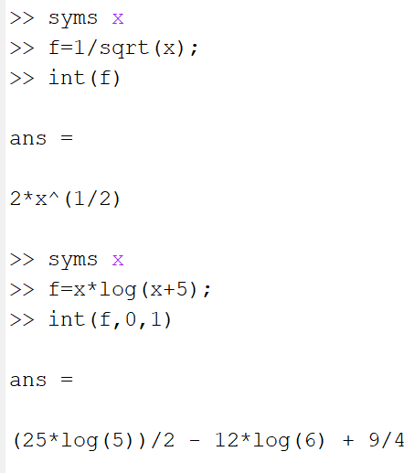
i- 𝑖𝑛𝑡(𝑓, 𝑎, 𝑏)
ii-𝑖𝑛𝑡(𝑓, 𝑥, 𝑎, 𝑏)
𝑑𝑥 1
example 1:- ∫ 2- ∫ 𝑥 log(𝑥 + 5)𝑑𝑥
√𝑥
0
10- Pretty
Pretty(f) : print the symbolic expression f in type set method
2
Example :- 𝑓(𝑥) = ^{log(𝑥 +7)}
𝑥⁴−5𝑥²+1

Slide 14
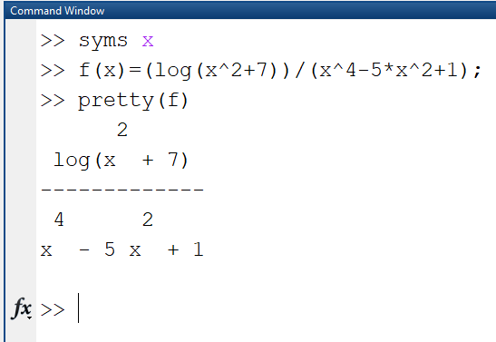
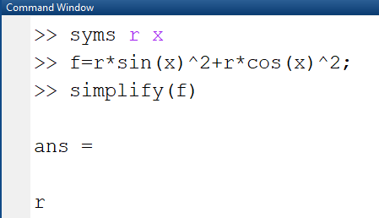
11-simplify
Example 1:- 𝑟𝑠𝑖𝑛²𝜃 + 𝑟𝑐𝑜𝑠²𝜃 = 𝑟
Example 2:-
Jacobian matrix of 𝑓 is

Slide 15
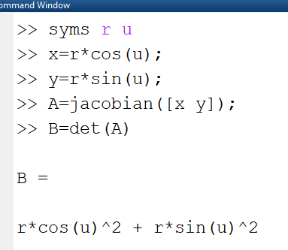
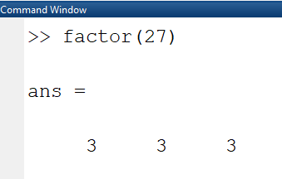
12- factor
𝑓𝑎𝑐𝑡𝑜𝑟(𝑛) return a vector containing the prime factor of 𝑛
Example 1:- factor of (27)
Example 2:- factor of (x^2-1)

Slide 16
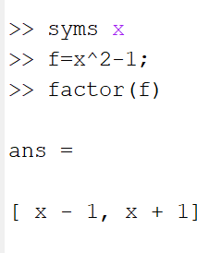
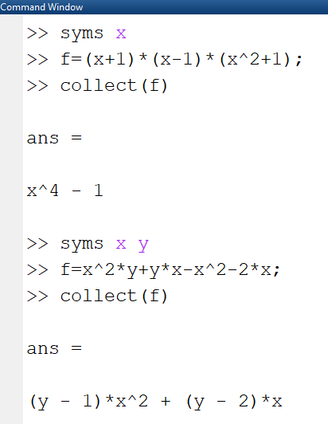
12- Collect
𝐶𝑜𝑙𝑙𝑒𝑐𝑡(𝑓, 𝑥) regard each element of the symbolic 𝑓 as a polynomial in 𝑥 and rewrite 𝑓 in terms of the pawer of 𝑥
Example:- 1 − 𝑓(𝑥) = (𝑥 + 1)(𝑥 − 1)(𝑥² + 1) 2 − 𝑓(𝑥) = 𝑥²𝑦 + 𝑦𝑥 − 𝑥² − 2𝑥

Slide 17
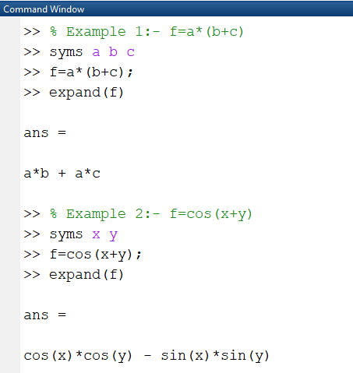
13- Expand
𝐸𝑥𝑝𝑎𝑛𝑑 (𝑓): −distributes product over summation
14- subsitution
𝑆𝑢𝑏𝑠(𝑓, 𝑣𝑎𝑟𝑖𝑎𝑏𝑙𝑒, 𝑝𝑜𝑖𝑛𝑡)
𝑆𝑢𝑏𝑠(𝑓, [𝑥, 𝑦, 𝑧], [𝑥₀, 𝑦₀, 𝑧₀])

Slide 18
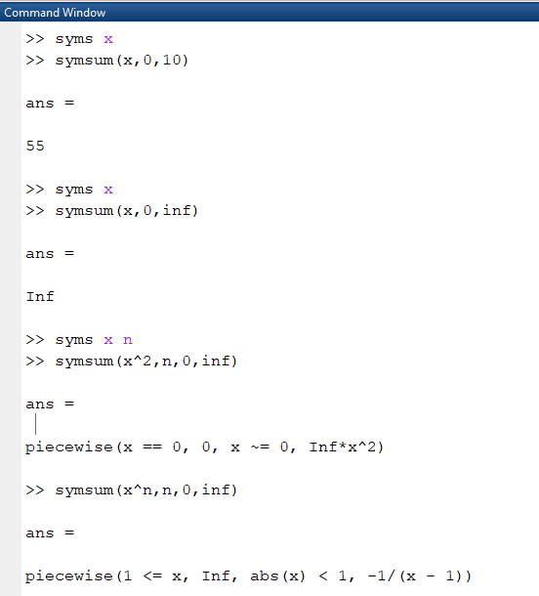
15- Sum ∑
𝑆𝑦𝑚𝑠𝑢𝑚(𝑠, 𝑥) is define summation of 𝑆 with respect to the symbolic variable determined by 𝑠𝑦𝑚𝑠
𝑆𝑦𝑚𝑠𝑢𝑚(𝑠, 𝑥) → ∑∞ 𝑥
𝑥=0
𝑆𝑦𝑚𝑠𝑢𝑚(𝑠, 𝑎, 𝑏) → ∑^{𝑏} 𝑥
𝑎

Slide 19
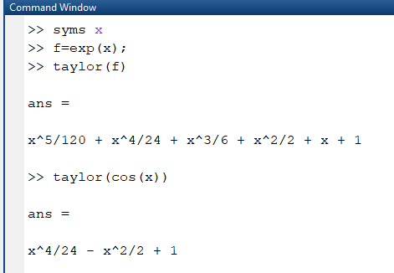
16- tayler Expression
1 − 𝑇𝑎𝑦𝑙𝑜𝑟(𝑓) find the fifth order maclorain polu appr. Of 𝑓
Example:- 𝑓(𝑥) = 𝑒^{𝑥}
17- Compose
𝑐𝑜𝑚𝑝𝑜𝑠𝑒 (𝑓, 𝑔) return 𝑔 ∘ 𝑓(𝑥) 𝑜𝑟 𝑔(𝑓(𝑥)) where 𝑓 = 𝑓(𝑥) and 𝑔 = 𝑔(𝑥) , then 𝑥 is symbolic variable of 𝑓 as define by syms and y is symbolic variable of f as define by syms.

Slide 20
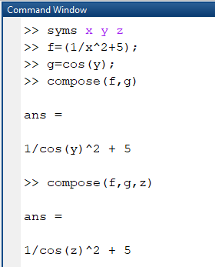
Home Work Section
H.W 1: Find the following results by using commands windows.
𝑓(𝑥) = 𝑥⁴ + 4𝑥³ + 5𝑥 + 3 , 𝑔(𝑥) = 𝑥³ + 6𝑥² + 3𝑥 + 1 ℎ(𝑥, 𝑦) = 𝑥⁷𝑦³ + 2𝑦² + 𝑒^{𝑦𝑥}
1- Derivative of product of two polys 𝑓 & 𝑔. 2- The roots of product of two polys 𝑓 & 𝑔.
3- Differentiation of ℎ with respect to y by using symbolic calculation.
4- ∫⁵ 𝑒^{𝑥}𝑑𝑥
2
5- If 𝑓(𝑥) = 𝑥⁴ + 4𝑥³ + 5𝑥 + 3 then find 𝑓 at point 𝑥 = 4.
H.W 2:- Find the following results by using commands windows.
1- lim 𝑥³.
𝑥→−2
4 6 3
Eigen value & Eigen vector of the matrix H=[ 0 −8 9]
−5 7 1
If 𝑓 = 𝑥³+𝑥² + 𝑥 find 𝑓(3) by using direct definition of the function
Find the factor of 95.
H.W 3:- Find the following results by using commands windows.
𝑓 = (𝑒^{2𝑥} cos(𝑦²) 𝑧²), 𝑤 = (5𝑥² − 1) , ℎ(𝑥) = 𝑥⁴ + 4𝑥³ + 5𝑥 + 3

Slide 21
1- 𝐸 = ∑¹¹
∑5
(𝑓) ,find the value of 𝐸 at 𝑥 = 2 by using symbolic of
𝑦=7 𝑧=0
summation in one statement .
5 2 ₂
∫₄ ∫₁ 𝑥 cos(𝑦) 𝑑𝑥 𝑑𝑦 .
2-
3- Differentiation of 𝑓 with respect to y by using symbolic calculation. 4- Find the roots of product of two polys ℎ, 𝑤.
5- Find the value of ℎ at point 𝑥 = 4.
H.W 4: Find the following results by using commands windows.
3 2
_{𝑓(𝑥) =} 𝑥 +3𝑥 +3𝑥
, 𝑔(𝑥, 𝑦, 𝑧) = (𝑥𝑦𝑧)³ + 𝑒^{𝑥𝑧} sin(𝑥𝑦)
_{𝑥𝑒}2𝑥
ℎ = 1555
Pretty of 𝑓 & 𝑔.
Differentiation of 𝑔 with respect to y by using symbolic calculation. 3- Simplify 𝑓
4- Find 𝑔 at point 𝑥 = 4 & 𝑦 = 2, 𝑧 = 5. 6- Factor of ℎ.

