Slide 1
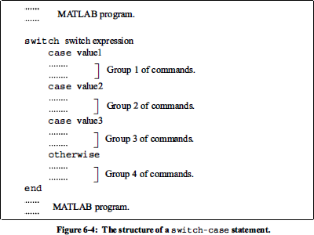
The Switch-Case Statement
Example 1:- Write a program to find the value of 𝑦 such that
𝑥² − 6
7𝑥³
𝑥² − 5𝑥 − 1
9𝑥 − 4
𝑖𝑓 𝑥 = −2
𝑖𝑓 𝑥 = 2
𝑖𝑓 𝑥 = 8
∀𝑥/{−2,2.8} 𝑜𝑟 𝑜𝑡ℎ𝑒𝑟𝑤𝑖𝑠𝑒
𝑦 =
𝗅
x=input('x='); switch x
case -2
y=x^2-6 case 2
y=7*x^3
case 8
y=x^2+5*x-1 otherwise
y=9*x-4
end

Slide 2
Example 2:- Write a program to find the value of 𝑦 such that
𝑥⁴ − 𝑥³ + 7
𝑖𝑓 𝑥 = 2
𝑖𝑓 𝑥 = 5
𝑖𝑓 𝑥 = −7
𝑜𝑡ℎ𝑒𝑟𝑤𝑖𝑠𝑒
𝑦 = {
cos 𝑥
𝑠𝑖𝑛𝑥
𝑡𝑎𝑛𝑥
x=input('x='); switch x
case 2
y=x^4-3*x^3+7; disp(y)
case 5
y=cos(x); disp(y)
case -7
y=sin(x)-1; disp(y)
otherwise
y=tan(x); disp(y)
end

Slide 3
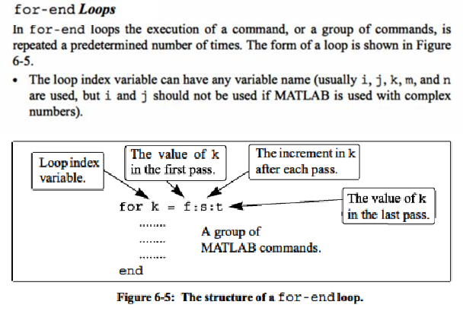
LOOPS
A loop is another method to alter the flow of a computer program. In a loop, the execution of a command, or a group of commands, is repeated several times consecutively. Each round of execution is called a pass. In each pass at least one variable, but usually more than one, or even all the variables that are defined within the loop
MATLAB has two kinds of loops. 1- for-end loops, 2- while-end loops

Slide 4
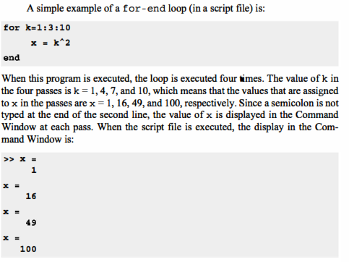
Example 1:- Write a program to find
%s:sum of number , s=0;
for i=1:50
s=s+i; end disp(s);
∑50
𝑖
𝑖=1

Slide 5
Example 2:- Write a program to find
1- The summation of even number from 1 to 20 2- The average of them.
%se:sum of even number ,ne: number of even numbers
s=0;ne=0; for i=2:2:20
s=s+i; ne=ne+1;
end avr=s/ne; disp(s); disp(avr);
(H.W)
Q: - Write a program to find
The summation of odd number from 1 to 20
The average of them.
Example 3:- Write a program to find the summation of even number and the average of odd numbers from 1 to 300 ?
se=0;so=0;ne=0;no=0; for i=1:300
if rem(i,2)==0 se=se+i;
else so=so+i; no=no+1; end
end avo=s/no; disp(se);

Slide 6
disp(avo);
Example 4:- Write a program to input (n) number then find 1- The summation
2- The factorial
Of the prime numbers among them ?
n=input('n='); sp=0;
for i=1:n
if isprime(i)
sp=sp+i; f=factorial(i);
disp(' disp([i,f]) end
n f ');
end
disp('sum of prime numbers') disp(sp)
Example 5:- Use a for-end loop in script file to calculate the sum of the first
𝑛 terms of series
∑𝒏
(−𝟏)^{𝒌}𝒌
𝒌=𝟏 _{𝟐}𝒌
n=input('n='); s=0;
for k=1:n
s=s+(-1)^k*k/2^k;
end
disp('the sum of the series is'); disp(s);

Slide 7
Example 6:- Use a for-end loop in script file to calculate the sum of the first 𝑛
terms of series
∑∞
_{(−𝟏)}𝒌_{𝒙}𝟐𝒌+𝟏
, Execute the script file for 𝑛 = 4, 𝑥 = 2.
𝒌=𝟎
(𝟐𝒌+𝟏)!
%Where 𝑛 is number of terms in the series.
n=input('n=');
x=input('x='); s=0;
for k=1:n
s=s+(-1)^k*x^(2*k+1)/factorial(2*k+1);
end
disp('the sum of the series is'); disp(s);
Home Work
Write program to find
3 5 𝑛
1) 𝑠𝑖𝑛𝑥 = 𝑥 − ^{𝑥} + ^{𝑥} − ⋯ + ^{𝑥}
3! 5! 𝑛!
(𝑥+𝑦) (𝑥+𝑦)³ (𝑥+𝑦)⁵ (𝑥+𝑦)²⁷
2) 𝑧 = + + + ⋯ +
3! 5! 7! 29!
2 4 n
3) cosx = 1 − ^{x} + ^{x} − ⋯ + ^{x}
2! 4! n!
4- A vector is given by
V = [5, 17, −3, 8, 0, −7, 12, 15, 20, −6, 6, 4, −7, 16]. Write
a program as a script file that doubles the elements that are positive and are
divisible by 3 or 5, and, raises to the power of 3 the elements that are negative
but greater than −5.

Slide 8
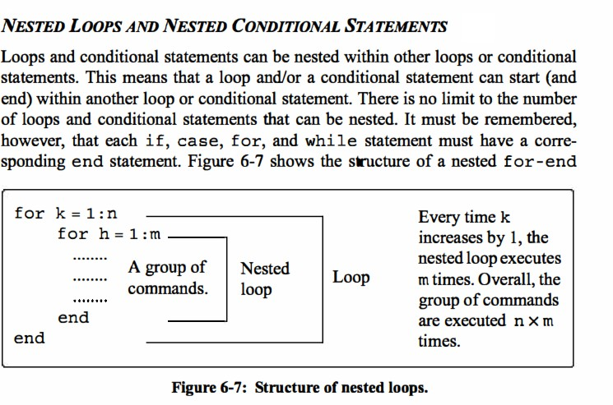
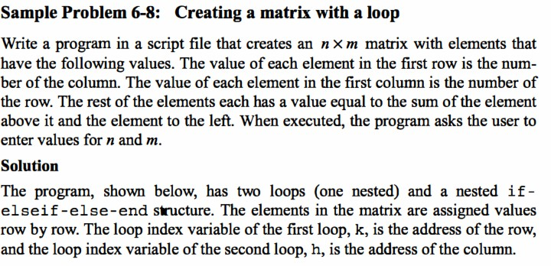

Slide 9
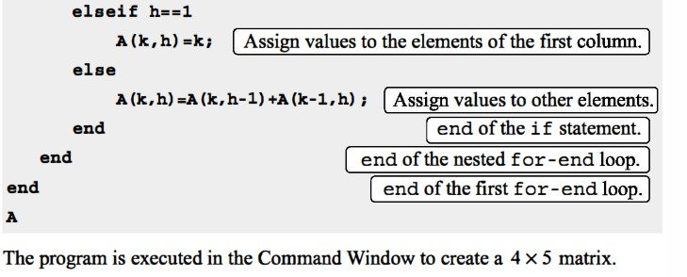
Example 2:- Write a program in script file to construct a matrix 𝐴 which the value of each element in the matrix 𝐴 equal to summation of the number of column and row which contain this element
n=input('n=');
m=input('m='); for i=1:n
for j=1:m
A(i,j)=i+j; end
end A
Quiz
Write a program in script file to construct
a matrix A as following
𝟗 | 𝟖 | 𝟖
𝑨 = [𝟏𝟏 | 𝟗 | 𝟖]
𝟏𝟏 | 𝟏𝟏 | 𝟗

Slide 10
hidden solution
Home Work

Slide 11
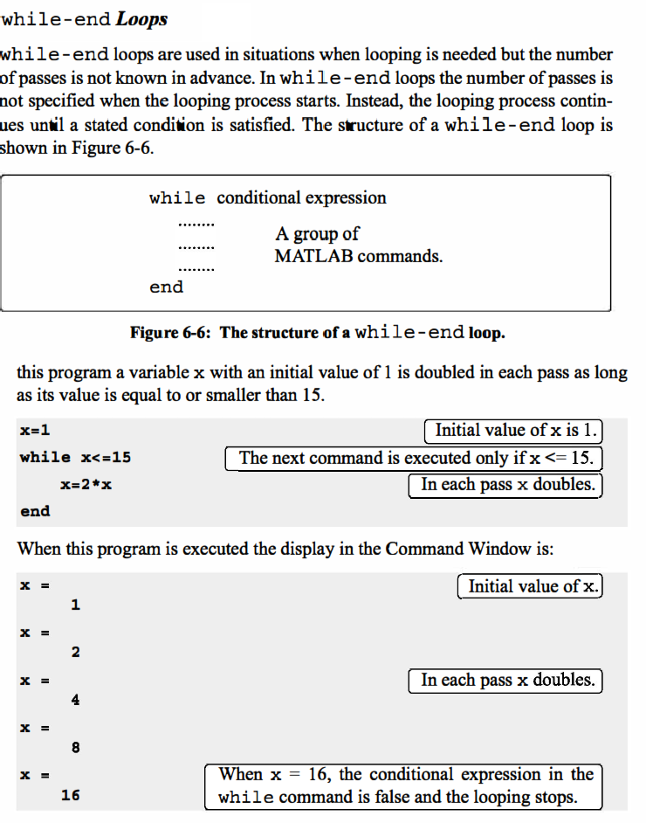
Example 1: Write program to find the summation of number from 1 𝑡𝑜 400
s=0;

Slide 12
i=1;
while i<=400
s=s+i; end disp(s);
Example 2: Write program to find the summation ∑^{𝑛} 𝑖 which not more than 300
𝑖=1
s=0; i=1;
while s<=300
s=s+i; i=i+1;
end
disp(s-i);
Example 3: Write program to find the summation of even numbers between 50 and 250 by using 1- for-end 2- while-end
1-
se=0; i=1;
for i=50:2:250 se=se+i;
end disp(se)
2-
se=0; i=50;
while i<=250
if rem(i,2)==0 se=se+i;
end end disp(se)

Slide 13
Quiz
Q/ | Write program | to input matrix A to | know
 | that A is | symmetric or not?
Home Work
Q/ Write program to find the summation where
S = √1⁵ + √3⁵ + √5⁵ + ⋯ + √n⁵
Find the largest n st. S ≤ 90
Q/ Write a MATLAB program using two for loops to produce the following pattern of asterisks
*
**
***
****
*****
******

Slide 14
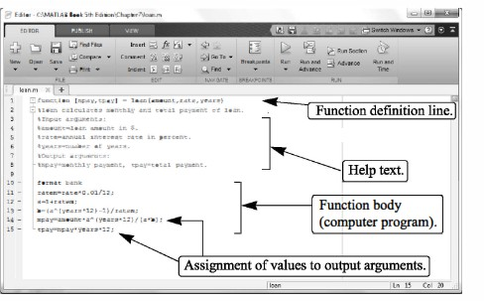
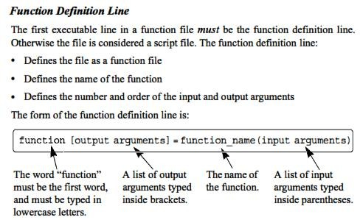
*******
********
Function m-file
Functions are m-file that can accept input argument.

Slide 15
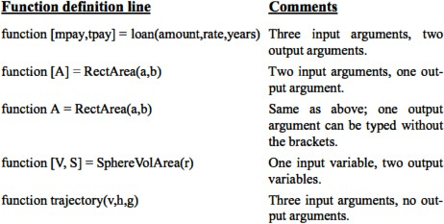
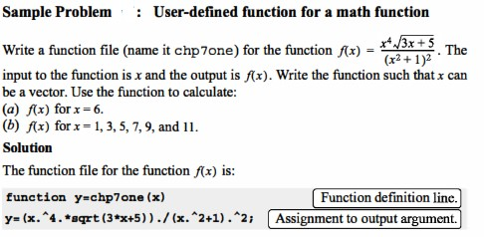

Slide 16
Example 1: Write program to find 𝑓(𝑥) = 𝑥⁷ − 3𝑥⁴ + 2𝑥 − 11 at 𝑥 = 5, using function.
1- function y=f(x)
2- y=x^7-3*x^4+2*x-11;
3- return
% save file as (f)
>> f(5)
ans =
76249
Example 2: Write program to find 𝑦₁ = 2 ∗ 𝑥₁ − 3 ∗ 𝑥₂ , 𝑦₂ = 5 ∗ 𝑥₁ + 3 ∗ 𝑥₂
at 𝑥₁ = 5, 𝑥₂ = 6 by using one m-function.
1-function [y1,y2]=f(x1,x2) 2-y1=2*x1-3*x2;
3-y2=5*x1+3*x2; 4-return
% save file as (f)
1-x1=input('x1=');
2-x2=input('x2=');

Slide 17
3-[y1,y2]=f(x1,x2);
4-disp([y1,y2]);
Save file as any name you wont
>> Untitled2 x1=5
x2=6
-8 43
Example 3: Write program to input (3) degree of a student to find the average (use function) then induce if the student pass or not ?
function y=avr(a,b,c) y=(a+b+c)/3;
return
% save file as (avr) a1=input('a=');
a2=input('b=');
a3=input('c=');
z=avr(a1,a2,a3); disp(z);
if z>=50
disp('the student is pass') else
disp('the student is faild')
end

Slide 18
>> Untitled2 a=50
b=50 c=49
49.6667
the student is faild
Example 4: Write program to input (𝑛) real number (𝑥) and find 𝑦 by using function? Where 𝑦 = 9𝑥³ − 5𝑥 + 2
function yy=f(xx) yy=9*(xx)^3-5*(xx)+2; return
% save file as (f) n=input('n=');
for i=1:n x=input('x='); y=f(x);
disp(' n
x
y')
disp([i x y]) end
Example 5: By using function write program to find value of 𝑦? Where 𝑦 =
{
𝑠𝑖𝑛𝑥+1
𝑥 ≠ 3, −3
𝑥 = 3, −3
𝑥
𝑒^{𝑥} − 2𝑥
function yy=f(xx) switch xx
case {3,-3}

Slide 19
yy=exp(xx)-2*(xx); otherwise yy=(sin(xx)+1)/(xx);
end
return
% save file as (f)
x=input('x='); y=f(x);
disp(y);
Quiz
Q: Write program to find n! by sing function 1-With using factorial function?
2-Without using factorial function?
Home Work
Q/ Write program to find value of y by sing function where
𝑦 = √6𝜋 ∑^{𝑛}
1
In case 𝑖 is even number, use
𝑖=1 _{𝑖}2!
𝑛 = 20
Q/ Write program to input the value of
𝐴, 𝐵, 𝐶 to find the solution of equation in second degree 𝐴𝑥² + 𝐵𝑥 + 𝐶 = 0 in real number by using if-elseif-else-end statement?

Slide 20
Solution is hidden

