Slide 1
Lecture 1 Photosynthesis
September 20 , 2023
Mohammed Qader Khursheed
Biology Dept., College of Education
Salahaddin University-Erbil
mohammed.khursheed@su.edu.krd

Slide 2
Photosynthesis
Processes can be:
Energy consuming (endergonic) or
Energy releasing (exergonic) and
Catabolic (breakdown) or
Anabolic (synthesis)
Photosynthesis is an anabolic, endergonic, carbon dioxide (CO₂) requiring process that uses light energy (photons) and water (H₂O) to produce organic macromolecules (glucose).
6CO₂ + 12H₂O → C₆H₁₂O₆ + 6O₂ ₊ 6H₂O

Slide 3
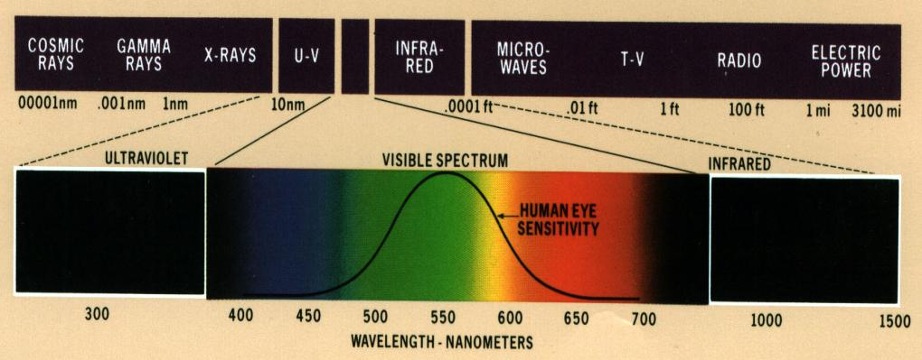
What is light
- Photon: a light particle.
- Wavelength: Length of a complete wave of light.
- Frequency: The number of waves per unit length.
- Sunlight is an electromagnetic radiation coming from the sun.
It has a wide spectrum from cosmic rays to radio waves.
Notes:
3
We talk about light and its importance to the greenhouse crop production. Let us look at light and its nature. Light is an electromagnetic radiation coming from the sun. The sun emits a very large spectrum radiation seen here on this graph. The rays are classified according to their length, called a wavelength. Cosmic rays have very short wavelength, 0.0001 nanometers, nanometer being one bilionth of a meter. Gamma rays, X-rays and UV-rays have progressively longer wavelengths. The shorter the wavelength, the more energy the rays carry. This is why gamma, X-and UV-rays are so destructive to the living beings. The Earth atmosphere stops these short wavelengths from entering our immediate environment.
Then we get to the visible light range. The term ‘light’ is actually applied to only this narrow range, 400 to 700 nanometers. As you can see, our eyes are only sensitive to this range. It starts with the blue, green, yellow, orange, and ends with red, the colors of a rainbow.
After the visible light, we have the infrared range, followed by the progressively longer microwaves, TV, radio , and electric power waves, which are really long. The infrared rays are associated with warmth.

Slide 4
Visible Light Is only a Small Portion of the Electromagnetic Spectrum

Slide 5
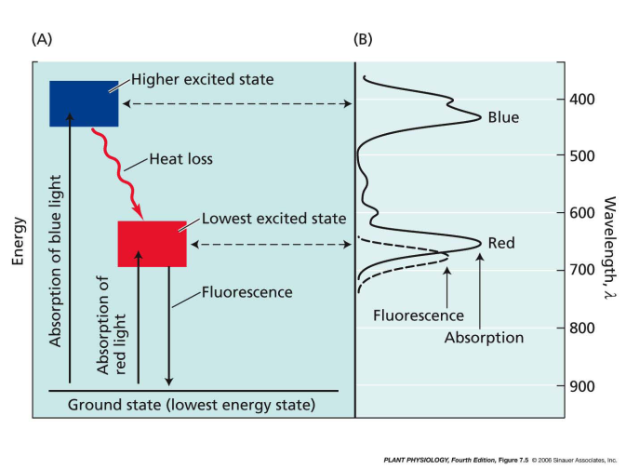
Light absorption and emission by chlorophyll
Stable for only about several nanoseconds (10⁻⁹s), any process that
captures its energy must be extremely rapid.

Slide 6
Light absorption and emission by chlorophyll
In the lowest excited state, the excited chlorophyll has four alternative pathway to dispose energy:
Fluorescence
Heat
Energy transfer
Photochemistry (Photosynthesis)

Slide 7
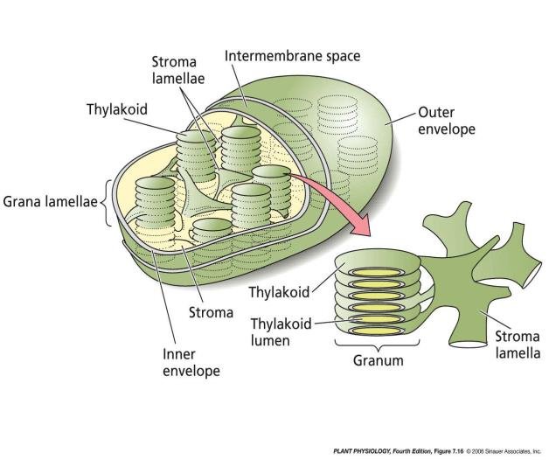
Chloroplasts

Slide 8
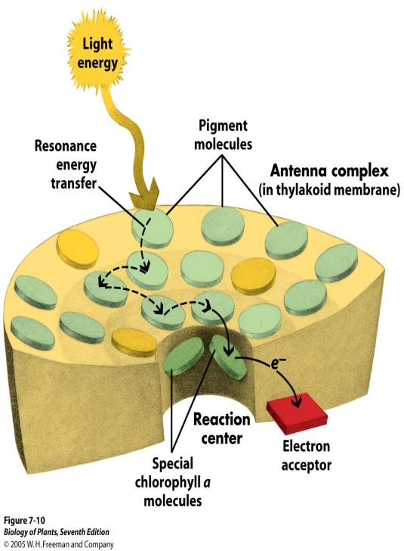
A pigment is any substance that absorbs light, the color of the pigment comes from the wavelengths of light reflected. Chlorophyll is the green pigment common to all photosynthetic cells, absorbs all wavelengths of visible light except green, which it reflects to be detected by our eyes. All photosynthetic organisms have chlorophyll a. accessory pigments absorb energy that chlorophyll a does not absorb:
chlorophyll b, xanthophylls and carotenoids (Beta-Carotene).

Slide 9
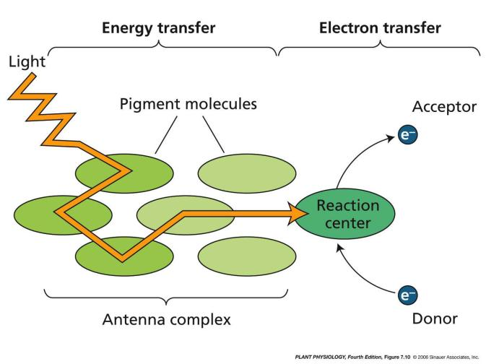
Basic concept of energy transfer during photosynthesis

Slide 10
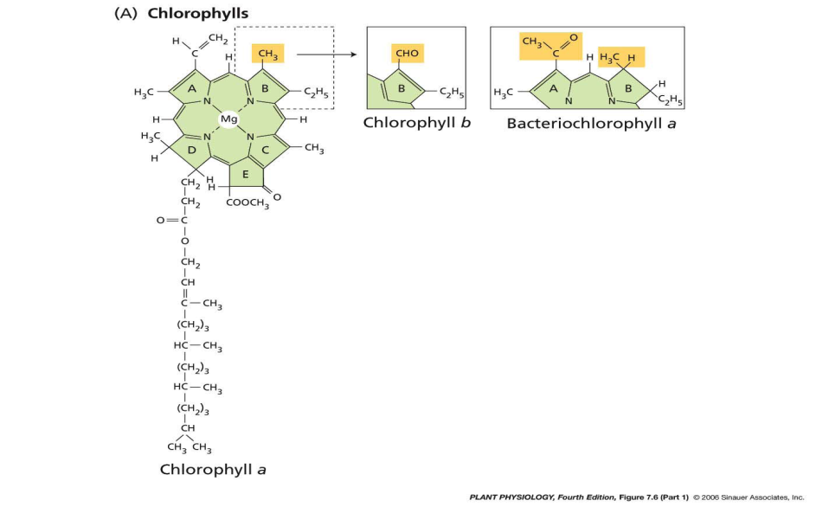
Molecular structure of some photosynthetic pigments

Slide 11
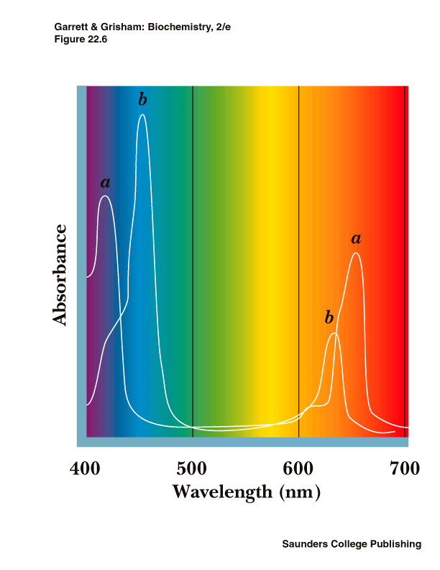
Absorption spectrum of Chlorophyll a and b

Slide 12
Photosynthesis Stages
2-Stage Process
Light Dependent Reactions
Require Light to Occur
Involves the Actual Harvesting of Light Energy
Occur in\on the Grana
Dark or Light Independent Reactions, Chemical Reactions
Do not Need Light to Occur
Involve the Creation of the Carbohydrates
Occur in the Stroma
Products of the Light Reaction Are Used to Form C-C Covalent Bonds of Carbohydrates

Slide 13
Light Reactions
When Light Strikes Magnesium (Mg) Atom in Center of Chlorophyll Molecule, the Light Energy Excites a Mg Electron and It Leaves Orbit from the Mg Atom.
The Electron Can Be Converted to Useful Chemical Energy. The Excited Electron (plus Additional Light Energy) eventually Provides Energy so a Phosphate Group Can Be Added to a Compound Called Adenosine Diphosphate (ADP), Yielding Adenosine Triphosphate (ATP)
ATP Is an Important Stored Energy Molecule

Slide 14
Photolysis (Hill Reaction)
The 2 Water Molecules Are Split into Hydrogen and Oxygen
The Hydrogen Is Attached to a Molecule Called Nicotinamide Adenine Dinucleotide Phosphate (NADP)
Produces NADPH₂
The Oxygen Is Given off as Oxygen Gas
2 H₂0 + NADP + light → NADPH₂ + O₂

Slide 15
During the light reaction, there are two possible routes for electron flow.
A.Cyclic Electron Flow
Occurs in the thylakoid membrane. Uses Photosystem I only. P700 reaction center- chlorophyll a.Uses Electron Transport Chain (ETC). Generates ATP only.

Slide 16
B.Noncyclic Electron Flow
Occurs in the thylakoid membrane. Uses PS II and PS I. P680 center (PSII) - chlorophyll a. P700 center (PS I) - chlorophyll a. Uses Electron Transport Chain (ETC). Generates O2, ATP and NADPH.

Slide 17
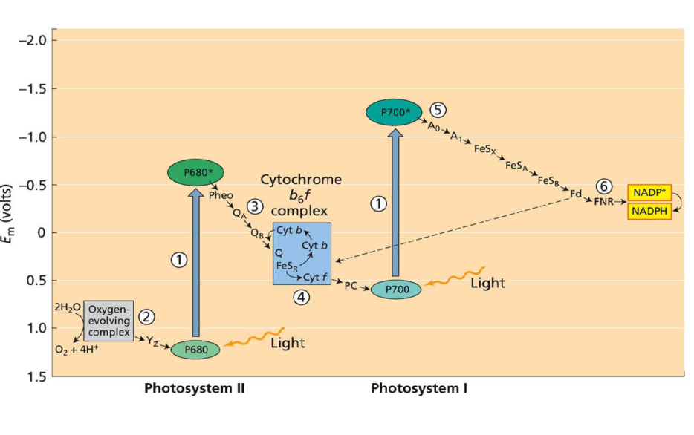
Z scheme for photosynthetic organisms

Slide 18
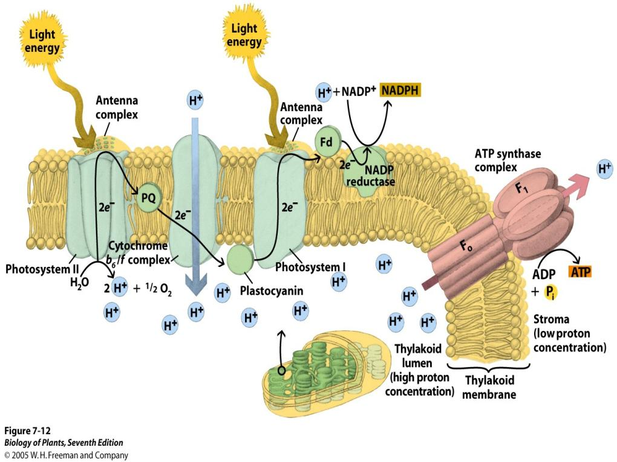

Slide 19
Photophosphorylation
Light-Driven ATP Synthesis: Electron transfer through the proteins of the Z scheme drives the generation of a proton gradient across the thylakoid membrane.
Protons pumped into the lumen of the thylakoids flow back out, driving the synthesis of ATP
ATP Synthase complex is composed CF0 and CF1, CF0 is a channel for H+ CF1 has several protein subunits for the reaction:
ADP + Pi + H+ → ATP+ H2O
ATP is the energy molecule of life.

Slide 20
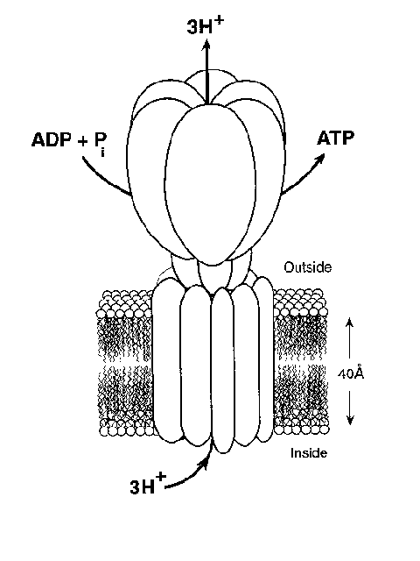
ATP Synthase complex is composed CF0 and CF1
CF0 is a channel for H+. CF1 has several protein subunits for the reaction ADP + Pi + H+ → ATP+ H2O
ATP is the energy molecule of life.

Slide 21
Thank You

