Slide 1
Lecture 4 Translocation in the Phloem
November 21 , 2023
Mohammed Qader Khursheed
Biology Dept., College of Education
Salahaddin University-Erbil
mohammed.khursheed@su.edu.krd

Slide 2
Translocation studies
Three lines of evidence to show that translocation takes place in the phloem
Aphid studies
Ringing experiment
Use of radioactive isotopes
These studies also show that transport in the phloem is bi-directional
Rate of phloem transport: Aphid experiments once again provide an answer...translocation rates average about 30 cm hour⁻¹ or even faster.

Slide 3
Materials translocated in phloem sap
Water is the most abundant substance transported in the phloem.
Sucrose The sugar that is most important and abundant in translocation, sucrose is a disaccharide, i.e., made up of two sugar molecules – an additional synthesis reaction is required after photosynthesis, is not a rigid structure, but mobile in itself.

Slide 4
Non-reducing sugars, which are translocated Sucrose, galactose, stachyose, Raffinose and verbascose. Translocated sugar alcohols include mannitol and sorbitol.
Nitrogen is found in amino acids and amides, especially glutamate and aspartate and their respective amides, glutamine and asparagine.
Almost all the endogenous plant hormones, including auxin, gibberellins, cytokinins, and abscisic acid.

Slide 5
. Nucleotide phosphates and proteins have also been found in phloem sap. Proteins found include filamentous Pproteins (which are involved in the sealing of wounded sieve elements), protein kinases (protein phosphorylation), ubiquitin (protein turnover), chaperones (protein folding), and protease inhibitors (protection of phloem proteins from degradation and defense against phloem-feeding insects).
- Inorganic solutes that move in the phloem include potassium, magnesium, phosphate, and chloride. In contrast, nitrate, calcium, sulfur, and iron are relatively immobile in the phloem.
.

Slide 6
Source to Sink
Metabolites move from source to sink.
SOURCE = area of supply
- exporting organs: mature leaves
- storage organs: seed endosperm
- root of second growing season beet
SINK = areas of metabolism (or storage)
- non-photosynthetic organs and organs that do not produce enough photosynthetic products to support their own growth or storage
- Example: roots, tubers, developing fruits/seeds, immature leaves
Notes:
6

Slide 7
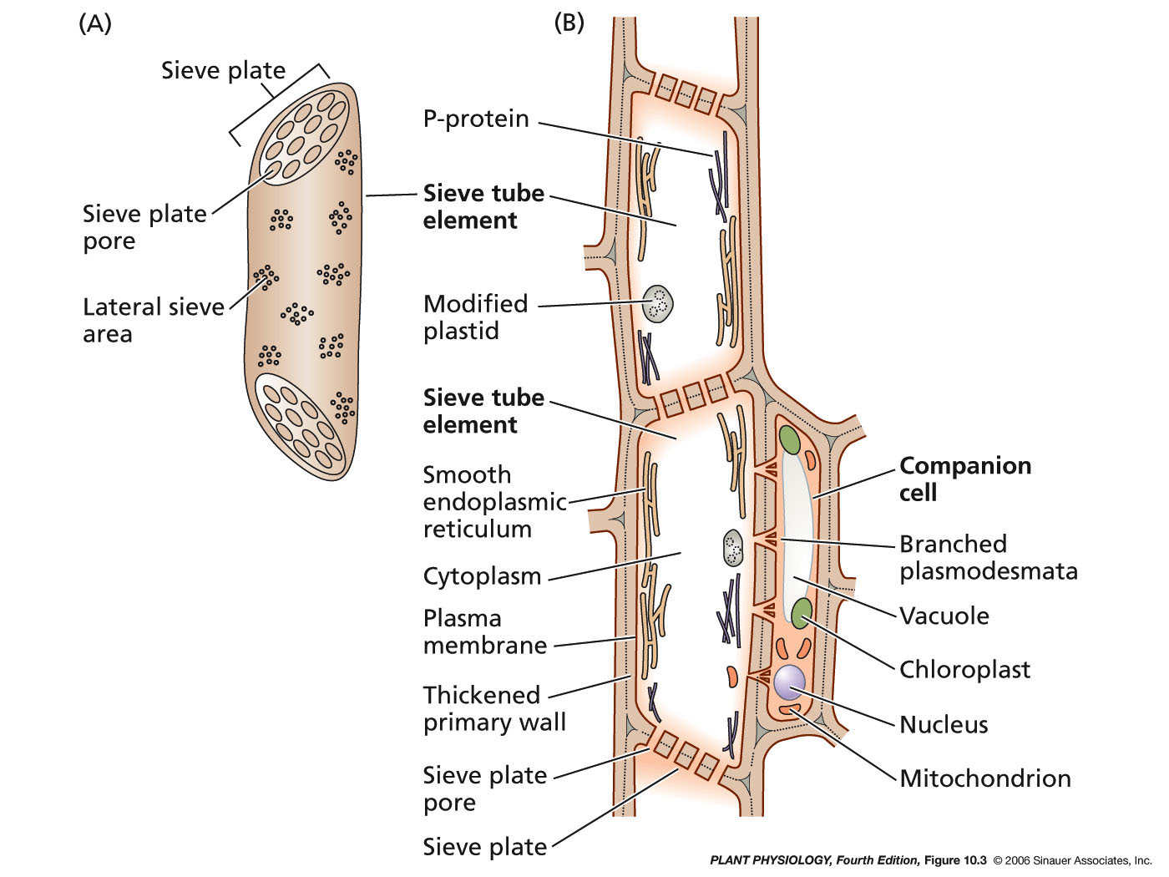
Sieve elements are highly specialized for translocation
Longitudinal section
External view
Notes:
7

Slide 8
Mechanisms of translocation in phloem Mass Flow (pressure flow) Hypothesis
Phloem transport is analogous to the operation of a double osmometer If solute is added to bulb A → osmotic potential decreases → osmotic uptake of water → pressure increases → bulk flow of water and solute to bulb B → pressures increases in bulb → water potential in B greater than in beaker → osmotic flow of water into the beaker → water returns to side A via the connection. This system could be maintained indefinitely if there is a mechanism to remove solute (sucrose) at the end (sink) and a mechanism to add solute (source).

Slide 9
At the source (leaves):
Photosynthesizing cells in leaves make sucrose
⎯→ water potential decreases
⎯→ water enters cells from xylem creating high pressure potential
At the sink (root):
sucrose either respired or stored as starch
⎯→ water potential increases
⎯→ low pressure potential

Slide 10
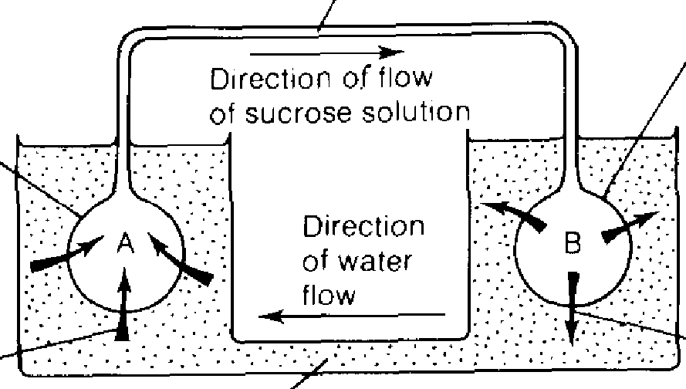
A gradient of pressure potential exists between the source & the sink with phloem linking them and as result liquid flows from the leaves to other tissues along the sieve tube elements.

Slide 11
Phloem loading
is the transfer of material into the phloem at the source:
1- Allow for apoplastic (from protoplast to wall to protoplast) or symplastic (from protoplasts to protoplast via plasmodesmata) transport. In some species, sucrose transport is symplastic - from mesophyll protoplast to cc-se protoplast via plasmodesmata. In others, sucrose loading into the cc-se complex involves an apoplastic step (mesophyll protoplasts to apoplast to cc-se protoplast.

Slide 12
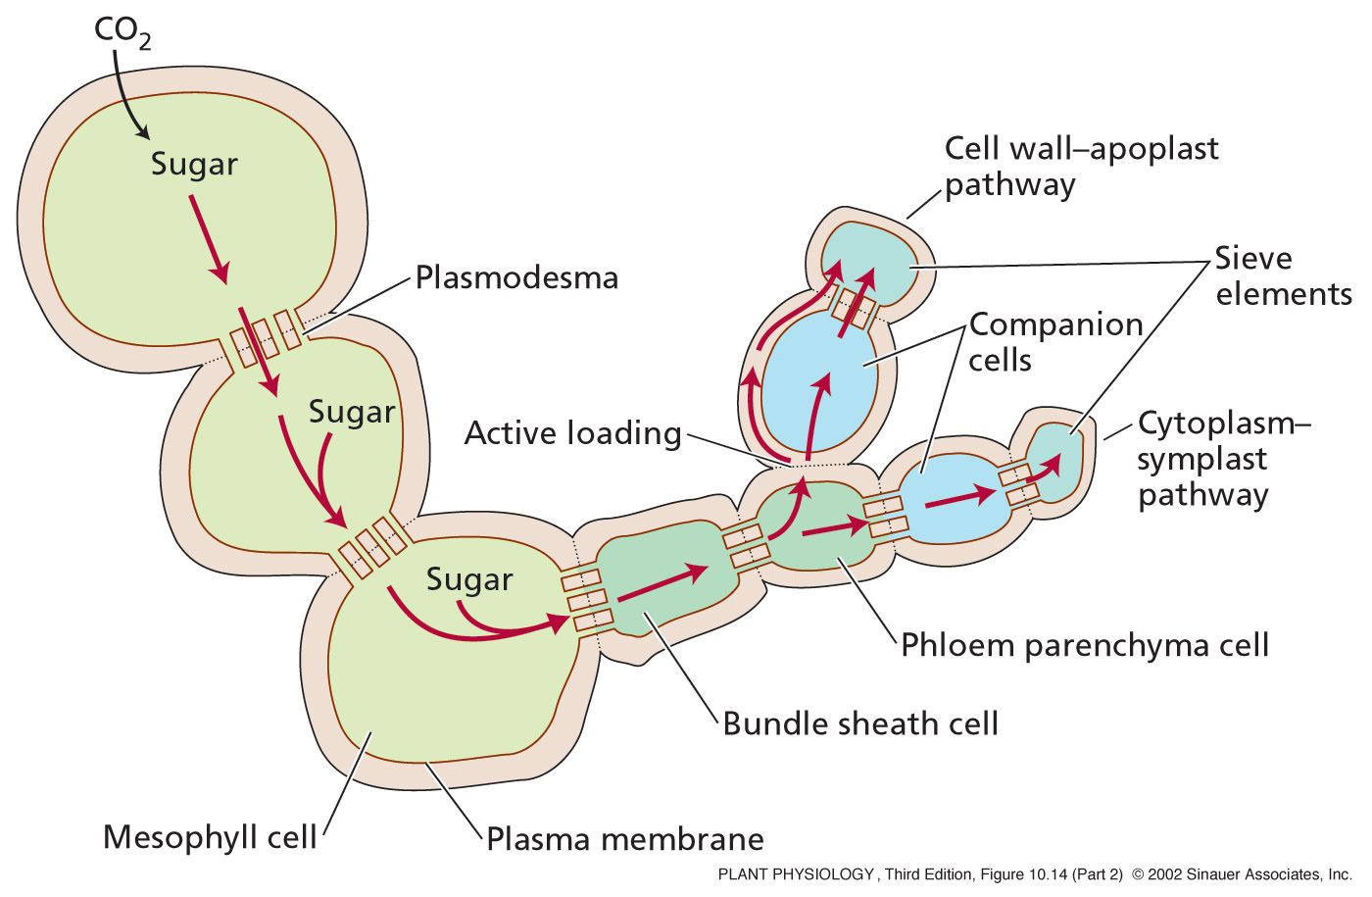
Sugars are moved from photosynthetic cells and actively (energy) loaded into companion & sieve cells.
Notes:
12
PP10142.jpg

Slide 13
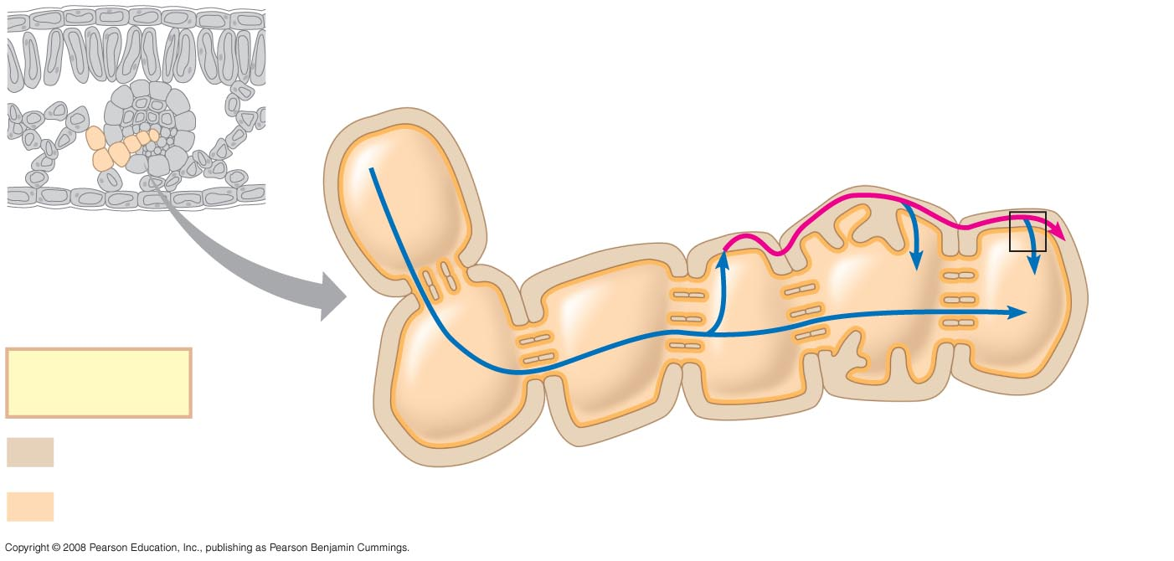
Mesophyll cell
Cell walls (apoplast)
Companion (transfer) cell
Sieve-tube element
Plasma membrane
Plasmodesmata
Key
Apoplast
Bundle- sheath cell
Phloem parenchyma cell
Symplast
Mesophyll cell
Notes:
13
Figure 36.19a Loading of sucrose into phloem

Slide 14
2- The sucrose/proton cotransport system. According to this model, protons are pumped out of the sieve cells into the apoplast by a membrane-bound H+-ATPase → the proton concentration increases in the apoplast → pH decreases → K+ is brought into the sieve cell to balance the charge → the proton gradient provides the driving force for transporting sucrose against a gradient → the sucrose and protons bind to a carrier protein in the membrane and are released in the sieve tube member. Evidence: the pH is high in sieve tubes; if the pH of the apoplast is increased there will be no sucrose uptake; there is a high potassium conc. in sieve tube members.

Slide 15
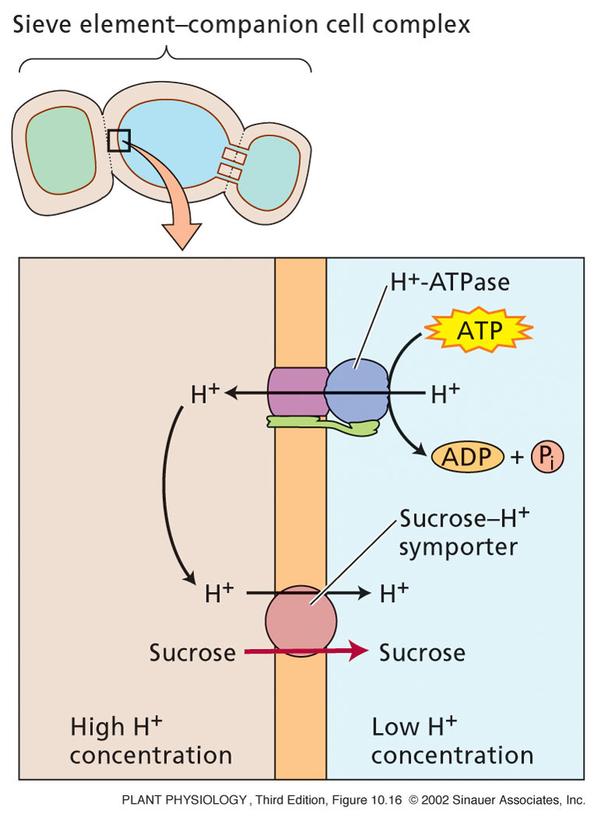
Phloem loading uses a
proton/sucrose symport.
Notes:
15
PP10160.jpg

Slide 16
Phloem unloading
is the removal of this material from the phloem in the sink.
Sucrose is unloaded into the apoplast in some tissues (i.e., ovules) and into the symplast of others (growing/respiring tissues like young leaves, meristems).
Apoplastic transport and unloading can occur via two methods:
(a) sucrose is hydrolyzed by invertase to glucose and fructose upon reaching the sink. This maintains the gradient for transport. The glucose and fructose are taken up by the sink cells and stored or further metabolized as in maize; or
(b) sucrose is unloaded into the sink by a carrier co-transport system like in sucrose loading.

Slide 17
P protein
MW 14,000-158,000 , synthesized in companion cells, Originally thought to be a carbohydrate, called slime because it gelled when exposed to the air , Various forms; bundles of fibers or amorphous areas or even crystalline , Only in angiosperms , at least two proteins, PP1 and PP2, Once the sieve pores form, the P-protein disperses through the pore. P protein plugs the pore when the cell is damaged.

Slide 18
Thank You
For your Listening

