Slide 1
Crown ether
Ethers are compounds having two alkyl or aryl groups.
Crown ether is molecules containing H,C & O atoms , each oxygen atom is bound between two of the C atoms and arranged in a ring
They are based on repeating (-OCH2CH2-) derived from ethylene glycol (HOCH2CH2OH)

Slide 2
Important members of this series are the tetramer (n = 4, or four ethyleneoxy units), the pentamer (n = 5), and the hexamer (n = 6). The term "crown" refers to the resemblance between the structure of a crown ether bound to a cation , and a crown sitting on a head.
In 1967, Charles Pedersen, discovered a simple method of synthesizing a crown ether when he was trying to prepare a complexing agent for divalent cations. His strategy involved linking two catecholate groups through one hydroxyl on each molecule. This linking defines a polydentate ligand that could partially envelop the cation and, by ionization of the phenolic hydroxyls, neutralize the bound dication.

Slide 3
Pederson was surprised to isolate a by-product that strongly complexed potassium cations. Citing earlier work on the dissolution of potassium in 16-crown-4,he realized that the cyclic polyethers represented a new class of complexing agents that were capable of binding alkali metal cations. He proceeded to report systematic studies of the synthesis and binding properties of crown ethers.

Slide 7
Crown ether

Slide 10
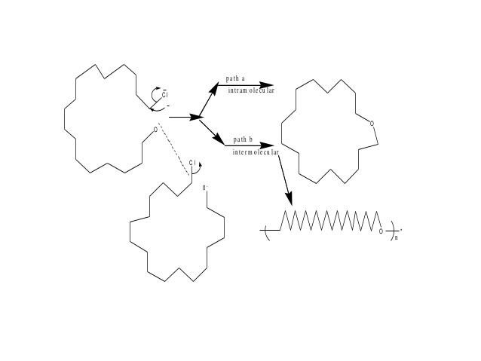

Slide 13
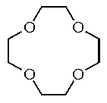
12-Crown-4
lithium-selective complexing agent
The cavity diameter of 12-crown-4 is estimated to be 1.2-1.5 Å, which is ideal for complexing with a lithium cation which has an ionic diameter of 1.36 Å.

Slide 14
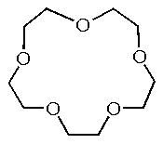
15-Crown-5
sodium-selective complexing agent used for the activation of various sodium salts such as the hypochlorite, sulfide, hydroxide, and imidazolide
The cavity diameter of 15-crown-5 is estimated to be 1.7-2.2 Å, which is ideal for complexing with a sodium cation (ionic diameter of 1.94 Å)

Slide 15
18-crown-6
18-crown-6 functions as a ligand for some metal cations with a particular affinity for potassium cations

Slide 16
Dibenzo-18-crown-6
Dibenzo-18-crown-6 is a benzannulated crown ether. This compound may be synthesized from catechol and bis(chloroethyl) ether This crown ether, like other crown ethers, has strong complexing abilities and has high affinity for alkali metal cations.

Slide 17
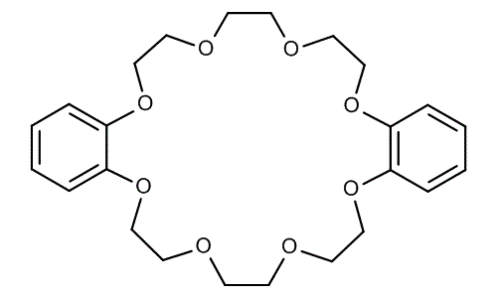
Dibenzo-24-crown-8

