Slide 1
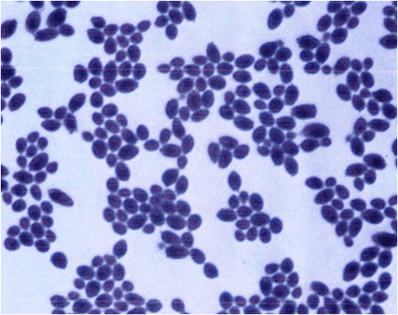
Opportunistic Fungi: Candidiasis
Assist.Prof.: Nareen Q. Faqi Abdullah

Slide 2
4. Candidiasis
It is due Candida spp., which is the most common opportunistic fungal infection
It may be classified as superficial or deep
Candida spp. are yeast and the most common cause of opportunistic mycoses that normally lives in small amounts in places like mouth or on skin without causing any problems
But When begins to multiply uncontrollably, it can cause an infection
This may occur because of people with weakened immune systems and those with compromised immune systems are also more likely to develop a severe infection as a result of candidiasis

Slide 3
There are many techniques that can be adopted by diagnostic laboratories to aid in the identification of Candida
starting from the collection of specimen
transporting them to a diagnostic laboratory
followed by staining, microscopy
biochemical tests (API)
molecular techniques

Slide 4
Candida infections (candidiasis) can be classified as follows:
1. Mucosal Candidiasis: Affects the mucosal lining of the host such as oral candidiasis, Genital Candidiasis, gastrointestinal candidiasis, and respiratory candidiasis
a. Oropharyngeal Candidiasis (Oral Thrush): When the candida yeast spreads in the mouth and throat, it can cause an infection called thrush. It’s most common in newborns, the elderly and people with weakened immune systems. Also more likely to get it are adults who are being treated for cancer, take medications like wide-spectrum antibiotics
b. Genital Candidiasis (Genital Yeast Infection): This occurs when too much yeast grows in the female genital tract. (Men also can get a genital yeast infection, but it's much less common). A yeast infection typically happens when the balance in the vagina changes

Slide 5
2. Cutaneous candidiasis: Affects the skin and nails, for example, candidal onychomycosis, diaper candidiasis and candidal folliculitis
a. Candidal onychomycosis: Is a common fungal infection affecting nails. Onychomycosis due to Candida is found in individuals having defective immunity and diabetes
b. Diaper candidiasis: Diaper rashes are usually caused by leaving a wet or soiled diaper on too long, once baby’s skin is irritated, infection is more likely

Slide 6
3. Systemic candidiasis:
Affects the deep-seated organs and the bloodstream
for example, candidemia, a form of fungemia that causes sepsis and invasive candidiasis
If candida yeast enters the bloodstream (usually through medical equipment or devices), it can travel to the heart, brain, blood, eyes, and bones
This can cause a serious, life-threatening infection
4. Antibiotic candidiasis: Is also known as iatrogenic candidiasis

Slide 7
Identification of yeasts and dimorphic fungi
API 20C AUX yeast system
The API 20C AUX BioMerieux system is designed for the precise identification of the most frequently encountered yeasts in medical laboratories
The API 20C AUX strip consists of 20 microtubes containing dehydrated substrates in which 19 assimilation tests are performed
The capsules on the strip are inoculated with a minimal medium and the yeasts only grow if they are capable of utilizing each substrate as a sole carbon source
The presence of hyphae or pseudohyphae is considered as the 21st test of the system
The reactions are interpreted by comparison to controls and the identification is made using the Analytical Profile Index
In each case additional test, i.e., determination of microscopic and macroscopic features is necessary to confirm the identification

Slide 8
Procedure:
Five ml of distilled water were distributed into honeycombed wells of the tray to create a humid atmosphere
API basal medium ampules (5ml) were inoculated with yeast colonies, each cupule was inoculated and trays were incubated for 48-72 hr. at 37ºC
Cupules showing turbidity significantly heavier than that of the negative control cupule (o cupule) were considered positive
Identification was made by generating a microcode, and the results are converted to a seven-digit biotype profiles number
Then using the API 20C analytical profile index on the results, sheet, the tests are separated into groups of three cupule, 1, 2 and 4, which are indicated for each, by adding the number corresponding to positive reaction within each group
Accordingly a-7-digit number is obtained which constitutes the number profile

