Slide 1
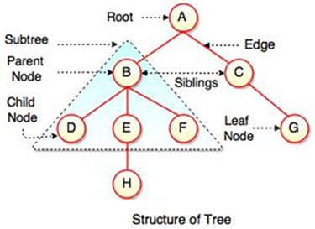
TREE
Trees are mainly used to represent data containing a hierarchical relationship between elements.
ex: family trees, table of contents and file system in computers.
Tree is a hierarchical data structure which stores the information in the form of a parent-child.
Tree is one of the most powerful and advanced data structures.
It is a non-linear data structure compared to arrays, linked lists, stack and queue.
It is a collection of elements called Nodes, where each node can have number of children.
It represents the nodes connected by edges.

Slide 2
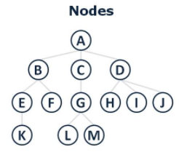
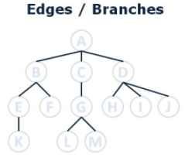
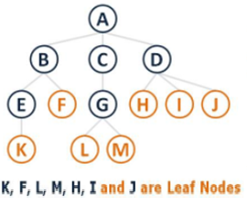
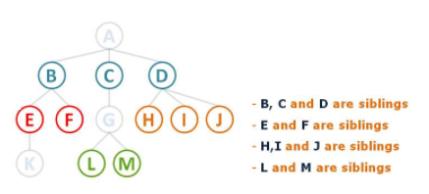
Tree data structure – terminology
Node: A node is a structure which contains a value of data.
Edge: The connection between one node and another.
In any tree with (n) nodes, there will be maximum of (n-1) edges
Root: The top node in a tree, the prime ancestor.
Leaf: A node with no children
Siblings: A group of nodes with the same parent.
Figure 1
Figure 2
Figure 3
Figure 4

Slide 3
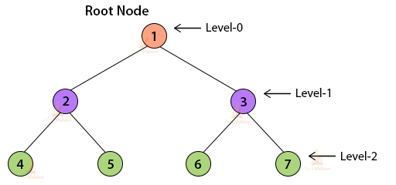
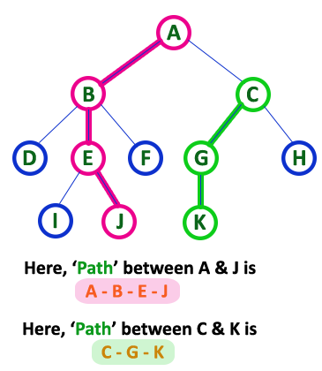
Level (Depth) : The distance between a node and the root. Or number of edges(links) between a node and the root
Figure 1
Figure 2
Path: A path from node n₁ to node n_{k} is a sequence of nodes n₁, n₂,....., n_{k} such that n_{i} is the parent of n _{i+1} for 1 <= i < k. The length of this path is the number of edges on the path ( = k - 1)
There is a path of length zero from every node to itself.
In a tree there is one and only one path from the root to each node.

Slide 4
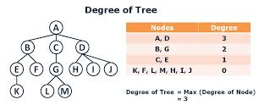
Degree of a node: is total number of children it has.
Degree of a Tree: The highest degree of a node among all the nodes in a tree is called as 'Degree of Tree'

Slide 5
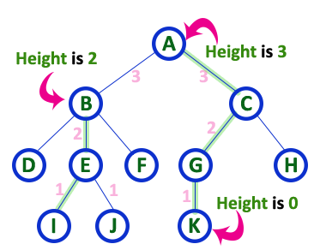
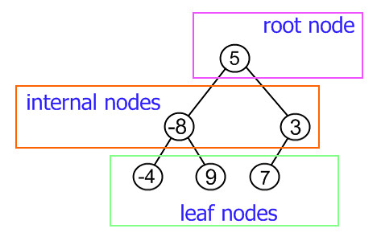
Height of a node: The number of edges on the longest path between a node and a descendant leaf.
Height of tree: The height of the root node or the maximum level of any node in the tree
Internal nodes: nodes that have children
External nodes or leaves: nodes that don’t have children
Figure 1
Figure 2

Slide 6
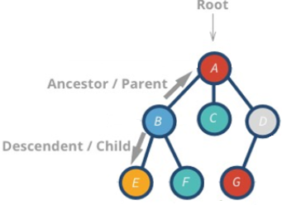
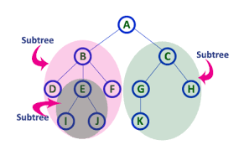
Ancestor: A node reachable by repeated proceeding from child to parent.
Descendant: A node reachable by repeated proceeding from parent to child.
Figure 1
Subtree: A subtree of a tree T is a tree S consisting of a node in T
and all of its descendants in T.
Figure 2

Slide 7
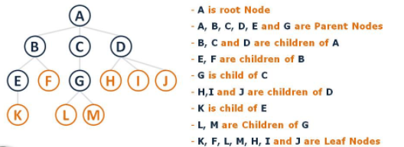
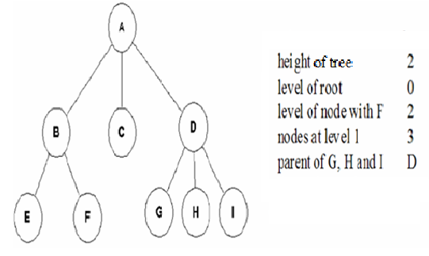
Example 1
Figure 1
Example 2
Figure 2

Slide 8
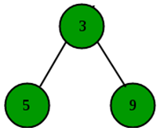
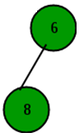
Example 3
You have the following tree, find:
all subtrees in the tree?
Max level
Ancestors of node (8)
Ancestors of node (3)
Descendants of node (3)
Descendants of node (1)
Descendants of node (5)
Solution:
1. Five subtrees
2. Max level = 2
Node 1 in level 0 , Nodes 3 & 6 in level 1 , Nodes 5 & 9 & 8 in level 2
The nodes: 6 1
4. Node 1
The nodes: 5 9
The nodes: 3 6 5 9 8
Zero ( descendants of leaf node = 0 )

