Slide 1
Multiplexer & DE multiplexer
Multiplexer mean (many into one) . It is a device that allows digital information from several sources to be routed onto a single line for transmission over that line to a common destination .
The basic multiplexer has several data-input lines and single output line .

Slide 2
Multiplexer & DE multiplexer
the selection of particular input line is controlled by a set of selection lines
Normally there are 2^{n} input lines and n selection lines whose bit combinations determine which input is selected .
Fig. below shows n-to-1 line multiplexer .

Slide 3
n-to-1 multiplexer

Slide 4
Multiplexer
Digital signals are commonly multiplexed using TIME DIVISION MULTIPLEXING (TDM) , in which the multiple signals are carried over the same channel in alternating time slots

Slide 5
Functional Block Diagram
D_{O}
D_{O}
X
D₁
D₁
Multiplexer
Demultiplexer
D₂
D₂
D₃
D₃
S_{o}
S₁
S_{o}
S₁

Slide 6
4-to-1 multiplexer
Y | D₃ | D₂ | D₁ | D_{O} | B | A
D_{O} |  |  |  | D_{O} | 0 | 0
D₁ |  |  | D₁ |  | 0 | 1
D₂ |  | D₂ |  |  | 1 | 0
D₃ | D₃ |  |  |  | 1 | 1

Slide 7
Final Equation
Y= ABD_{O} + ABD₁ + ABD₂ ABD₃

Slide 8
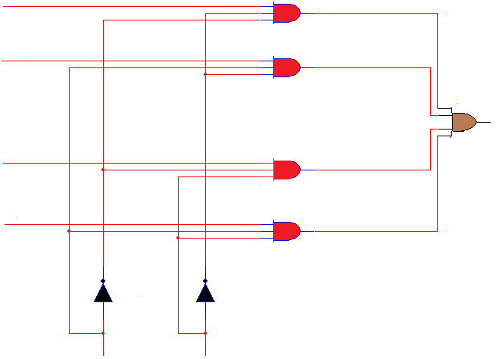
4-to-1 Multiplexer
D_{O}
D₁
D₂
D₃
S_{O}
S₁

Slide 9
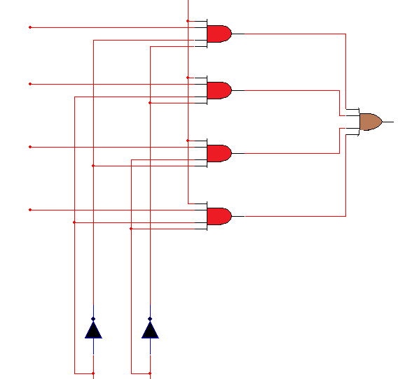
Enable
Data input
D_{O}
D₁
output
D₂
D₃
S_{O}
S₁

Slide 10
8-to-1 Multiplexer
Y=ABCD_{O}+ABCD₁ +ABCD ₂+ABCD₃ +ABCD₄ +ABCD₅ +ABCD₆ +ABCD₇

Slide 11
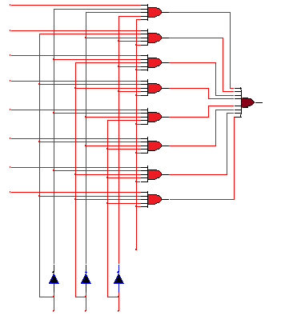
D₀
Data input
D₁
D₂
D₃
output
D₄
D₅
D₆
D₇
Enable
S₀
S₁
S₂

Slide 12
8:1 74151
D₃
V_{CC}
D₂
D₄
D₁
D₅
D₀
8:1
MUX
74151
D₆
Y
D₇
Y
S₀
E
S₁
GND
S₂

Slide 13
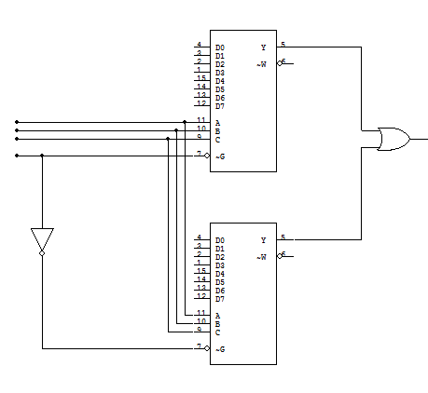
8:1
MUX
74151
S₀
S₁
Y
S₂
S₃
8:1
MUX
74151

Slide 14
Example
Implement following Boolean function using 8:1 multiplexer.
$$f\left(A,B,C\right)=\sum{m(1,3,5,6)}$$

Slide 15
Example
Implement the following Boolean function using 4:1 multiplexer.
$$f\left(A,B,C\right)=\sum{m(1,3,5,6)}$$

Slide 16
Example
Implement following Boolean function using 8:1 multiplexer
$$f\left(A,B,C,D\right)=\sum{m\left(0,2,6,10,11,12,13\right)+d(3,8,14)}$$

Slide 17
Solution
D_{O} | D₁ | D₂ | D₃ | D₄ | D₅ | D₆ | D₇
0 | 1 | 2 | 3 | 4 | 5 | 6 | 7
8 | 9 | 10 | 11 | 12 | 13 | 14 | 15
1 | 0 | 1 | 1 | D | D | 1 | 0
D
D

Slide 18
Example
Implement full adder circuit using two 4:1 multiplexers .

Slide 19
 | D_{O} | D₁ | D₂ | D3
C | 0 | 1 | 2 | 3
C | 4 | 5 | 6 | 7
 | C | C | C | C
 | D_{O} | D₁ | D₂ | D3
C | 0 | 1 | 2 | 3
C | 4 | 5 | 6 | 7
 | 0 | C | C | 1

Slide 20
H.W
Implement following Boolean function using 8:1 multiplexer
$$f\left(A,B,C,D\right)=πM(0,3,5,8,9,10,12,14)$$

Slide 21
1:4 Demultiplexer
D_{O} = Y . S_{O} . S₁
D₁ = Y . S_{O} . S₁
D₂ = Y . S_{O} . S₁
D₃ = Y . S_{O} . S₁

Slide 22
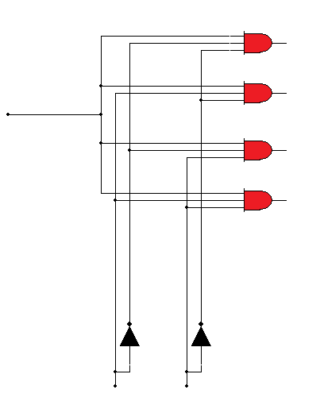
1:4 Demultiplexer
D_{O}
D₁
Y
D₂
D₃
S_{O}
S₁

