Slide 1
Analysis and design of
two-way slabs

Slide 2
Analysis and design of two-way slabs
Slabs can be considered as structural members whose depth, h, is small as compared to their length, L, and width, S. In reinforced concrete construction, slabs are used to provide flat, useful surfaces. A reinforced concrete slab is a flat plate, usually horizontal, with top and bottom surfaces parallel or nearly so. It may be supported by reinforced concrete beams (and is usually cast monolithically with such beams), by masonry or reinforced concrete walls, by structural steel members, directly by columns, or continuously by the ground.
Slabs may be supported on two opposite sides only, as shown in Fig.1-a, in which case the structural action of the slab is essentially one-way, the loads being carried by the slab in the direction perpendicular to the supporting beams. There may be beams on all four sides, as shown in Fig.1-b, so that two-way slab action is obtained. Intermediate beams, as shown in Fig.1-c, may be provided.
If the ratio of length to width of one slab panel is larger than about 2, most of the load is carried in the short direction to the supporting beams and one-way action is obtained in effect, even though supports are provided on all sides.

Slide 3
Concrete slabs may be in some cases be carried directly by columns, as shown in Fig.1-d, without the use of beams or girders. Such slabs are described as flat plates and are commonly used where spans are not large and loads not particularly heavy. Flat slab construction, shown in Fig.1-e is also beamless but incorporates a thickened slab region in the vicinity of the column and often employs flared column tops. Both are devices to reduce stresses due to shear and negative bending around the columns. They are referred to as drop panels and column capitals, respectively. Closely related to the flat plate slab is the two-way joist, also known as a grid or waffle slab, shown in Fig.1-f. To reduce the dead load of the solid-slab construction, voids are formed in a rectilinear pattern through use of metal of fiberglass form inserts, a two-way ribbed construction results. Usually inserts are omitted near the columns, so a solid slab is formed to resist moments and shears better in these areas.
In addition to the column-supported types of construction shown in Fig.1, many slabs are supported continuously on the ground, as for highways, airport runways and warehouse floors.
Reinforcing steel for slabs is primarily parallel to the slab surfaces. Straight-bar is generally used. Although in continuous slabs bottom bars are sometimes bent up to provide for negative reinforcement over the supports. Welded wire fabric is commonly employed for slabs on the ground. Slabs may also be prestressed using high tensile strength strands.
Reinforced concrete slabs of the types shown in Fig.1 are usually designed for loads assumed to be uniformly distributed over one entire slab panel, bounded by supporting beams or column centerlines. Minor concentrated loads can be accommodated through two-way action of the reinforcement (two-way flexural steel for two-way slab systems or one-way flexural steel plus lateral distribution steel for one-way systems). Heavy concentrated loads generally require supporting beams.

Slide 4
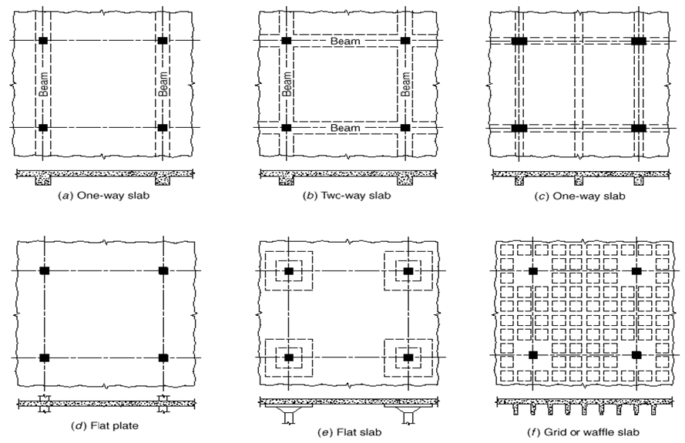
Drop panel
Column capital
Fig. 1- Types of structural slabs

Slide 5
Economical choice of concrete floor systems
Various types of floor systems can be used for general buildings, such as residential, office, and institutional buildings. The choice of an adequate and economic floor system depends on the type of building, architectural layout, aesthetic features, and the span length between columns. In general, the superimposed live load on buildings varies between 2.0 and 7.0 kN/m². A general guide for the economical use of floor systems can be summarized as follows:
1. Flat plates: Flat plates are most suitable for spans of 6.0 to 8.0 m and live loads between 3.0 and 5.0 kN/m². The advantages of adopting flat plates include low-cost formwork, exposed flat ceilings, and fast construction. Flat plates have low shear capacity and relatively low stiffness, which may cause noticeable deflection. Flat plates are widely used in buildings either as reinforced or prestressed concrete slabs.
2. Flat slabs: Flat slabs are most suitable for spans of 6.0 to 9.0 m and for live loads of 4.0 to 7.0 kN/m². They need more formwork than flat plates, especially for column capitals. In most cases, only drop panels without column capitals are used.
3. Waffle slabs: Waffle slabs are suitable for spans of 9.0 to 15.0 m and live loads of 4.0 to 7.0 kN/m². They carry heavier loads than flat plates and have attractive exposed ceilings. Formwork, including the use of pans, is quite expensive.
4. Slabs on beams: Slabs on beams are suitable for spans between 6.0 and 9.0 m and live loads of 3.0 to 6.0 kN/m². The beams increase the stiffness of the slabs, producing relatively low deflection. Additional formwork for the beams is needed.
5. One-way slabs on beams: One-way slabs on beams are most suitable for spans of 3.0 to 6.0 m and a live load of 3.0 to 5.0 kN/m². They can be used for larger spans with relatively higher cost and higher slab deflection. Additional formwork for the beams is needed.
6. One-way joist floor system: A one-way joist floor system is most suitable for spans of 6.0 to 9.0 m and live loads of 4.0 to 6.0 kN/m². Because of the deep ribs, the concrete and steel quantities are relatively low, but expensive formwork is expected. The exposed ceiling of the slabs may look attractive.

Slide 6
Two-way column supported slabs
When two-way slabs are supported by relatively shallow, flexible beams, or if column-line beams are omitted altogether, as for flat plates, flat slabs, or two-way joist systems, a number of new considerations are to be introduced. Fig.2-a shows a portion of a floor system in which a rectangular slab panel is supported by relatively shallow beams on four sides. The beams, in turn, are carried by columns at the intersection of their center lines. If a surface load w is applied, that load is shared between imaginary slab strips ℓ_{a} in the short direction and ℓ_{b} in the long direction. Note that the portion of the load that is carried by the long strips ℓ_{b} is delivered to the beams B1 spanning in the short direction of the panel. The portion carried by the beams B1 plus that carried directly in the short direction by the slab strips ℓ_{a}, sums up to 100 percent of the applied to the panel. Similarly, the short-direction slab strips ℓ_{a} deliver a part of the load to long-direction beams B2. That load, plus the load carried directly in the long direction by the slab, includes 100 percent of the applied load. It is clearly a requirement of static’s that, for column-supported construction, 100 percent of the applied load must be carried in each direction, jointly by the slab and its supporting beams.
A similar situation is obtained in the flat plate floor shown in Fig.2-b. In this case beams are omitted. However, broad strips of the slab centered on the column lines in each direction serve the same function as the beams of Fig.2-a; for this case, also, the full load must be carried in each direction. The presence of the dropped panels or column capitals near the columns does not modify this requirement of statics.
Fig.3-a shows a flat plate floor supported by columns at A, B, C, and D. Fig.3-b shows the moment diagram for the direction of span ℓ₁. In this direction, the slab may be considered as a broad, flat beam of width ℓ₂. Accordingly, the load per meter of the span is wℓ₂. In any span of a continuous beam, the sum of mid-span positive moment and the average of the negative moments at adjacent supports is equal to the mid-span positive moment of a corresponding simply supported beam. In terms of the slab, this requirement of statics may be written as:
A similar requirement exist in the perpendicular direction, leading to the relation:

Slide 7
Fig.2 –Column supported two-way slabs:
(a) Two-way slab with beams, (b) two-way slab without beams

Slide 8
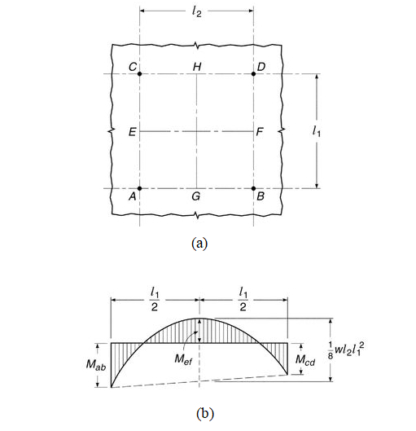
Fig.3 –Moment variation in column-supported two-way slabs
(a) Critical moment section; (b) moment variation along a span

Slide 9
ACI-318M: ( CHAPTER 8—TWO-WAY SLABS )
8.1.1 This chapter shall apply to the design of non-prestressed and prestressed slabs reinforced for flexure in two directions, with or without beams between supports, including (a) through (d):
(a) Solid slabs
(b) Slabs cast on stay-in-place, non-composite steel deck
(c) Composite slabs of concrete elements constructed in separate placements but connected so that all elements resist loads as a unit
(d) Two-way joist systems in accordance with 8.8
8.2.1 A slab system shall be permitted to be designed by any procedure satisfying equilibrium and geometric compatibility, provided that design strength at every section is at least equal to required strength, and all serviceability requirements are satisfied. The direct design method of 8.10 or the equivalent frame method of 8.11 is permitted for design where applicable.
8.2.4 A drop panel in a non-prestressed slab, where used to reduce the minimum required thickness in accordance with 8.3.1.1 or the quantity of deformed negative moment reinforcement at a support in accordance with 8.5.2.2, shall satisfy (a) and (b):
(a) The drop panel shall project below the slab at least one-fourth of the adjacent slab thickness.
(b) The drop panel shall extend in each direction from the centerline of support a distance not less than one-sixth the span length measured from center-to-center of supports in that direction.
8.2.5 A shear cap, where used to increase the critical section for shear at a slab-column joint, shall project below the slab soffit and extend horizontally from the face of the column a distance at least equal to the thickness of the projection below the slab soffit.
R8.2.4 and R8.2.5 Drop panel dimensions specified in 8.2.4 are necessary when reducing the amount of negative moment reinforcement following 8.5.2.2 or to satisfy minimum slab thicknesses permitted in 8.3.1.1. If the dimensions are less than specified in 8.2.4, the projection may be used as a shear cap to increase the shear strength of the slab. For slabs with changes in thickness, it is necessary to check the shear strength at several sections (Refer to 22.6.4.1(b)).

Slide 10
8.3—Design limits
8.3.1 Minimum slab thickness
R8.3.1 The minimum slab thicknesses in 8.3.1.1 and 8.3.1.2 are independent of loading and concrete modulus of elasticity, both of which have significant effects on deflections. These minimum thicknesses are not applicable to slabs with unusually heavy superimposed sustained loads or for concrete with modulus of elasticity significantly lower than that of ordinary normal-weight concrete. Deflections should be calculated for such situations.
8.3.1.1 For non-prestressed slabs without interior beams spanning between supports on all sides, having a maximum ratio of long-to-short span of 2, overall slab thickness h shall not be less than the limits in Table 8.3.1.1, and shall be at least the value in (a) or (b), unless the calculated deflection limits of 8.3.2 are satisfied:
(a) Slabs without drop panels as given in 8.2.4 ..........125 mm.
(b) Slabs with drop panels as given in 8.2.4 ...............100 mm.

Slide 11
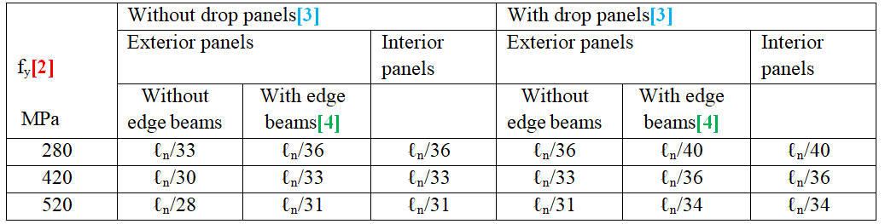
Table 8.3.1.1—Minimum thickness of non-prestressed two-way slabs without interior beams (mm)[1]
[1] ℓ_{n} is the clear span in the long direction, measured face-to-face of supports (mm).
[2] For f_{y} between the values given in the table, minimum thickness shall be calculated by linear interpolation.
[3] Drop panels as given in 8.2.4.
[4] Slabs with beams between columns along exterior edges. Exterior panels shall be considered to be without edge beams if α_{f} is less than 0.8. The value of α_{f} for the edge beam shall be calculated in accordance with 8.10.2.7.

Slide 12
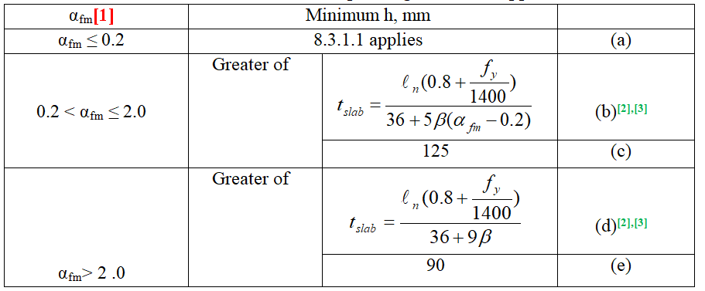
8.3.1.2 For non-prestressed slabs with beams spanning between supports on all sides, overall slab thickness h shall satisfy the limits in Table 8.3.1.2, unless the calculated deflection limits of 8.3.2 are satisfied.
Table 8.3.1.2- Minimum thickness of non-prestressed two-way slabs
With beams spanning between supports on all sides
[1] α_{fm} is the average value of α_{f} for all beams on edges of a panel and α_{f} shall be calculated in accordance with 8.10.2.7.
[2] ℓ_{n} is the clear span in the long direction, measured face-to-face of beams (mm).
[3] β is the ratio of clear spans in long to short directions of slab.
8.3.1.2.1 At discontinuous edges of slabs conforming to 8.3.1.2, an edge beam with α_{f} ≥ 0.80 shall be provided, or the minimum thickness required by (b) or (d) of Table 8.3.1.2 shall be increased by at least 10 percent in the panel with a discontinuous edge.
8.3.3 Reinforcement strain limit in non-prestressed slabs
8.3.3.1 For non-prestressed slabs, ε_{t} shall be at least 0.004.

Slide 13
8.4.1.1 The provisions of 8.10 for the direct design method shall be permitted for the analysis of non-prestressed slabs and the provisions of 8.11 for the equivalent frame method shall be permitted for the analysis of non-prestressed and prestressed slabs, except 8.11.6.5 and 8.11.6.6 shall not apply to prestressed slabs.
8.4.1.5 A column strip is a design strip with a width on each side of a column centerline equal to the lesser of 0.25ℓ₂ and 0.25ℓ₁. A column strip shall include beams within the strip, if present.
8.4.1.6 A middle strip is a design strip bounded by two column strips.
8.4.1.7 A panel is bounded by column, beam, or wall centerlines on all sides.
8.4.1.8 For monolithic or fully composite construction supporting two-way slabs, a beam includes that portion of slab, on each side of the beam extending a distance equal to the projection of the beam above or below the slab, whichever is greater, but not greater than four times the slab thickness.
Fig. R8.4.1.8—Examples of the portion of slab to be included with the beam under 8.4.1.8 (ACI 318-2014)

Slide 14
Note: For T- and L- sections, the following information can be used to find the gross moment of inertia of the section:
;
Where:
h = overall beam depth
t = h_{f} =overall slab thickness
b_{E} = effective width of flange
b_{w} = width of web

Slide 15
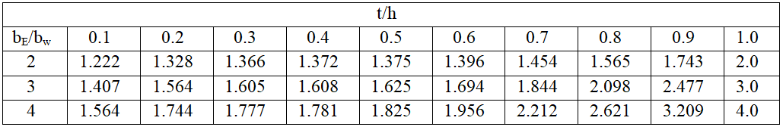
Typical values of k are tabulated in the following table:
Values of k in terms of (b_{E}/b_{w}) and (t/h)
Note that: k ≈ 1.0 + 0.2 (b_{E}/b_{w}) for 2 < b_{E}/b_{w}< 4 and 0.2 < t/h <0.5

Slide 16
8.4.3 Factored one-way shear
8.4.3.1 For slabs built integrally with supports, V_{u} at the support shall be permitted to be calculated at the face of support.
8.4.3.2 Sections between the face of support and a critical section located d from the face of support for non-prestressed slabs and h/2 from the face of support for prestressed slabs shall be permitted to be designed for V_{u} at that critical section if (a) through (c) are satisfied:
(a) Support reaction, in direction of applied shear, introduces compression into the end regions of the slab.
(b) Loads are applied at or near the top surface of the slab.
(c) No concentrated load occurs between the face of support and critical section.
8.4.4.1.1 Slabs shall be evaluated for two-way shear in the vicinity of columns, concentrated loads, and reaction areas at critical sections in accordance with 22.6.4.

Slide 17
21.2— Strength reduction factors for structural concrete members and connections
21.2.1 Strength reduction factors ϕ shall be in accordance with Table 21.2.1, except as modified by 21.2.2, 21.2.3, and 21.2.4.

Slide 18
21.2.2 Strength reduction factor for moment, axial force, or combined moment and axial force shall be in accordance with Table 21.2.2.
21.2.2.1 For deformed reinforcement, ε_{ty} shall be f_{y}/E_{s}. For Grade 420 deformed reinforcement, it shall be permitted to take ε_{ty} equal to 0.002.

Slide 19
8.5.3 Shear
8.5.3.1 Design shear strength of slabs in the vicinity of columns, concentrated loads, or. reaction areas shall be the more severe of 8.5.3.1.1 and 8.5.3.1.2.
85.3.1.1 For one-way shear, where each critical section to be investigated extends in a plane across the entire slab width, V_{n} shall be calculated in accordance with 22.5.
22.5.1.1 Nominal one-way shear strength at a section, V_{n}, shall be calculated by:
22.5.1.2 Cross-sectional dimensions shall be selected to satisfy Eq. (22.5.1.2).
(22.5.1.2)
22.5.1.3 For non-prestressed members, V_{c} shall be calculated in accordance with 22.5.5, 22.5.6, or 22.5.7.
22.5.5.1 For non-prestressed members without axial force, V_{c} shall be calculated by:
(22.5.5.1)
Unless a more detailed calculation is made in accordance with table 22.5.5.1.

Slide 20
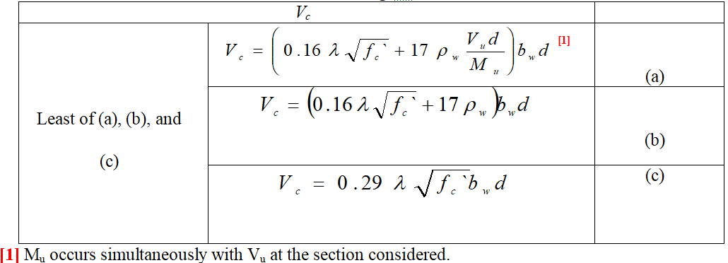
Table 22.5.5.1-Detailed method for calculating V_{c}
22.5.6 V_{c} for non-prestressed members with axial compression
N_{u} is positive for compression.
22.5.7 Vc for non-prestressed members with significant axial tension
N_{u} is negative for tension, and V_{c} shall not be less than zero.

Slide 21
22.5.3.1 The value of √f`_{c} used to calculate V_{c} for one-way shear shall not exceed 8.3 MPa.
22.5.3.3 The values of f_{y} and f_{yt} used to calculate V_{s} shall not exceed the limits in 20.2.2.4.
20.2.2.4 Types of non-prestressed bars and wires to be specified for particular structural applications shall be in accordance with Table 20.2.2.4a for deformed reinforcement (Note: According to this table f_{y} and f_{yt}≤ 420 MPa. For welded deformed wire reinforcement this value is raised to 550 MPa).
19.2.4.2 The value of λ shall be based on the composition of the aggregate in the concrete mixture in accordance with Table 19.2.4.2 or as permitted in 19.2.4.3.
8.5.3.1.2 For two-way shear, v_{n} shall be calculated in accordance with 22.6.
22.6.1.2 Nominal shear strength for two-way members without shear reinforcement shall be calculated by:
22.6.1.4 Two-way shear shall be resisted by a section with a depth d and an assumed critical perimeter b_{o} as defined in 22.6.4.
22.6.2.1 For calculation of v_{c} and v_{s} for two-way shear, d shall be the average of the effective depths in the two orthogonal directions.
22.6.3.1 The value of √f`_{c} used to calculate v_{c} for two-way shear shall not exceed 8.3 MPa.
22.6.4.1 For two-way shear, critical sections shall be located so that the perimeter b_{o} is a minimum but need not be closer than d/2 to (a) and (b):
(a) Edges or corners of columns, concentrated loads, or reaction areas
(b) Changes in slab or footing thickness, such as edges of capitals, drop panels, or shear caps (see Fig.R22.6.4.1).

Slide 22
Fig.R22.6.4.1- Location of critical shear perimeters
and critical sections in a slab with drop panels
Location of critical shear perimeters

Slide 23
22.6.4.1.1 For square or rectangular columns, concentrated loads, or reaction areas, critical sections for two-way shear in accordance with 22.6.4.1(a) and (b) shall be permitted to be defined assuming straight sides.
22.6.4.1.2 For a circular or regular polygon-shaped column, critical sections for two-way shear in accordance with 22.6.4.1(a) and (b) shall be permitted to be defined assuming a square column of equivalent area.
22.6.4.3 If an opening is located within a column strip or closer than 10h from a concentrated load or reaction area, a portion of b_{o} enclosed by straight lines projecting from the centroid of the column, concentrated load or reaction area and tangent to the boundaries of the opening shall be considered ineffective.

Slide 24
ACI Commentary suggested that the side faces of the critical perimeter would extend to the edge of the slab if the distance from the face of the column to the edge of the slab does not exceed the larger of:
(i) four slab thicknesses, 4t , or (ii) twice the development length, 2ℓ_{d} , of the flexural reinforcement perpendicular to the edge, shown by the distances labeled A and B in the Figs. (b) and (c).
Figs. b and c- Critical sections and tributary areas for shear in a flat plate
22.6.5.1 For non-prestressed two-way members, v_{c} shall be calculated in accordance with 22.6.5.2

Slide 25
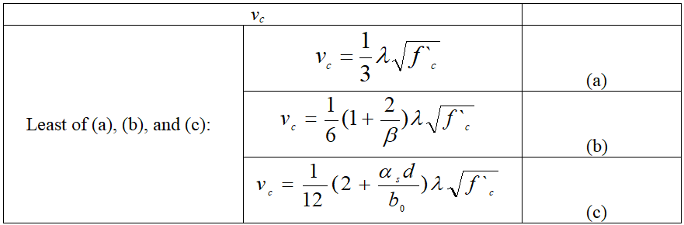
Table 22.6.5.2- calculation of v_{c} for two-way shear
Note: β is the ratio of long side to short side of the column, concentrated load, or reaction area and α_{s} is given in 22.6.5.3.
22.6.5.3 The value of α_{s} is 40 for interior columns, 30 for edge columns, and 20 for corner columns.

Slide 26
8.5.4 Openings in slab systems
8.5.4.1 Openings of any size shall be permitted in slab systems if shown by analysis that all strength and serviceability requirements, including the limits on deflections, are satisfied.
8.5.4.2 As an alternative to 8.5.4.1, openings shall be permitted in slab systems without beams in accordance with (a) through (d).
(a) Openings of any size shall be permitted in the area common to intersecting middle strips, but the total quantity of reinforcement in the panel shall be at least that required for the panel without the opening.
(b) At two intersecting column strips, not more than one-eighth the width of column strip in either span shall be interrupted by openings. A quantity of reinforcement at least equal to that interrupted by an opening shall be added on the sides of the opening.
(c) At the intersection of one column strip and one middle strip, not more than one-fourth the width of column strip in either strip shall be interrupted by openings. A quantity of reinforcement at least equal to that interrupted by an opening shall be added on the sides of the opening.
(d) If an opening is located within a column strip or closer than 10h from a concentrated load or reaction area, 22.6.4.3 for slabs without shear heads or 22.6.9.9 for slabs with shear heads shall be satisfied.

Slide 27
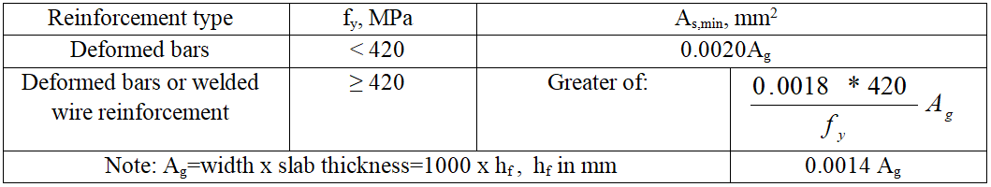
8.6—Reinforcement limits
8.6.1.1 A minimum area of flexural reinforcement, A_{s},_{min}, shall be provided near the tension face in the direction of the span under consideration in accordance with Table 8.6.1.1.
Table 8.6.1.1—Asmin for non-prestressed two-way slabs
R8.6.1.1 The required area of deformed or welded wire reinforcement used as minimum flexural reinforcement is the same as that required for shrinkage and temperature in 24.4.3.2. However, whereas shrinkage and temperature reinforcement is permitted to be distributed between the two faces of the slab as deemed appropriate for specific conditions, minimum flexural reinforcement should be placed as close as practicable to the face of the concrete in tension due to applied loads.
8.7.1.1 Concrete cover for reinforcement shall be in accordance with 20.6.1.
8.7.1.2 Development lengths of deformed and prestressed reinforcement shall be in accordance with 25.4.
8.7.1.3 Splice lengths of deformed reinforcement shall be in accordance with 25.5.
8.7.1.4 Bundled bars shall be detailed in accordance with 25.6.
8.7.2.1 Minimum spacing s shall be in accordance with 25.2.
8.7.2.2 For non-prestressed solid slabs, maximum spacing s of deformed longitudinal reinforcement shall be the lesser of 2h and 450 mm at critical sections, and the lesser of 3h and 450 mm at other sections.

Slide 28
R8.7.2.2 The requirement that the center-to-center spacing of the reinforcement be not more than two times the slab thickness applies only to the reinforcement in solid slabs, and not to reinforcement in joists or waffle slabs.
This limitation is to ensure slab action, control cracking, and provide for the possibility of loads concentrated on small areas of the slab.
8.7.3.1 At exterior corners of slabs supported by edge walls or where one or more edge beams have a value of α_{f} greater than 1.0, reinforcement at top and bottom of slab shall be designed to resist M_{u} per unit width due to corner effects equal to the maximum positive M_{u} per unit width in the slab panel.
8.7.3.1.1 Factored moment due to corner effects, M_{u}, shall be assumed to be about an axis perpendicular to the diagonal from the corner in the top of the slab and about an axis parallel to the diagonal from the corner in the bottom of the slab.
8.7.3.1.2 Reinforcement shall be provided for a distance in each direction from the corner equal to one-fifth the longer span.
8.7.3.1.3 Reinforcement shall be placed parallel to the diagonal in the top of the slab and perpendicular to the diagonal in the bottom of the slab. Alternatively, reinforcement shall be placed in two layers parallel to the sides of the slab in both the top and bottom of the slab.

Slide 29
R8.7.3.1 Unrestrained corners of two-way slabs tend to lift when loaded. If this lifting tendency is restrained by edge walls or beams, bending moments result in the slab. This section requires reinforcement to resist these moments and control cracking. Reinforcement provided for flexure in the primary directions may be used to satisfy this requirement. Refer to Fig. R8.7.3.1.

Slide 30
8.7.4 Flexural reinforcement in non-prestressed slabs
8.7.4.1.1 Where a slab is supported on spandrel beams, columns, or walls, anchorage of reinforcement perpendicular to a discontinuous edge shall satisfy (a) and (b):
(a) Positive moment reinforcement shall extend to the edge of slab and have embedment, straight or hooked, at least 150 mm into spandrel beams, columns, or walls.
(b) Negative moment reinforcement shall be bent, hooked, or otherwise anchored into spandrel beams, columns, or walls, and shall be developed at the face of support.
8.7.4.1.2 Where a slab is not supported by a spandrel beam or wall at a discontinuous edge, or where a slab cantilevers beyond the support, anchorage of reinforcement shall be permitted within the slab.
8.7.4.1.3 For slabs without beams, reinforcement extensions shall be in accordance with (a) through (c):
(a) Reinforcement lengths shall be at least in accordance with Fig. 8.7.4.1.3a, and if slabs act as primary members resisting lateral loads, reinforcement lengths shall be at least those required by analysis.
(b) If adjacent spans are unequal, extensions of negative moment reinforcement beyond the face of support in accordance with Fig. 8.7.4.1.3a shall be based on the longer span.
(c) Bent bars shall be permitted only where the depth-to-span ratio permits use of bends of 45 degrees or less.

Slide 31
R8.7.4.1.3 The minimum lengths and extensions of reinforcement shown in Fig. 8.7.4.1.3a were developed for slabs of normal proportions supporting gravity loads. These minimum lengths and extensions may not be sufficient for thick two-way slabs such as transfer slabs, podium slabs, and mat foundations. As illustrated in Fig. R8.7.4.1.3b, punching shear cracks, which can develop at angles as low as about 20 degrees, may not be intercepted by the tension reinforcement, substantially reducing punching shear strength. Providing continuous reinforcement or extending the minimum lengths in Fig. 8.7.4.1.3a, should be considered for slabs with ℓ_{n}/h ratios less than about 15. Also, for moments resulting from combined lateral and gravity loadings, the minimum lengths and extensions of bars in Fig. 8.7.4.1.3a may not be sufficient. Bent bars are seldom used and are difficult to place properly.

Slide 32
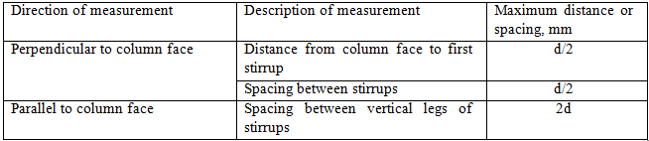
Fig. R8.7.4.1.3b-punching shear cracks in slabs with reinforcement extensions consistent with Fig. 8.7.4.1.3a.
8.7.6 Shear reinforcement – stirrups
8.7.6.1 Single-leg, simple-U, multiple-U, and closed stirrups shall be permitted as shear reinforcement.
8.7.6.2 Stirrup anchorage and geometry shall be in accordance with 25.7.1.
8.7.6.3 If stirrups are provided, location and spacing shall be in accordance with Table 8.7.6.3.
Table 8.7.6.3—First stirrup location and spacing limits

Slide 33
8.8—Nonprestressed two-way joist systems
8.8.1.1 Non-prestressed two-way joist construction consists of a monolithic combination of regularly spaced ribs and a top slab designed to span in two orthogonal directions.
8.8.1.2 Width of ribs shall be at least 100 mm at any location along the depth.
8.8.1.3 Overall depth of ribs shall not exceed 3.5 times the minimum width.
8.8.1.4 Clear spacing between ribs shall not exceed 750 mm.
8.8.1.5 V_{c} shall be permitted to be taken as 1.1 times the values calculated in 22.5.
8.8.1.6 For structural integrity, at least one bottom bar in each joist shall be continuous and shall be anchored to develop f_{y} at the face of supports.
8.8.1.7 Reinforcement area perpendicular to the ribs shall satisfy slab moment strength requirements, considering load concentrations, and shall be at least the shrinkage and temperature reinforcement area in accordance with 24.4.

