Slide 1
Pre-stressed concrete

Slide 2
Prestressed concrete
Prestress is defined as a method of applying pre-compression to control the stresses resulting due to external loads below the neutral axis of the beam tension developed due to external load which is more than the permissible limits of the plain concrete. The pre-compression applied (may be axial or eccentric) will induce the compressive stress below the neutral axis or as a whole of the beam c/s. Resulting either no tension or compression.
Basic Concept
Prestressed concrete is basically concrete in which internal stresses of a suitable magnitude and distribution are introduced so that the stresses resulting from the external loads are counteracted to a desired degree.
Terminology
1. Tendon: A stretched element used in a concrete member of structure to impart prestress to the concrete.
2. Anchorage: A device generally used to enable the tendon to impart and maintain prestress in concrete.
3. Pretensioning: A method of prestressing concrete in which the tendons are tensioned before the concrete is placed. In this method, the concrete is introduced by bond between steel & concrete.
4. Post-tensioning: A method of prestressing concrete by tensioning the tendons against hardened concrete. In this method, the prestress is imparted to concrete by bearing.

Slide 3
Materials for prestress concrete members:
1. Cement: The cement used should be any of the following
(a) Ordinary Portland cement
(b) Portland slag cement. But the slag content should not be more than 50%.
(c) Rapid hardening Portland cement
(d) High strength ordinary Portland cement.
2. Concrete: Prestress concrete requires concrete, which has a high compressive strength reasonably early age with comparatively higher tensile strength than ordinary concrete. The concrete for the members shall be air-entrained concrete composed of Portland cement, fine and coarse aggregates, admixtures and water. The air-entraining feature may be obtained by the use of either air-entraining Portland cement or an approved air-entraining admixture. The entrained air content shall be not less than 4 percent or more than 6 percent.
Minimum cement content of 300 to 360 kg/m3 is prescribed for the durability requirement.
The water content should be as low as possible.
3. Steel: - High tensile steel, tendons, strands or cables
The steel used in prestress shall be any one of the following: -
(a) Plain hard-drawn steel wire
(b) Cold drawn indented wire
(c) High tensile steel wire bar
(d) Uncoated stress relived strand
High strength steel contains: 0.7 to 0.8% carbons, 0.6% manganese, 0.1% silica

Slide 4
Durability, Fire Resistance & Cover Requirements for P.S.C Members: -
20 mm cover for pretensioned members
30 mm or size of the cable which ever is bigger for post tensioned members.
If the prestress members are exposed to an aggressive environment, these covers are increased by another 10 mm.
Necessity of high grade of concrete & steel:
Higher the grade of concrete higher the bond strength which is vital in pretensioned concrete, also higher bearing strength which is vital in post-tensioned concrete. Further creep & shrinkage losses are minimum with high-grade concrete.
Generally minimum M30 grade concrete is used for post-tensioned & M40 grade concrete is used for pretensioned members.
The losses in prestress members due to various reasons are generally in the range of 250 N/mm2 to 400 N/mm2. If mild steel or deformed steel is used the residual stresses after losses is either zero or negligible. Hence high tensile steel wires are used which varies from 1600 to 2000 N/mm2.
Advantage of Prestressed Concrete
1. The use of high strength concrete and steel in prestressed members results in lighter and slender members than is possible with RC members.
2. In fully prestressed members the member is free from tensile stresses under working loads, thus whole of the section is effective.
3. In prestressed members, dead loads may be counter-balanced by eccentric prestressing.
4. Prestressed concrete member posse’s better resistance to shear forces due to effect of compressive stresses presence or eccentric cable profile.

Slide 5
5. Use of high strength concrete and freedom from cracks, contribute to improve durability under aggressive environmental conditions.
6. Long span structures are possible so that saving in weight is significant & thus it will be economic.
7. Factory products are possible.
8. Prestressed members are tested before use.
9. Prestressed concrete structure deflects appreciably before ultimate failure, thus giving ample warning before collapse.
10. Fatigue strength is better due to small variations in prestressing steel, recommended to dynamically loaded structures.
Disadvantages of Prestressed Concrete
1. The availability of experienced builders is scanty.
2. Initial equipment cost is very high.
3. Availability of experienced engineers is scanty.
4. Prestressed sections are brittle.
5. Prestressed concrete sections are less fire resistant.
Classifications and Types
Prestressed concrete structures can be classified in a number of ways depending upon the feature of designs and constructions.
1. Pre-tensioning: In which the tendons are tensioned before the concrete is placed, tendons are temporarily anchored and tensioned and the prestress is transferred to the concrete after it is hardened.
2. Post-tensioning: In which the tendon is tensioned after concrete has hardened. Tendons are placed in sheathing at suitable places in the member before casting and later after hardening of concrete.

Slide 6
The various methods by which pre-compression are imparted to concrete are classified as follows:
1. Generation of compressive force between the structural elements and its abutments using flat jack.
2. Development of hoop compression in cylindrically shaped structures by circumferential wire binding.
3. Use of longitudinally tensioned steel embedded in concrete or housed in ducts.
4. Use of principle of distortion of a statically indeterminate structure either by displacement or by rotation of one-part relative to the remainder.
5. Use of deflected structural steel sections embedded in concrete until the hardening of the latter.
6. Development of limited tension in steel and compression in concrete by using expanding cements.
The most widely used method for prestressing of structural concrete elements is longitudinal tensioning of steel by different tensioning devices. Prestressing by the application of direct forces between abutments is generally used for arches and pavements, while flat jacks are invariably used to impart the desired forces.
Tensioning Devices:
The various types devices used for tensioning steel are grouped under four principal categories, viz.
1. Mechanical devices: The mechanical devices generally used include weights with or without lever transmission, geared transmission in conjunction with pulley blocks, screw jacks with or without gear devices and wire-winding machines. These devices are employed mainly for prestressing structural concrete components produced on a mass scale in factory.
2. Hydraulic devices: These are simplest means for producing large prestressing force, extensively used as tensioning devices.
3. Electrical devices: The wires are electrically heated and anchored before placing concrete in the mould. This method is often referred to as thermo-prestressing and used for tensioning of steel wires and deformed bars.
4. Chemical devices: Expanding cements are used and the degree of expansion is controlled by varying the curing condition. Since the expansive action of cement 90
while setting is restrained, it induces tensile forces in tendons and compressive stresses in concrete.

Slide 7
Prestressing System:
1. Pretensioning system: In the pre-tensioning systems, the tendons are first tensioned between rigid anchor-blocks cast on the ground or in a column or unit –mould types pretensioning bed, prior to the casting of concrete in the mould. The tendons comprising individual wires or strands are stretched with constant eccentricity or a variable eccentricity with tendon anchorage at one end and jacks at the other. With the forms in place, the concrete is cast around the stressed tendon.
a) Prior to prestressing
b) Effect of prestressing, ignoring self-weight
c) Prestress plus self-weight
d) Prestress plus self-weight and live load
Fig. 2 Effect of load during Prestressing

Slide 8
2. Post-tensioned system:
In post-tensioning the concrete unit are first cast by incorporating ducts or grooves to house the tendons. When the concrete attains sufficient strength, the high-tensile wires are tensioned by means of jack bearing on the end of the face of the member and anchored by wedge or nuts. The forces are transmitted to the concrete by means of end anchorage and, when the cable is curved, through the radial pressure between the cable and the duct. The space between the tendons and the duct is generally grouted after the tensioning operation.
Most of the commercially patented prestressing systems are based on the following principle of anchoring the tendons:
1. Wedge action producing a frictional grip on the wire.
2. Direct bearing from the rivet or bolt heads formed at the end of the wire.
3. Looping the wire around the concrete.
fpc : compressive strength of concrete due to effective prestress force only (after allowance for
all prestress losses)
fs: 1. for jacking force may not exceed the smaller of 0.8fpu or 0.94 fpy
2. Immediately after prestress transfer =0.82 fpy < 0.74fpu
fpy : yield strength of prestress tendons
fpu : ultimate tensile strength of prestress tendons .

Slide 9
Post tension: In post-tensioning the concrete unit are first cast by incorporating ducts or grooves to house the tendons. When the concrete attains sufficient strength, the high-tensile wires are tensioned by means of jack bearing on the end of the face of the member and anchored by wedge or nuts. The forces are transmitted to the concrete by means of end anchorage and, when the cable is curved, through the radial pressure between the cable and the duct. The space between the tendons and the duct is generally grouted after the tensioning operation. Most of the commercially patented prestressing systems are based on the following principle of anchoring the tendons:
1. Wedge action producing a frictional grip on the wire.
2. Direct bearing from the rivet or bolt heads formed at the end of the wire.
3. Looping the wire around the concrete.
Differences of Prestressed Concrete over Reinforced Concrete:
1. In prestress concrete member steel plays active role. The stress in steel prevails whether external load is there or not. But in R.C.C., steel plays a passive role. The stress in steel in R.C.C members depends upon the external loads. i.e., no external load, no stress in steel.
2. In prestress concrete the stresses in steel is almost constant where as in R.C.C the stress in steel is variable with the lever arm.
3. Prestress concrete has more shear resistance, where as shear resistance of R.C.C is less.
4. In prestress concrete members, deflections are less because the eccentric prestressing force will induce couple which will cause upward deflections, where as in R.C.C., deflections are more.
5. In prestress concrete fatigue resistance is more compare to R.C.C. because in R.C.C. stress in steel is external load dependent where as in P.S.C member it is load independent.
6. Prestress concrete is more durable as high grade of concrete is used which are denser in nature. R.C. is less durable.
7. In prestress concrete dimensions are less because external stresses are counterbalance by the internal stress induced by prestress. Therefore, reactions on column & footing are less as a whole the quantity of concrete is reduced by 30% and steel reduced by about 60 to 70%. R.C. is uneconomical for long span because in R.C. dimension of sections is large requiring more concrete & steel. Moreover,as self-weight increases more reactions acted on columns & footings,which requires higher sizes.

Slide 10
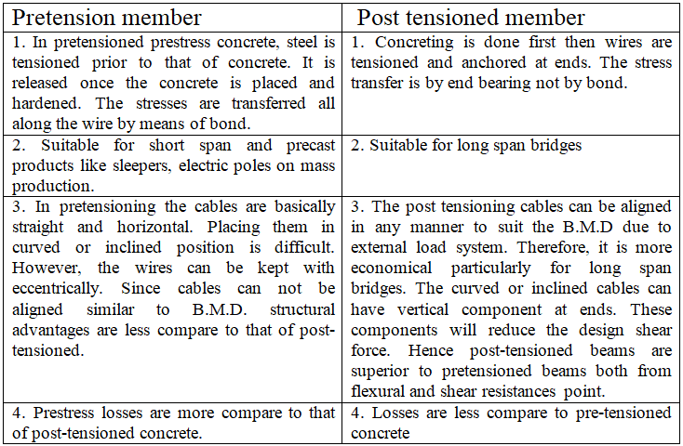
Comparative Study: Pretension Vs Post-Tensioned Member

Slide 11
Losses in Prestress
The initial prestressing concrete undergoes a gradual reduction with time from the stages of transfer due to various causes. This is generally defined as total “Loss of Prestress”. The various losses are explained below:
Types of losses in prestress Pretensioning
1. Elastic deformation of concrete
2. Relaxation of stress in steel
3. Shrinkage of concrete
4. Creep of concrete
Post-tensioning
1. No loss due to elastic deformation if all wires are simultaneously tensioned. If the wires are successively tensioned, there will be loss of prestress due to elastic deformation of concrete.
2. Relaxation of stress in steel
3. Shrinkage of concrete
4. Creep of concrete
5. Friction
6. Anchorage slips Loss due to elastic deformation of the concrete

Slide 12
Elastic deformation of concrete
The loss of prestress due to deformation of concrete depends on the modular ratio & the average stress in concrete at the level of steel.
If fc : stress in concrete at the level of steel
Es: Modulus of elasticity of steel
Ec: Modulus of elasticity of concrete
n: Modular ratio = Es/ Ec
Strain in concrete at the level of steel = fc / Ec
Stress in steel corresponding to this strain = fc Es /Ec
Therefore, Loss of stress in steel = nfc
If the initial stress in steel is known, the percentage loss of stress in steel due to elastic deformation of concrete can be computed.

Slide 13
Example 1: (Elastic deformation)
A pre-stressed concrete beam, 100 mm wide and 300 mm deep, is pre-tensioned by straight, wires carrying an initial force of 150kN at an eccentricity of 50 mm. The modulus of elasticity of steel and concrete are 200 and 33.33 kN/mm² respectively. Estimate the percentage loss of stress in steel due to elastic deformation of concrete if the area of steel wires is 188 mm2.
Solution:
P= 150 kN, y at level of steel = 50mm
Ag = 100 x 300 = 30000mm²
I= bh³ / 12 = 225x 10⁶mm⁴
Initial stress in steel = P / 188 = 798 MPa
Stress in concrete, fc = P/A + P.e.y /I = 5+1.67 = 6.67 MPa
Loss of stress due to elastic deformation = nxfc = 6x6.67 = 40 MPa
Loss in steel stress = 40x100 /798 = 5%

Slide 14
Loss due to shrinkage of concrete
Factors affecting the shrinkage in concrete
1. The loss due to shrinkage of concrete results in shortening of tensioned wires & hence contributes to the loss of stress.
2. The shrinkage of concrete is influenced by the type of cement, aggregate & the method of curing used.
3. Use of high strength concrete with low water cement ratio results in reduction in shrinkage and consequent loss of prestress.
4. The primary cause of drying shrinkage is the progressive loss of water from concrete.
5. The rate of shrinkage is higher at the surface of the member.
6. The differential shrinkage between the interior surfaces of large member may result in strain gradients leading to surface cracking.
Hence, proper curing is essential to prevent cracks due to shrinkage in prestress members. In the case of pretensioned members, generally moist curing is restored in order to prevent shrinkage until the time of transfer. Consequently, the total residual shrinkage strain will be larger in pretensioned members after transfer of prestress in comparison with post-tensioned members, where a portion of shrinkage will have already taken place by the time of transfer of stress.
If ε_{t}: Total residual shrinkage strain= 300x10⁻⁶ for pre-tensioning and = [200x10⁻⁶ / Log₁₀(t+2) for post-tensioning. Where, t: Age of concrete at transfer in days.
Then, the loss of stress = ε_{t}. Es

Slide 15
Example 2: (Shrinkage)
A concrete beam is pre-stressed by a cable carrying an initial pre-stressing force of 300kN. The cross-sectional area of the wires in the cable is 300 mm². Calculate the percentage loss of stress in the cable only due to shrinkage of concrete assuming the beam to be,
(a) pre-tensioned and
(b) post-tensioned.
Assume Es = 200 kN/mm2 and age of concrete at transfer = 8 days.
Solution:
Initial stress in wires =300x1000 / 300 = 1000 N/mm2
If the beam is pre-tensioned, the total residual shrinkage strain = 300x10⁻⁶ units
∴Loss of stress = ε_{t} x Es = 300x10⁻⁶ × 200 x10³ =60 N/mm²
Percentage loss of stress = 60 x 100 / 1000 = 6 %
If the beam is post-tensioned, the total residual shrinkage strain ε_{t} = [200x10⁻⁶ / Log₁₀(t+2) = 200 x10⁻⁶ units
∴ Loss of stress = 200 x10⁻⁶ . Es = 40N/mm2
Percentage loss of stress 40 x100 /1000 = 4%

Slide 16
Loss due to creep of concrete
The sustained prestress in the concrete of a prestress member results in creep of concrete which is effectively reduces the stress in high tensile steel. The loss of stress in steel due to creep of concrete can be estimated if the magnitude of ultimate creep strain or creep-coefficient is known.
1. Ultimate Creep strain method
The loss of stress in steel due to creep of concrete = ε_{cu} fc Es
ε_{cu} : Ultimate creep strain for a sustained unit stress.
fc: Compressive stress in concrete at the level of steel
2. Creep Coefficient Method
Creep coefficient, φ = Creep strain(ε_{c})/ Elastic strain (ε_{t} )
Therefore, loss of stress in steel = φ. εc. Es = φ fc n
The magnitude of creep coefficient varies depending upon the humidity, concrete quality, duration of applied loading and the age of concrete when loaded. The general value recommended varies from 1.5 for watery situation to 4.0 for dry conditions with a relative humidity of 35%.

Slide 17
Example 3: (Creep)
A concrete beam of rectangular section, 100 mm wide and 300 mm deep, is pre-stressed by five wires of 7 mm diameter located at an eccentricity of 50 mm, the initial stress in the wires being 1200 N/mm². The modulus of elasticity of steel and concrete are 200 and 33.33 kN/mm2 respectively. φ =1.6 and ε_{cu} = 41 x10⁻⁶mm/mm per MPa. Estimate the percentage loss of stress in steel due to creep of concrete using the ultimate creep strain method and the creep coefficient method.
Solution:
Pi = Aps. fsi = 5 x 38.5 x 1200x10⁻³ = 231 kN
Stress in concrete, fc = P/A + P.e.y /I = 231000/100x300 + 231000x50x50/225000000 = 7.7 + 2.6 = 10.3MPa
Ultimate Creep Strain Method
Loss of stress in steel = ε_{cu} fc Es = 41x10⁻⁶x 10.3 x 200x10³ = 84.5 N/mm²
Creep Coefficient Method
Loss of stress in steel = φ fc n = 1.6 x 10.3 x 6 = = 98.9 N/mm²
Percentage = 98.9 x100 / 1200 = 8%

Slide 18
Loss due to relaxation of stress in steel
Most of the codes provide for the loss of stress due to relaxation of steel as a percentage of initial stress in steel. Specifications recommend a value varying from 0 to 90 N/mm2 for stress in wires varying from 0.5 fpu to 0.80 fpu.
Where, fpu : Ultimate tensile strength of pre-stressing tendon.

Slide 19
Loss of stress due to friction
The magnitude of loss of stress due to friction is of the following types: -
a. Loss due to curvature effect, which depends upon the tendon form or alignment, which generally follows a curved profile along the length of the beam.
b. Loss of stress due to wobble effect, which depends upon the local deviations in the alignment of the cable. The wobble or wave effect is the result of accidental or unavoidable misalignment, since ducts or sheaths cannot be perfectly located to follow a predetermined profile throughout the length of beam.
P_{x} = P_{o} e ^{–(µα + kx)}
P_{o} : The Prestressing force at the jacking end.
µ : Coefficient of friction between cable and duct
α : The cumulative angle in radians through the tangent to the cable profile has turned between any two points under consideration.
k : Friction coefficient for wave effect. The following value recommended for k value:
k = 0.15 per 100 m for normal condition and k = 1.5 per 100 m for thin walled ducts where heavy vibration are encountered and in other adverse conditions.

Slide 20
Example 4 (friction)
A concrete beam of 10 m span, 100 mm wide and 300 mm deep, is pre-stressed by 3 cables. The area of each cable is 200 mm² and the initial stress in the cable is 1200 N/mm². Cable 1 is parabolic with an eccentricity of 50 mm above the centroid at the supports and 50 mm below at the center of span. Cable 2 is also parabolic with zero eccentricity at supports and 50 mm below the centroid at the center of span. Cable 3 is straight with uniform eccentricity of 50 mm below the centroid. If the cables are tensioned from one end only, estimate the percentage loss of stress in each cable due to friction. Assume µ = 0.35 and k= 0.015 per m.
Equation of parabola is given by: y = ( 4 e / L²)(L-x²)
Slope at ends (at x = 0), dy / dx = ( 4 e / L²)(L-2x) = ( 4 e / L)
Solution:
For cable 1, e = 100 mm, Slope at end = 4 x 100 /10000 = 0.04
∴ Cumulative angle between tangents, α= 2 x 0.04 = 0.08radians
For cable 2 e = 50 mm, Slope at end =0.02
∴ Cumulative angle between tangents, α = 0.02 x 2 = 0.04 radians
Initial pre-stressing force in each cable, P_{o} = 200 x 1200 = 240 kN
If prestressing force (stress) in the cable at the farther end, P_{x} = P_{o} e ^{–(µα + kx)}
For small values of (µα+kx), we can write P_{x} = P_{o}(1- (µα + kx))
Loss of stress = P_{o} (µα + kx)
Cable 1, Loss of stress = P_{o} (0.35x 0.08 + 0.0015 x 10) = 0.043 P_{o} = 10.32kN (4.3%)
Cable 2, Loss of stress = P_{o} (0.35x 0.04 + 0.0015 x 10) = 0.029 P_{o} = 6.96kN (2.9%)
Cable 3, Loss of stress = P_{o} (0.35x 0.00 + 0.0015 x 10) = 0.015 P_{o} = 3.6kN (1.5%)

Slide 21
Loss due to Anchorage slip
The magnitude of loss of stress due to the slip in anchorage is computed as follows: -
If Δ : Slip of anchorage, in mm
L : Length of the cable, in mm
A :Cross-sectional area of the cable in mm²
Es: Modulus of elasticity of steel in N/mm²
P: Prestressing force in the cable, in kN
∆ = PL / A E_{s}
Hence, Loss of stress due to anchorage slip = P / A = ∆E_{s} / L

Slide 22
Example 5:(Anchorage slip)
A concrete beam is post-tensioned by a cable carrying an initial stress of 1000 N/mm2. The slip at the jacking end was observed to be 5 mm. The modulus of elasticity of steel is 200 kN/mm2. Estimate the percentage loss of stress due to anchorage slip if the length of the beam is 30 m.
Solution:
Loss of stress due to anchorage slip = ∆E_{s} / L = 5x200x10³ / 30x10³ = 33.33 N/mm²
Percentage loss of stress = 33.33 x 100 / 1000 = 3.33%
Since the loss is caused by a definite total amount of shortening, the percentage loss is higher for short members than for long members.

Slide 23
Total loses allowed for design
It is a normal practice in the design of prestressed concrete members to assume the total loss of stress as a percentage of the initial stress & provide for this in the design computation. Since the loss of prestress depends on several factors it is difficult to generalize the exact amount of total loss of prestress. However, typical values of the total losses of the stress that could be encountered under normal conditions of work are recommended as follows:
The typical values for losses are as follows: -
In these recommendation, it is assumed that temporary over stressing is done to reduce relaxation, and to compensate for friction and anchorage losses.
If fpe: effective stress in tendons after loss
f_{pi}: Stress in tendon at transfer
η: Reduction factor for loss of prestress
Then, η = f_{pe} / f_{pi}
η = 0.75 for pretensioned members
= 0.80 for post-tensioned member

Slide 24
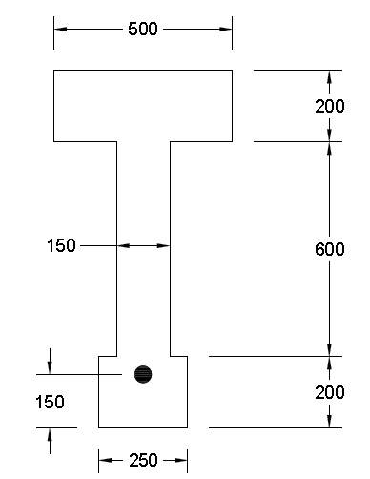
Example 6
The prestressed post tensioned beam shown, service live load moment is 648 kN.m, prestress force after transfer is (Po=1600kN). Assume total losses of 15%, .
Calculate:
1. Crack moment (for Mdl only consider self wt).
2. Stresses at top &bottom Fibers at transfer.
3. Stresses at top &bottom Fibers at service.
Sol.
18m

Slide 25
Mcr = 1009Kn.m > M_{DL}
Note: Cracking moment more than M_{DL} + M_{LL}, The section un cracked.
2. Stressed at transfer (DL + P)
3. At service (DL + LL + Prestress after losses)
, ,
-0.84
17.19
10.44
-1

Slide 26
Example 7
Check the concrete stresses immediately after prestress transfer and at service load for the simply supported beam shown.
Given data:
Roof load = 0.96 kN/m²
Live load= 1.92 kN/m²
Span= 14.63 m
Aps (8-12.7mm) = 8x98.71 = 789.7mm²
e = 248mm
fpu= 1862 MPa , fpy = 1676 MPa , fsi = 1332 MPa
Total losses is 15%
Ac = 289677mm²
Ic = 9.3523 x 10⁹mm⁴
y_{t} = 158.2mm
y_{b}= 451.4mm
Sol.

Slide 27
Sustained load.
1. Stress immediately after transfer
2. At service due to sustained load
2.39
7.16

Slide 28
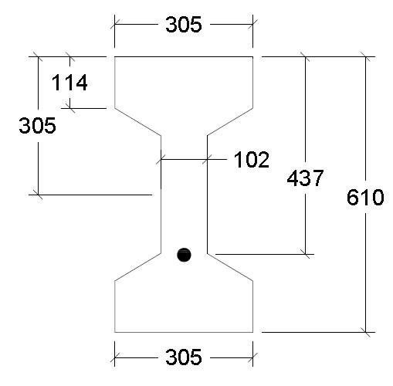
3. Due to total moment.
Comment: either increase section size or increase f`c or decrease l.l. for roof slab.
Example 8
The section of the beam shown is pretensioned with 5-12.7mm (Aps= 494mm²) low relaxation strands Grade 1862, fpu=1862MPa, effective prestress, fse= 1103MPa, =27.6MPa
Calculate the design strength of the beam.
Sol.
For grade 1862 fpu= 1862MPa
Approximate ACI equations are applicable.
, for fpy/fpu=0.9
=0.28, β₁=0.85, w=w¹=0.0
Analysis as flanged sec.
,

Slide 29
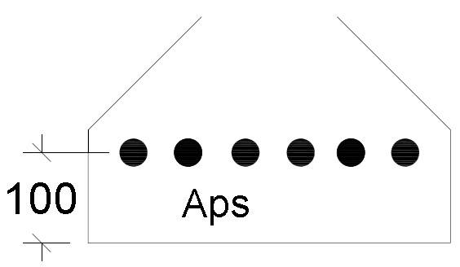
c = a/0.85 =147.9mm, c/d =0.338 ˂ 0.6 tension failure.
tens. Cont. Ø=0.9
Example 9
The longitudinal section of a beam shown below, the beam is post tensioned and to be designed to carry a uniform dist. load (8.76 kN/m as live load and 2.2 kN/m as super imposed dead load) in addition to its own wt., losses of prestress of about 20%
1. Select a section from AASHTO Standard section &
2. Calculate amount of (Aps) required.
3. Check stresses at top &bott. At service.
4. Determine safety factor for the section.
Sol.
1-based on the span length, AASHTO type I can be selected with the following properties

Slide 30
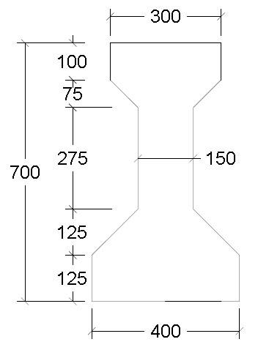
2-Amount of required. strands according to type I, try with 6-12.7mm located at 100mm from bottom of girder.
Check
Resisting moment. (Mr) or Mu
Assume:
,
According to ASTM , for Grade 1862
Mpa
,
For post tension,

Slide 31
3-Check stresses
=0.6 42 =25.2 MPa OK
OK
4- Factor of safety

Slide 32
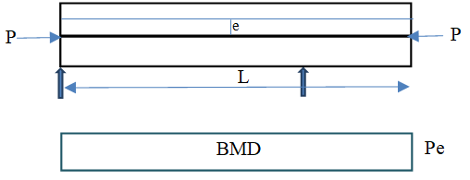
Deflections
Factors influencing deflection:
1. Imposed load & self load
2. Magnitude of prestressing force
3. Cable profile
4. Second moment of area of cross-section
5. Modulus of elasticity of concrete
6. Shrinkage, creep & relaxation of steel stress
7. Span of the member
8. Fixity condition
Deflection due to tendon profile:
1. Straight tendon
Deflection, δ = -P e L² / 8 EI
2. Parabolic tendons (Central Anchors)
Deflection, δ = -5P e L² / 48 EI

Slide 33
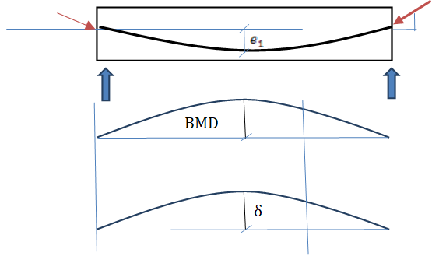
3. Parabolic tendons (Eccentric Anchors)
Deflection, δ = P L² (-5e₁+e₂) / 48 EI
Deflection due to external loads:
1. Deflection due to Dead Load
δ = 5 (DC+DW) L⁴ / 384EI
DC: Self weight of the beam per meter
DW: Uniformly distributed superimposed load per meter
2. Deflection due to live load (Standard Truck according to AASHTO):
δ = R L³ / 48 EI
Note: if the live load is uniformly distributed, use the same equation as for DC.

Slide 34
Example 10:
A concrete beam with cross-sectional area of 32000mm² & the radius of gyration is 72mm is prestressed by a parabolic cable carrying an effective stress of 1000 N/mm2. Modulus of elasticity, E = 38 kN/mm2, the span of the beam is 8 m. The cable, composed of 6 wires of 7mm diameter (Aps₁=38.5mm²), has an eccentricity of 50mm at the centre & zero at the supports. Find the central deflection of the beam due to:
(a) Self-weight + prestress
(b) Self-weight + prestress + live load of 2 kN/m.
Solution: -
Data Provided;
Cross sectional area of beam, A= 32000mm²
Modulus of elasticity, E = 38 kN/mm²;
Unit weight of concrete = 24 kN/mm³;
Radius of gyration, r = 72 mm;
Span, L =8 m =8000 mm;
Eccentricity, e =50 mm
I = Ar² = 166x10⁶mm⁴
Prestressing force, P = 6 x 38.5 x 1000 =231 kN
Self weight, DC = Area x 24 = 0.77 kN/m
Downward deflection due to self weight = 5 (DC+DW)L⁴ / 384EI = 6.5 mm
Upward deflection due to prestressing force = -5P e L² / 48 EI = -12.2 mm
Downward deflection due to live load = 5 (LL)L⁴ / 384EI = 16.9 mm
(a) Deflection due to (self-weight + prestress) =(6.5-12.2) =- 5.7 mm(↑)
(b) Deflection due to (self-weight + prestress + live load) = (6.5-12.2+16.9) =11.2 mm(↓)

Slide 35
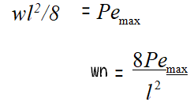
Concept of load balancing
In the prestress concrete, it is possible to select cable profile in such a way that the transverse component of the cable force balances the given type of external loading.
The prestressing force may be considered as an upward uniformly distributed load.
The maximum prestressing moment can be equated to the maximum BM due to upward uniformly distributed load on the beam. So
If wp The downward load
Then net load, w0 = w − wp
Net bending moment, M

Slide 36
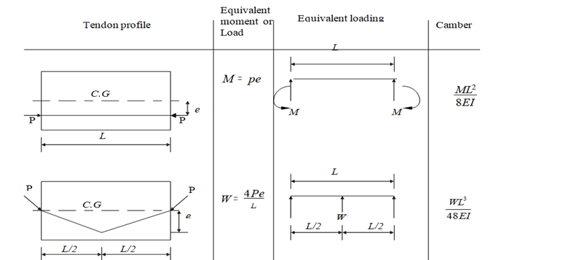
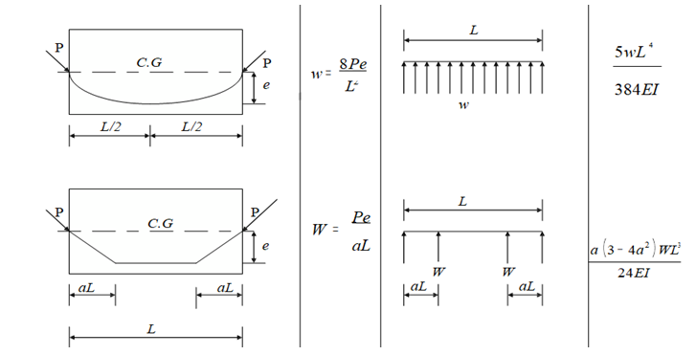

Slide 37
Example 11: (Load balancing concept)
A rectangular concrete beam 300 mm wide, 800 mm deep supports two concentrated loads of 20 kN each at third point of a span of 9 m.
a) Suggest a suitable cable profile. If eccentricity of the cable profile is 100 mm for middle third portion of the beam, calculate the prestressing force required to balance the bending effect of the concentrated loads neglecting the self weight.
b) For the same cable profile find effective force in cable if the resultant stress due to self wt., imposed load, and prestressing force is zero at the bottom fiber of mid span section. (Assume density of concrete = 24 kN/m3)
Solution: -
Here given section = 300 mm × 800 mm; Span (L) = 9 m
For (a) : A trapezoidal cable profile is selected since the bending moment diagram is trapezoidal in shape.
W = P e /α L
P = W x α L / e = 20 x 3000 / 100 = 600 kN
For (b) : Self wt of beam, g = (0.3 × 0.8 × 24) = 5.76 kN/m
Self wt moment, Mg = (0.125 × 5.76 × 92) = 58.32 kNm
Bending stress= M c /I = 1.82 N/mm²
Reactions, LL = 20kN
Moment at center,LL= 20x4.5 – 20x1.5 =60
Stress at center = 60 x10⁶ / 32x10⁶ = 1.875 N/mm
Total tensile bending stress at the bottom fiber = 1.82 + 1.875 = 3.695 N/mm2
Let, P be required prestressing force in cable,
e = 100 mm, Area of the concrete section, A =300 × 800=24 × 104 mm2
Thus,

Slide 38
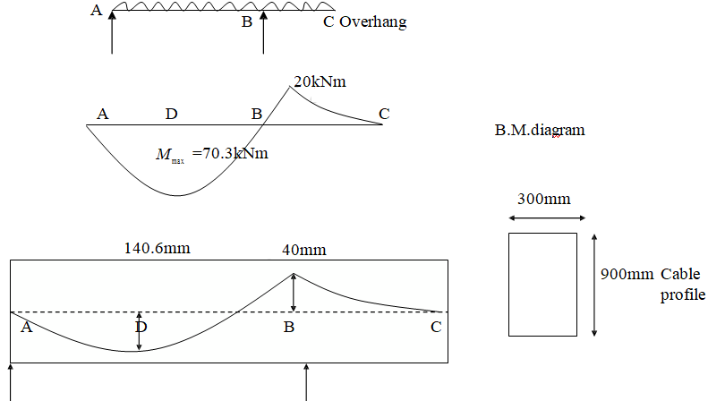
Example 12:- (Concrete beam with over hang)
A concrete beam with a single overhang is simply supported at A & B over a span of 8 m & the overhang BC is 2 m. The beam is of rectangular section 300 mm wide 900 mm deep & supports a uniformly distributed live load of 3.52 kN/m over the entire length in addition to its self-weight. Determine the profile of the prestressing cable with an effective force of 500 kN which can balance the dead & live loads on the beam. Sketch the profile of the cable along the length of the beam. The single overhang beam ABC supporting the UDL is shown in the figure below.
Solution:-
Span = 8 m, overhang = 2 m. Section = 300 mm × 900mm
Udl = 3.52 kN/m

Slide 39
Prestressing force in the cable, P = 500 kN.
Self weight of the beam = (0.3 × 0.9 × 24) = 6.48 kN/m
Live load on the beam = 3.52 kN/m
Thus, the total load = 10.00 kN/m Reactions at A and B are
Ra = 37.5 kN; Rb = 62.5 kN
Mb = 0.5 × 10 × 22 = 20 kN.m
Bending moment at a distance x from a is
M x = 37.5 × x - 0.5 × 10 ×x²
For maximum BM:
Hence, maximum BM = 37.5 × 3.75 – 0.5 × 10 × 3.75² = 70.3 kNm 2
M x = 0, at x = 7.5 m [As, 5x² – 37.5x = 0]
The eccentricity of the cable at the position of maximum BM is
Since the bending moment at point A and C are zero, the cable is concentric at these points. The cable profile is parabolic with eccentricity of 140.6 mm below the centroidal axis at D and 40 mm above the centroidal axis at support section B.

Slide 40
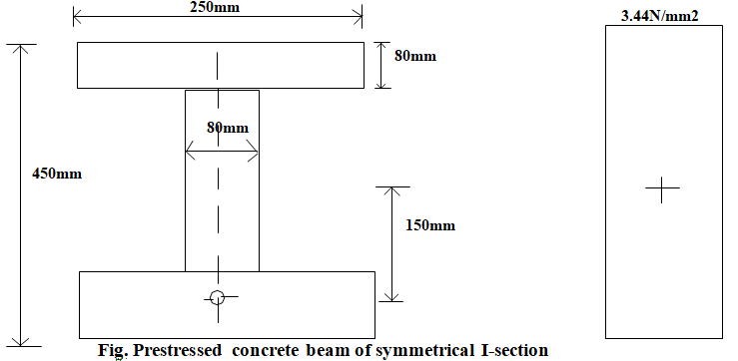
Example 13:-
A beam of symmetrical I-section spanning 8 m has a flange width of 150mm & flange thickness of 80 mm respectively. The overall depth of the beam is 450 mm. Thickness of the web is 80 mm. The beam is prestressed by a parabolic cable with an eccentricity of 150 mm at the centre of the span & zero at the supports. The LL on the beam is 2.5 kN/m.
(a) Determine the effective force in he cable for balancing the DL & LL on the beams.
(b) Sketch the distribution of resultant stress at the centre of span section for the above case.
(c) Calculate the shift of the pressure line from the tendon–centre–line.
Solution:
The properties of the I-section are as follows: Area of the section, A = 0.63 m² & Moment of inertia, I = 1.553×109 mm4
Section modulus, Z = 6.9 ×106 mm3 & Eccentricity, e = 150 mm
Span, L = 8 m
Live load, wl = 2.5 kN/m
Dead load, wd = 0.63 ×25 = 1.57 kN/m [Assuming unit weight of concrete as 25 kN/m3]

Slide 41
The BM at the centre of the span due to DL, Md =(0.125 × 1.57 × 82) =12.56 kN.m
The BM at the centre of the span due to LL, Ml = (0.125 × 2.5 × 82) = 20.00 kN.m
Therefore,
Total moment, M = (Md + Ml ) = 12.56 + 20=32.56 kN.m
If , P tendon force
For load balancing we have
The center–of-span section is subjected to a direct stress of intensity,
Shift pressure line,

