Slide 1
Lecture 1 Introduction to MIS

Slide 2
Outline
Definition of MIS
Objectives of MIS
Advantages of MIS
Roles of MIS
Challenges of MIS
Business Information Systems
The purpose of Information System
Data, Information and Information Systems

Slide 3
Definition of MIS

Slide 4
Definition of MIS
“A formal method of collecting timely information in a presentable form in order to facilitate effective decision making and implementation, in order to carry out organizational operations for the purpose of achieving the organizational goals.”
Walter I. Kennevan

Slide 5
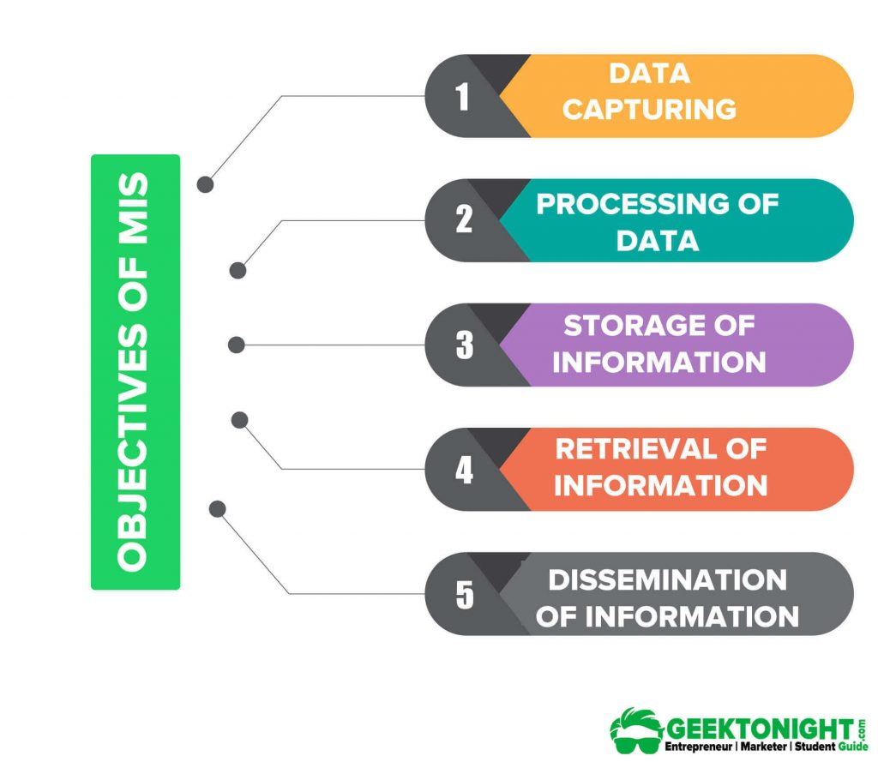
Objectives of MIS
Data Capturing
Processing of Data
Storage
Retrieval
Dissemination

Slide 6
Advantages of MIS
The following are some of the benefits of a good MIS.
Increased customer satisfaction
Improved quantity and quality of information
Improved quality and quantity management decisions
Improved responsiveness number of the competitor’s condition
Improved operational efficiency and flexibility
Improved quality of internal and external communications
Improved quality of planning
Improved quality control and supervision

Slide 7
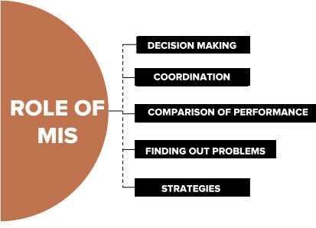
Roles of MIS
A management information system (MIS) plays an important role in business organizations.
Decision making
Coordination among the department
Finding out Problems
Comparison of Business Performance
Strategies for an Organization

Slide 8
Challenges of MIS
There are three major challenges of MIS: high cost, training of employees and maintenance cost. These are briefly discussed below:
High Cost
Training of Employee
Maintenance Cost

Slide 9
Challenges of MIS(Cont’d)
1- High Cost
Development of new computerized based information system is a problem for the organization due to the cost factor and it creates problems because with the change of time there is need of up-to-date of the information system.

Slide 10
Challenges of MIS(Cont’d)
2- Training of Employee
Employees should have the capacity of learning of the information system with the changing competitive and business environment; otherwise, it will be difficult for the organization to stay in the market.

Slide 11
Challenges of MIS(Cont’d)
3- Maintenance Cost
Sometimes a problem arises due to server crash and website crash. Sometimes it leads to the loss of information. So, maintenance cost is needed to tackle the above problem.

Slide 12
Business Information System
Solving problems and Making decisions.
Generating business information.
Managing extensive amount of data.
Gathering useful information from customers to add new products or services.
Does information technology matter?

Slide 13
Purpose of Information Systems
Businesses use information systems
To make sound decisions
To solve problems
Problem is any undesirable situation.
Decision arises when more than one solution to problem exists.
Problem solving and decision making require information.
Keys to success in business are:
Gathering correct information
Storing information
Using information

Slide 14
Data, Information, and Information Systems
“Data”, “information” and “system” are commonly used terms
Important to understand their similarities and differences.
Data: a given or fact.
Can be number, statement, or picture
Information: facts or conclusions that have meaning within context.
Composed of data that is manipulated.

Slide 15
Summary
Definition of MIS
Objectives of MIS
Advantages of MIS
Roles of MIS
Business Information Systems
The purpose of Information System
Data, Information and Information Systems

Slide 16
Questions?

