Slide 1
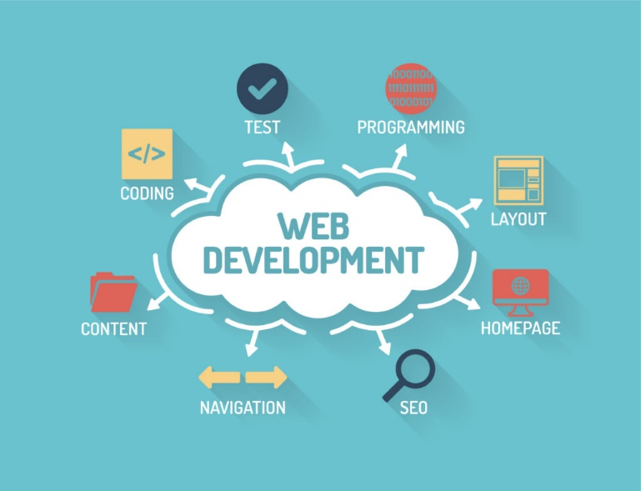
Web Programming II
Salahaddin University-Erbil
College of Science
Computer Science& IT Department
Lecture 2: Java Script
Third Stage CS -Course 2
Mrs. Saja A. Muhammed
Eamil: saja.Muhammed@su.edu.krd
Time & place: Sunday:10:30Am-12:30 pm, Hall 1

Slide 2
Review previous Lecture for 5 Minutes

Slide 3
Lecture Objective
In this lecture we will learn how to write JS code
How to insert code into HTML file
How to output data using JS

Slide 4
Outline
Inserting JS Code Into HTML
JS OUTPUT
Innerhtml
Document.write()
Alert()
Console.log()
External Scripting
JS Statements
Data Type and typeof Operator

Slide 5
Inserting JS Code Into HTML
The primary method of inserting JavaScript into an HTML page is via the < script > element.
The < script > elements has the following attributes:
charset — Optional. The character set of the code specified using the src attribute. This attribute is rarely used, because most browsers do not honor its value.
defer — Optional. Indicates that the execution of the script can safely be delayed until after the document’s content has been completely parsed and displayed.
language — Deprecated. Originally indicated the scripting language being used by the code block (such as “ JavaScript ” , “ JavaScript1.2 ” , or “ VBScript “ ). Most browsers ignore this attribute; it should not be used.
src — Optional. Indicates an external file that contains code to be executed.
type — Required. Seen as a replacement for language ;
There are two ways to use the < script > element: embed JavaScript code directly into the page or include JavaScript from an external file.
3

Slide 6
Inserting JS Code Into HTML
To call it up, you place your JavaScript code between opening <script> and closing </script> HTML tags.
It could be placed inside the head part or inside the body part of the HTML document.
Ex:
<html>
<head><title>Hello World</title></head>
<body>
<script type="text/javascript"> document.write("Hello Third Stage Students")
</script>
</body>
</html>
4

Slide 7
JS OUTPUT
Data in JS can be displayed in these different ways:
In HTML element, using innerHTML.
In HTML output using document.write().
In an alert box, using window.alert().
In the browser console, using console.log().
5

Slide 8
innerHTML
<!DOCTYPE html>
<html>
<body>
<h1>Output in JS using innerHTML </h1>
<p>Watch the paragraph below</p>
<p id="demo"></p>
<script>
document.getElementById("demo").innerHTML = "H"+"E"+"L"+"L"+"O"
</script>
</body>
</html>
document.getElementById(id) is a method that’s used to access an HTML element.
The id attribute defines the HTML element.
The innerHTML property defines the HTML content.
6

Slide 9
window.alert()
Alert() or window.alert() is a method used to display data.
<!DOCTYPE html>
<html>
<body >
<h1>Output in JS using Alert</h1>
<script>
window.alert("HELLO");
//window.alert("H"+"E"+"L"+"L"+"O");
</script>
</body>
</html>
7

Slide 10
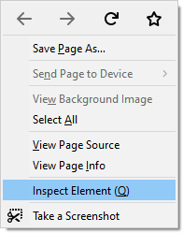
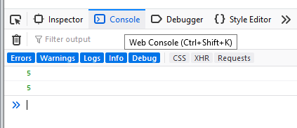
Console.log()
Consol.log() is a method used to display data on console screen. Its almost used for debugging purposes.
<!DOCTYPE html>
<html>
<body>
<script>
Z=2; y=3; x=Z+y;
console.log(x);
console.log(2+3);
</script>
</body>
</html>
To open console screen right click
Anywhere in the document then
Choose inspect element this window→
Will open finally click on console tab
8

Slide 11
Document Writing
document.write simply outputs the supplied string to the current document, where it is displayed.
document.write could be used to write html elements, like “header or a paragraph”.
Syntax:
document.write(exp1, exp2, exp3, ...);
exp1, exp2, exp3, ... Optional. What to write to the output stream. Multiple arguments can be listed and they will be appended to the document in order of occurrence.
//Write some text directly to the HTML document:
document.write("Hello World!");
// This will write a header:
document.write("<h1>Header or title</h1>");
// This will write a paragraph:
document.write("<p>Random Paragraph</p>");
//Write HTML elements with text directly to the HTML document:
document.write("<h1>Hello World!</h1><p>Have a nice day!</p>");
9

Slide 12
Document Writing
The document.writeln() method is similar to write(), only it adds a newline character after each statement.
<body>
<p>Note that write() does NOT add a new line after each statement:</p>
<pre>
<script>
document.write("HelloWorld!"); document.write("Have a nice day!");
</script>
</pre>
<p>Note that writeln() add a new line after each statement:</p>
<pre>
<script>
document.writeln("Hello World!"); document.writeln("Have a nice day!");
</script>
</pre>
</body>
10

Slide 13
Document Writing
//Write some text directly to the HTML document, with a new line after each statement (using <br>):
document.write("Hello World! <br>"); document.write("Have a nice day!");
//Write the Date object directly to the HTML document:
document.write(Date());
//Write thebold date as string
<p> The current date and time is:<br>
<script type="text/javascript">
document.write("<strong> " + (new Date()) + " </strong> ");
</script >
</p>
<noscript> and </noscript> pair of tags. These are used when you wish to offer alternative HTML to users whose browsers do not support JavaScript or who have it disabled.
11

Slide 14
External Scripting
In addition to writing JavaScript code directly in HTML documents, you can include external files of JavaScript code.
The syntax for this is:
<script type="text/javascript" src="scriptFileName.js"></script>
There is no need for the <script>and </script> tags in the external js file.
// symbol is used to denote that everything follows on that line must be ignored.
Ex. // This is a comment
For multiline comments /* Comment */ is used Ex: /* This is a section of multiline
comments that will not be interpreted */
12

Slide 15
JS Statements
Statements are terminated by a semicolon, though omitting the semicolon makes the parser
determine where the end of a statement occurs, as in the following examples:
var sum = a + b //valid even without a semicolon - not recommended
var diff = a - b; //valid - preferred
Including semicolons helps prevent errors of omission, such as not finishing what you were typing, and allows developers to compress the Script code by removing extra white space (such compression causes syntax errors when lines do not end in a semicolon).
Multiple statements can be combined into a code block by using C - style syntax, beginning with a left curly brace ( { ) and ending with a right curly brace ( } ):
if (test)
{ test=false; alert(test); }
Control statements, such as if, requires code blocks only when executing multiple statements. However, it is considered a best practice to always use code blocks with control statements, even if there’s only one statement to be executed, as in the following examples:
if (test) alert(test); //valid, but error-prone and should be avoided
if (test) { alert(test); } //preferred
13

Slide 16
Data Type and typeof Operator
Because JS is, loosely typed (meaning that a variable can hold any type of data) there needs to be a way to determine the data type of a given variable.
The typeof operator provides that information.
Using the typeof operator on a value returns one of the following strings:
“undefined” →if the value is undefined
Examples
var s = “Nicholas”; var b = true;
var i = 22; var u;
var n = null;
var o = new Object();
alert(typeof s); //string
alert(typeof b); //boolean alert(typeof i); //number alert(typeof u); //undefined alert(typeof n); //object alert(typeof o); //object
“boolean”→
“string” →
“number” →
“object” →
if the value is a Boolean if the value is a string
if the value is a number
if the value is an object or null
“function” → if the value is a function
The typeof operator is called like this:
var message = “some string”; alert(typeof message); //”string” alert(typeof(message)); //”string” alert(typeof 95); //”number”
Note that because typeof is an operator and not a function, no parentheses are required (although they can be used).
14

Slide 17
H.W 1
Q1) Write js program to print the date of today as h1?
Q2) Write js program to type the area of 10x20 rectangle in console screen?
Q3)Write js program to show “Welcome” message to all page users?
Q4) Write js program to print the type of 4 different variables on a webpage?
Q5)Write js program to change the content of a paragraph to “I’ve been changed”?
Q6) Write js program to print each word of this message on a line “ hello third stage”?

Slide 18
Reference

Slide 19
Questions?

