Slide 1
University of salahaddin / Erbil Computer science & Information technology department third stage Web Design & Programming I
Saja A. Muhammed
MSc. Computer science (Salahaddin Uni.)
BSc. Computer Science (Baghdad Uni.)
E-Mail: saja.muhammed@su.edu.krd
Lecture date and time:
Sunday 10:30 3rd CS Hall(1)
2022-2023

Slide 2
Outline
Review Previous Lecture
Objectives and Outcome
Images in HTML
Image Map in HTML
Colors in HTML
Summary
Next Lecture
Home Work
References

Slide 3
Review Previous Lecture
Html <p> tag is used to insert a paragraph
Html <h1>…<h5> tags are used to insert different sizes headings.
Html <b> tag is used to change the font style to bold text.
Html <i> tag is used to change the font style to italic text.
Html <u> tag is used to change the font style to underlined text.

Slide 4
Objectives
In this lecture we will learn the following:
How to insert an image into a web page
How to map an image
Colors in HTML
Outcome
At end of this lecture students will be able to write html code to insert any image saved in different location to their webpage.
Write html code to map the inserted image.
And manipulate colors in HTML

Slide 5
HTML Images
Images are very important to beautify as well as to depict many complex concepts in simple way on your web page.
You can insert any image in your web page by using <img> tag.
Following is the simple syntax to use this tag.
< img src = “Image URL” >

Slide 6
HTML Image Attributes
An HTML img tag can have following attributes:
Src: The src attribute defines the url (web address) of the image.
Src=“ image name. image type”
Width/Height: You can set image width and height based on your requirement using width and height attributes. You can specify width and height of the image in terms of either pixels or percentage of its actual size.
Width=“200px”

Slide 7
HTML Image Attributes
Image Alignment: specifies how to align an image within the text “top middle..”.
Align=“top”
Image Border: By default image will have a border around it, you can specify border thickness in terms of pixels using border attribute. A thickness of 0 means, no border around the picture.
Border=“4px”
Alt: The alt attribute specifies an alternate text for the image, if it cannot be displayed.
Alt=“red flower image”

Slide 8
Image Map
Image maps are images that have been divided into regions; clicking in a region of the image cause the web browser to be surf a new URL. Image maps are graphical form of creating links between pages.
There are two type of image maps:
Client side and server side
Both types of image maps involve a listing of coordinates
Coordinates define the mapping regions and which URLs those coordinates are associated with.
This is known as the map file.

Slide 9
Image Maps
Client-side image maps (USEMAP) use a map file that is part of the HTML document (in an element called MAP), and is linked to the image by the Web browser.
Ex:
<IMG SRC="note.GIF" Width=200 Height=200 border="5" USEMAP="#map1">
<MAP NAME="map1">
<AREA SHAPE="RECT" COORDS="0,0,90,90" HREF="hi.html" ALT="see me…">
<AREA SHAPE="RECT" COORDS="100,100,160,160" HREF="divPara.html" ALT="see him…" >
<AREA SHAPE="CIRCLE" COORDS="150,50,20" HREF="house.html" ALT="see it">
</MAP>
We can use Poly as well as Rect……

Slide 10
Map tag
The <map> tag is used to define a client-side image-map. An image-map is an image with clickable areas.
The required name attribute of the <map> element is associated with the <img>'s usemap attribute and creates a relationship between the image and the map.
The <map> element contains a number of <area> elements, that defines the clickable areas in the image

Slide 11
Area tag Attributes:
The <area> element is always nested inside a <map> tag.
Shape:This attribute specifies the shape of an area.and it’s used together with the coords attribute to specify the size, shape, and placement of an area.
Ex: <area shape="rect|circle">
Notes:
Default doesn’t need coords all img will be map

Slide 12
Area tag Attributes
Coords:This attribute specifies the coordinates of an area in an image-map.The coordinates of the top-left corner of an area are 0,0.
x1,y1,x2,y2: Specifies the coordinates of the left, top, right, bottom corner of the rectangle (for shape="rect")
x,y,radius: Specifies the coordinates of the circle center and the radius (for shape="circle")
href: Specifies the hyperlink target for the area.
Notes:
Default doesn’t need coords all img will be map

Slide 13
Area shapes used!

Slide 14
Shapes, Coords
Types of Shapes
Rect : used for squares and ordered shapes.
Circle : used for circles.
Poly : used for unordered shapes.
Number of coordenations for each shape:
Rect : 4 numbers for two corners
Circle : 3 numbers for the center & R
Poly : depends on the number of corners of the shape( 2 numbers for each corner)

Slide 15
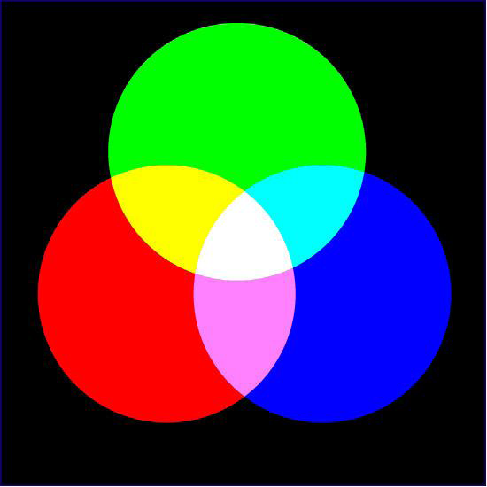
HTML Colors
There are following three different methods to set colours in your web page:
Color names: You can specify color names directly like green, blue or red.
e.g.1 : setting background color <body style=”background-color : lime”>
e.g.2 : setting border color of an image <img src=“penguins.jpg”
style=“border: green dotted 2px ”>
G
R
B
Main colors

Slide 16
HTML Colors
2. Hex codes: The hex color code is a 6 or 3 digit (short-form) hexadecimal (base 16) value. The most common way to specify a color in design is via the hex color code value. There are 16,777,216 colors to choose from.
e.g.1 : setting background color as cyan color
<body style="background-color:#00ffff">
e.g.2 : setting border color of an image as green color
<img src=“penguins.jpg” style="border : #00ff00 double 4px“>

Slide 17
Colors Hexa Code

Slide 18
HTML Colors
3. Color decimal or percentage values: RGB is an acronym which stands for Red, Green, and Blue. Each value ranges from 0 to 255. It is represented as a three-dimensional coordinate i.e. (R,G,B).
e.g. 1: Setting background color as blue
<body style="background-color :rgb(0,0, 255)">
e.g. 2 : setting border color of an image as red
<img src=“shek.jpg" style="border : rgb(255,0,0) double 4px“>

Slide 19
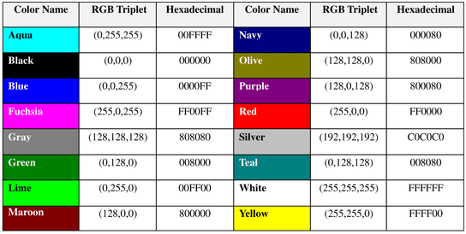
All three formats of 16 basic colors

Slide 20
Summery
HTML <img> tag allow the web developer to insert images saved in separate files into their webpage.
HTML <map> file allows to divide an image into regions
Three main color types are exist in html
Decimal
Color name
And, Hexacode colors

Slide 21
Next Lecture
Next lecture we will learn the following:
HTML Lists Types
HTML Tables

Slide 22
Homework
What are the advantages of adding “alt” attribute within HTML <img> element?
H.W. Deadline is Saturday 21th Oct. 12:00 AM.
Searching the net for the answer is allowed.
Copy paste answers are not allowed.

Slide 23
References
F. Elezabith and F. Eric.(2006). Head First HTML.USA:O’Reilly Media, Inc.
www.w3schools.com. Online web tutorial . Avilable at[https://www.w3schools.com/]

Slide 24
Thanks for your attention
Please don’t hesitate to ask any question about todays subject
If you didn’t ask you’ll never know!

