Slide 1
Statements

Slide 2
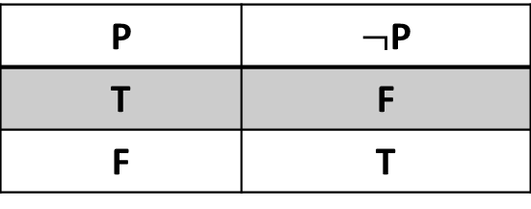
Statement: Statement is any collection of symbols, which is either true or false but not both denoted by capital letter. Logical Connectives and Truth Table Negation: The negation of statement is generally formed by prefixing the statement with the word “not” and denote by “$¬$” , So if P is statement then “$¬$P” is its negation read as “not P”. The Truth Table for the Negation
P | $¬$P
T | F
F | T

Slide 3
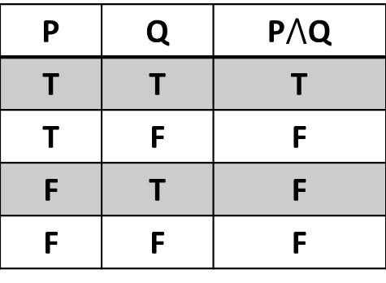
Conjunction: The conjunction of two simple statements P and Q is the statement (P$⋀$Q) which read as P and Q. it has truth value T whenever both P and Q are T otherwise F. The Truth Table for the Conjunction
P | Q | P$⋀$Q
T | T | T
T | F | F
F | T | F
F | F | F

Slide 4
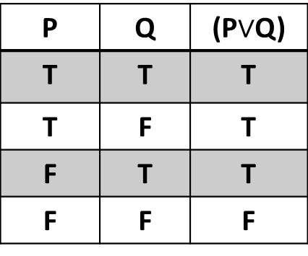
Disjunction: The disjunction of two simple statements P and Q is the statement (P$∨$Q) which read as P or Q. it has truth value F whenever both P and Q are F otherwise T. The Truth Table for the Disjunction
P | Q | (P$∨$Q)
T | T | T
T | F | T
F | T | T
F | F | F

Slide 5
Conditional and Biconditional Statements Conditional Statement: Let p and q be Statements (propositions). The conditional statement p → q is the proposition “if p, then q.” The conditional statement p → q is false when p is true and q is false, and true otherwise. In the conditional statement p → q, p is called the hypothesis (or antecedent or premise) and q is called the conclusion (or consequence).

Slide 6
The Truth Table for the Conditional Statement
p | q | p → q
T | T | T
T | F | F
F | T | T
F | F | T
Note: In English language and mathematics, each of the following expressions is an equivalent form of the conditional statement

Slide 7
“if p, then q” “p implies q” “if p, q” “p only if q” “p is sufficient for q” “a sufficient condition for q is p” “q if p” “q whenever p” “q when p”

Slide 8
“q is necessary for p” “a necessary condition for p is q” “q follows from p” “q unless ￢p” Biconditional Statement: Let p and q be Statements (propositions). The biconditional statement p ↔ q is the proposition “p if and only if q.” The biconditional statement p ↔ q is true when

Slide 9
p and q have the same truth values, and is false otherwise. Biconditional statements are also called bi-implications. The Truth Table for the Biconditional Statement
p | q | p ↔ q
T | T | T
T | F | F
F | T | F
F | F | T

Slide 10
Note: In English language and mathematics, each of the following expressions is an equivalent form of the biconditional statement: “p is necessary and sufficient for q” “if p then q, and conversely” “p iff q.” Tautology: A compound proposition that is always true, no matter what the truth values of the propositional variables that occur in it, is called a tautology.

Slide 11
Contradiction: A compound proposition that is always false is called a contradiction. Contingency: A compound proposition that is neither a tautology nor a contradiction is called a contingency. Equivalence Statements: Let A and B are two statements. Formula consist of p₁, p₂,……..p_{n}, if the truth value of A is equal to the truth value of B for every one of 2^{n} possible sets of the truth values assigned to (p₁, p₂,……..p_{n}), then A and B are said to be Equivalence and denoted by A ≡ B .

Slide 12
Laws of Algebra for Propositions 1. Associative laws (p ∨ q) ∨ r ≡ p ∨ (q ∨ r) (p ∧ q) ∧ r ≡ p ∧ (q ∧ r) 2. Commutative laws p ∨ q ≡ q ∨ p p ∧ q ≡ q ∧ p 3. Idempotent laws p ∨ p ≡ p p ∧ p ≡ p

Slide 13
4. Distributive laws p ∨ (q ∧ r) ≡ (p ∨ q) ∧ (p ∨ r) p ∧ (q ∨ r) ≡ (p ∧ q) ∨ (p ∧ r) 5. De Morgan’s laws ￢(p ∧ q) ≡ ￢p ∨￢q ￢(p ∨ q) ≡ ￢p ∧￢q 6. Double negation law ￢(￢p) ≡ p 7. p → q ≡ ￢p ∨ q

Slide 14
8. Identity laws p ∧ T ≡ p p ∨ F ≡ p 9. Domination laws p ∨ T ≡ T p ∧ F ≡ F 10. Negation laws or (Complement laws) p ∨￢p ≡ T p ∧￢p ≡ F 11. Absorption laws p ∨ (p ∧ q) ≡ p p ∧ (p ∨ q) ≡ p

Slide 15
Predicates: Statements involving variables, such as: “x > 3,” “x = y + 3,” “x + y = z,” and “computer x is under attack by an intruder,” and “computer x is functioning properly,” are often found in mathematical assertions, in computer programs, and in system specifications. These statements are neither true nor false when the values of the variables are not specified. In this section, we will discuss the ways that propositions can be produced from such statements.

Slide 16
The statement “x is greater than 3” has two parts. The first part, the variable x, is the subject of the statement. The second part—the predicate, “is greater than 3”—refers to a property that the subject of the statement can have. We can denote the statement “x is greater than 3” by P(x), where P denotes the predicate “is greater than 3” and x is the variable. The statement P(x) is also said to be the value of the propositional function P at x. Once a value has been assigned to the variable x, the statement P(x) becomes a proposition and has a truth value.

Slide 17
Statement Function: Let H be a predicate “is a strong” and let b=Ali, c=Kurdistan, d= building, if we write H(x) for x is a strong, then H(b), H(c), H(d) all denote statements, which are obtained the form H(x) by replacing object (x) by appropriate name since H(x) is not statement but statement function and is a simple statement function. A compound statement function consists of one or more simple statement function compound by logical connectives.

Slide 18
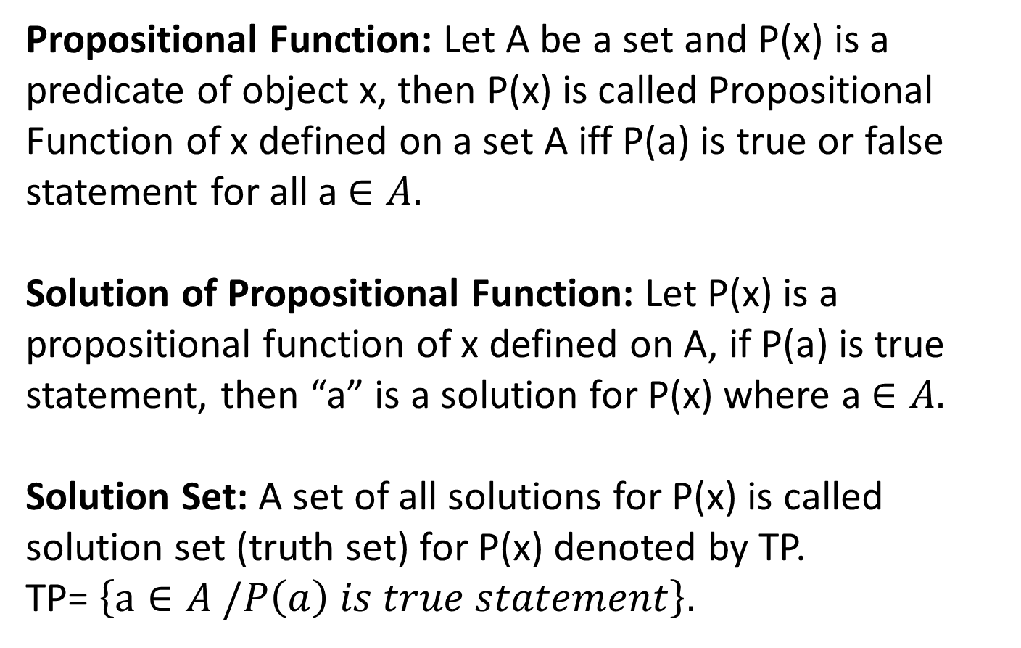
Propositional Function: Let A be a set and P(x) is a predicate of object x, then P(x) is called Propositional Function of x defined on a set A iff P(a) is true or false statement for all a $∈A.$ Solution of Propositional Function: Let P(x) is a propositional function of x defined on A, if P(a) is true statement, then “a” is a solution for P(x) where a $∈A.$ Solution Set: A set of all solutions for P(x) is called solution set (truth set) for P(x) denoted by TP. TP= $\left\{a∈A /P\left(a\right) is true statement\right\}.$

Slide 19
Quantifiers: Universal Quantifier: Let P(x) be a propositional function of x defined on A. the statement (for all $x ∈A$ P(x) is true) is called Universal Quantifier, which is denoted by $∀ x ∈A, P\left(x\right).$ Note: the Universal Quantifier was used to translate expressions such as: for every for any for all for each given any for arbitrary

Slide 20
Existential Quantifier: Let P(x) be a propositional function of x defined on A. the statement (there exist $x ∈A$ P(x) is true) is called Existential Quantifier, which is denoted by $∃ x ∈A, P\left(x\right).$ Note: the Existential Quantifier was used to translate expressions such as: there exist there is at least for some there is

Slide 21
Negation of Propositions which contain quantifiers: -∀x P(x). ￢∀x P(x) ≡ ∃x ￢P(x). -∃x P(x). ￢∃x P(x) ≡ ∀x ￢P(x).

