Slide 1
Concepts of Graph Theory

Slide 2
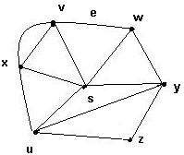
Introduction
What is a graph ?
It is a pair G = (V, E), where
V = V(G) = set of vertices
E = E(G) = set of edges
Example:
V = {s, u, v, w, x, y, z}
E = {(x,s), (x,v), (x,u), (v,w),
(s,v), (s,u), (s,w), (s,y), (w,y), (u,y), (u,z),(y,z)}

Slide 3
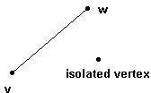
Edges
An edge may be labeled by a pair of vertices, for instance e = (v,w).
e is said to be incident on v and w.
Isolated vertex = a vertex without incident edges.

Slide 4
The KÖnigsberg Bridge Problem
Königsber is a city on the Pregel river in Prussia
The city occupied two islands plus areas on both banks
Problem:
Whether they could leave home, cross every bridge exactly once, and return home.
X
W
Y
Z

Slide 5
A Model
A vertex : a region
An edge : a path(bridge) between two regions
X
e₁
e₆
X
e
2
W
Y
W
Y
e₅
e₄
e
e
Z
3
7
Z

Slide 6
Order and Size
The order of a graph G, written n (G ), is the number of vertices in G.
An n-vertex graph is a graph of order n.
The size of a graph G, written e (G ), is the number of edges in G.
For n∈N, the notation [n ] indicates the set
{1,…, n }.

Slide 7
Loop, Multiple edges
Loop : An edge whose endpoints are equal
Multiple edges : Edges have the same pair of endpoints
Multiple edges
loop

Slide 8
Adjacent, neighbors
Two vertices are adjacent and are neighbors
if they are the endpoints of an edge
Example:
A and B are adjacent
A and D are not adjacent
A
B
C
D

Slide 9
Finite Graph, Null Graph
Finite graph : an graph whose vertex set and edge set are finite
Null graph : the graph whose vertex set and edges are empty

Slide 10
Connected and Disconnected
Connected : There exists at least one path between two vertices
Disconnected : Otherwise
Example:
H₁ and H₂ are connected
H₃ is disconnected
b b
a
a
H
c
H
H₃
c
1
2
e
e
d
d
d

Slide 11
Subgraphs
❑ A subgraph of a graph G is a graph H such that:
– V(H) ⊆ V(G) and E(H) ⊆ E(G) and
– The assignment of endpoints to edges in H is the same as in G.

Slide 12
Subgraphs
❑ Example: H₁, H₂, and H₃ are subgraphs of G
a
b
G
c
e
d
a
b
a
b
c
H₃
c
H
H
1
d
2
e
d
e
d

Slide 13
Walks, Trails
A walk : a list of vertices and edges v₀, e₁, v₁,
…., e_{k}, v_{k} such that, for 1 ≤ i ≤ k, the edge e_{i}
has endpoints v_{i-1} and v_{i} .
A trail : a walk with no repeated edge.

Slide 14
Paths
A u,v-walk or u,v-trail has first vertex u and last vertex v; these are its endpoints.
A u,v-path : a u,v-trail with no repeated vertex.
The length of a walk, trail, path, or cycle is its number of edges.
A walk or trail is closed if its endpoints are the same.

Slide 15
Path and Cycle
❑ Path : a sequence of distinct vertices such that two consecutive vertices are adjacent
– Example: (a, d, c, b, e) is a path
– (a, b, e, d, c, b, e, d) is not a path; it is a walk
❑ Cycle : a closed Path
– Example: (a, d, c, b, e, a) is a cycle
a
b
c
e
d

Slide 16
Components
The components of a graph G are its maximal connected subgraphs
A component (or graph) is trivial if it has no edges; otherwise it is nontrivial
An isolated vertex is a vertex of degree 0
r
s
u v
w
y z
q
t
p
x

Slide 17
Theorem: Every graph with n vertices and k
edges has at least n-k components .
Proof:
An n-vertex graph with no edges has n
components
Each edge added reduces this by at most 1
If k edges are added, then the number of components is at least n - k

Slide 18
Theorem: Every graph with n vertices and k edges has at least n-k components.
❑ Examples:
n =2, k =1,
1 component
n =3, k =2,
1 component
n =6, k =3,
3 components
n =6, k =3,
4 components

Slide 19
Complement
❑ Complement of G: The complement G’ of a simple graph G :
– A simple graph
– V(G’) = V(G)
– E(G’) = { uv | uv ∉E(G) }
u
u
v
y
G’
v
G
y
w
x
w
x

Slide 20
Clique and Independent set
A Clique in a graph: a set of pairwise adjacent vertices (a complete subgraph)
An independent set in a graph: a set of pairwise nonadjacent vertices
Example:
– {x, y, u} is a clique in G
– {u, w} is an independent set
u
G
v
y
x
w

Slide 21
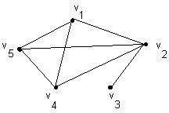
Simple graph
A simple graph G (V , E) consists of a non-empty set of vertices ‘V’ and a set ‘E’ of edges,
such that each edge ‘e’ belongs to E is associated with an unordered pair of distinct vertices, called its endpoints.
It is a simple graph.
Multiple edges
loop
It is not simple graph.

Slide 22
Multigraphs (or Pseudo-graphs)
Loop : An edge whose endpoints are same
Multiple edges : Edges have the same pair of endpoints
Unlike simple graphs, it contains the edges with same endpoints.
Multiple edges
Loop
Note: Multigraphs doesn’t contain loops.

Slide 23
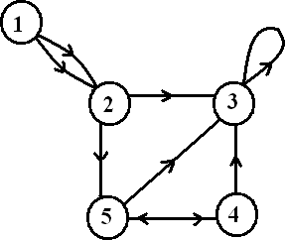
Digraphs
A digraph is a pair G = (V , A) of a set ‘V’, whose elements are called vertices or nodes,
With a set ‘A’ of ordered pairs of vertices, called arcs, directed edges, or arrows (and sometimes simply edges with the corresponding set named E instead of A).
loop
multiple arc
arc
node

Slide 24
Graph Terminology
Type | Edges | Multiple Edges Allowed? | Loops Allowed?
Simple graph | Undirected | No | No
Multigraph | Undirected | Yes | No
Pseudo graph | Undirected | Yes | Yes
Simple Directed graph | Directed | No | No
Directed Multigraph | Directed | Yes | Yes
Mixed graph | Undirected & Directed | Yes | Yes

Slide 25
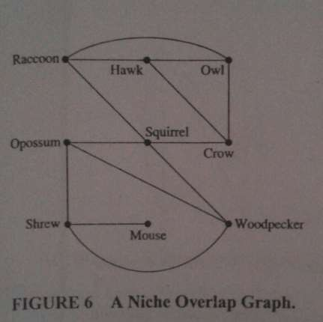
Graph Models
1. NICHE OVERLAP
Graphs in Ecosystem
Graphs are used in many models involving the interaction of different species of animals. For instance, the competition b/w species in an ecosystem can be modeled using a niche overlap graph.

Slide 26
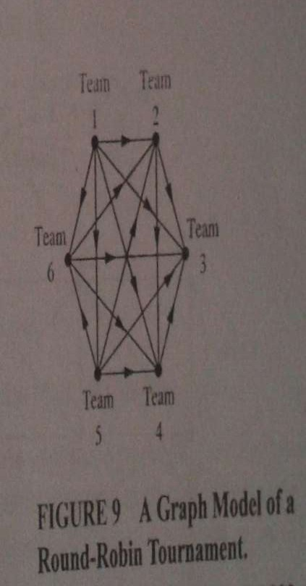
2. Round-Robin Tournaments
A tournament where each team plays each other team exactly once is called a round- robin tournament. Such tournaments can be modeled using directed graphs where each team is represented by a vertex.
Note: (a , b) is an edge if team a beats team b and if the edge is directed in the vertex then that team is defeated by the other one and vice-versa.

Slide 27
Degree of graph
The degree of a vertex in a simple graph, denoted by deg(v), is
the number of edges incident on it.
Degree also means number of adjacent vertices. For a Node,
The number of head endpoints adjacent to a node is called the Indegree and it is denoted by deg⁻ (v).
The number of tail endpoints adjacent to a node is called
Outdegree and it is denoted by deg⁺ (v).

Slide 28
For example in the digraph,
Out-deg(1) = 2
In-deg(1) = 0
Out-deg(2) = 2
In-deg(2) = 2
Out-deg(3) = 1
In-deg(3) = 4
And so on…….

Slide 29
Degree of Graph
The degree of vertex v in a graph G, written or d (v ), is the number of edges incident
to v, except that each loop at v counts twice
The maximal degree is Δ(G )
The minimum degree is δ (G )
G
A
B
d(B) = 3, d(C) = 2
Δ(G) = 3, δ(G) = 2
F
C
E
D

Slide 30
Handshaking Lemma
Let G = (V , E) be an undirected graph with e edges. Then,
2e = _{𝒗∈𝑽} 𝒅𝒆𝒈( ).
For example,
How many edges are there in a graph with 10 vertices each of degree six?
Solution:
deg( ) = 6*10 = 60
which follows 2e = 60 ,i.e., e = 30

Slide 31
Corollary of Handshaking theorem
Theorem:
In any simple graph, there are an even number of vertices of odd
degree.

Slide 32
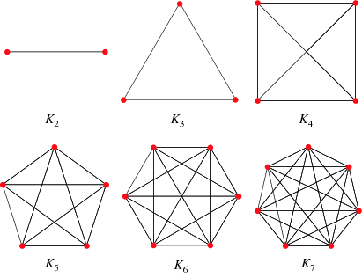
Some Special Graphs
1. Complete graph K_{n} :
The complete graph K_{n} is the graph with ‘n’ vertices and every pair of vertices is joined by an edge , like in Mesh topology.
The figure represents K₂,K₃,………,K₇.

Slide 33
2. Cycle Graph :
A cycle graph C_{n} , where n >= 3, sometimes simply known as an n- Cycle, is a graph on n nodes , 1,2,…….,n , and edges {1,2} , {2,3} , …. , {n-1,n} , {n,1}.
C₅
C₃
C₄
C₆

Slide 34
3. Wheel Graph :
A Wheel graph W_{n} contain an additional vertex to the cycle C_{n}, for n>=3 , and connect this new vertex to each of the n vertices in C_{n}, by new edges. The wheels W₃ , W₄ , W₅ , W₆ are displayed below.
W₅
W₃
W₄
W₆

Slide 35
4. N-Cube :
The n-cube (hypercube) Q_{n} is the graph whose vertices represent 2^{n} bit strings of length n. Two vertices are adjacent if and only if the bit strings differ in exactly one position.
110
111
 | 101
010
100
Figure represents
Q₃
011
000
001

Slide 36
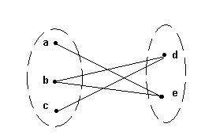
Bipartite Graphs
A bipartite graph G is a graph such that
– V(G) = V(G₁) ∪ V(G₂)
– |V(G₁)| = m, |V(G₂)| = n
– V(G₁) ∩V(G₂) = Ø
No edges exist between any two vertices in the same subset V(G_{k}), k = 1,2
G
G
1
2

Slide 37
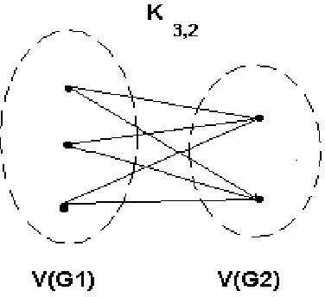
Complete Bipartite graph K_{m,n}
A bipartite graph is the complete bipartite graph K_{m,n} if every vertex in V(G₁) is joined to a vertex in V(G₂) and conversely,
|V(G₁)| = m , |V(G₂)| = n

Slide 38
Bipartite Graphs in terms of Graph Coloring
Theorem:
A simple graph is bipartite if and only if it is possible to assign one of two different colors to each vertex of the graph so that no two adjacent vertices are assigned the same color.
^{K}2 , 3
V₁
V₂

Slide 39
Proof:
First, suppose that G = (V , E) is a simple graph. Then V = V₁ U V₂, where V₁ and V₂ are disjoint sets and every edge in E connects a vertex in V₁ and a vertex in V₂. If we assign one color to each vertex in V₁ and a second color to each vertex in V₂, then no two adjacent vertices are assigned the same color.
Now suppose that it is possible to assign colors to the vertices of the graph using just two colors so that no two adjacent vertices are assigned the same color. Let V₁ be the set of vertices assigned one color and V₂ be the set of vertices assigned the other color. Then, V₁ and V₂ are disjoint and V = V₁ U V₂. Furthermore, every edge connects a vertex in V₁ and a vertex in V₂ because no two adjacent vertices are either both in V₁ or both in V₂.
Consequently, G is bipartite.

Slide 40
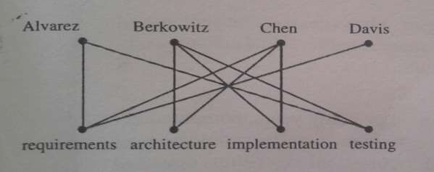
Applications of Special Types of Graphs
1. Job Assignments :
Suppose that there are m employees in a group and j different jobs that need to be done where m<=j. Each employee is trained to do one or more of these j jobs. We can use a graph to model employee capabilities. We represent each employee by a vertex and each job by a vertex. For each employee, we include an edge from the vertex representing that employee to the vertices representing all jobs the employee has been trained to do.

Slide 41
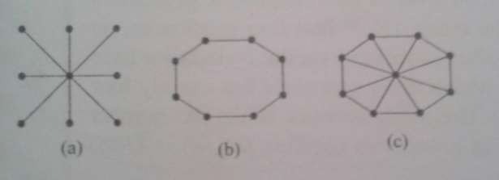
2. Local Area Network :
Various computers in a building, such as minicomputers and personal computers, as well as peripheral devices such as printers and plotters, can be where all devices are connected to a central control device. A local network can be represented using a complete bipartite graph K_{1,n}. Messages are sent from device to device through the central control device.
Other local area networks are based on a ring topology, where each device is connected to exactly two others. Local area networks with a ring topology are modeled using n-cycles, C_{n}. Messages are sent from device to device around the cycle until the intended recipient of a message is reached.

