Slide 1
Digital Communication
4th year/ Electronic and Communication Eng.
Prof. Dr Samah Abdulkareem Mustafa

Slide 2
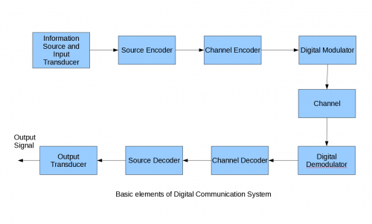
Basic elements of digital communication system
http://wirelesscafe.wordpress.com/2009/07/10/tutorial-i-basic-elements-of-digital-communication-system/

Slide 3
Why digital communication ?
Digital cct.
Resolution
Storage size
Error performance
Regeneration

Slide 4
Pulse Code Modulation PCM
Sampling
PAM or PPM or PWM
Quantization
Linear
Nonlinear
Binary encoding
Line coding

Slide 5
Sampling theorem
It shows that a bandlimited analog signal that has been sampled can be perfectly reconstructed from an infinite sequence of samples if the sampling rate exceeds or equal 2B samples per second, where B is the highest frequency of the original signal
Otherwise it leads to aliasing
It refers to an effect that causes different signals to become indistinguishable (or aliases of one another) when sampled. It also refers to the distortion that results when the signal reconstructed from samples is different from the original continuous signal.

Slide 6
Some amount of aliasing always occurs when such signals are sampled.
Actual signals have finite duration and their frequency content has no upper bound (Fourier Transform).
Signals whose frequency content is bounded (bandlimited) have infinite duration, is sampled at a low rate

Slide 7
Introduction
let
x(t) represent a continuous-time signal
X(f) be the continuous Fourier transform of that signal
The signal x(t) is said to be bandlimited if
|X(f)|=0 if |f|>B
Then the sufficient condition for exact reconstructability from samples at a uniform sampling rate f_{s} (in samples per sec) is fs>= 2B
2B is called the Nyquist rate of the bandlimited signal, while f_{s}/2 is called the Nyquist frequency of the sampling system.
The time interval between successive samples is referred to as the sampling interval Ts

Slide 8
The theorem describes two processes in signal processing:
a sampling process, in which a continuous time signal is converted to a discrete time signal, and
a reconstruction process, in which the original continuous signal is recovered from the discrete time signal.
Reconstruction of the original signal is an interpolation process that mathematically defines a continuous-time signal x(t) from the discrete samples x[n] and at times in between the sample instants nTs

Slide 9
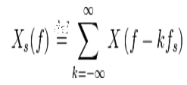
If fs > 2B

Slide 10
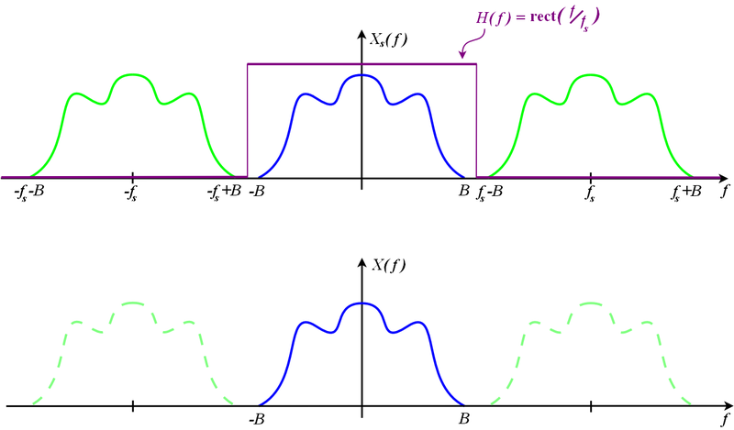

Slide 11
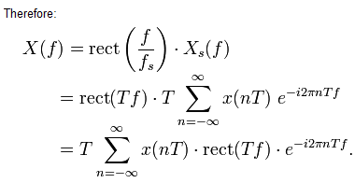
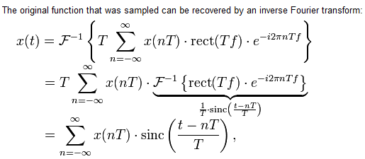

Slide 12
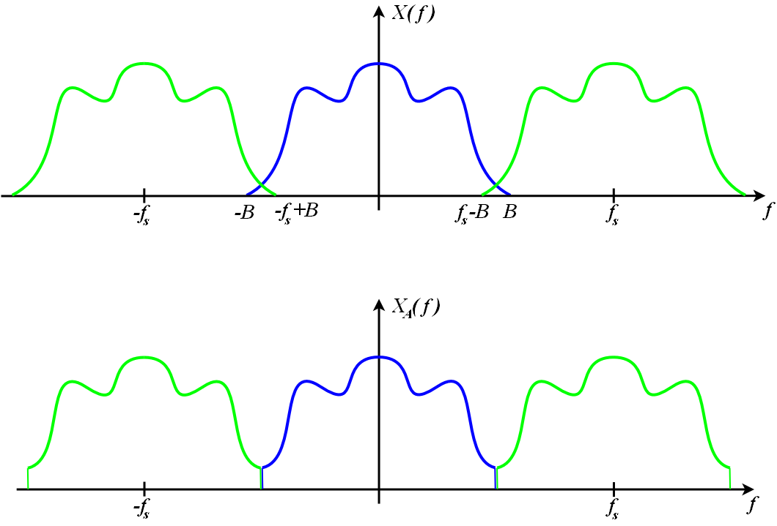
If fs < 2B → down sampling → aliasing

Slide 13
If fs < 2B → down sampling → aliasing

Slide 14
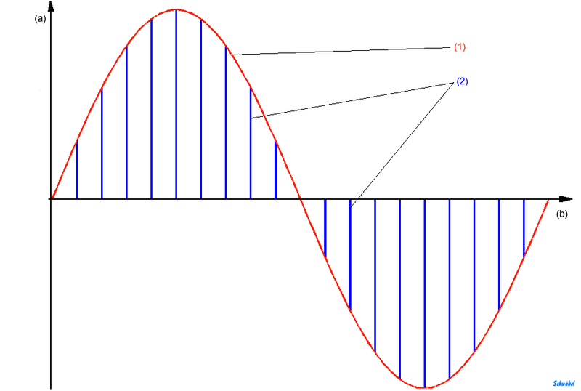
Pulse Amplitude Modulation
In PAM, the information is encoded in the amplitude of a series of signal pulses.
Demodulation is performed by detecting the amplitude level of the carrier at every symbol period.

Slide 15
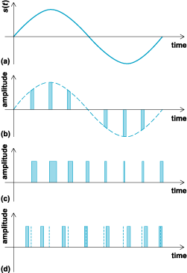
Other types of pulse modulation
PAM
Pulse Width Modulation
PWM: the pulses have constant amplitudes but vary in time duration in direct proportion to the sample value
Pulse Position Modulation
PPM: varying the position of a pulse of constant duration relative to its nominal time of occurrence

Slide 16
Application
PAM, PWM, and PPM found significant application early in the development of digital communications,
However, by now almost completely, converted their transmission facilities to PCM technology

Slide 17
Quantization
Quantization is the procedure of constraining something from a relatively large or continuous set of values (such as the real numbers) to a relatively small discrete set (such as the integers)
The difference between the actual analog value and quantized digital value is called quantization error or quantization distortion
Quantization noise is a model of quantization error introduced by quantization in the analog-to-digital conversion (ADC) in telecommunication systems and signal processing.

Slide 18
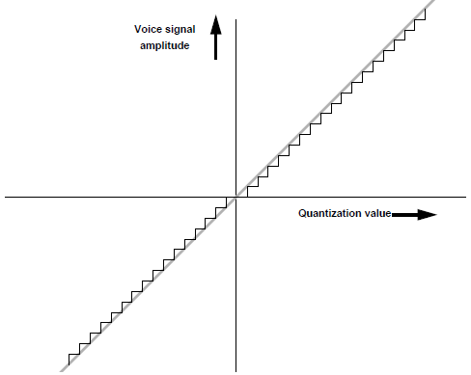
Linear Quantization
As a voice signal sample increases in amplitude the quantization levels increase uniformly
quantization levels are spread evenly over the voice signal’s dynamic range

Slide 19
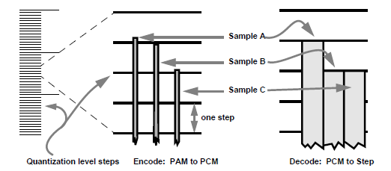
Quantization error or quantization noise
Example,
if a PAM sample’s level lies between two steps, it is assigned the value of the highest step it crosses, and
if PAM sample just reaches this step would be given the same quantization value
Obviously, the reconstructed waveform will be different from the original waveform

Slide 20
Nonlinear Quantization –(companding)
Quantization error is another reason for using compressed encoding for digitizing a voice signal
Dividing the amplitude of the voice signal up into equal positive and negative steps is not an efficient way to encode voice into PCM
Quantization levels distributed according to a logarithmic, instead of linear, function gives smaller quantization steps, at lower signal amplitudes
A-Law adopted by ITU-T for 30 channel PCM. µ-law used mainly in USA, Canada and Japan

Slide 21
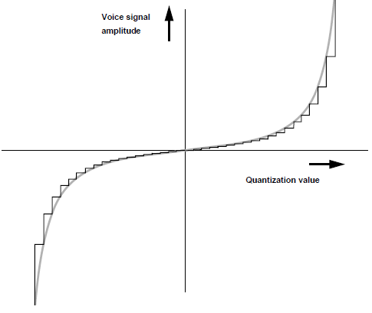
companding
As signal amplitude gets smaller, N_{Q} must get smaller to keep SN_{Q}R from dropping.
Compression accomplishes this by forcing quantization error magnitude to decrease with lower amplitudes.

Slide 22
Binary Encoding
assign umber of bits to represent each quantized level
2^{n} ≥ M
Higher number of bits == higher number of quantization levels → less quantization noise
Less number of bits → compression

Slide 23
Bandwidth of PCM signal
Rate of PCM signal R
R=f_{s} * n
Disadvantage in PCM signal is high bandwidth compared to bandwidth of analog information signal

Slide 24
Line encoding
In telecommunication, a line code (also called digital baseband modulation, or digital baseband transmission method)
Line coding is often used for digital data transport
The waveform pattern of voltage or current used to represent the 1s and 0s of a digital data on a transmission link is called line encoding. The common types of line encoding are unipolar, polar, bipolar and Manchester encoding.

Slide 25
Unipolar Encoding
Traditionally, a unipolar scheme was designed as a non-return-to-zero scheme, in which the positive voltage defines bit 1 and the zero voltage defines bit 0. It is called NRZ because the signal does not return to zero at the middle of the bit.

Slide 26
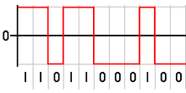
Polar encoding
Polar NRZ signal
Polar RZ?

Slide 27
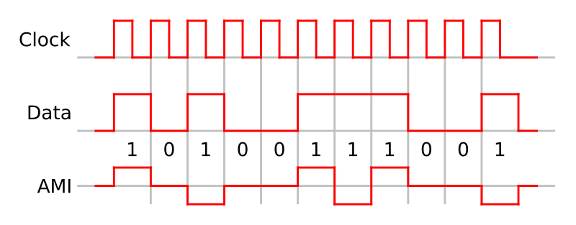
Bipolar encoding
A binary 0 is encoded as zero volts as in unipolar encoding, but
1 is encoded alternately as a positive and a negative voltage. This prevents a significant build-up of DC, as the positive and negative pulses average to zero volts

Slide 28
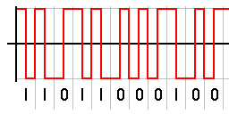
Manchester encoding
It is a line code in which the encoding of each data bit has at least one transition and occupies the same time. It therefore has no DC component, and is self-clocking (a clock signal can be recovered from the encoded data)

