Slide 1
DPCM and DM

Slide 2
What is DPCM?
converting an analog into a digital signal in which an analog signal is sampled and then the difference between the actual sample value and its predicted value (predicted value is based on previous sample or samples) is quantized and then encoded forming a digital value.
DPCM code words represent differences between samples unlike PCM where code words represented a sample value
Basic concept of DPCM - coding a difference, is based on the fact that most source signals show significant correlation between successive samples -→ lower bit rate

Slide 3
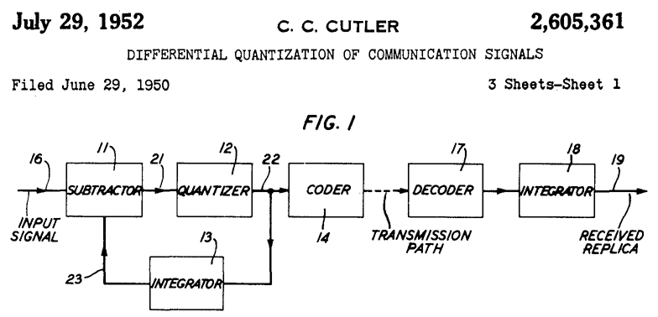
DPCM
Option 1: difference between two consecutive quantized samples
Option 2: quantize the difference between two consecutive samples

Slide 4
DM
It is a subclass of DPCM, in which 1-bit quantizer is used
It was developed for voice telephony applications
DM output is 0 if waveform falls in value, 1 represents rise in value
Each bit indicates direction in which signal is changing (not how much), i.e.
DM codes the direction of differences in signal amplitude instead of the value of difference (DPCM).

