Slide 1
Digital Modulation

Slide 2
Digital modulation
Example: ASK, FSK, PSK, QAM
Binary digital modulation
Multilevel digital modulation

Slide 3
Amplitude Shift Keying
Binary-ASK --- BASK
Or On-Off Keying OOK
Uses two amplitude levels for the modulated carrier
Frequency and phase of the carrier are kept constant
ASK modulation and demodulation processes are relatively inexpensive
ASK is commonly used to transmit digital data over optical fiber

Slide 4
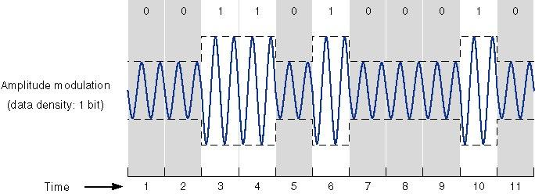
ASK signal

Slide 5
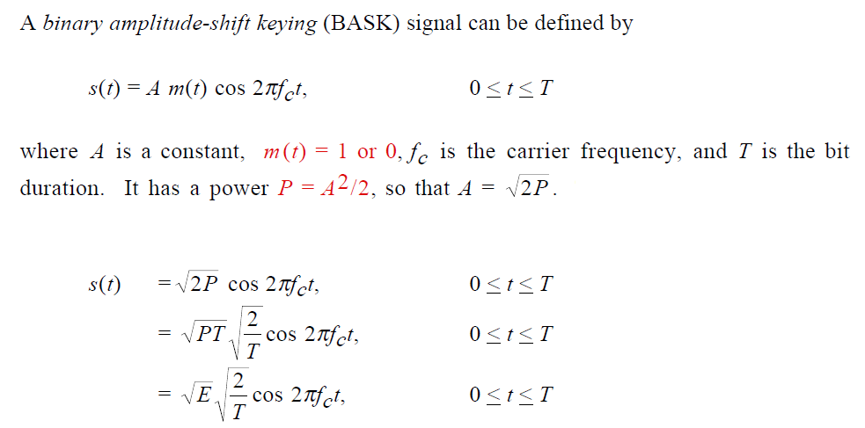

Slide 6
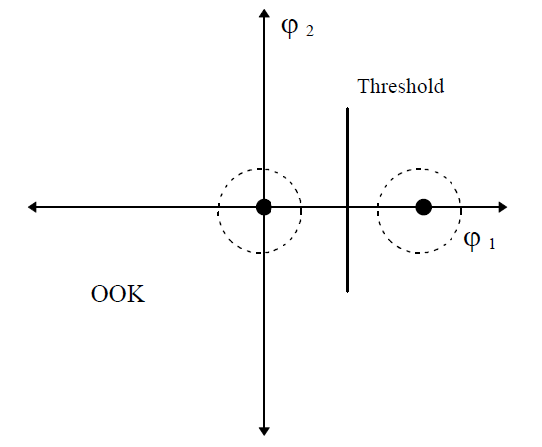
Constellation diagram

Slide 7
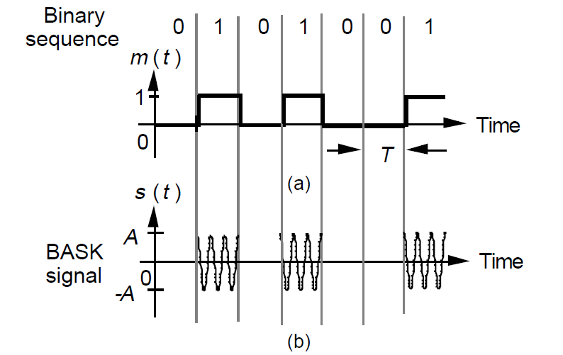
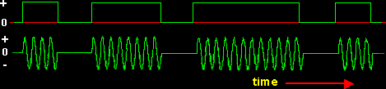
Original ASK signal

Slide 8
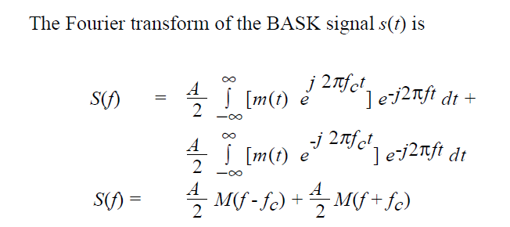
Power Spectral Density PSD

Slide 9
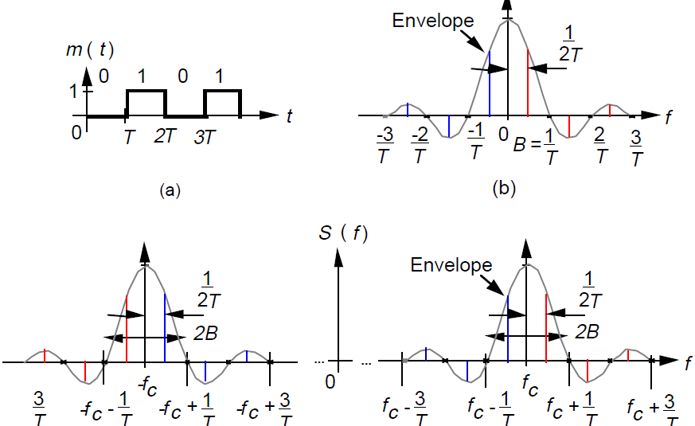

Slide 10
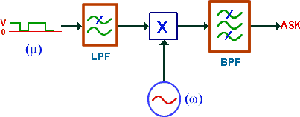
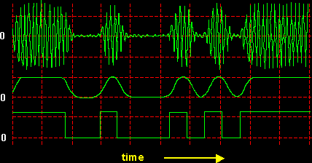
Modified ASK signal

Slide 11
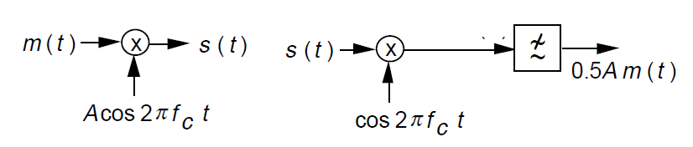
Demodulation
Coherent demodulation
non Coherent demodulation→ envelop detector

Slide 12
Others:
  Spectral efficiency
  Bandwidth
Advantage and disadvantages

Slide 13
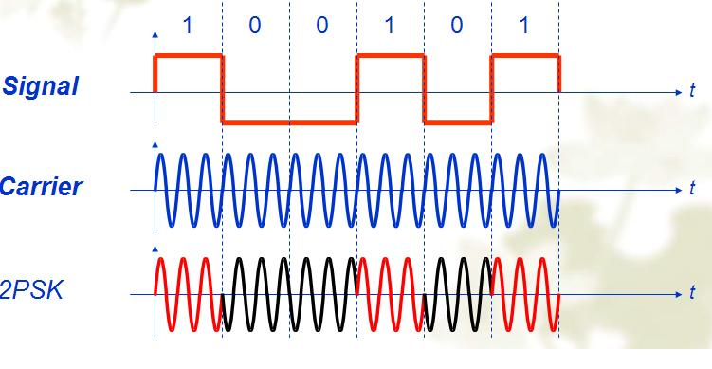
Phase Shift Keying PSK
Information signal modulates the phase of the carrier signal
BPSK uses two of phases, each assigned 1 bit of binary digits

Slide 14
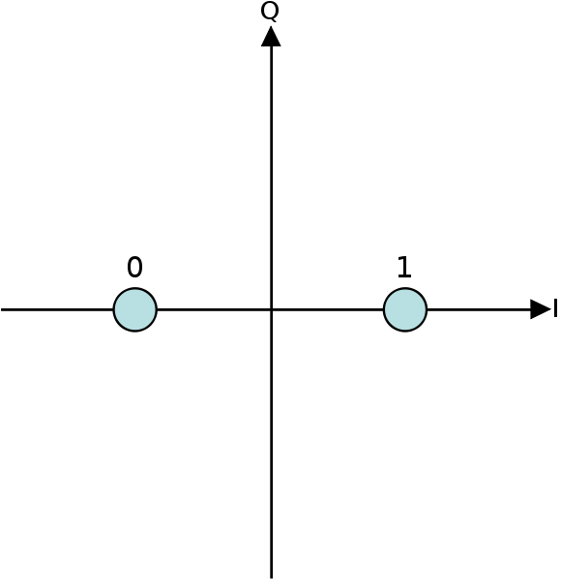
Constellation Diagram
In PSK, the constellation points chosen are usually positioned with uniform angular spacing around a circle

Slide 15
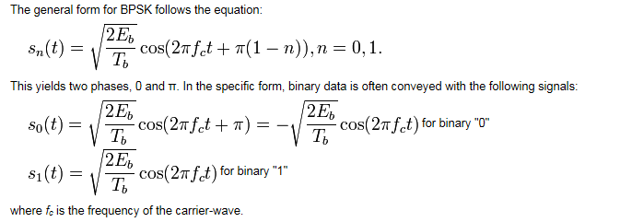
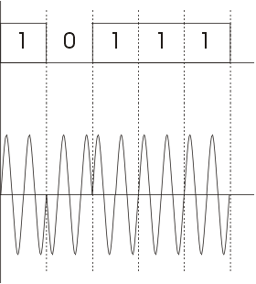

Slide 16
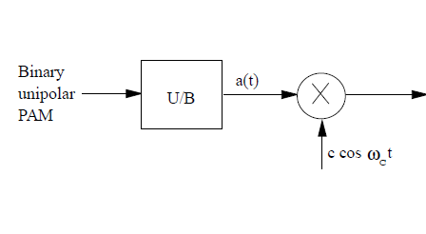
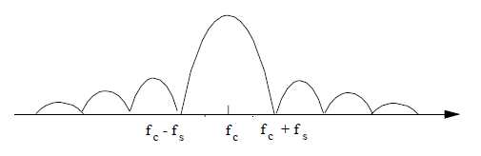
Original BPSK
Unmodulated carrier is not exist

Slide 17
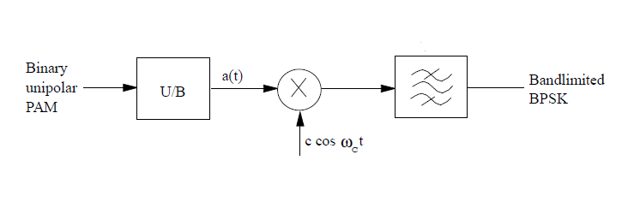
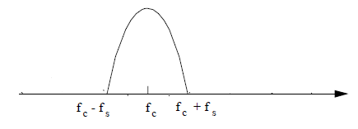
Band limited BPSK

Slide 18
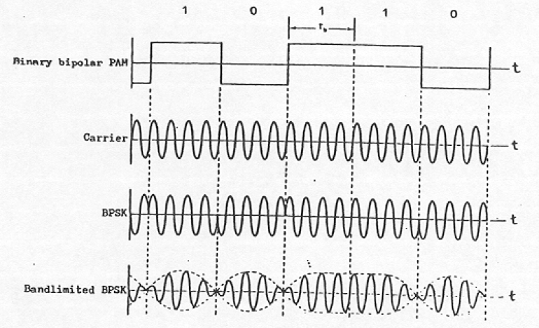

Slide 19
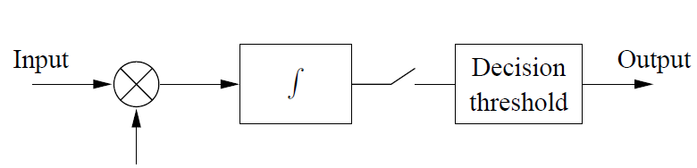
PSK Demodulation
Coherent demodulation
  Synchronous detection of PSK signals is required, due to the absence of a large carrier component.
A coherent reference for synchronous detection cannot be obtained by an ordinary cct., since there are no spectral line components at ± fc
Carrier signal

Slide 20
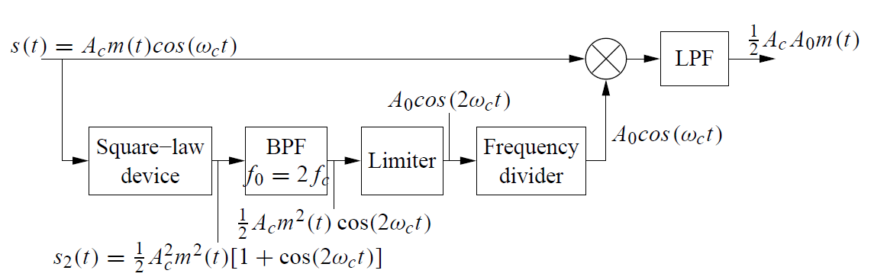
However, the signal has a spectrum that is symmetric with respect to the (suppressed) carrier frequency, a squaring loop can be used to obtain synchronization
Carrier recovery is more complex and expensive.

Slide 21
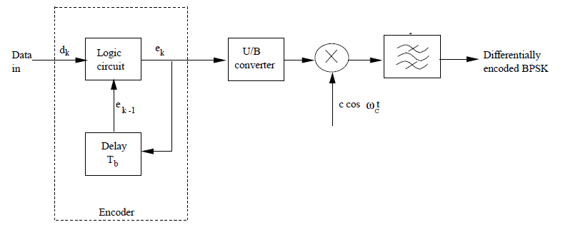
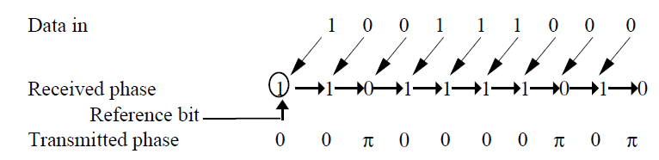
Differential PSK (DPSK)

Slide 22
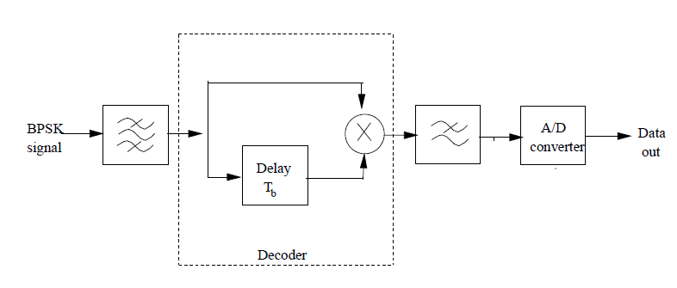
DPSK demodulation

Slide 23
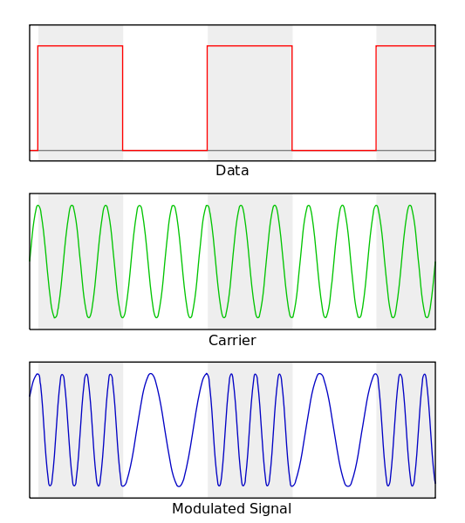
Frequency Shift Keying FSK
FSK is a frequency modulation scheme in which digital information is transmitted through discrete frequency changes of a carrier wave

Slide 24
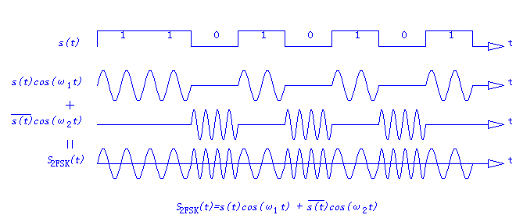
FSK= ASK_{f1} + ASK_{f2}

Slide 25
Binary FSK

Slide 26
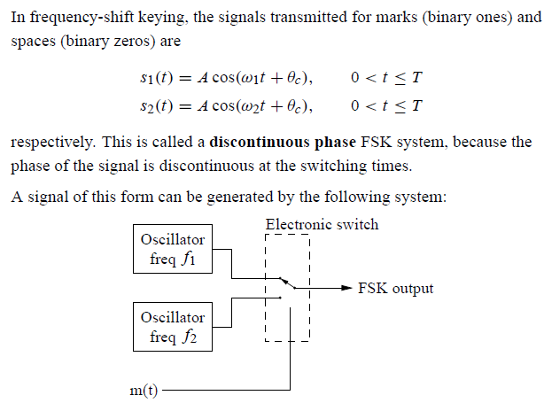

Slide 27
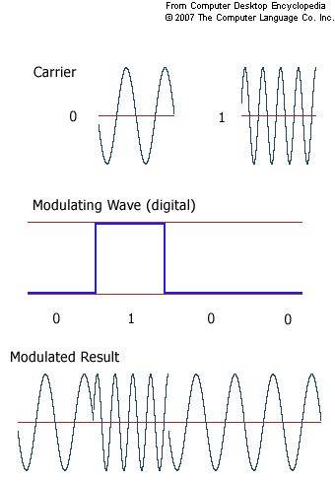
Discontinuous FSK

Slide 28
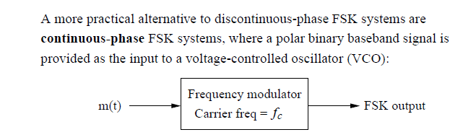
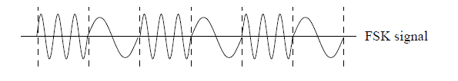

Slide 29
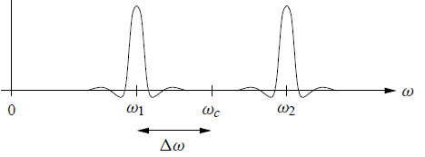
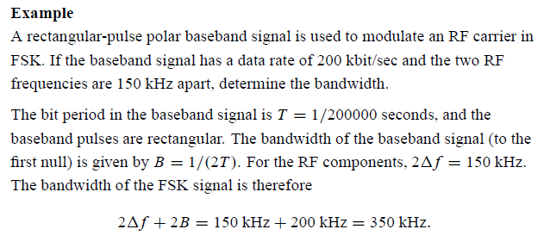

Slide 30
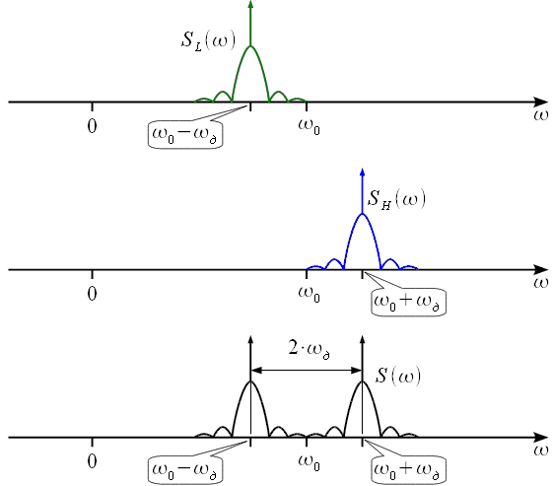
Spectrum of BFSK

Slide 31
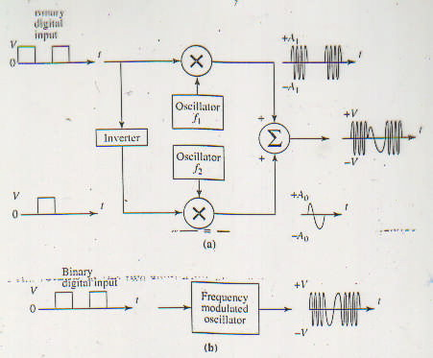
BFSK Modulator

Slide 32
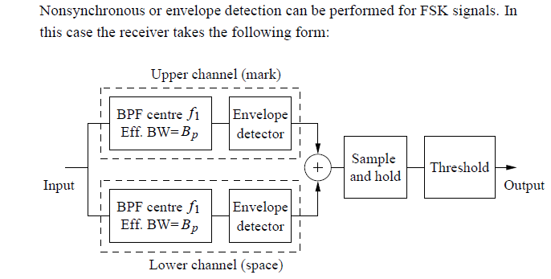
FSK Demodulator

Slide 33
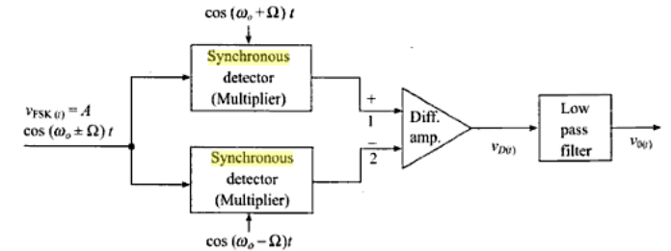
Synchronous or coherent detection

Slide 34
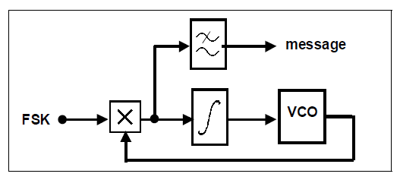
PLL as FSK demodulator

Slide 35
Error Performance
The order of performance, from worst to best, is
  Non coherent ASK
  Coherent ASK
  Non coherent FSK
  Coherent FSK
  DPSK
  Coherent PSK.
The three most widely used digital modulation methods for communication systems are PSK, DPSK, and non coherent FSK.

