Slide 1
Multi-Level Digital Modulation
M-ary Modulation

Slide 2
M-ary Communications
Send multiple, M, waveforms
Choose between one of M symbols instead of 1 or 0.
Waveforms differ by phase, amplitude, and/or frequency
Advantage: Send more information at a time
Disadvantage: Harder to tell the signals apart or more bandwidth needed.
Different M’ary types can be used.
  Multiamplitude (MASK)
  Multiple phase (MPSK, QPSK)
  Multitone (MFSK)
  Quadrature Amplitude Modulation (combines MASK and MPSK)

Slide 3
M-ary Communications
As M increases, it is harder to make good decisions, more power is used
But, more information is packed into a symbol so data rates can be increased
Generally, higher data rates require more power (shorter distances, better SNR) to get good results

Slide 4
Multi-Amplitude Shift Keying (MASK)
Send multiple amplitudes to denote different signals
4-ary Amplitude Shift Keying
Each symbol sends 2 bits
Deciding which level is correct gets harder due to fading and noise
Receiver needs better SNR to achieve accuracy
10
11
Received Signal
01
00

Slide 5
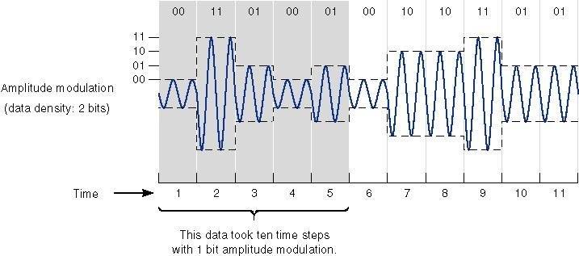
4-ASK signal

Slide 6
Quadrature PSK
Multi -PSK
Send multiple phases to denote different signals
Phase space is 2π/M
QPSK can be used either to double the data rate compared with a BPSK system while maintaining the same bandwidth of the signal, or to maintain the data-rate of BPSK but halving the bandwidth needed

Slide 7
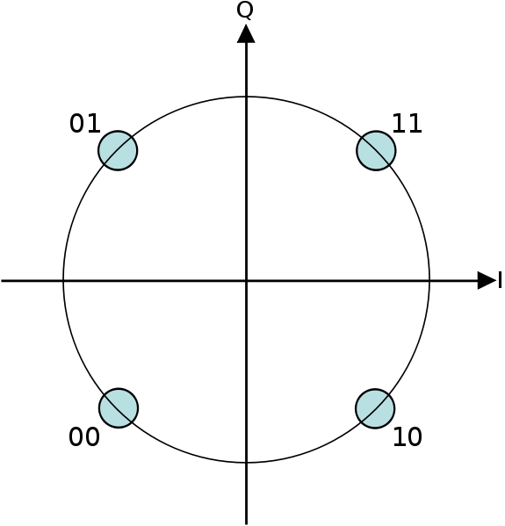
QPSK
QPSK can encode two bits per symbol, shown in the diagram with gray coding to minimize the bit error rate

Slide 8

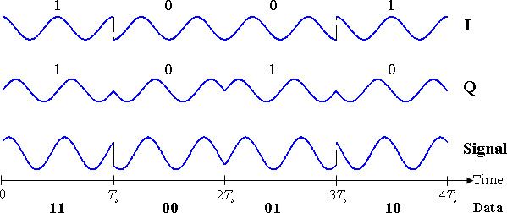
This yields the four phases π/4, 3π/4, 5π/4 and 7π/4 as needed

Slide 9
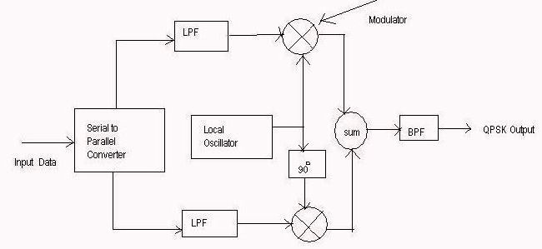
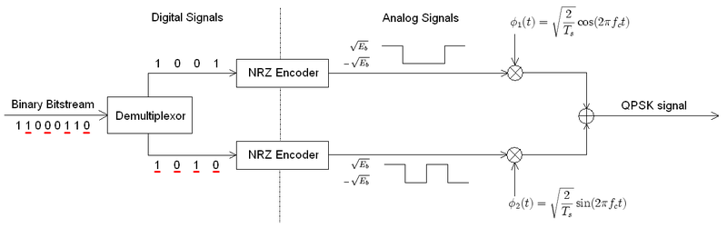
QPSK modulator

Slide 10
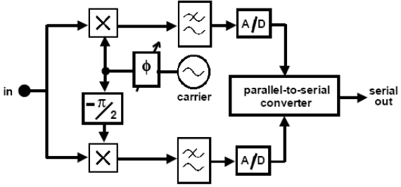
QPSK demodulator (1)

Slide 11
QPSK demodulator (2)
x
LPF
Decision
cos ω_{c}t
BPF
Multiplex
90
x
LPF
Decision

Slide 12
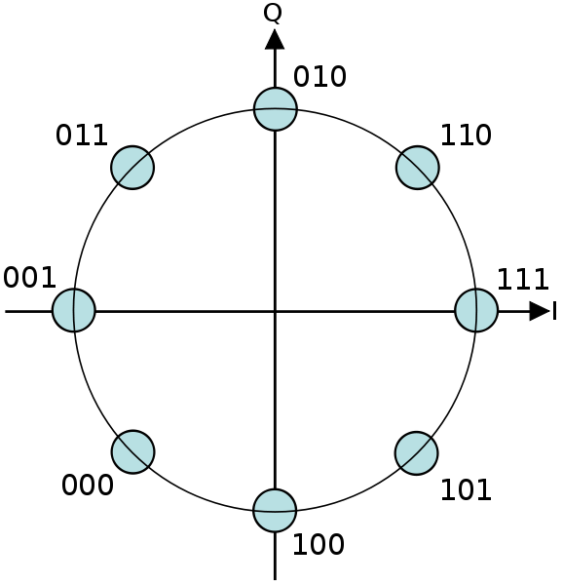
Higher order PSK

Slide 13
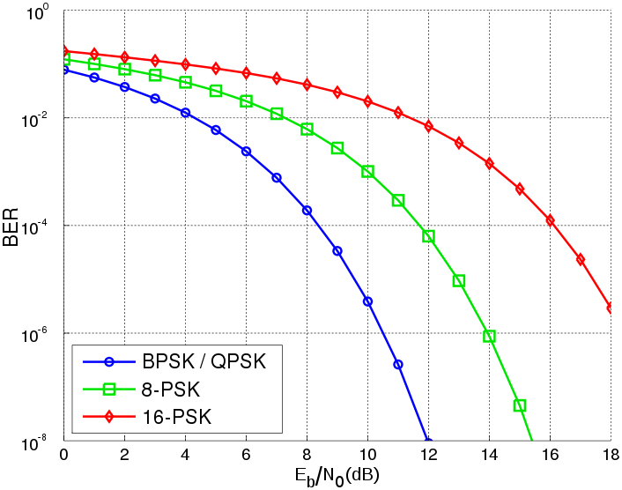
BER

Slide 14
Quadrature Amplitude Modulation

Slide 15
Quadrature Amplitude Modulation (QAM)
Amplitude-phase shift keying (APK)
r_{i}
θ_{i}

Slide 16
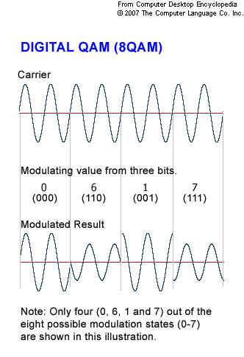

Slide 17
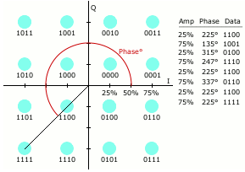
Rectangular Constellation Diagram 16-QAM

Slide 18
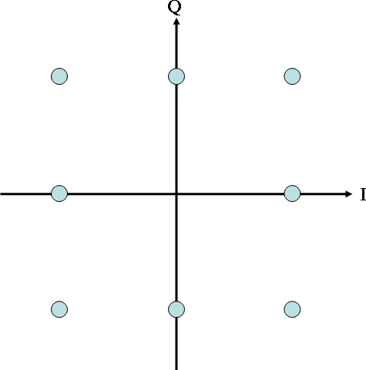
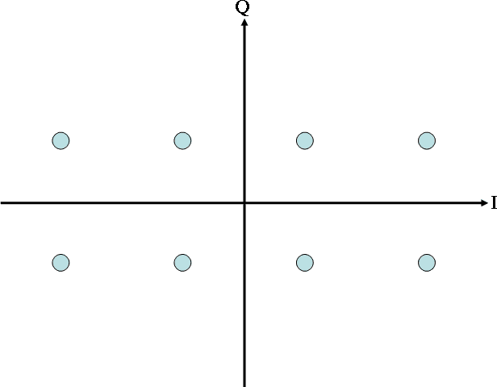
Rectangular Constellation
8-QAM

Slide 19
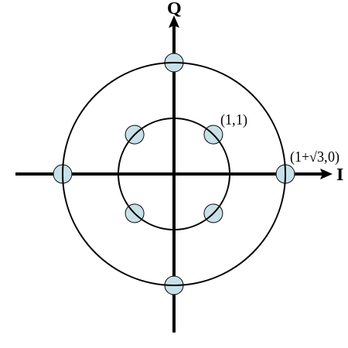
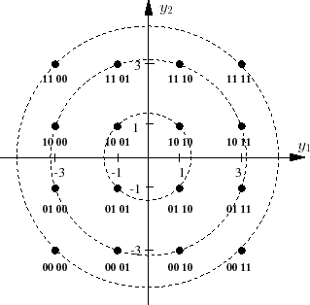
Circular Constellation Diagram
8-QAM and 16-QAM

Slide 20
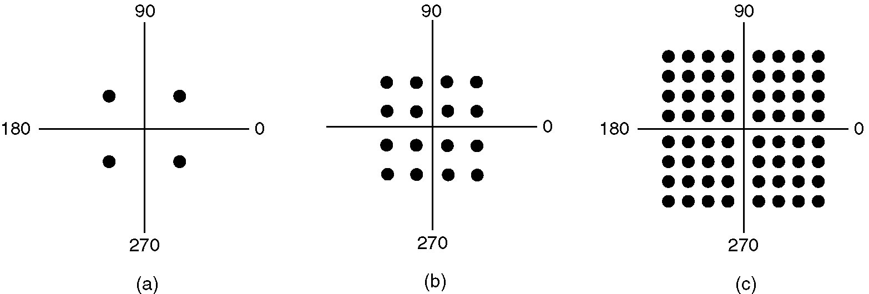
QPSK 16-QAM 64-QAM

Slide 21
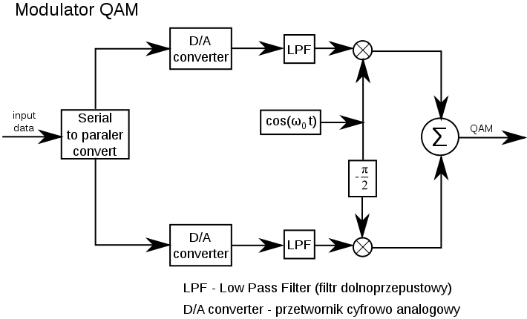

Slide 22
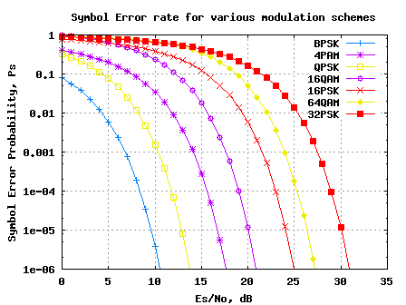
Error Performance

Slide 23
M-FSK
At each symbol interval, transmit one of few frequencies
Modulator is based either on VCO or frequency synthesizer or number of oscillators
MFSK is characterized by
  Complex Circuit
  Higher bandwidth
  Lower signal power

Slide 24
MFSK demodulator
x
LPF
1/Ts
cos ω₁t
x
LPF
Comparator
1/Ts
cos ω₂t
x
LPF
1/Ts
cos ω_{M}t

Slide 25
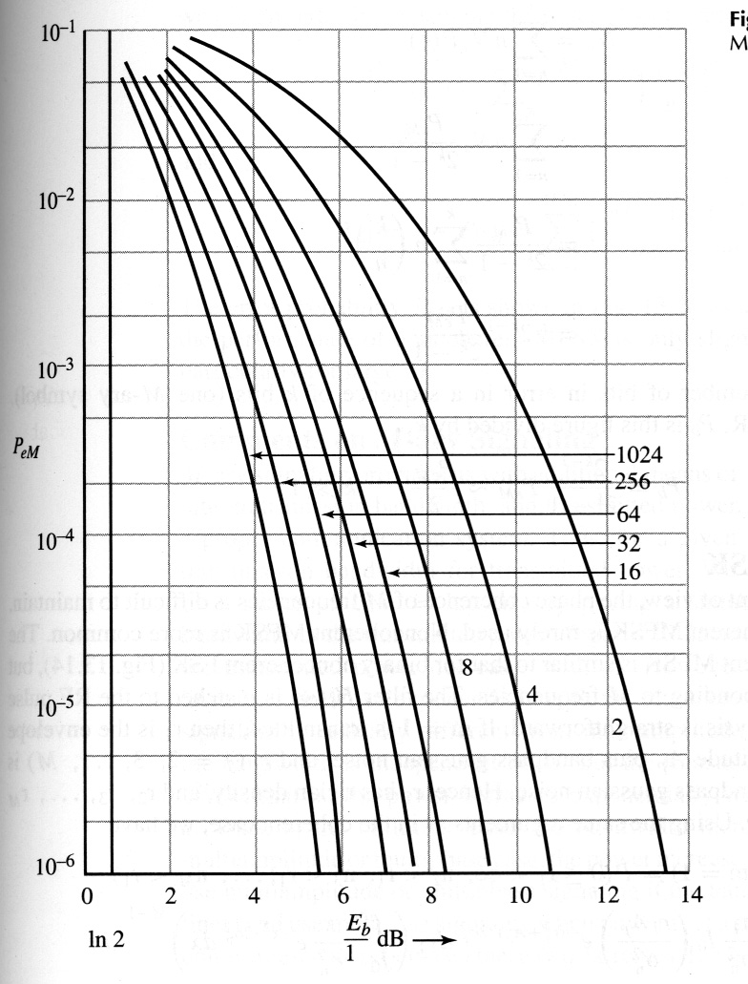
Error Performance

Slide 26
