Slide 1
SPREAD SPECTRUM
In spread spectrum (SS), we spread a signal over a wide bandwidth (larger than BW in traditional communication systems)
- These techniques are used for a variety of reasons, including the establishment of secure communications, increasing resistance to natural interference, noise and jamming
Spread Spectrum systems:
Direct Sequence Spread Spectrum (DSSS)
Frequency Hopping Spread Spectrum (FHSS)
Time Hopping (THSS)
Hybrid

Slide 2
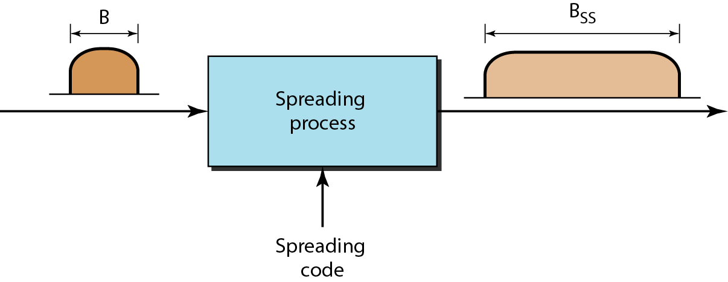
Pseudo noise (PN) code is required in SS systems
Pseudo noise (PN) code symbols are called chips
Chip rate or PN code rate R_{c} >> R_{original signal}

Slide 3
Theoretical Justification
Shannon and Hartely channel capacity theorem
C=B log₂(1+S/N)
S/N is low for SS systems, so roughly
C/B ≈ 1.433 * S/N
or N/S ≈ B/C
To send error-free information for a given N/S in a channel, one need only perform the fundamental signal-spreading operation: increase B.
Notes:
C performance, B price, S/N channel condition

Slide 4
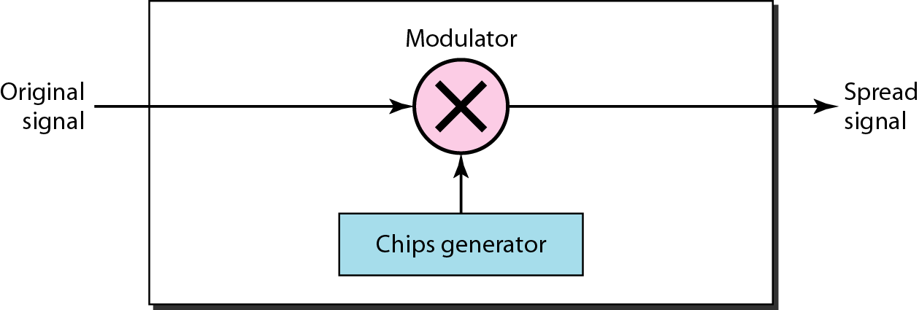
Direct Sequence Spread Spectrum DSSS
DSSS phase-modulates the original signal with a continuous string of pseudonoise (PN) code symbols, each of which has a much shorter duration than an information bit.

Slide 5
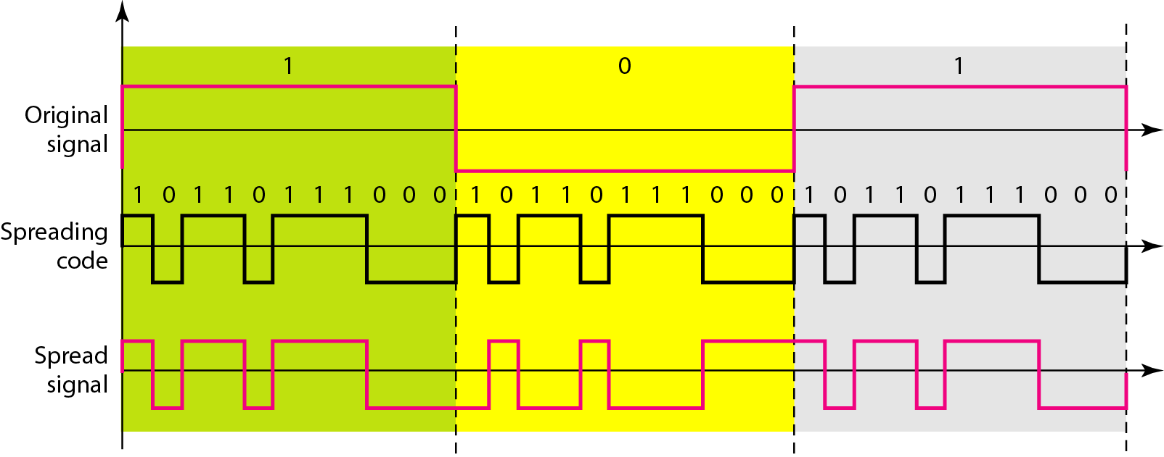
DSSS example

Slide 6
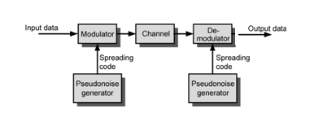
General Model of Spread Spectrum System
Receiver uses same sequence to demodulate signal

Slide 7
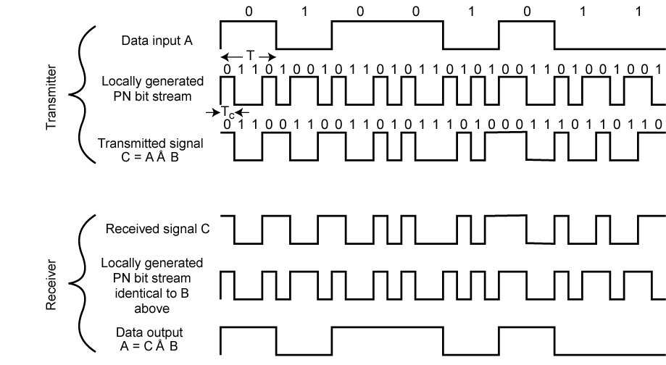
DSSS Example

Slide 8
DSSS Receiver
DSSS Transmitter

Slide 9
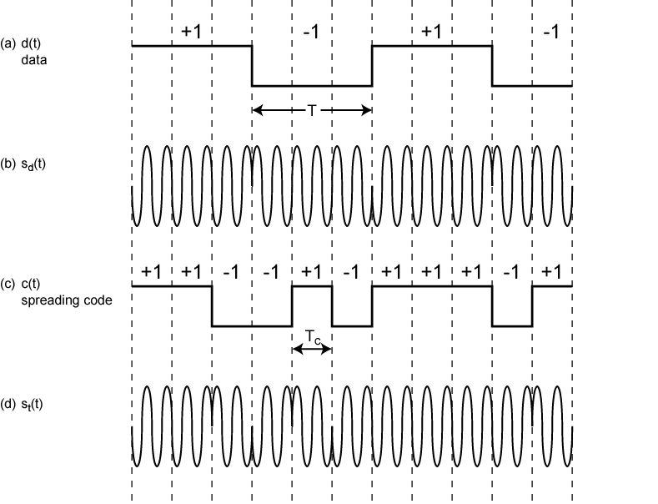
DSSS Using BPSK Example

Slide 10
RF bandwidth of DSSS
Power distribution {(sinx)/x}² …………..
Null-to-null bandwidth is 2R_{c}
90% of the power in the main-lobe
Other modulations like QPSK , MFSK …………….
Notes:
MFSK 1.5Rc and good suppression of sidelobe and fast sidelobe rolloff . First sidelobe is -23db while other modulation is only -13dB

Slide 11
Gains
Immunity from various noise and multipath distortion
Including jamming
Can hide/encrypt signals
Only receiver who knows spreading code can retrieve signal
Several users can share same higher bandwidth with little interference
Cellular telephones
Code division multiple access (CDMA)

Slide 12
Process Gain, typically 10-60 dB
G_{P}
Benefits:
Resistance to Interference and Anti-jamming Effects

Slide 13
More benefits
Resistance to Interception
Resistance to Fading
Addressing
High resolution ranging
Multi access technique CDMA

Slide 14
Code Division Multiple Access (CDMA)
Multiplexing Technique used with spread spectrum
It plays a critical role in building efficient, robust, and secure radio communication systems
Start with data signal rate D
Called bit data rate
Break each bit into k chips according to fixed pattern specific to each user
User’s code
New channel has chip data rate kD chips per second
E.g. k=6, three users (A,B,C) communicating with base receiver R
Code for A = <1,-1,-1,1,-1,1>
Code for B = <1,1,-1,-1,1,1>
Code for C = <1,1,-1,1,1,-1>
Notes:
mprovement in handover / handoff: Using CDMA it is possible for a terminal to communicate with two base stations at once. As a result, the old link only needs to be broken when the new one is firmly established. This provides significant improvements in terms of the reliability of handover / handoff from one base station to another.

Slide 15
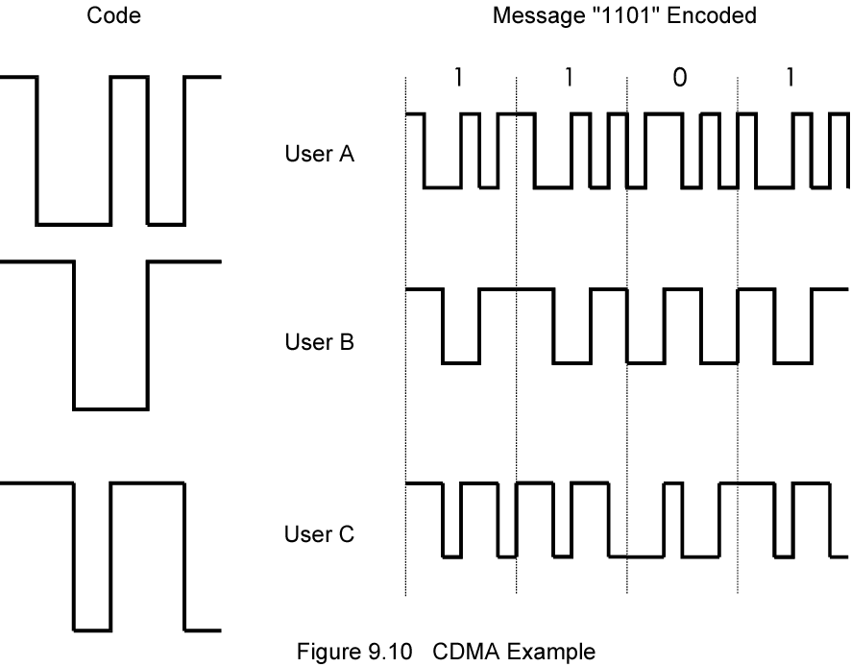
CDMA Example

Slide 16
CDMA Explanation
Consider A communicating with base
Base knows A’s code
Assume communication already synchronized
A wants to send a 1
Send chip pattern <1,-1,-1,1,-1,1>
A’s code
A wants to send 0
Send chip[ pattern <-1,1,1,-1,1,-1>
Complement of A’s code
Decoder ignores other sources when using A’s code to decode
Orthogonal codes

Slide 17
CDMA for DSSS
n users each using different orthogonal PN sequence
Modulate each users data stream
Using BPSK
Multiply by spreading code of user

Slide 18
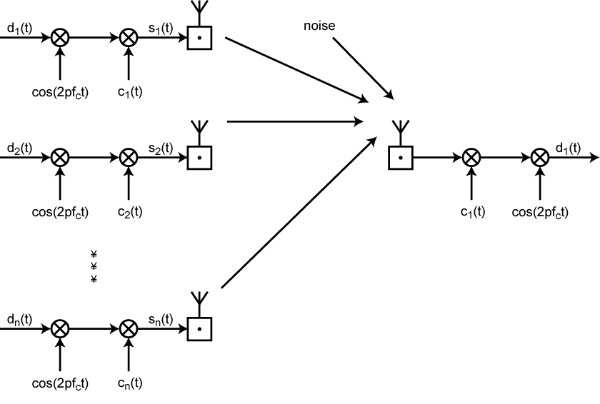
CDMA in a DSSS Environment

Slide 19
Frequency Hopping Spread Spectrum (FHSS)
Signal broadcast over series of frequencies
Receiver hops between frequencies in sync with transmitter
Eavesdroppers hear unintelligible blips
Jamming on one frequency affects only a few bits

Slide 20
Basic Operation
Typically 2^{k} carriers frequencies forming 2^{k} channels
Channel spacing corresponds with bandwidth of input
Each channel used for fixed interval
Ex. 300 ms in IEEE 802.11

Slide 21
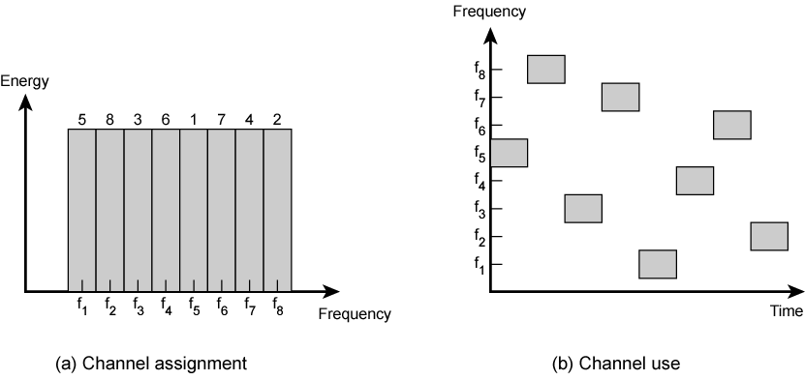
Frequency Hopping Example

Slide 22
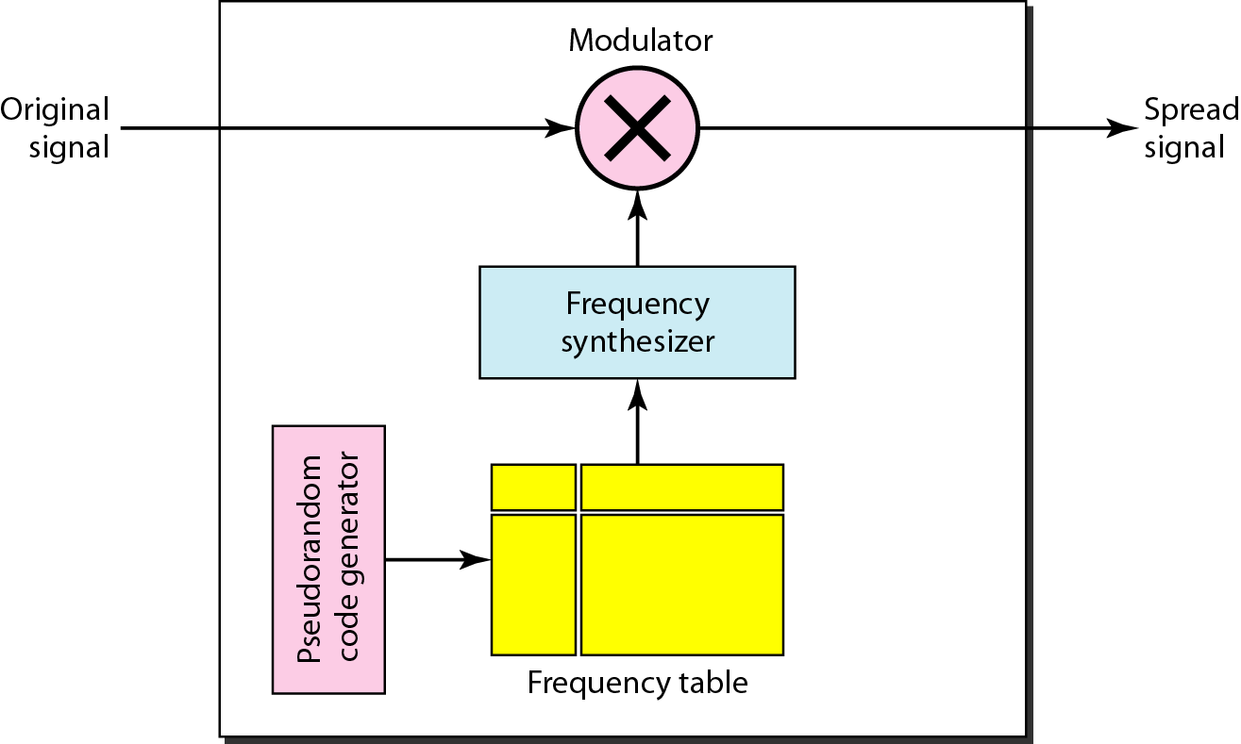
Frequency hopping spread spectrum (FHSS)

Slide 23
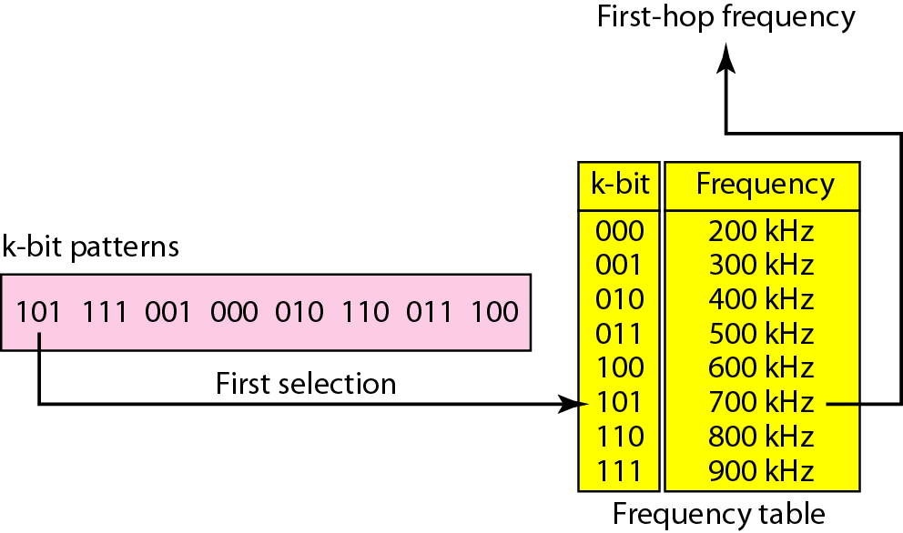
Frequency selection in FHSS

Slide 24
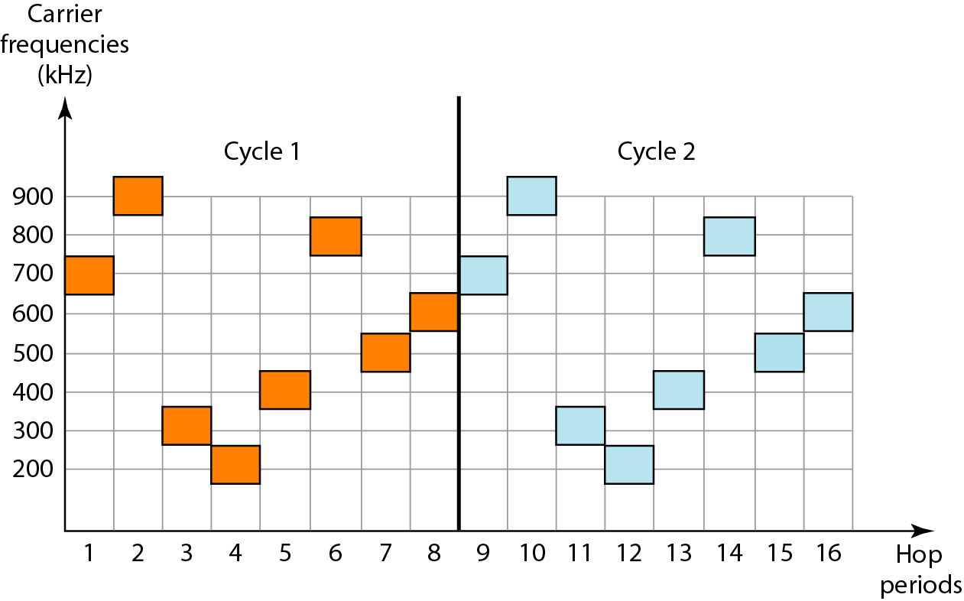
FHSS cycles

Slide 25
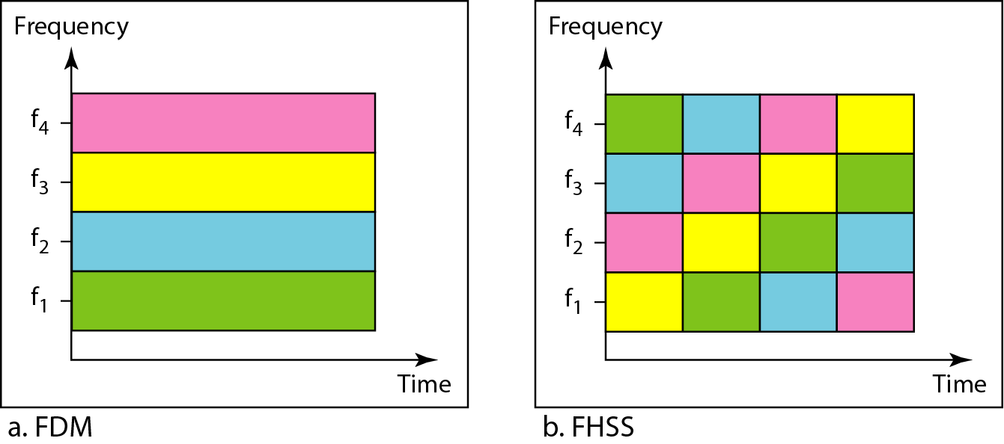
Bandwidth sharing

