Slide 1
Cellular System

Slide 2
Licensed & unlicensed spectrum
licensing spectrum
provides immunity from interference outside of the system itself,
bandwidth is very expensive.
High focus on higher spectrally efficient as possible.
no hard constraints on transmitted power but it is expected to decay rapidly outside.

Slide 3
Cellular system on licensed spectrum
Network with no. if cells and each cell is divided into 3 sectors using directional antennas
Multiple access…how the users in a cell share the resources ( intra-cell)
Interference management … simultaneous transmission from users in different cells (inter-cell)
TDD or FDD to allocate the resource between uplink and downlink
Either narrowband or wideband system

Slide 4
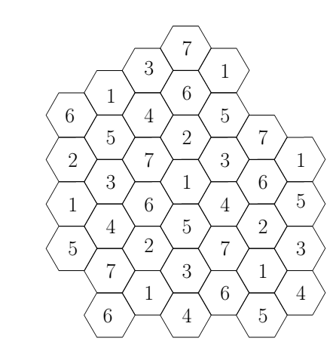
Narrowband system
Users within a cell and neighboring cells use different narrowband channels
It reduces the frequency reuse in the network.
The level of interference is kept minimal→ high SINR

Slide 5
Wideband system
Universal frequency reuse: the same spectrum is used in every cell
Simultaneous transmissions can interfere → low SINR
Two system designs differ in how the users’ signals are spread: OFDM and CDMA
In CDMA, intra-cell and inter-cell interference
In OFDM by hopping in time-frequency grid, inter-cell interference

Slide 6
In CDMA-based system
users in the same cell and different cells share all the time-frequency degrees of freedom.
by using long PN sequence, interference seen by any user (other users signals) appears as pseudo white noise.
tight power control among users within the same cell to ensure that the received power of each user is no more than the minimum level needed for demodulation
averaging the interference of many geographically distributed users in nearby cells →
the aggregate interference look Gaussian
less randomness of interference level because of different locations of the interferers
Higher link reliability.
soft capacity limit
soft handoff: a user on the edge of a cell can receive or transmit signals to two or more base stations → diversity technique
IS-95 standard

Slide 7
CDMA Uplink
For K users and using BPSK
m is chip time
The aggregate interference for user 1
is the total average energy received per chip from the kth user due to the multipath.

Slide 8
Performance of user1 depend on
The detection of an information symbol is accomplished
by projecting the in-phase component of the received signal onto the sequence u = [s^{I}₁[0], s^{I}₁[1], . . ., s^{I}₁[G − 1]], and G = W/R

Slide 9
To maintain a target SINR=β, transmit power control is needed. suppose
user k is assigned to base station c_{k}.
P_{k} is the transmit power of user k
g_{k},_{ck} is the attenuation of user k’s signal to base station c_{k}
Also, there is a limit of the transmit powers as well:
If there is no a feasible solution for the powers at all, then the system is in outage
Zero outage probability is not possible

Slide 10
Interference averaging, an important property of CDMA systems→ larger system capacity
out-of-cell interference averaging: Users are in random independent locations in network, and when there are many users → the fluctuations of the aggregate interference in the adjacent cell is reduced.
users’ burstiness averaging: Independent users are unlikely to be active all the time, thus allowing the system to admit more users than if it is assumed that every user sends at peak rate all the time.
imperfect power control averaging: these errors tend to occur independently across the different users and average out.
For a single cell with K users power controlled to a common base station and no out-of-cell interference

Slide 11
CDMA Downlink
near-far problem does not exist since all the signals transmitted from BS go through the same channel to reach any given user. Thus, power control is less crucial
since signals are all transmitted at BS, it is possible to make the users orthogonal to each other, that is more difficult in the uplink. This reduces intra-cell interference
inter-cell interference is more poorly behaved since there are there are only a few neighboring base stations but each transmits at high power
multiple BSs have to simultaneously transmit to a mobile in soft handoff. Since each cell has a fixed number of orthogonal codes for the users, i.e. a user in soft handoff is consuming twice or more system resources.

Slide 12
In OFDM-based system
bandwidth W is divided into N_{c} sub-carriers such that OFDM symbol period (N_{c}/W) < T_{c}
n sub-carriers per user should be spread out in frequency to take advantage of frequency diversity
No intra-cell interference, there is however inter-cell interference.
For example on the uplink. Two users in neighboring cells sharing the same sub-carrier in any OFDM symbol time interfere with each other directly
If there were no hopping and coding across the sub-carriers, OFDM system would behave poorly
Interference seen over a frame can be attributed to most of the user transmissions in the neighboring cell → overall interference seen over a frame is a function of the average received power of all the users in the neighboring cells.

Slide 13
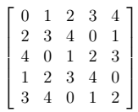
Hopping Pattern
n sub-carriers for the user as spread out as possible and further, hop the n subcarriers every OFDM symbol time.
Periodic hopping patterns can be represented by a square matrix of dimension N_{c}

Slide 14
Wideband Systems: OFDM
n sub-carriers for the user as spread out as possible and further, hop the n subcarriers every OFDM symbol time.
How to accomplish interference diversity
n subcarriers hop every OFDM symbol time
periodic hopping pattern
(i, j) entry of the matrix corresponds to the virtual channel number the ith sub-carrier is taken on by, at OFDM symbol time j
every virtual channel hop over all the sub-carriers in each period for maximal frequency diversity.
Each base station has its own hopping matrix
to maximize interferer diversity requires minimal overlap between virtual channels of neighboring BSs.
For prime Nc, and a = 1, . . ., N_{c} − 1
subcarriers
OFDM symbol time

Slide 15
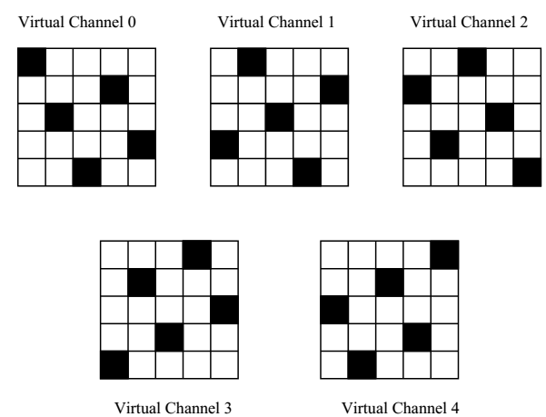
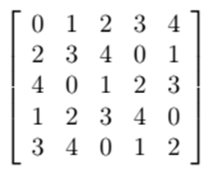
Hopping Pattern
For a=2 & Nc=5

Slide 16
SINRs levels in OFDM are mid way between these in narrowband and CDMA systems
Users close to BS can have high SINRs while users at edge of cell cannot support high SINRs
Dynamic range of SINRs can be reduced by sectorization
Inter-sector interference affects users regardless of whether they are at cell edge or close to BS

