Slide 1
Lecture 6
Immunology

Slide 2
A/ Chemical barriers to infection
Saliva/ is produced by the salivary glands, saliva helps by
Dilute and wash away the m.o from both the surface of the teeth and the mucus membrane of the mouth, this help and prevent colonization by microbes.
Contain enzymes – lysozyme – that damage the microbial cell wall and membrane and cause leakage of cytoplasm.
Contain antibodies that opsonize microbes.

Slide 3
Tears / Secrete by tear duct that are found inside corners of the eye, near the nose. The functions of tears are: -
Washing the eyes, so removing the m.o before they can penetrate into the soft tissue of the eye ball.
Contain lysozyme which lyses bacteria.
Sebum / Is produced by sebaceous gland that prevent hair from drying, also forms a protective film over the surface of the skin, the component of the sebum is unsaturated fatty acids (like caprylic acid) which inhibit the growth of pathogenic bacteria and fungi, and fatty acid denature proteins of the cell membrane.
The sweat glands of the skin produce perspiration which help maintain body temperature, eliminate certain waste and flush m.o from the surface of the skin. Perspiration also contains lysozyme which inhibit the growth of G +ve bacteria.

Slide 4
Vaginal secretions / Lactic acid removes microbes from genital tract by maintain acidic environment to m.o. An acid environment kills most pathogenic microbes while promoting the growth of non-pathogenic bacteria like Lactobacillus in the vagina.
Spermine / A pH dependent polyamine found in seminal fluids which inhibits the growth of G +ve bacteria.
Lysozyme / Also known as muramidase or N- acetyle muramide glycanhydrolase. Is a basic protein present in a number of secretions such as tears, saliva, urine and mucus, it is also found in cytoplasmic granules of the polymorphonuclear neutrophils (PMN). Large amounts of lysozyme can be found in egg whites. This enzyme damage bacterial cell walls (G +ve) by catalyzing or hydrolysis of the glycosidic bond that connects N-acetylmuramic acid and N-acetylglycose amine.

Slide 5
Opsonin / Is any molecule that act as a binding enhancer for the process of phagocytosis, for example, by coating the negatively-charged molecules on the membrane. Opsonin like antibodies IgG & IgA, complements fragments, C3b, C4b and mannose-binding lectin. Both the membrane of a phagocytosing cell and its target have negative charge (zeta-potential) making it difficult for the two cells to come close together. During the process of opsonization, Ags are bound by Ab and/or complement molecules. Phagocytic cells express receptors that bind opsonin molecules, these include Fc receptors, with the Ag coated in these molecules, binding of the Ag to the phagocyte is greatly enhanced. Most phagocytic binding cannot occur without opsonization of the Ag.

Slide 6
B-Lysin / Is a protein produced by platelet when they rupture during coagulation, can lyses many G +ve bacteria by acting as a cationic detergent. Lactoperoxidase / Is found in saliva and milk. Its mechanism of action is similar to that of myeloperoxidase (equal to catalase). It splits H2O2 and release toxic oxygen metabolite (O-, O-3, OH-) which destroy bacteria.
Humoral factor / contribute to nonspecific immunity, like antibody & complement. Normal serum can kill and lyses some G – ve bacteria, this property is the result of the combined action of Ab & complement fragments, both of which are present in normal serum. The activities destroyed by heating the serum at 56 C⁰ for 30 min.

Slide 7
Interferon –INF- / Termed interferon because they “interfere” with viral replication. Are natural proteins produced by the cells of the immune system in response to challenges by foreign agents such as viruses, tumor cells and parasites. INF is produced by a cell in response to the presence of double-strand RNA, a key indicator of viral infection. INF produced by virally infected cells to protect other cells in the area. Mechanisms of INF
1- secreted IFNs bind to cell surface IFN-receptor,
2- induce host cell proteins that inhibit viral replication
3- active Natural Killer (NK) cells to lyse infected cells and to secrete cytokines
4-IFNs serve as a firebreak to prevent spread of virus in tissue.

Slide 8
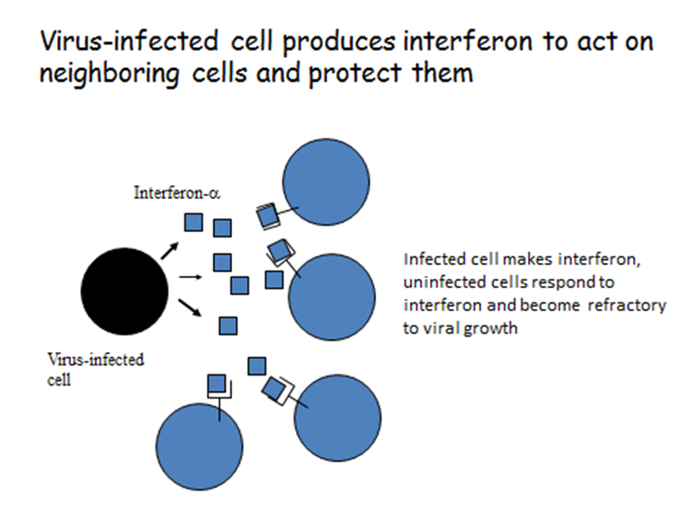

Slide 10
There are three types of INFs: -
1- INF-α – secreted by macrophage and other leukocytes, is induced by viruses.
2- INF –β – secreted by fibroblast also induced by viruses and synthetic polynucleotide.
3- INF –δ – secreted by T-cell after stimulation with the specific Ag.

Slide 11
Protective effects of INF: -
1- Activate cellular genes, including neighboring cells to produce antiviral proteins that interfere with the translation of viral m-RNA.
2- Block viral translation by two enzyme-mediated processes protein kinase & oligonucleotide polymerase.
3- Enhancing T- cell activity.
4- Activating macrophage.
5- Increasing the cytotoxic action of natural killer (NK) cell.

Slide 12
C-reative protein (CRP) / Is a protein found in the blood in response to inflammation (an acute phase protein). It is produced by the liver and by fat cells (Adipocytes). Its level increase or rise during inflammatory processes occurring in the body due to a rise in the plasma concentration of IL-6 which is produced by macrophages as well as adipocytes. It is assisted in complement binding to foreign and damaged cells and enhances phagocytosis by macrophages which express a receptor for CRP. It is used mainly as a marker of inflammation, apart from liver failure.

Slide 13
Lactoferrin / Also known lactotransferrin- is protein with antimicrobial activity (bactericide & fungicide), and is part of innate defense mainly at mucosas. It is found in milk, many mucosal secretions such as saliva and tears and in secondary granules of PMN. Human colostrums has the highest concentration followed by human milk. Lactoferrin antimicrobial activity is due to its high affinity for Fe+3 (ferric state). When LF proteolysis produces lactoferricin, kaliocin (small peptide with antimicrobial activity).

Slide 14
The End

